Slide 1

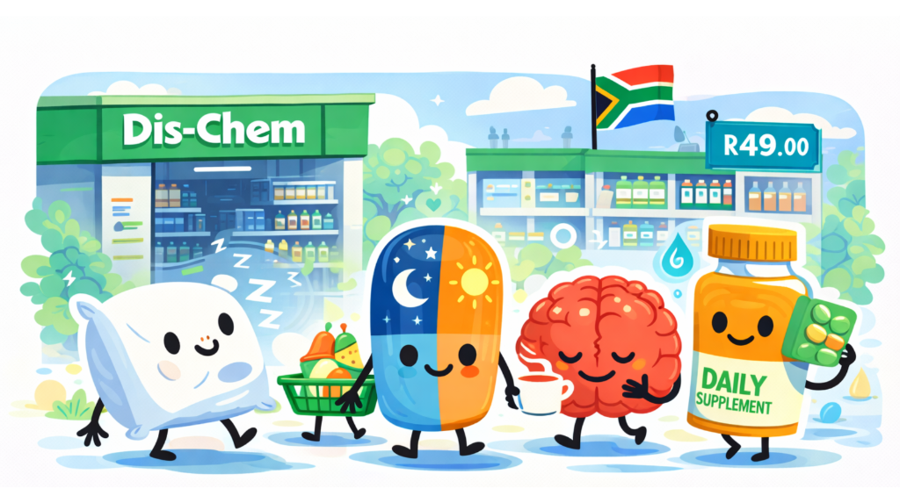

Dis-Chem didn’t make health better.
It made it usable.
How South Africans are managing wellness—and what it means for health brands.

Slide 2




Why This Matters Now
South African health decisions are driven by survival, not optimisation.
Cost pressure is still the defining reality. Almost half of households (49%) report they only have income for basics. Health spend must be fiercely justified.
49%
of consumers
Report having income
only for absolute basics.
Energy is scarce (physical and mental). Load shedding hangover, long workdays, and commuting fatigue leave zero capacity for complex new routines.
Critical Constraint
The "Value-Hacking" mindset rules. Consumers are stacking deals and sticking to what works. Risky switches to unproven health trends are down.
The Consequence
Health isn't about "getting ahead" anymore. It's about stability.
Usability is now a premium feature.
Decision fatigue has peaked.Low tolerance for lifestyle overhauls. If it's hard to figure out, it's ignored.

Slide 3




THE OLD MODEL
The Old Model
of Health
Innovation
Transformation Promises
Discipline-Led Routines
Marketing focused on "new you" narratives and radical lifestyle overhauls.
Success required strict adherence, complex regimens, and high effort.
For years, brands built strategies on the assumption that consumers wanted to be transformed.
Long-Term Aspiration
“Become Better” Framing
Benefits were framed as distant rewards rather than immediate relief.
Health was positioned as a project of self-optimization and constant growth.
Dominant logic until ~2024
Historical Context

Slide 4






The Reality of
Daily Health
Behaviour
People are stretched
Consistency is fragile
Between load shedding, commuting, and cost pressure, mental bandwidth is at zero. Health "admin" is the first thing to get cut.
Routines are easily broken by external shocks. A plan that requires 100% adherence fails at the first interruption.
South Africans aren't failing at health because they lack ambition. They are failing because the "ideal" version of health requires resources—time, energy, certainty—that they simply don't have right now.
Complexity drives drop-off
Function beats ideals
Decision fatigue is high. If a product requires education, a new routine, or complex instructions, it stays on the shelf.
"Will this get me through the day?" is a more powerful purchase driver than "Will this extend my life?"
Behavioural Signal

Slide 5




The Core Shift
Health Innovation 2026
Health hasn’t become less ambitious.
It’s become more realistic.
1
2
3
Fewer goals,
clearer needs.
Support over
self-improvement.
Health as usable help,
not a new identity.
Consumers are trading broad wellness aspirations for specific, functional necessities that get them through the day.
The mindset has shifted from "fix me" to "help me." Products are hired to support survival, not demand transformation.
Integration wins. If it requires a new lifestyle to work, it gets rejected. If it fits the existing chaos, it stays.
Strategic Pivot

Slide 6








Launch Spotlight
Strategy Deconstruction
Focused on immediate deficits
What Dis-Chem
Actually Did
Shifted assortment prominence to solve for exhaustion and burnout—problems people feel right now.
Everyday-use framing
They stopped selling "wellness" as a destination and started selling it as fuel for the journey.
Moved language from "program" to "daily support." Positioned products alongside coffee as routine essentials.
Minimal behaviour change
Products don't ask users to wake up earlier or meditate. They simply ask to be taken. Lowers the "effort tax."
Core Focus Areas
Energy
Sleep
Stress
Integration into pressure points
Immunity
Targeted specific high-stress moments: the Monday drag, Sunday anxiety, and the mid-week slump.

Slide 7







Strategic Insight
Why Usability Matters
In a context of fatigue and financial pressure, ease of use isn't just a feature—it's a psychological safety mechanism.
Reduces Failure Anxiety
Encourages Repeat
Consumers fear investing in routines they can't sustain. Usability removes the risk of "another failed attempt" before they even buy.
Adoption is easy; retention is hard. Products that feel achievable on a bad day are the ones that get purchased again on a good day.
Lowers Mental Resistance
Builds Confidence
When decision fatigue is high, the brain rejects friction. Low-effort formats bypass the mental "too hard" filter at the shelf and at home.
Clarity is a proxy for trust. Simple, usable propositions signal that the brand understands reality, making the consumer feel secure.
Key Driver Analysis

Slide 8







Strategy
Integration as Strategy
Products that
fit into life
Not products that
demand life changes
Background Support
Obvious Moments
Familiar Formats
Health isn't the main event; it’s the backstage crew. In a busy week, products must support daily function without becoming another task to manage.
Usage occasions must be self-evident. "Take when tired" wins over complex timing protocols. Clarity reduces cognitive load.
Innovation lies in the benefit, not the format. Using known vehicles (gummies, shots, simple pills) lowers the barrier to trial.
Strategic Principle

Slide 9












Local Context
South Africa
Local Pressure
Context
Infrastructure
Time Poverty
Load Shedding & Unpredictability
Long Workdays & Commutes
Routines are constantly disrupted. Products requiring timing or electricity face high barriers to use.
With extensive travel, energy is depleted early. Solutions must work in the exhausted "5-9" window.
Social Load
Economic
The South African consumer environment is unique. Innovation cannot just be "good"—it must survive the specific frictions of local daily life.
Tight Budgets & Value Checks
Multi-Role Stress
Managing careers, households, and extended family simultaneously. Support is a necessity, not a luxury.
"Value-hacking" prevails. Consumers scrutinize every purchase to see if it earns its keep or gets cut.
Key Stressors shaping behaviour
Market Reality
Source: Innovatr 2026 Research

Slide 10



This Is Not Anti-Health.
Clarifier
Core Shift
IT IS NOT
IT IS
Anti-Goals or Anti-Prevention
Pro-Function & Sustainability
It doesn't mean giving up on better outcomes or lowering standards.
Prioritizing routines that people can sustain creates better long-term health than broken ambitious plans.
A "Giving Up" Signal
It isn't a rejection of health, but a rejection of the impossible effort often required to achieve it.
Coexistence of Relief & Care
Immediate relief (energy, sleep) acts as the gateway to long-term prevention.
Clarity as Confidence
In this market, clarity signals competence. Hype signals risk.

Slide 11









Research Patterns
What Innovatr Health Research
Consistently Shows
Preference Shift
Purchase Driver
Function > Transformation
Immediate Needs Rule
Specific, single-minded benefits (energy, gut health) outperform broad "holistic wellness" claims. Ambiguity creates hesitation; clarity drives choice.
Across functional beverages, wellness, and supplements, we see the same behavioral signature.
Energy, sleep, and stress relief—problems felt today—consistently outrank long-term preventative goals in purchase hierarchy.
The consumer isn't rejecting health; they are editing it for feasibility.
Drop-off Risk
Behavioral Gap
Complexity Kills Conversion
Interest ≠ Action
Decision fatigue explains the gap between high interest and low sales. Consumers engage with many ideas but only buy the one that feels effortless.
Drop-off rates spike when products require a routine overhaul (>2 steps). Simplicity is currently the strongest retention metric.
Source
Innovatr Q1 2026 Analysis

Slide 12



The Consumer Filter
Functional Permission
Before any health purchase is made, it must pass through two critical filters. If the answer is vague, the wallet stays closed.
The Immediacy Filter
The Reality Filter
"Will this help me get through today?"
"Can I actually keep this up?"
If the routine requires high discipline or effort, it is rejected as a "future failure." Usability creates the belief that consistency is possible.
Consumers are solving for present-tense survival (energy, stress), not just future-tense prevention.
Usability and plain language are not just "user experience"—they create trust under budget scrutiny.
Decision Logic
Source: Innovatr 2026 Qualitative Insights

Slide 13





Reframe
Coping Beats Optimising.
Right now, health is not about becoming a "better version" of yourself. It is about supporting the version of yourself that is trying to survive the week.
Connected Trend
OLD MINDSET
NEW REALITY
Improvement
Maintenance
Indulgence Without Guilt
We see the exact same logic in snacking behaviour. Consumers are seeking small, sustaining wins they can justify and repeat.
Ambition
Relief
Transformation
Support
Emotional Job-to-be-Done:
"Help me keep going."
Innovatr Launch Spotlight
Source: Innovatr Health & Snacking Research

Slide 14






Friction Analysis
Where Health Innovation
Loses People
Drop-off isn't apathy.
It's a reaction to the price of engagement being too high.
Lifestyle Promises
Behavioral Demands
Over-Education
Guilt-Based Framing
Transformational promises like "New You" feel heavy and unattainable, creating a psychological gap consumers fear they can't cross.
Strict routines break the moment life gets busy. High-maintenance protocols are the first thing sacrificed during stress.
Science lessons confuse rather than clarify. If consumers have to "study" to understand the benefit, decision fatigue sets in instantly.
Messaging that implies failure. In a high-pressure context, guilt is not a motivator—it is a valid reason to disengage entirely.
Innovatr Diagnostics

Slide 15


Success Factors
Where Health
Innovation Wins
Clear Role
Specific jobs-to-be-done: Energy, Sleep, Stress, Immunity. No vague "wellness" claims.
Easy Integration
In a constrained market, winning propositions don't ask for more effort—they offer immediate relief.
Fits into existing daily rhythms. Doesn't demand a new morning ritual or lifestyle overhaul.
Immediate Relevance
Solves a problem felt today. Immediate relief beats long-term theoretical prevention.
The Golden Rule
"If I have to read the instructions twice, I'm not buying it."
Low Effort & Risk
Low cognitive load to understand, low price barrier to try. Reversible choices.
Innovation Criteria
Source: Innovatr 2026 Analysis
Familiar Formats
Gummies, shots, simple pills. Formats that feel like treats or basics, not interventions.

Slide 16










Commercial Impact
Acquisition
Faster Adoption
The Advantage of
Practical Launches
Low-complexity products reduce the "risk barrier," making trial an easier decision for stretched consumers.
Retention
In a fatigued market, "boring" functionality is currently outperforming "exciting" transformation. The metrics tell the story.
Stronger Retention
Ease creates habit. Low mental effort products stay in the routine long after motivation fades.
Stability
Less Dropout
"Reliability is the new excitement. A service that consistently delivers what it promises is more exciting than one that lures them in and disappoints."
Removing behavioral demands protects the user from "failing," keeping them securely in the funnel.
Innovatr Trends 2025
Brand Equity
More Credibility
Claims matching felt effects build trust instantly. Delivering "better sleep" wins over "a new you."
Source: Innovatr Commercial Analysis

Slide 17






Strategic Action
What This Means for Health Brands
Simplify Usage
Respect Fatigue
One clear job-to-be-done. Don't ask a consumer to learn a new system; solve one problem perfectly.
Remove steps, shrink decisions. If it requires willpower, it fails. Design for the tired consumer.
The Usability Mandate
Winners won't be brands with biggest promises, but ones with lowest barriers.
Design for Real Lives
Price & Pack for Repeat
Use familiar cues and obvious moments. Avoid strict regimens. Make it reversible and forgiving.
Entry points must be low risk. Ensure "cost of failure" feels negligible. Enable consistency the budget can carry.
Shift: Aspiration → Integration
Brand Implications

Slide 18

Strategy
The New Brief
Core Strategic Principle
Design for function, not transformation.
1
2
3
Reduce Friction
Support Reality
Enable Consistency
Remove steps at every touchpoint. If it feels like 'admin' or extra work, it will be the first thing cut when energy is low.
Don't try to rewrite their lives. Build products that fit into the chaotic, tired, budget-conscious reality they already manage.
Create routines the budget can actually carry. Success is defined by what the consumer can afford to do again tomorrow.
Innovation Guidelines

Slide 19

Innovatr POV
“
Health innovation in South Africa isn’t about becoming better versions of ourselves.
It’s about coping better within the lives we already have.
Brands that support functionality will earn long-term trust.
Our Perspective
Strategic Implication

Slide 20











This isn't a Dis-Chem move.
It's a behavioural shift.
Energy
Sleep
Stress
Usability
Innovatr Intelligence
Different brands. Same direction.
Members don't just track health launches. They understand the behaviour shaping them.
Innovatr Intelligence exists to identify these shifts early — across categories and launches — so brands understand what health means to South Africans now, not what it used to mean.
Join the conversation
Closing Thought

Slide 21

The detail sits
behind the data.
This deck represents directional insight, not the full diagnostic. Innovatr members have access to the complete report, including deeper data cuts, category-specific formatting, and ongoing behavioral tracking.
To access the full report:
innovatr.co.za
hannah@innovatr.co.za

