Slide 1
CS 151: Operating Systems Fundamentals and Security
October 14th, 2025

Slide 2
01
02
OS Basics
Types of OS
Table of contents
03
04
OS Security Basics
Access Control

Slide 3
01
OS Basics

Slide 4
What is an Operating System?
A piece of software that manages computer hardware and software resources.
Responsible for:
Process Scheduling
Memory Management
I/O (Input-Output) Management
File Management
User Interface

Slide 5








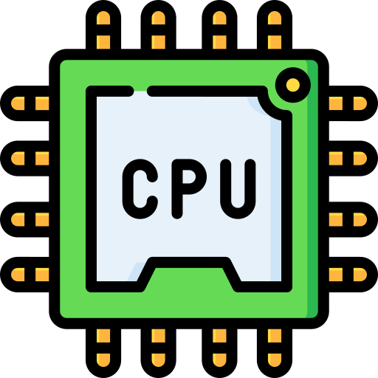


What is an Operating System?
Operating System

Slide 6
Operating System Key Terms & Concepts
Kernel – Core part of the OS, responsible for acting as a “bridge” between software and hardware resources.
Shell – Program that provides an interface to the kernel.
Why shell? Outer layer of the kernel

Slide 7
Operating System Key Terms & Concepts
32-bit vs 64-bit
Refers to the type of processor that can be supported
32-bit (x86) vs. 64-bit (x64)
2³² = 4,294,967,296 values
2⁶⁴ = 18,446,744,073,709,551,616 values
32-bit OS CANNOT run 64-bit drivers/applications, but 64-bit OS can run 32-bit applications

Slide 8
02
Types of OS

Slide 9



Desktop Operating Systems Families
Desktop OS
Windows
MacOS
Linux
Microsoft
XP, 7, 8, 10, 11
Apple
Sonoma, Tahoe
Linus Torvalds
Debian, Ubuntu, Arch

Slide 10
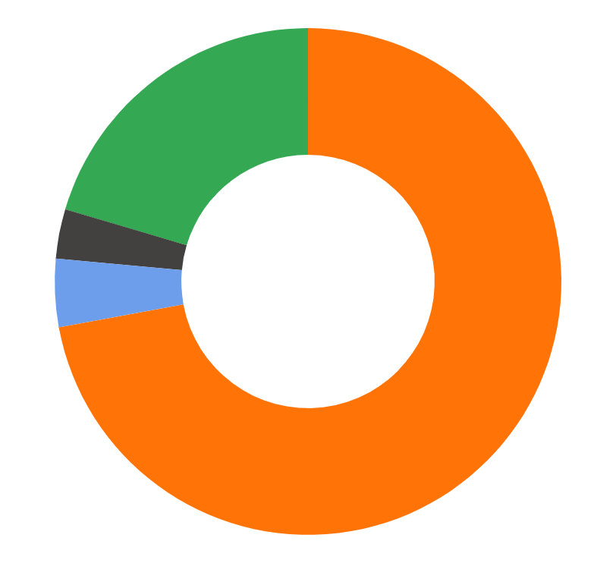
Desktop OS Market Shares
Other
Windows
20.45%
72.3%
Linux
3.17%
MacOS
4.35%
Data from GlobalStats

Slide 11


Mobile Operating Systems Familes
Mobile OS
Android
iOS
HarmonyOS
Google
Apple
Huawei

Slide 12

Mobile OS Market Shares
iOS
Android
24.44%
75.18%
Data from GlobalStats

Slide 13
Windows Operating Systems
Developed by Microsoft in 1985
Built to provide a GUI for MS-DOS
Windows NT – Windows New Technologies
Various editions
Home, Home Pro, Pro, Education, Enterprise, etc.

Slide 14
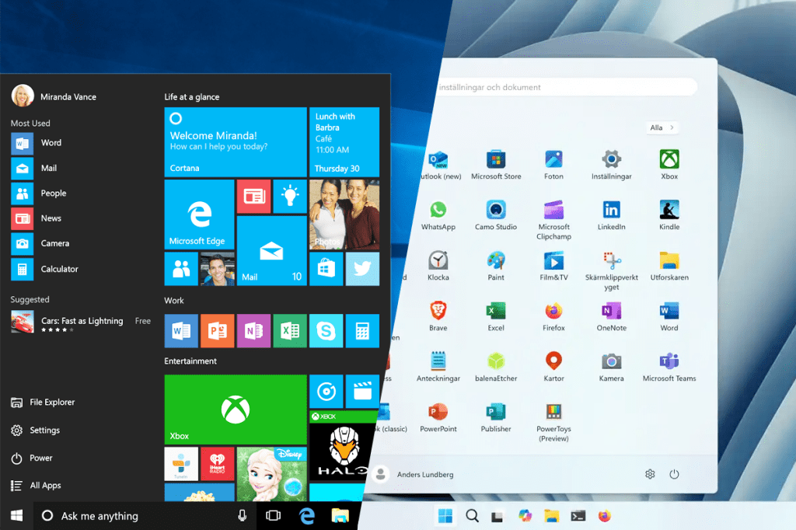
Windows Operating Systems

Slide 15
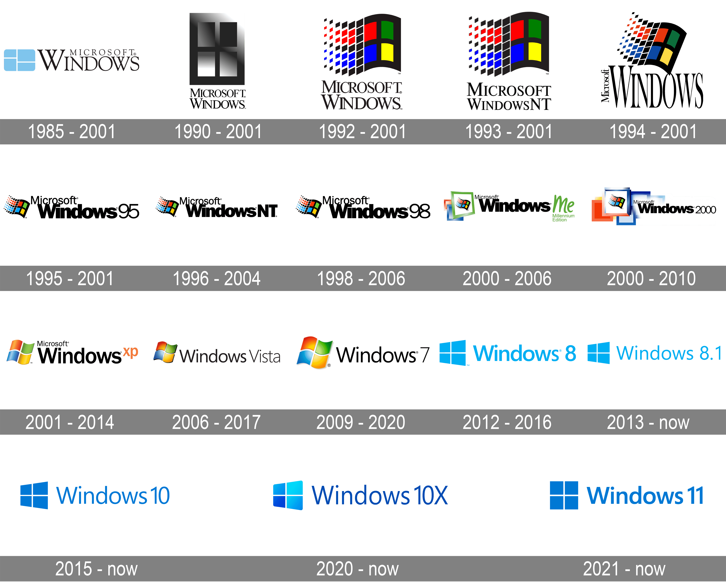
Windows Operating Systems

Slide 16
Mac Operating System
Developed by Apple in 2001
Unix-like OS
Derived from OPENSTEP and FREEBSD
Succeeds classic Mac OS
Used by the Macintosh Systems from 1984 - 2001

Slide 17
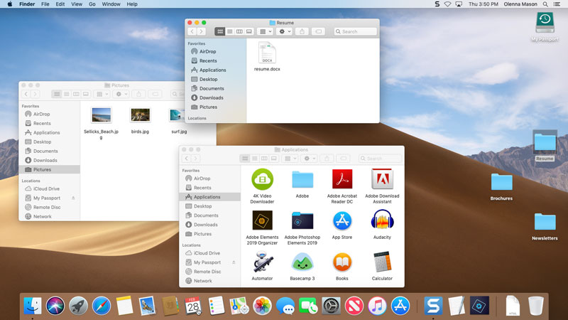
Mac Operating System

Slide 18
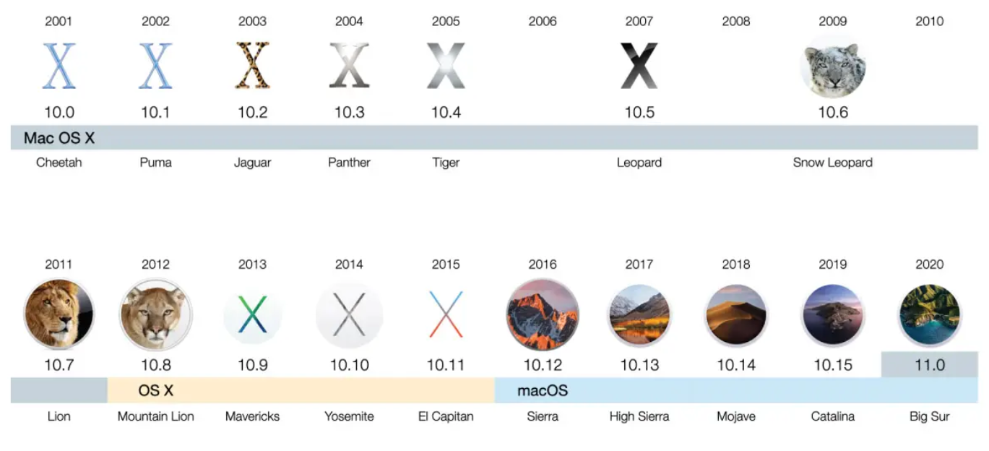
Mac Operating System

Slide 19
Linux Operating Systems
UNIX is NOT LINUX
Unix is proprietary, but other OS can be described as Unix-like
Unix was developed by Ken Thompson and Dennie Ritchie in the 1960s
Default Shell is the Bourne Shell

Slide 20
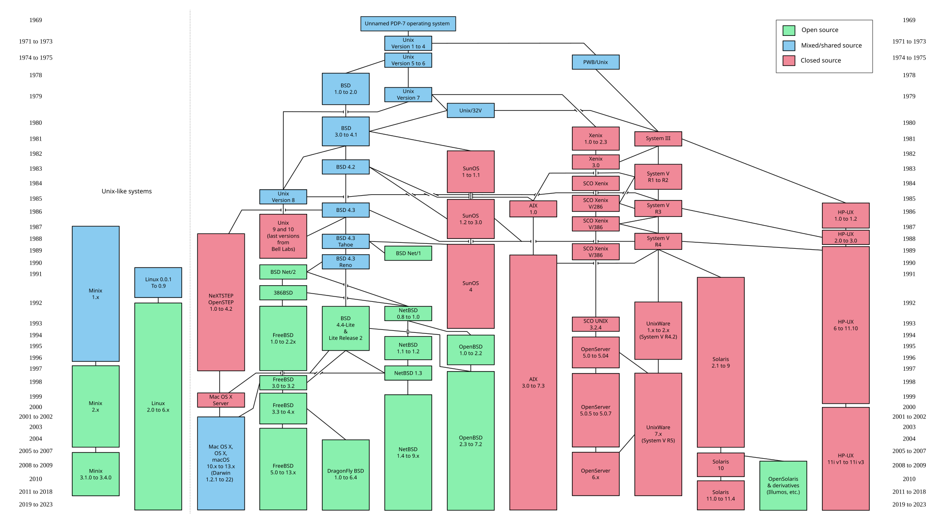
Unix Evolution

Slide 21
Linux Operating Systems
Linux was developed by Linux Torvalds in the 1990s and is typically characterized as free and open-source.
Ubuntu, Debian, Solaris, RedHat, Arch, etc.
Default shell is the Bourne Again Shell (BASH)

Slide 22
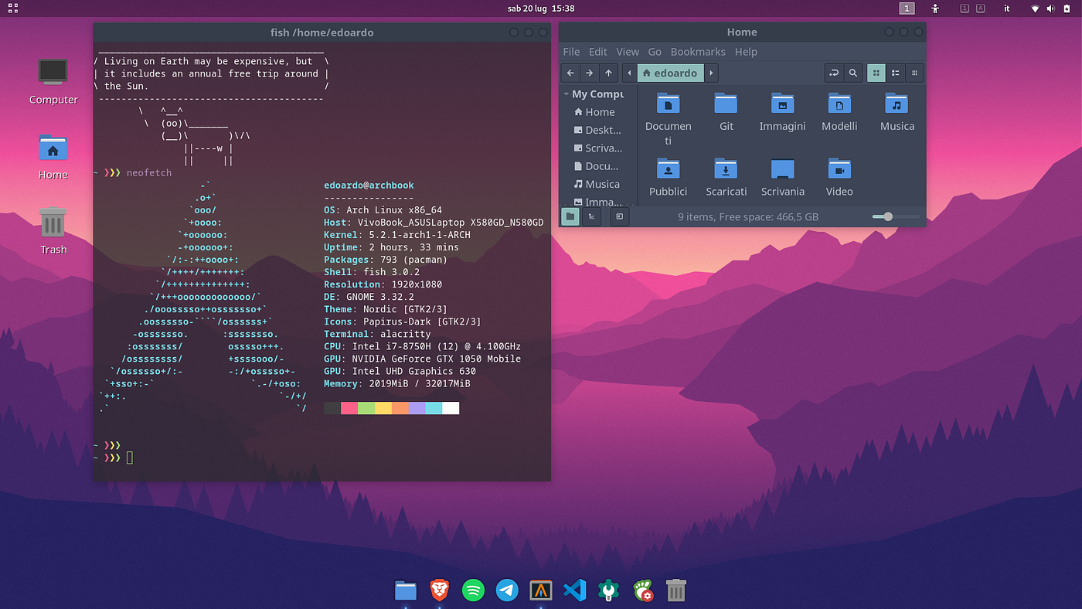
Linux Operating Systems

Slide 23
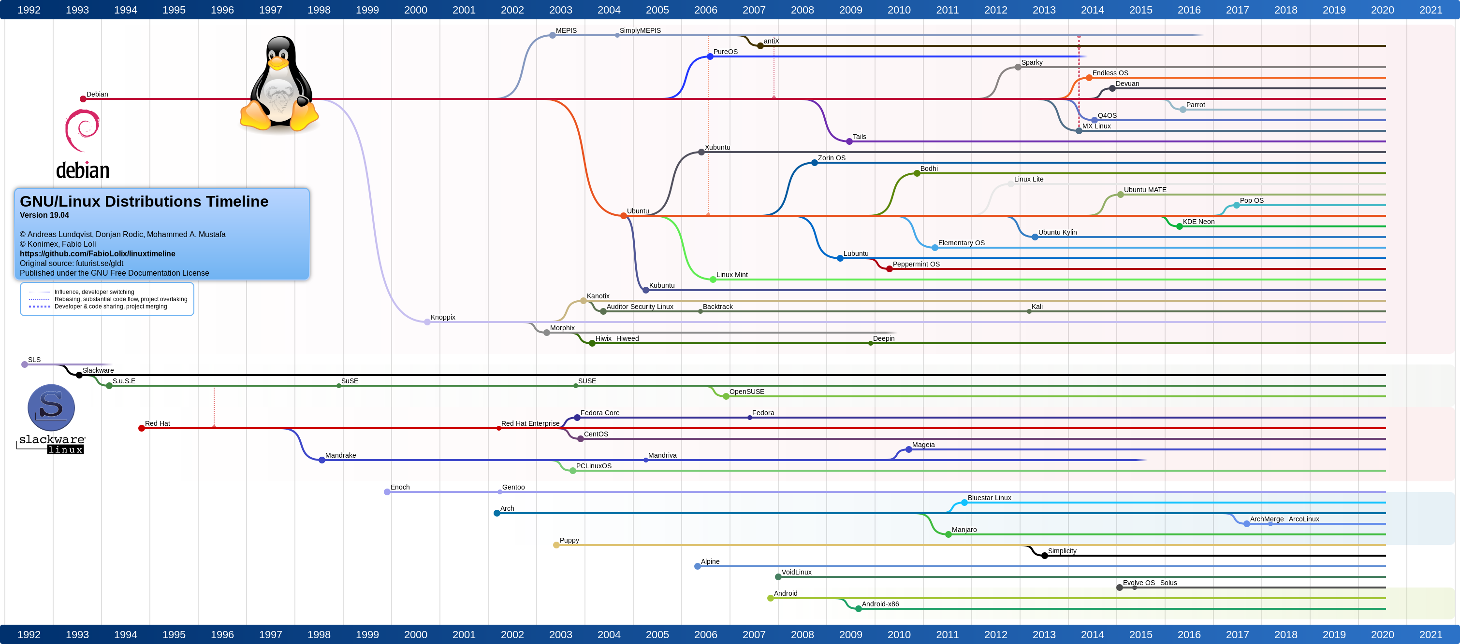
Linux Operating Systems

Slide 24
Why do we care?
Security-perspective
Need be aware of different types of OS, the underlying differences, and limitations between all.
Need to be able to communicate to other professionals, as well as average users.
Hardening/Defense begins with the OS, and understanding attack vectors requires OS knowledge

Slide 25
Why do we care about Linux?
Greater support for open-source/customizable tooling, especially in the networking/cybersecurity space.
Many Linux Distributions that are not general-purpose OS and instead have a specific-purpose and come preinstalled with useful software.
Kali Linux, ParrotOS, BlackArch
Security Onion, SIFT Workstations (Forensics), REMnux (Reverse Engineering)

Slide 26
03
OS Security

Slide 27
Key Terms & Concepts
Principle of Least Privilege
Defense in Depth
Open-Design
Give only the absolute minimum permissions necessary to perform a required task/function
Multiple layers of security controls should be implemented
(Physical, Technical, Administrative)
Security should not depend on secrecy of its design.

Slide 28
User-Space vs Kernel-Space
Operating System

Slide 29
User-Space vs Kernel-Space
OS

Slide 30
User-Space vs Kernel-Space
Kernel-Space
OS
User-Space

Slide 31
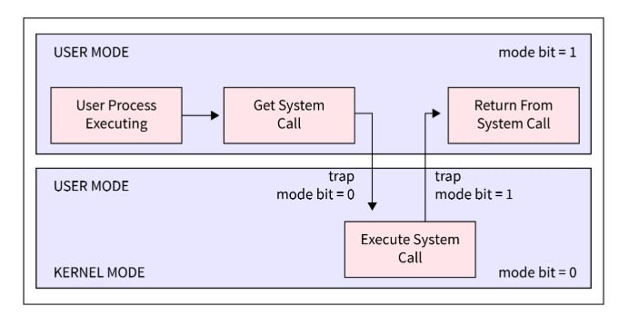
User-Space vs Kernel-Space

Slide 32
User-Space vs Kernel-Space
Operating System
Process A - Google
Process B - Discord
Process C - Word
RAM

Slide 33
User-Space vs Kernel-Space
Operating System
Process A - Google
Process B - Discord
Process C - Word
RAM

Slide 34
User-Space vs Kernel-Space
Operating System
Process A - Google
Process B - Discord
Process C - Word
RAM

Slide 35
User-Space vs Kernel-Space
Operating System
Process A - Google
Process B - Discord
Process C - Word
RAM

Slide 36
User-Space vs Kernel-Space
Operating System
Process A - Google
Process B - Discord
Process C - Word
RAM

Slide 37
04
Access Control

Slide 38
Access Control Key Terms & Concepts
Subjects – Model for users, application, etc. Wants to access a resource/object.
Objects – Data to be interacted with or accessed

Slide 39
Access Control Key Terms & Concepts
Access Control Lists – Also known as ACLs, a list that describes who can access what (files, network resources, etc.)
Authorization – Granting (or denying) permission to perform an action
Authentication – Determining a subject is who they say they are

Slide 40
Access Control Key Terms & Concepts
Users – Individual within a computing system.
Groups – Set of people within a single unit.

Slide 41
Access Control Models
There are various different types of Access Control Models:
Discretionary
Mandatory
Role-Based

Slide 42
Discretionary Access Control (DAC)
Owner of an object controls who can read, write, or execute the given resource.
Owner can give access to users or groups.

Slide 43
Mandatory Access Control (MAC)
Access to resources is determined by predefined security- levels.
Object-focused, not user-focused.

Slide 44
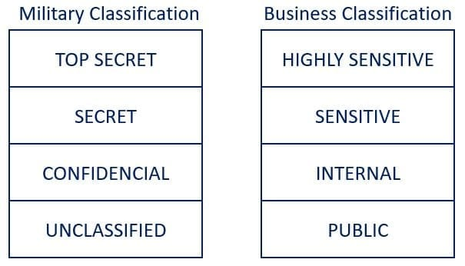
Mandatory Access Control (MAC)

Slide 45
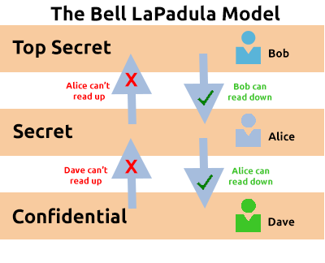
Bell – Lapadula Model

Slide 46
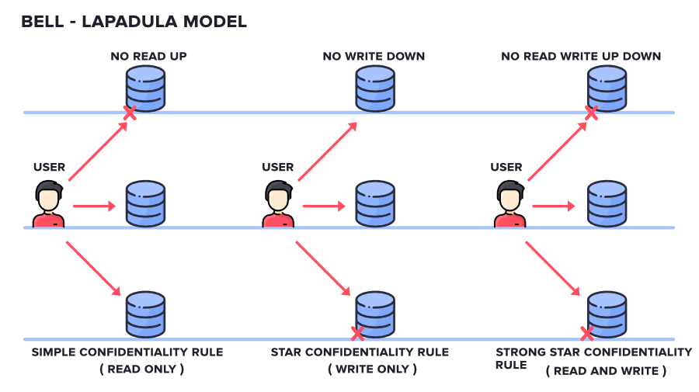
Bell – Lapadula Model

Slide 47
Role-Based Access Control (RBAC)
System Administrator creates roles, in which users or groups within a role obtain the corresponding permissions.
User-focused, not object-focused.

Slide 48
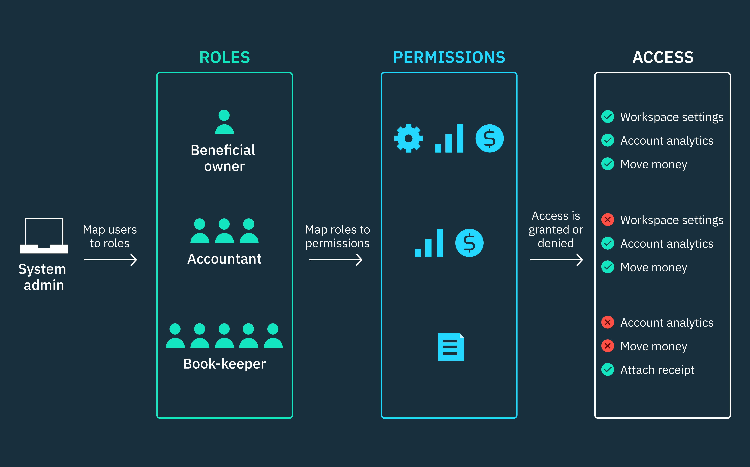
Role-Based Access Control (RBAC)

Slide 49
Thank you!
Do you have any questions?

