Slide 1

Cyber Laws & Regulations
Nancy LaTourrette, CISSP
Computer Science & Engineering
CS 151 – Introduction to Cybersecurity

Slide 2
Security & Privacy Controls
NIST Special Publication 800-53 provides security and privacy controls and a process for selecting controls to protect organizational assets, individuals, and the Nation from hostile cyber attacks, natural disasters, structural failures, and human errors. The controls are customizable and implemented as part of an organization-wide process.
-- (NIST) Security and Privacy Controls for Federal Information Systems and Organizations, Revision 4, 2013
CS 151 – Introduction to Cybersecurity

Slide 3
Computer Security Act
The Computer Security Act (1987¹) directed NIST² to establish a computer standards program for federal computer systems, including guidelines for security.
Use security guidelines developed by the NSA³ regarding protecting sensitive information.
Develop standards of minimum acceptable practices.
Establishment of security policies for federal computer systems that contain sensitive information.
Mandatory security awareness training for federal employees that use those systems.
CS 151 – Introduction to Cybersecurity
Notes:
Repealed in 2002 and replaced with FISMA
NIST then known as National Bureau of Standards
The Rainbow Series (1980s – 1990s) is a library of documents about computer security. Topics range from password management to configuration management and audits to covert channels.
Rainbow Series: https://fas.org/irp/nsa/rainbow.htm

Slide 4
FISMA
The Federal Information Security Management Act (FISMA) requires federal agencies to develop, document, and implement an information security and protection program.
Reduces the security risk to federal data and manages federal spending on information security.
Includes information security programs provided or managed by another agency, contractor, or other sources.
Risk-based policy for cost-effective security.
Conduct annual review of the agency's information security program.
Expanded to include state agencies administering federal programs like Medicare.
CS 151 – Introduction to Cybersecurity
Notes:
FISMA signed into law 2002.
Updated 2014.
NIST is responsible for developing standards, guidelines, and associated methods and techniques

Slide 5
FISMA
Top FISMA requirements:
Information Security Inventory – keep an inventory of all information systems used.
Risk Categorization – categorize information in order or risk (most sensitive).
Security Plan – create and maintain a security plan.
Security Controls – implement NIST 800-53 security controls into security plan.
Risk Assessments – conduct a three-tiered¹ risk assessment.
Security Reviews – conduct an annual security review.
CS 151 – Introduction to Cybersecurity
Notes:
Risk assessment conducted at organizational level, business process level, and information system level.

Slide 6
NIST 800-53
NIST Special Publication 800-53 Revision 4:
Step 1: Categorize the information system based on impact assessment.
Step 2: Select the applicable security control baseline based on security categorization.
Step 3: Implement the security controls and document the design, development, and implementation.
Step 4: Assess the security controls to determine extent to which the controls are producing the desired outcome.
Step 5: Authorize information system operation based on a determination of risk.
Step 6: Monitor the security controls on an ongoing basis to determine effectiveness.
CS 151 – Introduction to Cybersecurity

Slide 7
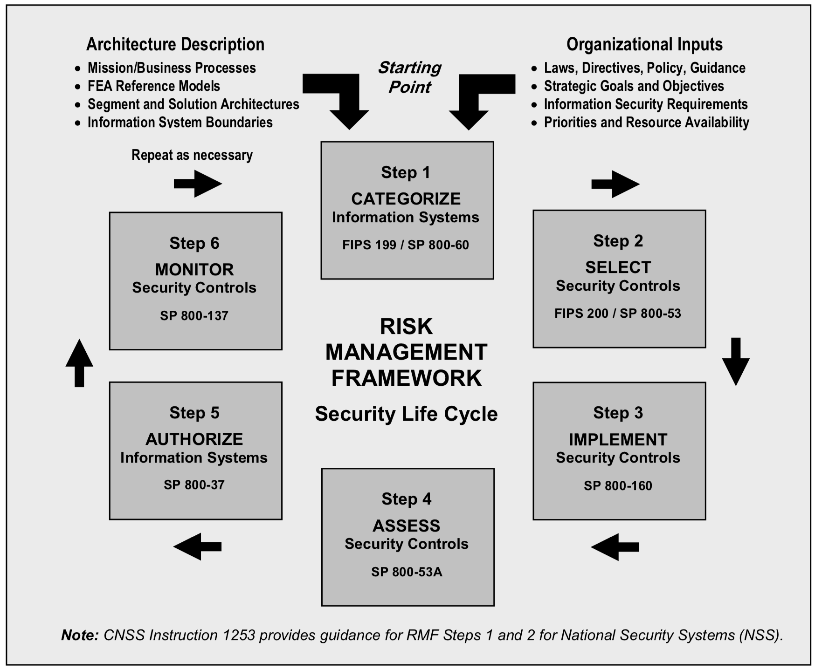
NIST 800-53
CS 151 – Introduction to Cybersecurity

Slide 8
Common Criteria
The Common Criteria for Information Technology and Security evaluation are ISO standards specifying security requirements and evaluation criteria.
Rainbow Series (1980s-1990s) – is a library of documents about computer security. Topics range from password management to configuration management and audits to covert channels.
Common Criteria (late 1990s) – goal is to provide increased confidence in information security. Based on Orange Book¹ but more flexible and adaptable as information technology evolved.
Formal Actions – taken during developing, evaluating and operating process.
Requirements – a common set of security requirements for use in evaluation of systems. Functional and Assurance requirements define the desired security behavior and are effective and implemented correctly.
CS 151 – Introduction to Cybersecurity
Notes:
First pub was the Orange Book in 1983 – Trusted Computer System Evaluation Criteria (TCSEC). Focused primarily on protecting information confidentiality.
Rainbow Series: https://fas.org/irp/nsa/rainbow.htm
Information based on Computer Security Principles and Practices, Stallings & Brown, 4th Edition.

Slide 9
USA Patriot Act
The USA Patriot Act was signed into law in 2001 as a response to the 9/11 attacks to improve the ability of law enforcement to detect and deter terrorism.
Updated laws to reflect technological advancements.
Expanded powers of information gathering¹.
Sunset Provisions specific to cyber:
Section 209 – seize voice mail with search warrant vs. surveillance order.
Section 217 – treats cyber hackers same as physical intruders.
Section 220 – search warrant obtained for ISP outside jurisdiction of courts.
CS 151 – Introduction to Cybersecurity
Notes:
Controversial: Privacy vs. Security

Slide 10
Federal Cyber Protection Laws
Americans with Disabilities Act (Section 508) – requires federal agencies to make all public-facing content accessible. Updated to include non public-facing content such as emergency notifications.
FDA 21 CFR 806 – requires reporting of changes in medical devices to FDA. Reduced reporting requirements for cybersecurity routine updates, patches and device enhancements with certain provisos^{1.}
Cybersecurity Information Sharing Act (CISA) - allows the sharing of internet traffic information between the U.S. government and technology and manufacturing companies.
CS 151 – Introduction to Cybersecurity
Notes:
Such as participating in an Information Sharing & Analysis Organization (ISAO); no adverse events; remediation within a timeline.

Slide 11
International Data Privacy
Organization for Economic Co-Operation and Development (OECD) promotes policies that will improve the economic and social well-being of people around the world.
OECD’s guidelines governing the protection of privacy and transborder flow of personal data:
Limit the collection of personal data
Collection should be relevant to use
Specify purposes for collection
Limit data disclosure to purpose specified
Protected by reasonable safeguards
Transparent practices and policies
Individual rights to obtain personal data
Data controller responsible for compliance
CS 151 – Introduction to Cybersecurity
Notes:
A discussion on legal jurisdictions and transborder flow, especially regarding cloud computing, could occur here.
Relevant paper: https://www.usitc.gov/journals/policy_challenges_of_cross-border_cloud_computing.pdf
Relevant paper: http://www.oecd-ilibrary.org/docserver/download/5kg0s2fk315f.pdf?expires=1470956445&id=id&accname=guest&checksum=6FE096B69FB3A016AF1406EEA531A3CF

Slide 12
EU Laws & Regulations
EU Data Protection Directive protects the fundamental rights and freedoms of natural persons, and in particular their right to privacy with respect to the processing of personal data.
EU-U.S. Privacy Shield protects the fundamental rights of anyone in the EU whose personal data is transferred to the United States as well as bringing legal clarity for businesses relying on transatlantic data transfers.
EU General Data Protection Regulation (GDPR) updates the data protection framework to increase individual’s control over their data; unify rules and enforcement throughout the EU; ensure data protection in a globalized world; and extend the framework to include data use by police and criminal justice operations.
CS 151 – Introduction to Cybersecurity
Notes:
EU DPD 95/46/EC 1995
EU laws regarding data privacy are stricter than US.
The EU's DPD foresees specific rules for transfer of personal data outside the EU for best protection when exported abroad.
EU-US Privacy Shield adopted July 2016 - strong data protection obligations on companies receiving personal data from the EU safeguards on U.S. government access to data; effective protection and redress for individuals; annual joint review to monitor the implementation.
EU GDP Regulation adopted 2016 but goes into effect 2018.

Slide 13
Data Breach Laws
Data Breach Laws may be dependent on industry, data category, number of records exposed or time since breach. There are national and state laws with several new state data breach laws taking effect in 2020.
General Data Protection Regulation (GDPR) - notification to the supervisory authority is made within 72 hours or shall be accompanied by reasons for the delay.
California Consumer Privacy Act (CCPA) - consumers can sue when unencrypted or nonredacted data exposed as a result of failure to implement and maintain reasonable security procedures.
Federal Exchange Data Breach Notification Act of 2015 – requires a health insurance exchange to notify customers of a cyber breach no later than 60 days.
CS 151 – Introduction to Cybersecurity

Slide 14
Cybercrime Laws
“Computer crime laws encompass a variety of actions that destroy or interfere with normal operation of a computer system. All 50 states have computer crime laws; most address unauthorized access or computer trespass. Some state laws also directly address other specific types of computer crime, such as spyware, phishing, denial of service attacks, and ransomware.”
-- Computer Crime Statutes, National Conference of State Legislatures, June 2018
CS 151 – Introduction to Cybersecurity

Slide 15
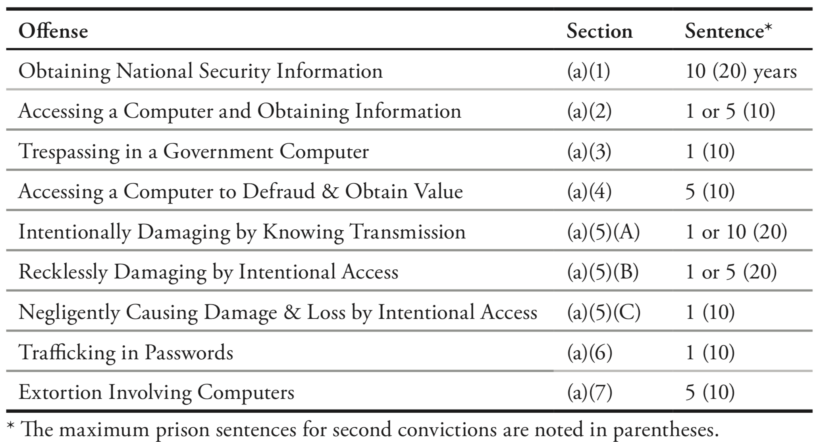
Computer Fraud and Abuse Act
Computer Fraud and Abuse Act (CFAA) - This law has been amended and expanded as internet technology has advanced, and it continues to form the basis for federal prosecutions of computer-related criminal activities.
CS 151 – Introduction to Cybersecurity
Notes:
(1) Image: Prosecuting Computer Crimes, Computer Crime and Intellectual Property Section Criminal Division, DOJ, page 3, https://www.justice.gov/sites/default/files/criminal-ccips/legacy/2015/01/14/ccmanual.pdf

Slide 16
Federal Cybercrime Laws
Electronic Communications Privacy Act (ECPA) - updated the Federal Wiretap Act of 1968 to apply to interception of computer and other digital and electronic communications.
Stored Communications Act (SCA) – Title II of ECPA, regarding email privacy and ISP voluntary and mandatory disclosure.
Identity Theft Enforcement and Restitution Act of 2008 (ITERA) – lowers damage amount needed to prosecute; expands definition of cyber-extortion.
Child Pornography Prevention Act - revises the definition of "visual depiction" to include data stored on computer disk or by electronic means.
Cyber Security Enhancement Act (CSEA) – amends sentencing guidelines for some computer crimes. Allows an ISP to disclose customer data to government agencies if deemed an emergency.
CS 151 – Introduction to Cybersecurity

Slide 17
International Treaties & Agreements
G8 Communique (1997) – G8 countries adopted 10 principles to combat “high tech” crime.
Convention on Cybercrime (2001) - known as the Budapest Convention, addressed the jurisdictional issues and disjoint cybercrime laws due to rise of the internet.
Additional Protocol to the Convention on Cybercrime (2003) – obligation to enact laws to criminalize racist or xenophobic acts that are expressed or otherwise communicated online.
Joint Cybercrime Action Taskforce (J-cat) - facilitating the joint identification, prioritization, preparation and initiation of cross-border investigations and operations against cybercrime threats.
CS 151 – Introduction to Cybersecurity

Slide 18
References
[1] H.R.145 - COMPUTER SECURITY ACT OF 1987
https://www.congress.gov/bill/100th-congress/house-bill/145
[2] NSA/NCSC RAINBOW SERIES
https://fas.org/irp/nsa/rainbow.htm
[3] FEDERAL INFORMATION SECURITY MANAGEMENT ACT (FISMA) IMPLEMENTATION PROJECT
https://www.nist.gov/programs-projects/federal-information-security-management-act-fisma-implementation-project
[4] DEFINITION OF FISMA COMPLIANCE
https://digitalguardian.com/blog/what-fisma-compliance-fisma-definition-requirements-penalties-and-more
[5] SUBCOMMITTEE ON CRIME, TERRORISM, AND HOMELAND SECURITY, STEVEN M. MARTINEZ DEPUTY ASSISTANT DIRECTOR, CYBER DIVISION, FBI, APRIL 2005
https://archives.fbi.gov/archives/news/testimony/computer-provisions-of-the-usa-patriot-act
CS 151 – Introduction to Cybersecurity

Slide 19
References (cont’d)
[6] GOVERNMENT COLLECTION OF PRIVATE INFORMATION: BACKGROUND AND ISSUES RELATED TO THE USA PATRIOT ACT REAUTHORIZATION IN BRIEF, CRS
https://fas.org/sgp/crs/intel/R44042.pdf
[7] SECURITY AND PRIVACY CONTROLS FOR FEDERAL INFORMATION SYSTEMS AND ORGANIZATIONS, NIST 800-53 REVISION 4
https://nvlpubs.nist.gov/nistpubs/SpecialPublications/NIST.SP.800-53r4.pdf
[8] EUROPEAN UNION DATA PROTECTION DIRECTIVE, http://eur-lex.europa.eu/legal-content/EN/TXT/?uri=celex:31995L0046
[9] OECD, GUIDELINES ON THE PROTECTION OF PRIVACY AND TRANSBORDER FLOWS OF PERSONAL DATA, http://www.oecd.org/sti/ieconomy/oecdguidelinesontheprotectionofprivacyandtransborderflowsofpersonaldata.htm
[10] CCPA AND GDPR COMPARISON CHART, PRACTICAL LAW, L.JEHL A. FRIEL, BAKERHOSTETLER LLP
https://www.bakerlaw.com/webfiles/Privacy/2018/Articles/CCPA-GDPR-Chart.pdf
CS 151 – Introduction to Cybersecurity

Slide 20
References (cont’d)
[11] COMPUTER CRIME STATUES, NATIONAL CONFERENCE OF STATE LEGISLATURES, JUNE 2018
http://www.ncsl.org/research/telecommunications-and-information-technology/computer-hacking-and-unauthorized-access-laws.aspx
[12] INTERNATIONAL CYBERCRIME TREATY: LOOKING BEYOND RATIFICATION, DANIEL ROBEL, SANS INSTITUTE, 2006
https://www.sans.org/reading-room/whitepapers/incident/paper/1756
[13] PROSECUTING COMPUTER CRIMES, COMPUTER CRIME AND INTELLECTUAL PROPERTY SECTION CRIMINAL DIVISION, DOJ
https://www.justice.gov/sites/default/files/criminal-ccips/legacy/2015/01/14/ccmanual.pdf
[14] MEETING OF JUSTICE AND INTERIOR MINISTERS OF THE EIGHT, COMMUNIQUE, 1997
https://www.justice.gov/sites/default/files/ag/legacy/2004/06/08/97Communique.pdf
[15] THE COUNCIL OF EUROPE’S CONVENTION ON CYBERCRIME, A. WEBER
http://scholarship.law.berkeley.edu/cgi/viewcontent.cgi?article=1416&context=btlj
CS 151 – Introduction to Cybersecurity

