Slide 1

Economics & Risk Management
Nancy LaTourrette
Computer Science & Engineering
CS 151 – Introduction to Cybersecurity

Slide 2
Cyber-Risk Oversight
Five principles of balancing cybersecurity with profitability:
Directors need to understand and approach cybersecurity as an enterprise-wide risk management issue, not just an IT issue.
Directors should understand the legal implications of cyber risks as they relate to their company’s specific circumstances.
Boards should have adequate access to cybersecurity expertise, and discussions about cyber-risk management should be given regular and adequate time on the board meeting agenda.
CS 151 – Introduction to Cybersecurity
Notes:
Cyber-Risk Oversight, 2014 Edition - National Association of Corporate Directors

Slide 3
Cyber-Risk Oversight
Directors should set the expectation that management will establish an enterprise-wide cyber-risk management framework with adequate staffing and budget.
Board-management discussion of cyber risk should include identification of which risks to avoid, accept, mitigate, or transfer through insurance, as well as specific plans associated with each approach.
-- Cyber-Risk Oversight, 2014 Edition
National Association of Corporate Directors
CS 151 – Introduction to Cybersecurity

Slide 4
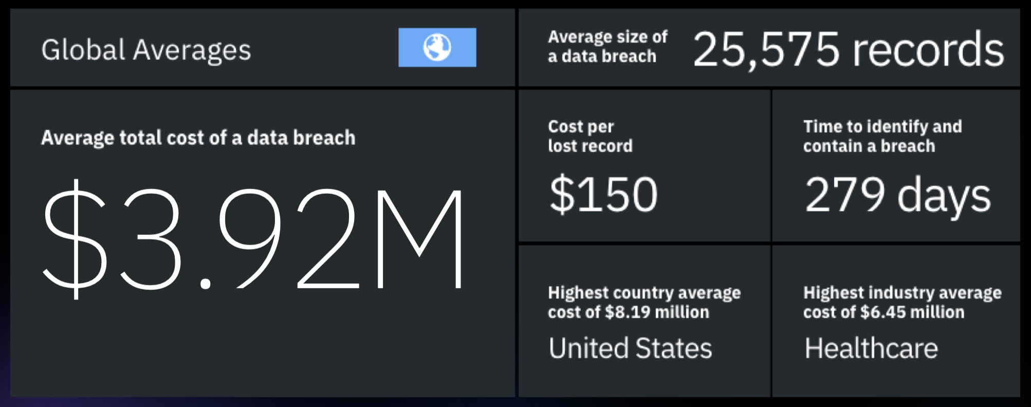









Losses Due to Cybersecurity Breaches
-- IBM Security – Cost of a Data Breach Report 2019
CS 151 – Introduction to Cybersecurity

Slide 5
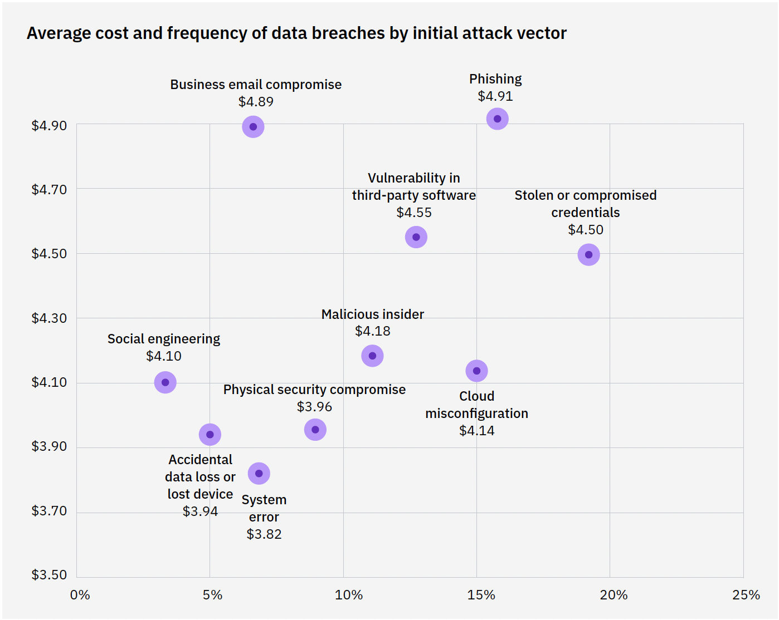




Costs and Frequency by Attack Vector
-- IBM Security – Cost of a Data Breach Report 2022
CS 151 – Introduction to Cybersecurity

Slide 6
Economic Losses
Direct costs:
Theft of financial assets, lost revenues during outages, loss of sensitive business information, cost of recovery, compensation to victims, deferred investments.
Indirect costs:
Reputational damage, loss of confidence in cyber transactions, lower returns on innovation.
CS 151 – Introduction to Cybersecurity

Slide 7
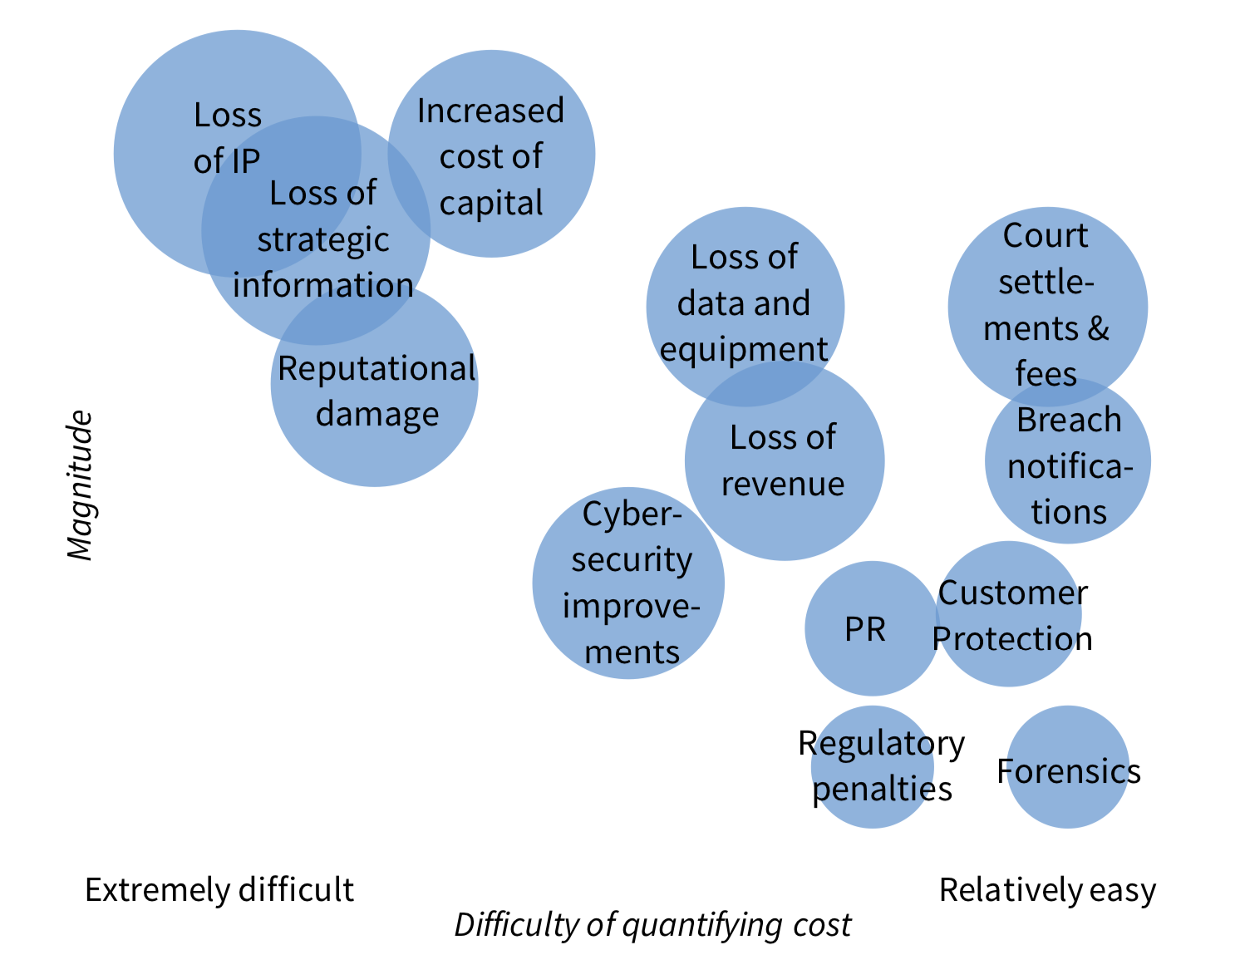
Cost Component of Cyber Breach
-- The Cost of Malicious Cyber Activity to the U.S. Economy, Council of Economic Advisors 2018
CS 151 – Introduction to Cybersecurity

Slide 8
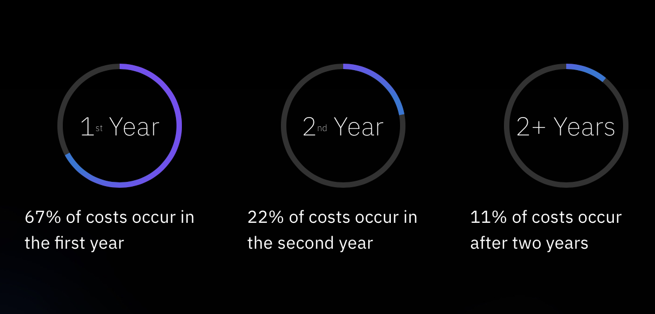
Longtail Cost of Cyber Breach
-- IBM Security – Cost of a Data Breach Report 2019
CS 151 – Introduction to Cybersecurity

Slide 9
Asymmetric Costs
Asymmetric costs of defense vs. offense:
Attacking is easy and cheap.
Defending is extremely expensive, with perfect security unachievable.
According to Ponemon Institute, “real-world cost of an unmitigated attack is $40,000 per hour,” while the price of launching certain kinds of attacks (DDOS) is about $38 dollars per hour.
CS 151 – Introduction to Cybersecurity

Slide 10
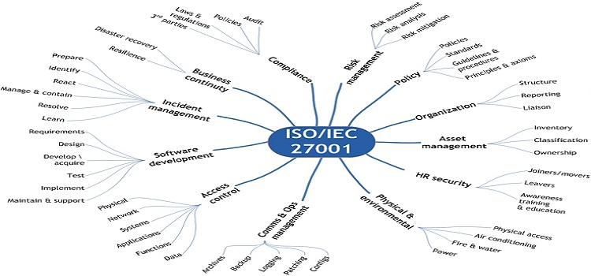
Cost of Compliance
Public and private attempts to establish cybersecurity standards entail a significant cost of compliance:
CS 151 – Introduction to Cybersecurity
Notes:
Committee on National Security Systems Instruction 2015

Slide 11
Cybersecurity Risk Management
Risk is the extent to which an entity is threatened by a potential adverse event.
Risk Dependencies: (1) Negative impacts that arise if the adverse event occurs, and (2) Likelihood of occurrence of the adverse event.
Risk Management: Process of identifying and controlling risks.
Risk Identification: Process of examining organization’s current security situation.
Risk Control: Applying controls to reduce risks.
CS 151 – Introduction to Cybersecurity

Slide 12
Risk Function
Risk = threat x vulnerability x asset
Asset: Any tangible or intangible thing or characteristic that has value to an organization.
Threat: Circumstance or event with the potential to adversely impact organizational operations (including mission, functions, image, or reputation), organizational assets, individuals, other organizations, or the Nation through an information system [CNSSI 4009].
Vulnerability: Weakness in an information system, system security procedures, internal controls, or implementation that could be exploited by a threat source [CNSSI 4009].
CS 151 – Introduction to Cybersecurity
Notes:
Committee on National Security Systems Instruction 2015

Slide 13
Risk Assessment
Risk assessment evaluates relative risk for each vulnerability and assigns a risk rating or score to each information asset.
Likelihood:
The probability that a specific vulnerability will be the object of a successful attack.
Assign numeric value: number between 0.1 (low) and 1.0 (high), or a number between 1 and 100.
Zero not used since vulnerabilities with zero likelihood are removed from asset/vulnerability list.
Use selected rating model consistently.
Use external references for values that have been reviewed/adjusted for your circumstances.
Risk Determination:
For the purpose of relative risk assessment risk equals:
Likelihood of vulnerability occurrence TIMES value (or impact)‏.
MINUS percentage risk already controlled.
PLUS an element of uncertainty.
RISK = (LIKELIHOOD X VALUE) – ALREADY CONTROLLED + UNCERTAINTY
CS 151 – Introduction to Cybersecurity

Slide 14
Risk Control Strategies
Once risk assessment is complete, choose (business continuity) strategy to control each risk:
Defend (Preferred Approach) - Attempt to prevent exploitation of the vulnerability.
Transfer - Control approach that attempts to shift risk to other assets, processes or organizations.
Mitigate - Attempt to reduce impact of through planning and preparation.
Incident Response Plan
Disaster Recovery Plan
Business Continuity Plan
CS 151 – Introduction to Cybersecurity

Slide 15
Risk Control Strategies
Accept – Do not protect a vulnerability and accept the outcome of its exploitation.
Terminate – Avoid those business activities that introduce uncontrollable risks.
CS 151 – Introduction to Cybersecurity

Slide 16
Risk Control Strategies
Risk control strategies from a technology standpoint:
Attack Prevention – Stop attacks before they can hit their target.
Attack Detection – Detect attacks as they occur.
Attack Source Identification – Locate the attack sources.
Attack Reaction – Eliminate or curtail the effects of an attack.
CS 151 – Introduction to Cybersecurity

Slide 17
Risk Control Characteristics
Important characteristics of risk control strategies:
Effective – Stops disruptive and degrading attacks. Successful against variants and does not “push problem upstream”.
Accurate – Attack traffic is dropped while legitimate traffic continues. Low collateral damage.
Reasonable Cost – Defense system is economical and relatively low cost, especially when no attack is occurring.
Deployable – Defense systems on or near to the potential target.
Complete – Ideal defense system should handle most types of attacks and easily evolve.
CS 151 – Introduction to Cybersecurity

Slide 18
Risk Control Methodologies
Common risk control assessment and management methodologies:
National Institute of Standards & Technology (NIST) Methodology
ISO/IEC 27001/27002
OCTAVE® - Operationally Critical, Threat, Asset and Vulnerability Evaluation
FRAP - Facilitated Risk Assessment Process
COBRA - Consultative, Objective and Bi-functional Risk Analysis
COBIT - Control Objectives for IT
CS 151 – Introduction to Cybersecurity

Slide 19


Acknowledgement
This material is based upon work supported by the National Science Foundation under Grant No. 1516724.
CS 151 – Introduction to Cybersecurity

