Slide 1

UNR DF Presentation
9/25/2025
Notes:
1

Slide 2
Disclaimer
The opinions expressed in this presentation, and on the following slides, are solely those of the presenter.
Nothing in this presentation constitutes legal advice. This is general information presented for educational purposes based on the training and experience of the presenter. Consult your legal advisor prior to implementing any new practices, standards or policies based on the information provided.
The presenter is not being compensated by the companies, products, or tools in the following presentation and has no employment affiliation with said businesses except as a customer.

Slide 3
WHO’S THIS GUY?
Retired Detective Josh Watson
20+ Years at Reno Police Department
6 yrs Patrol Officer
8 yrs Sex Crimes/Child Abuse Unit
12+ yrs Computer Crimes Unit
Over 1000 hours of Forensic Training
Conducted over 2300 exams of computers, cell phones, DVRs, vehicles, etc…If it’s been done, I’ve seen it.

Slide 4
How Fast Is Data Growing?
More data has been created in the past two years than in the entire previous history of the human race
“With the rise of social media, people have come to rely on the internet to satisfy their daily data needs.
In 2020, users generated 64.2 ZB of data, which exceeded the number of detectable stars in the cosmos. Experts expect the figures to rise, with data creation reaching 147 ZB by the end of 2024.
Sources: Forbes Online, Edgedelta.com

Slide 5
How Fast Is Data Growing?
With around 5.35 billion internet users worldwide, each person can potentially generate approximately 15.87 TB of data daily.
Facebook produces approximately 4,000 TB daily, ranking #1 in most visited sites globally in 2023.
X (Twitter) garners around 500 million tweets daily, which amounts to 560 GB of data.
In 2024, on average, TikTok videos produce approximately 7.35 TB of data daily.
YouTube hosted over 720,000 hours of videos daily in 2023, which is equivalent to about 4.3 PB of data.
Google processes around 3.5 billion searches daily, amounting to 20 PB.
In 2023, the average internet user created about 1.7 MB of data per second, equal to 146,880 MB daily.
An average household of 4 can create about 506,736 MB of data daily.
Sources: Edgedelta.com

Slide 6
Computer Crimes Unit (CCU)
-Two full time Detectives
-Several part-time collateral Detectives
One Supervisor (Fraud Sgt)

Slide 7
ASSIGNED DUTIES
-All forensic and digital media exams for department
-Forensic exams for affiliate or other local agencies (P&P, Storey County, Lyon County, Carson City, Douglas, NDI, NHP, USSS, DEA, etc)
-Internal data recovery
-Archive all exam data, reports, evidence

Slide 8
ASSIGNED DUTIES Con’t
-Manage CCU budget
-Monitor/Manage CCU Equipment, lic. fees, software, etc.
-Assigned other projects related to pretty much anything digital
Advise other agencies on exams, tools, etc.

Slide 9
EQUIPMENT
FRED (x3), Tableau (TD1 and physical writeblockers, Ultra Bay II), MacBook Pros (x4), UFED Touch (x4), external storage, Faraday Enclosure, about a billion flash drives

Slide 10
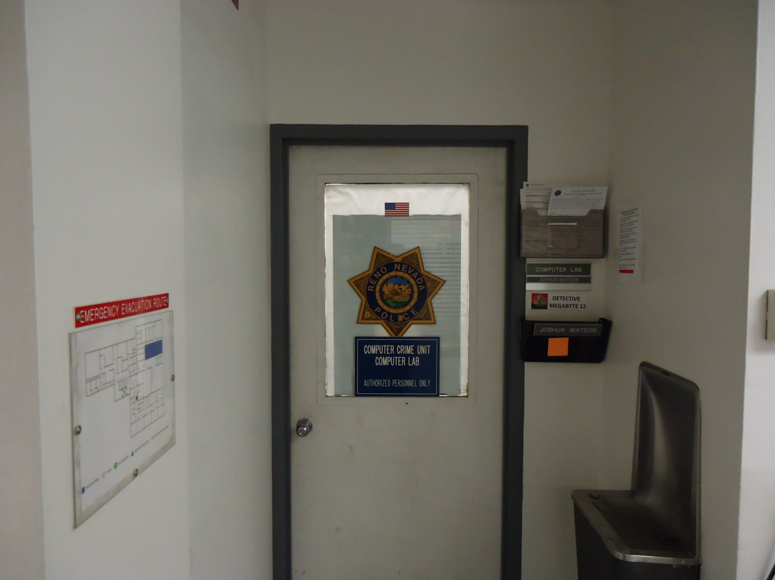

Slide 11
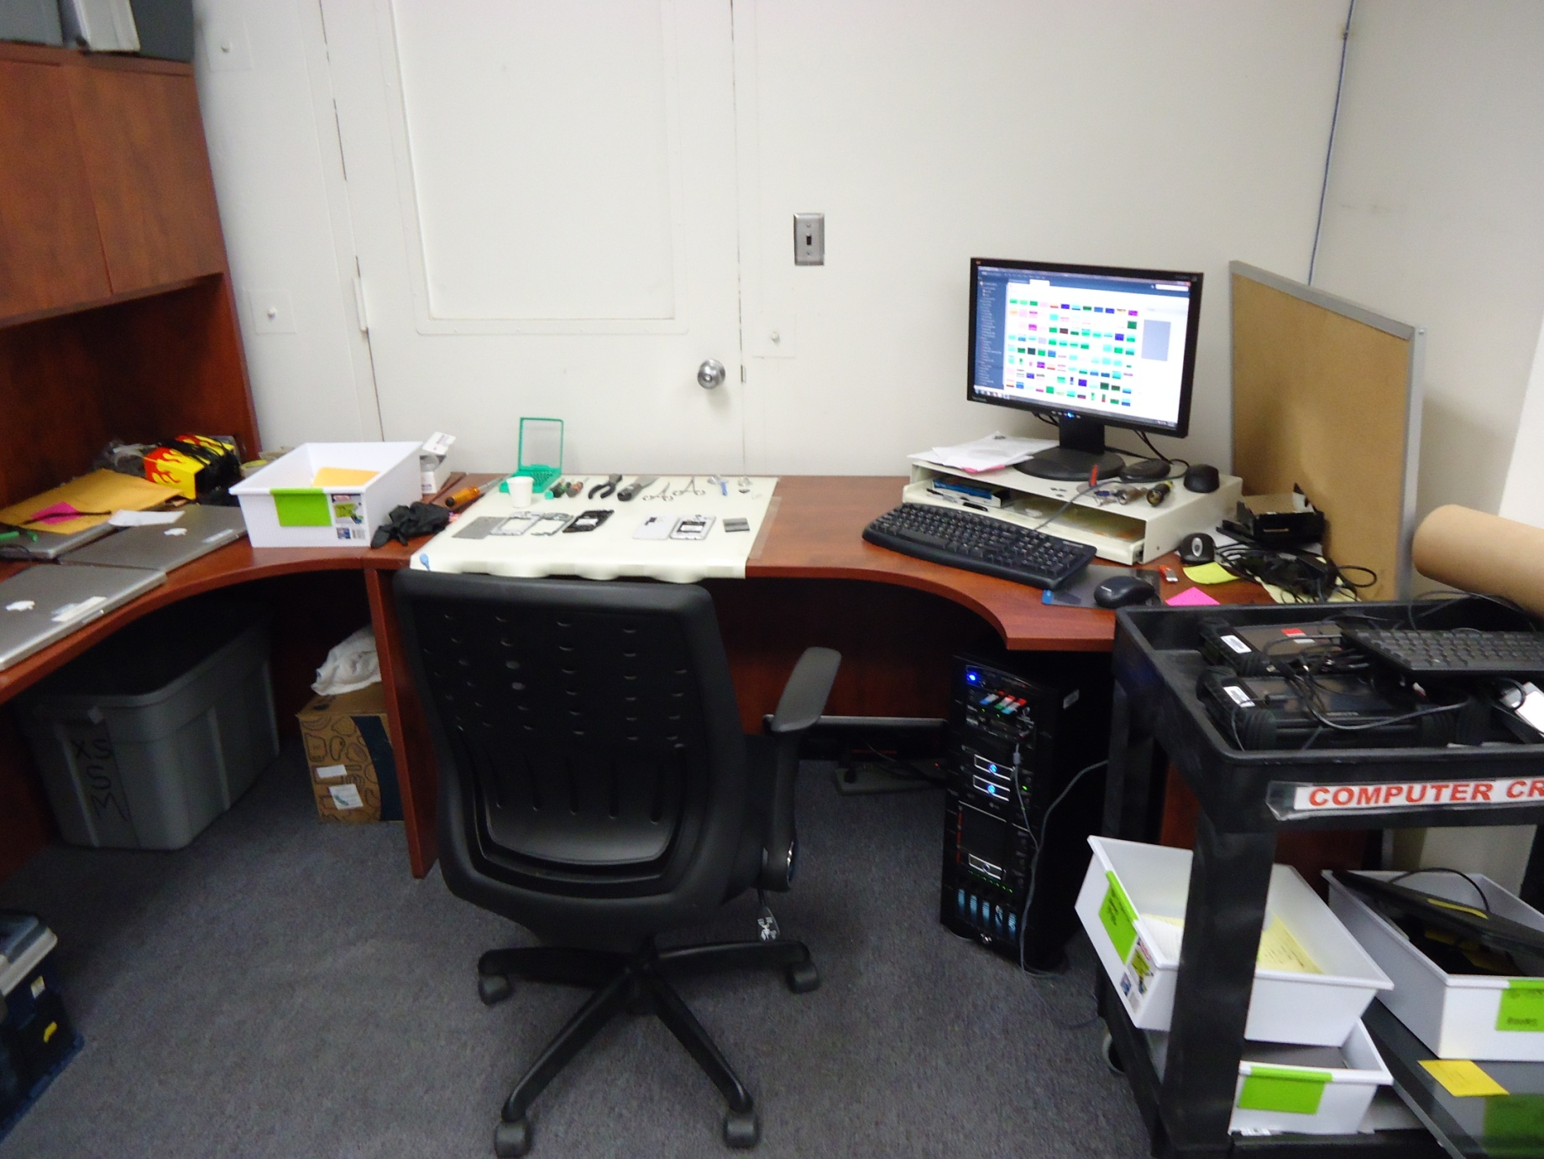
RPD CCU Lab

Slide 12
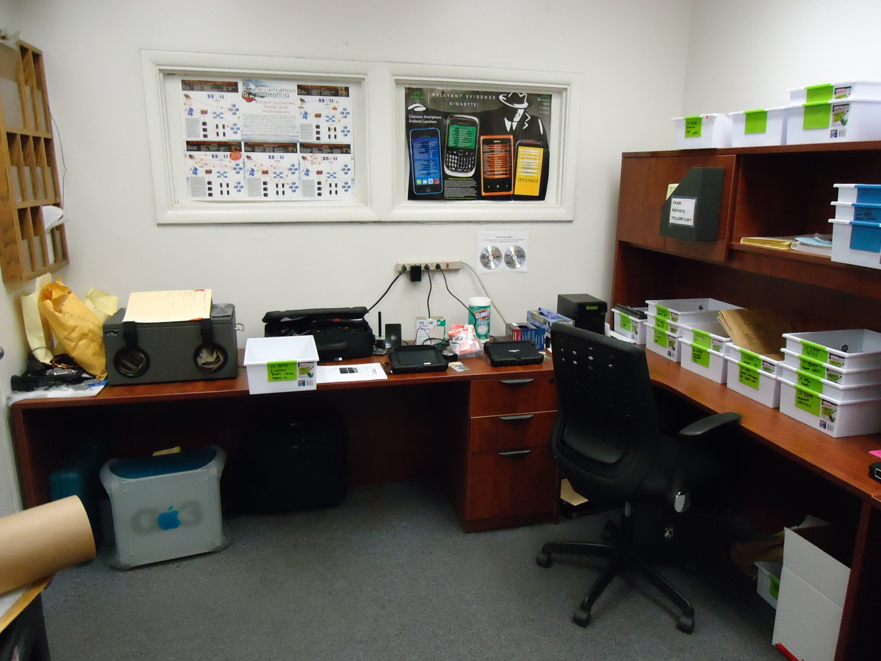
RPD CCU Lab

Slide 13
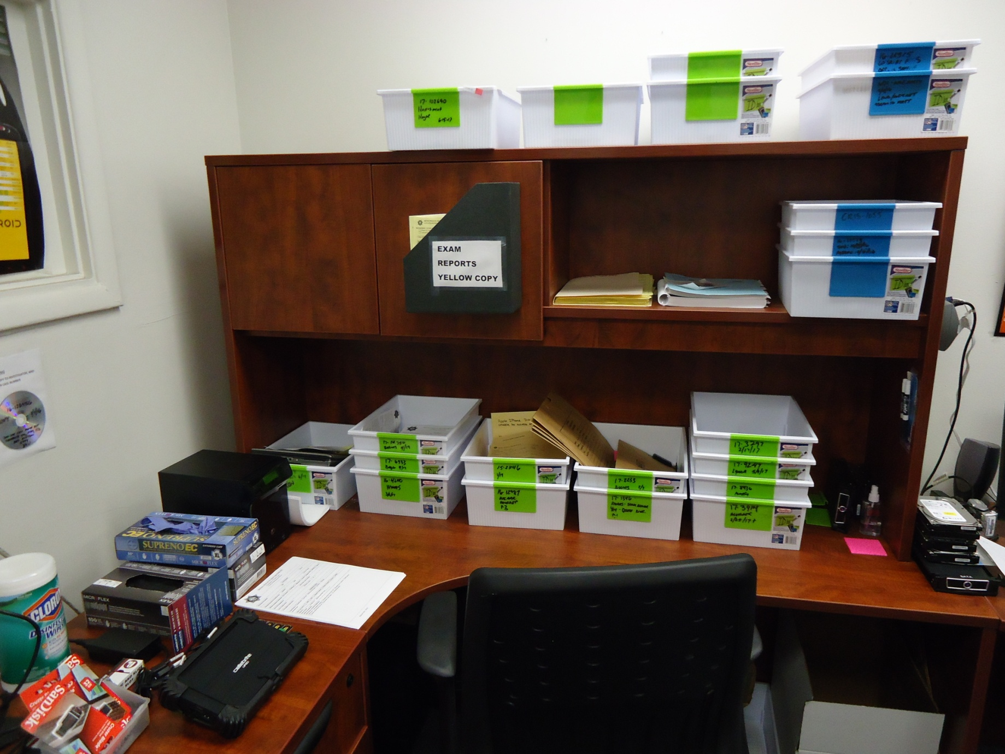
“Tupperware” case management

Slide 14
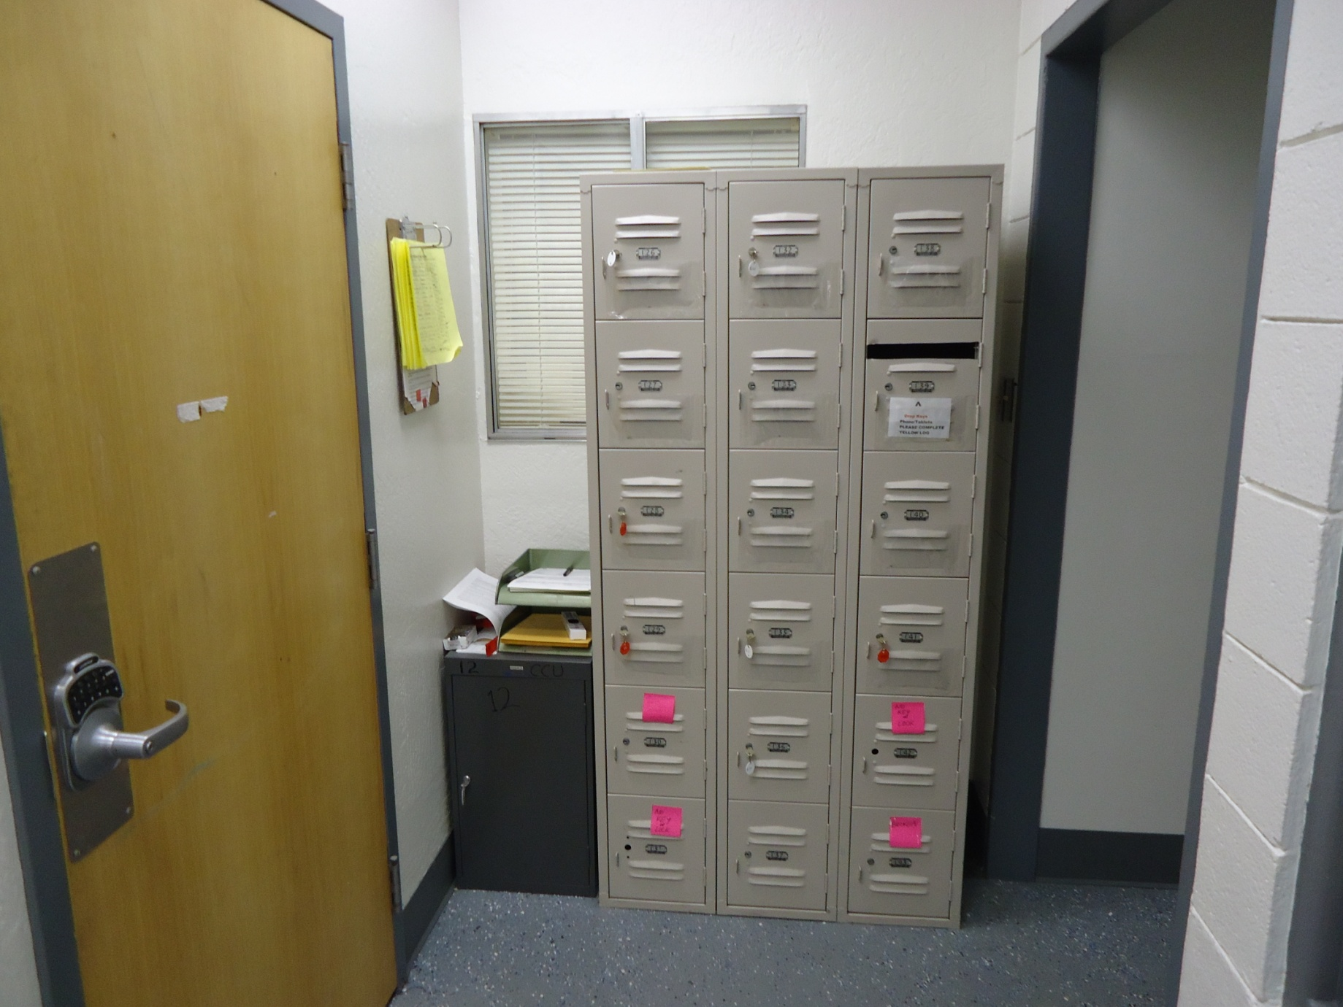
Evidence Submission

Slide 15
Software – Dead Box
EnCase
Access Data FTK
Magnet IEF/Axiom
X-Ways
BlackLight (Mac)
VMWare
Virtual Box
Autopsy (open source)

Slide 16
Software – Phone/Mobile
Cellebrite Physical Analyzer
Magnet Axiom
XRY
Paraben Device Seizure
Susteen Secure View
Internet Evidence Finder

Slide 17
Software – Memory/Network
OS Triage, IEF, Moonsols dumpit, VDC (Volatile Data Collector), Volatility, Redline, HBGary, Wireshark (network protocol analyzer), Sawmill (log analysis)
Notepad++ (Great for looking at server log files: +/- are your friend!!
VMWare, Virtual Box

Slide 18
Cell Phone/Mobile Exams
Exam Request
Booking Evidence
Legal (consent, search clause, warrant)
Tool Selection (Murder vs DOP)
Report Generation (generic vs directed)

Slide 19
Computer Forensics
Exam Request
Booking Evidence
Legal (consent, search clause, warrant)
Tool Selection
Report Generation (generic vs directed)

Slide 20
Live Machine/Memory
Exam Request/Case assignment
Legal (consent, search clause, warrant)
Tool Selection (IOS Triage, Dumpit, FTK, IEF, Axiom)
*Recent Locations/activity
Malware Argument

Slide 21
Network Intrusion Cases
Skimming
Back-of-house Server
POS systems
Social Networking hack

Slide 22
Network Intrusion Cases
Type: Malicious code, Probes/scans (Recon), DOS, Other
What was/is compromised?
Sensitive data
Other unclassified
Classified

Slide 23
Legal
ECPA - The Electronic Communications Privacy Act (18U.S.C. 2510 et seq) - Extends wiretap laws to electronic communications: IPs, Phones, cell providers, satellite services, etc.
Can get basic subscriber info and call logs with subpoena, Transactions need court order, any content (GPS, SMS, MMS, Chat, pics, vid, email content, etc) requires a warrant

Slide 24
Dr. Frankenstein?
LG Aristo – Released January 23, 2017
Left at crime-scene by Suspect
Screen/Digitizer completely shattered
Verified viable via audio upon start-up
5 days to order new screen
Procured new phone at retail store

Slide 25
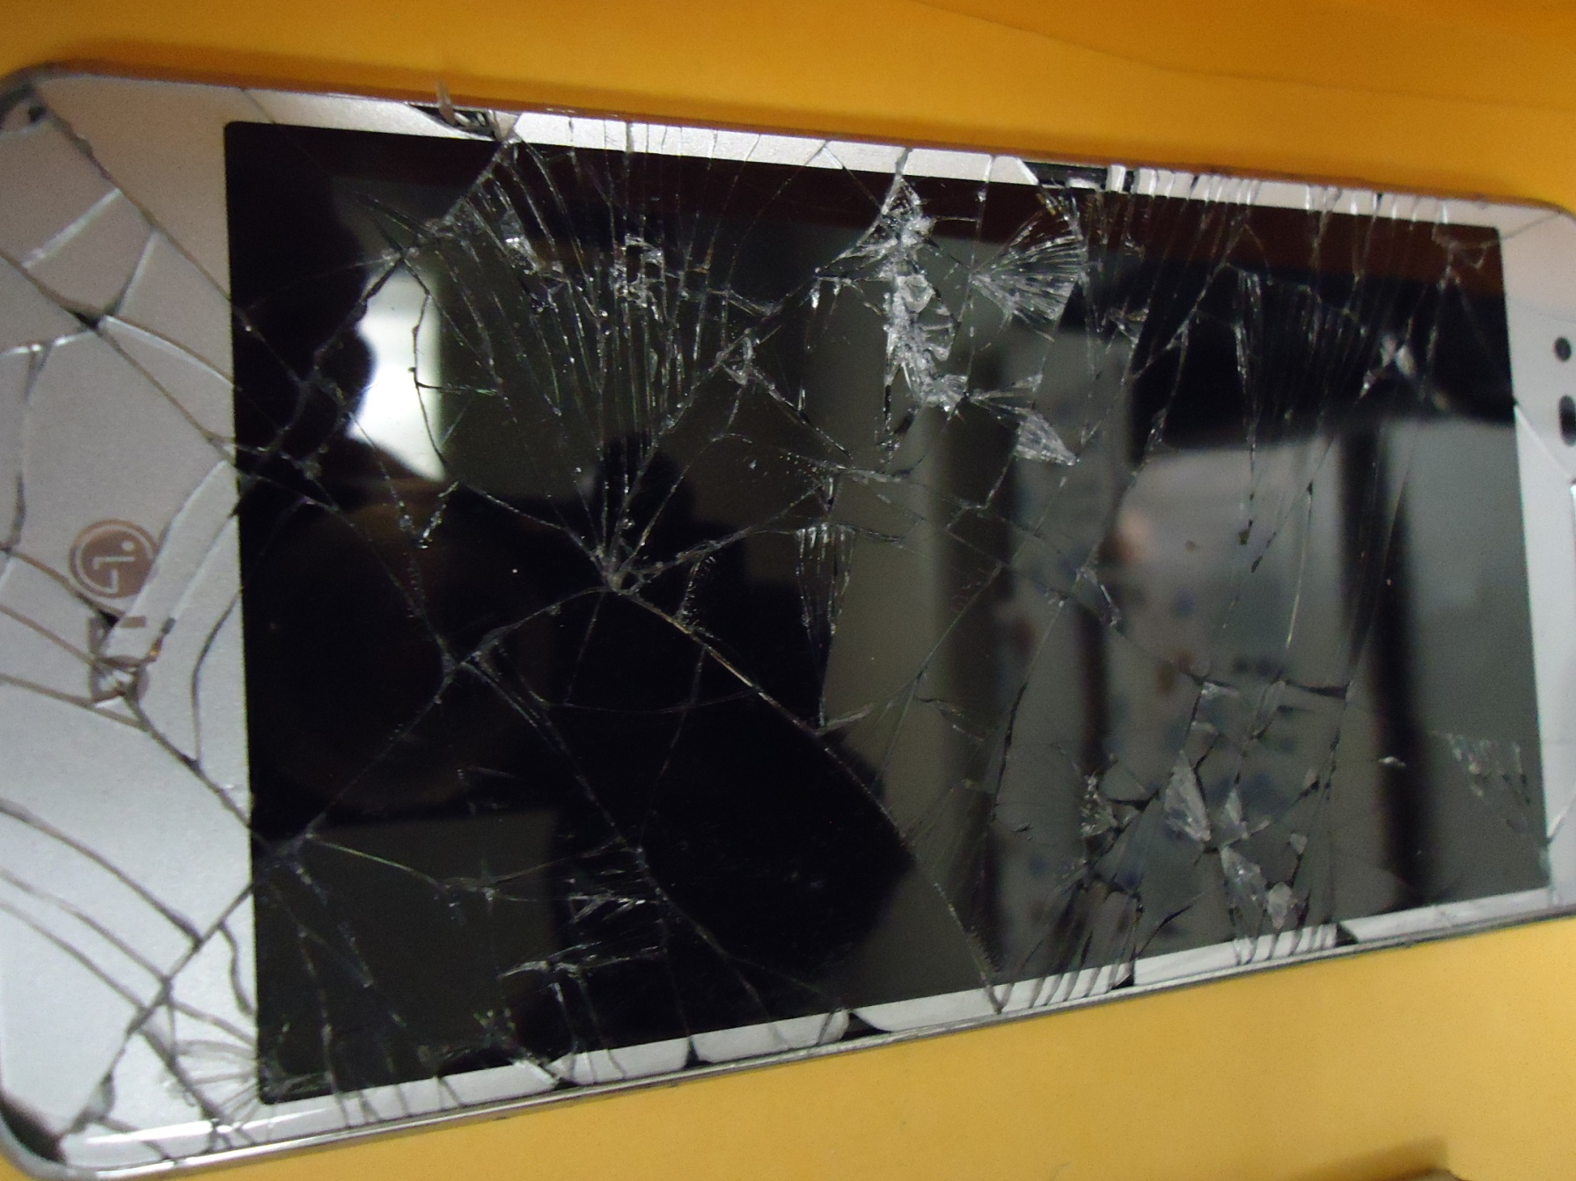
LG Aristo – As submitted

Slide 26
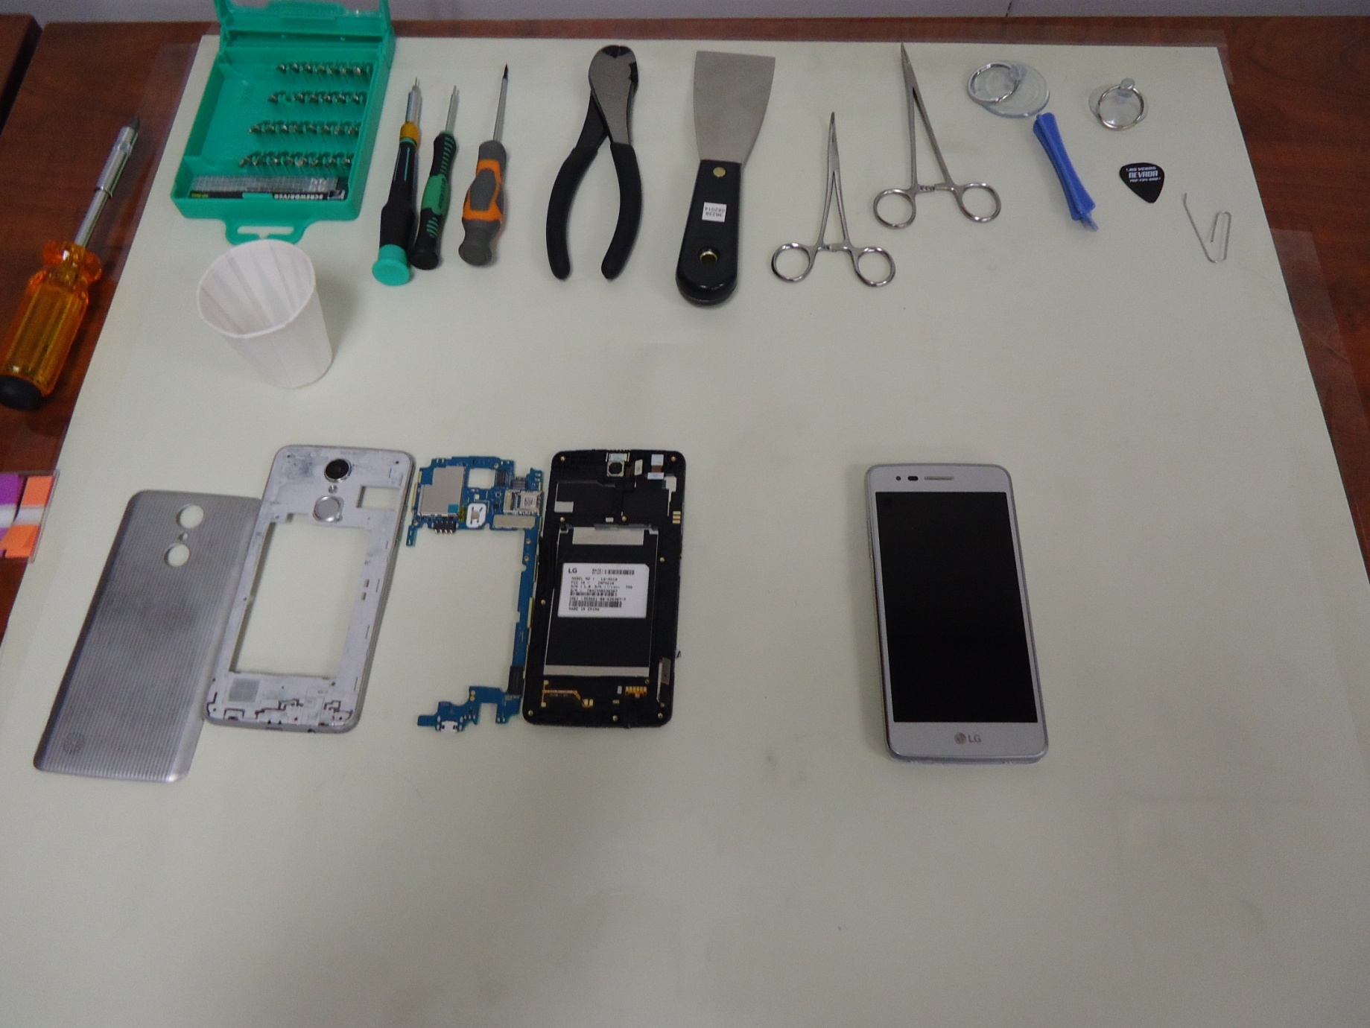
LG Aristo - Rebuild
SUSPECT PHONE
DONOR PHONE

Slide 27
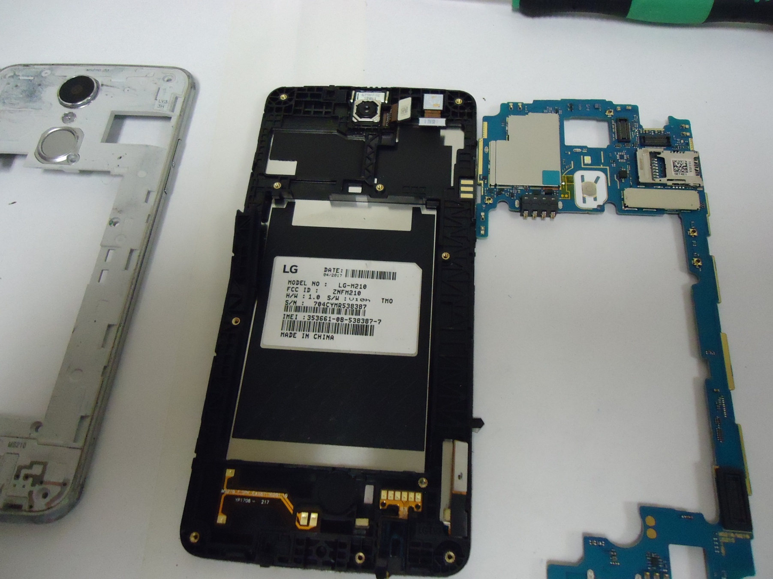
LG Aristo - Rebuild

Slide 28
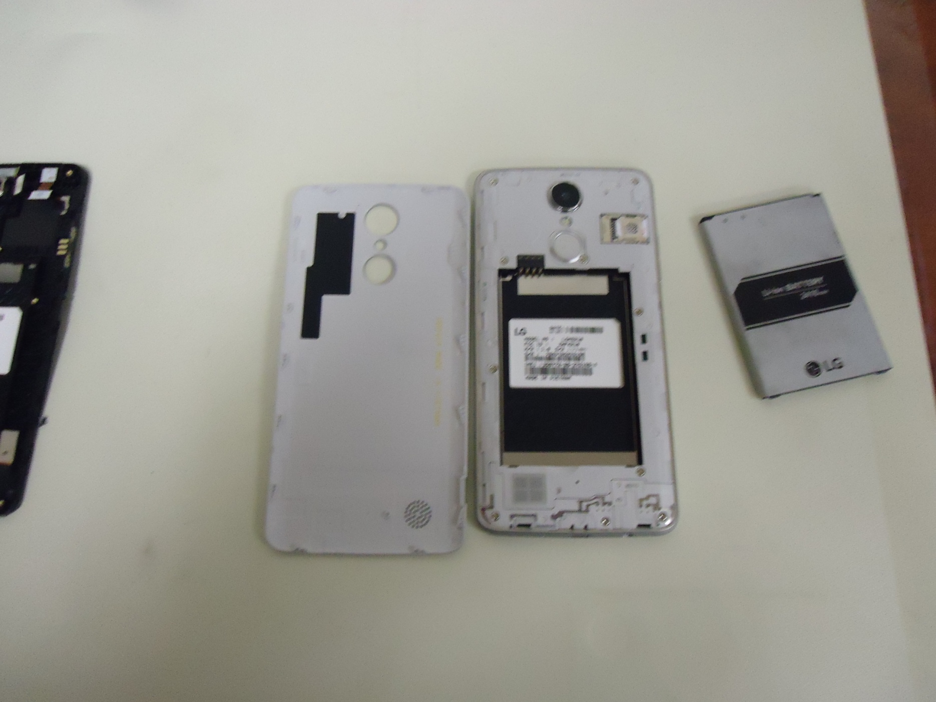
LG Aristo – Completed Donor

Slide 29
LG Aristo
Rebuild was success!
I was able to examine phone as normal using Cellebrite UFED, recover key evidence in the crime, and identify the previously unknown Suspect.

Slide 30
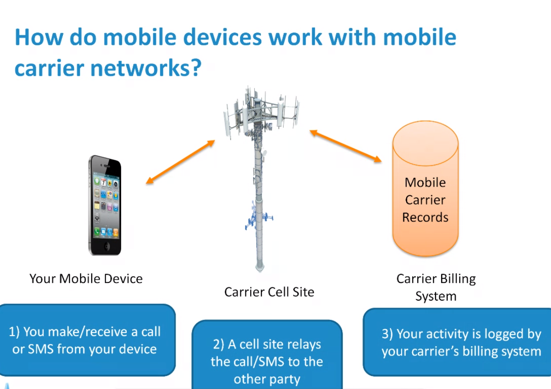

Slide 31
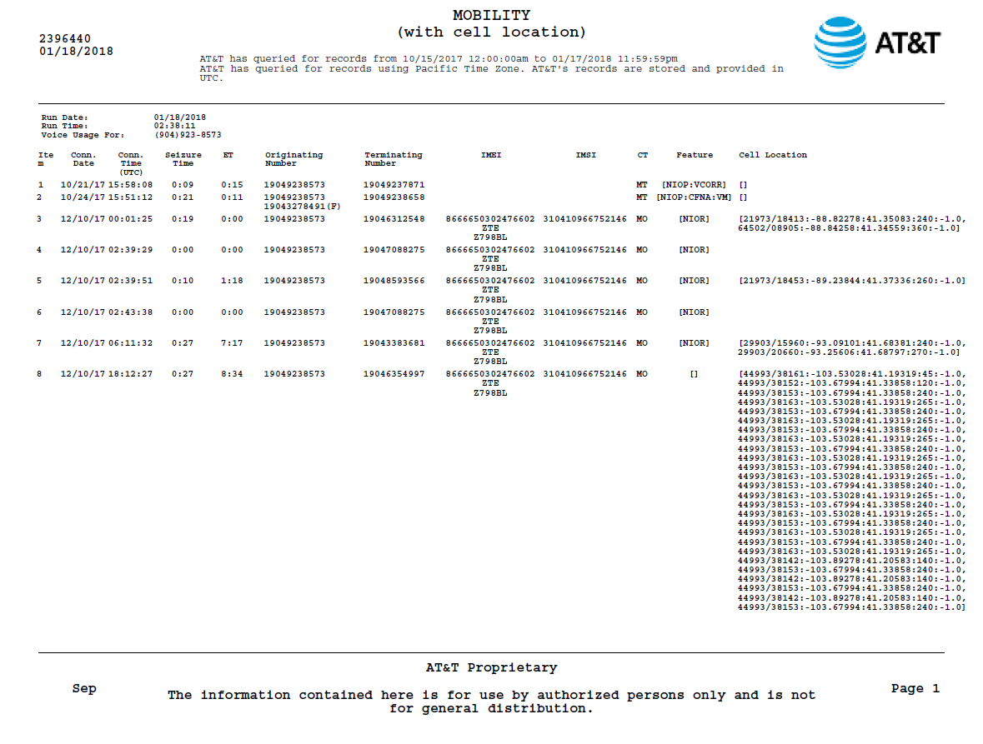

Slide 32
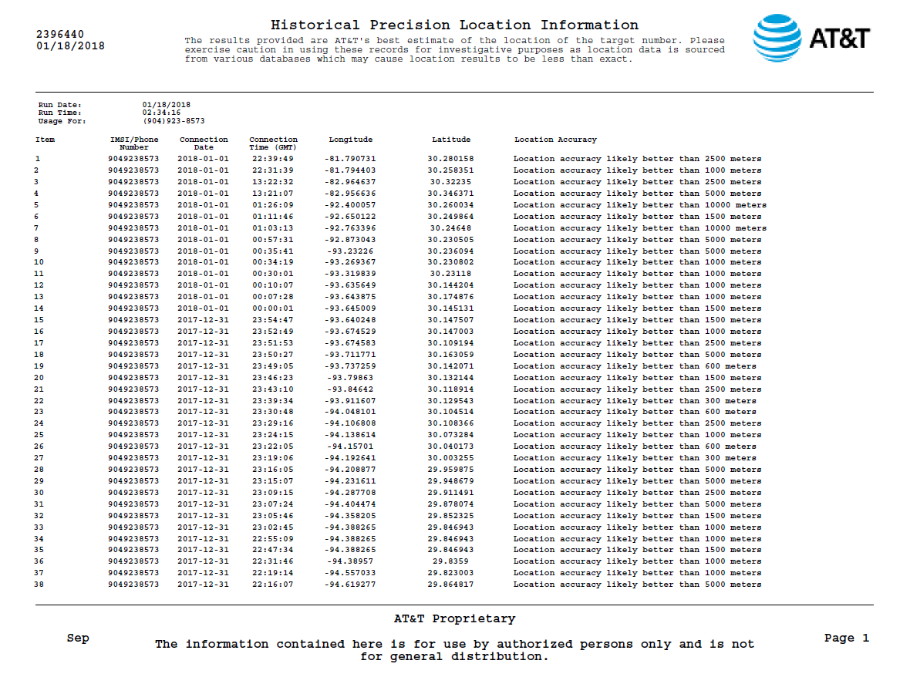

Slide 33
CDR Mapping

Slide 34
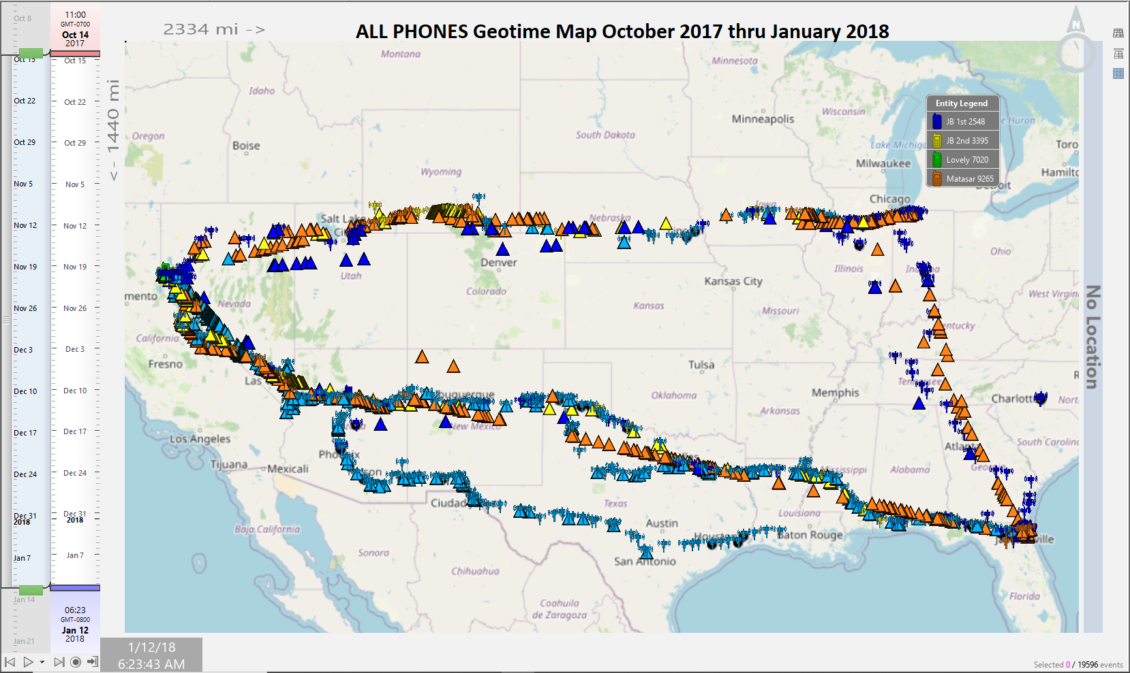

Slide 35
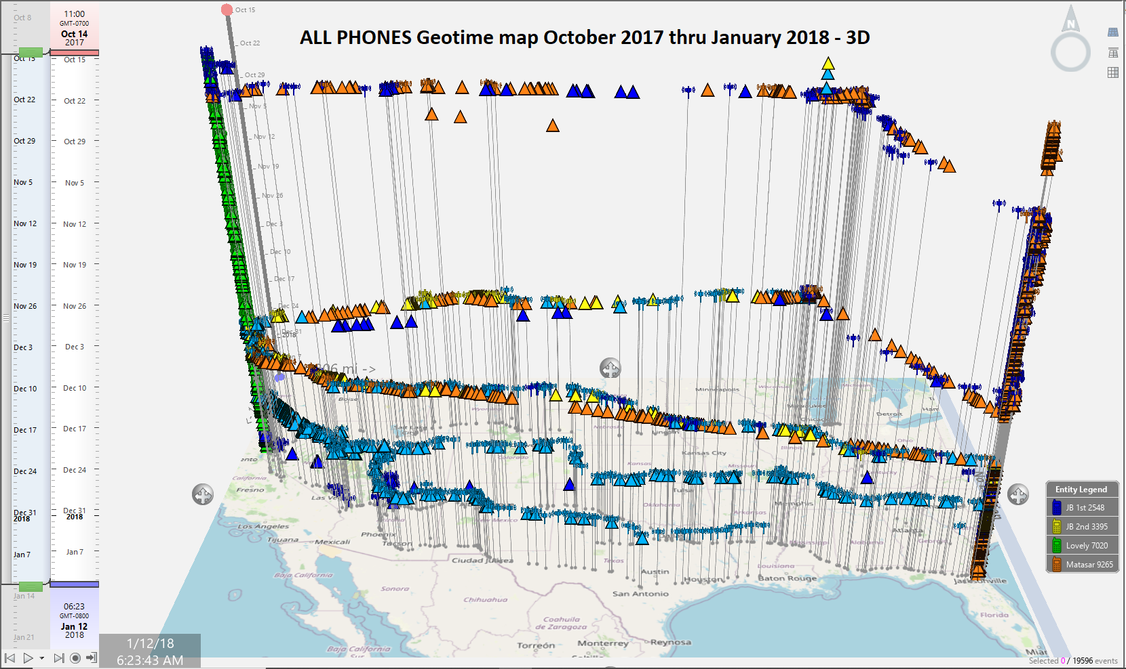

Slide 36
CDR Mapping

Slide 39
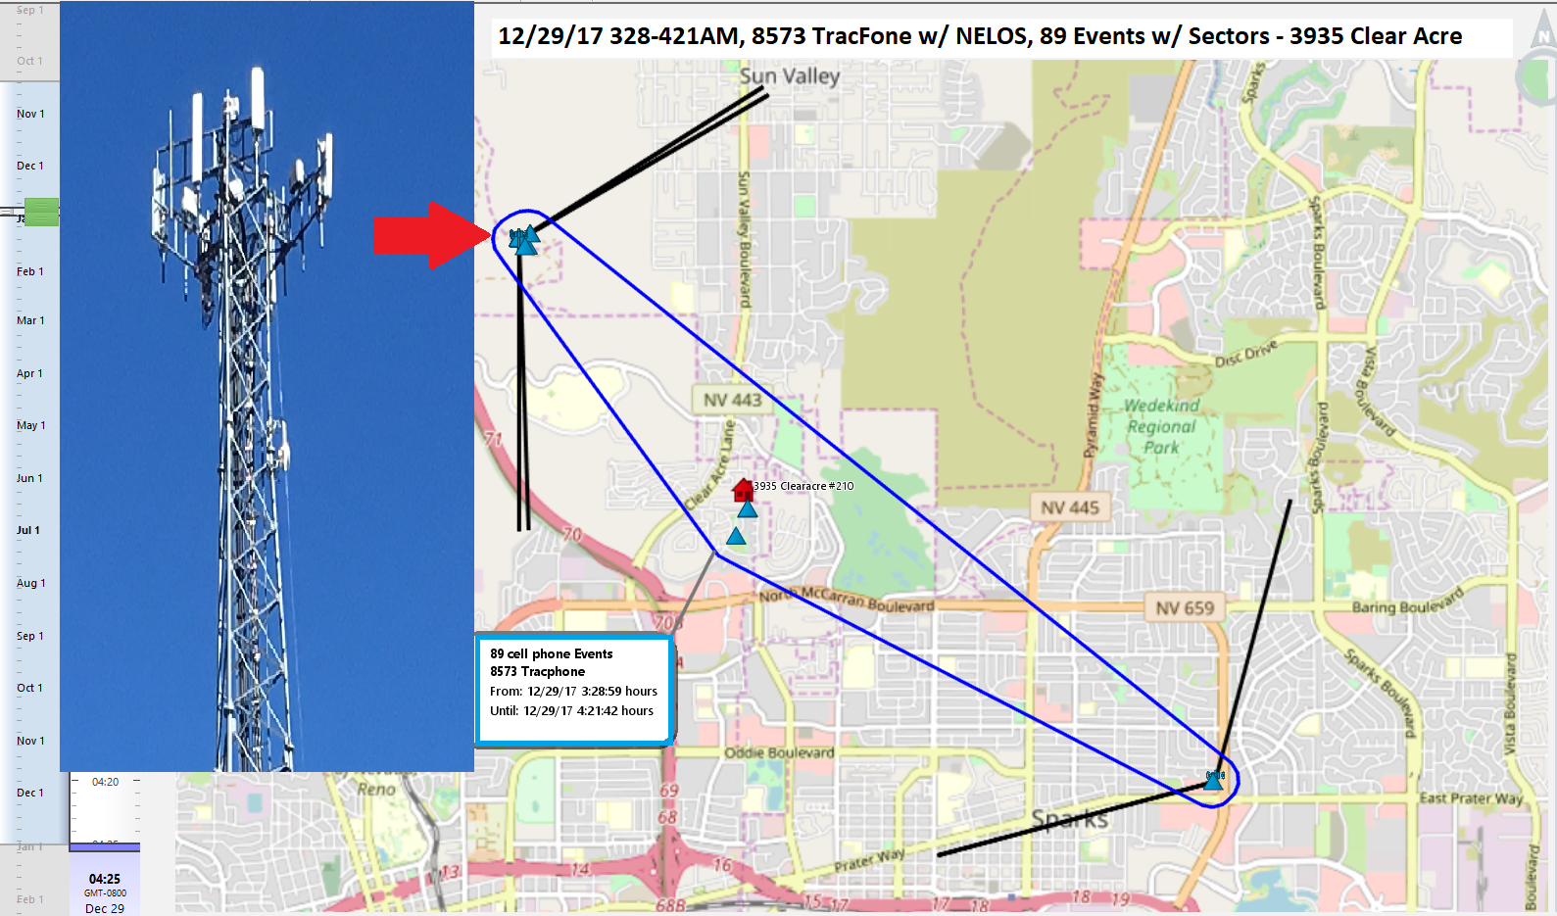

Slide 40
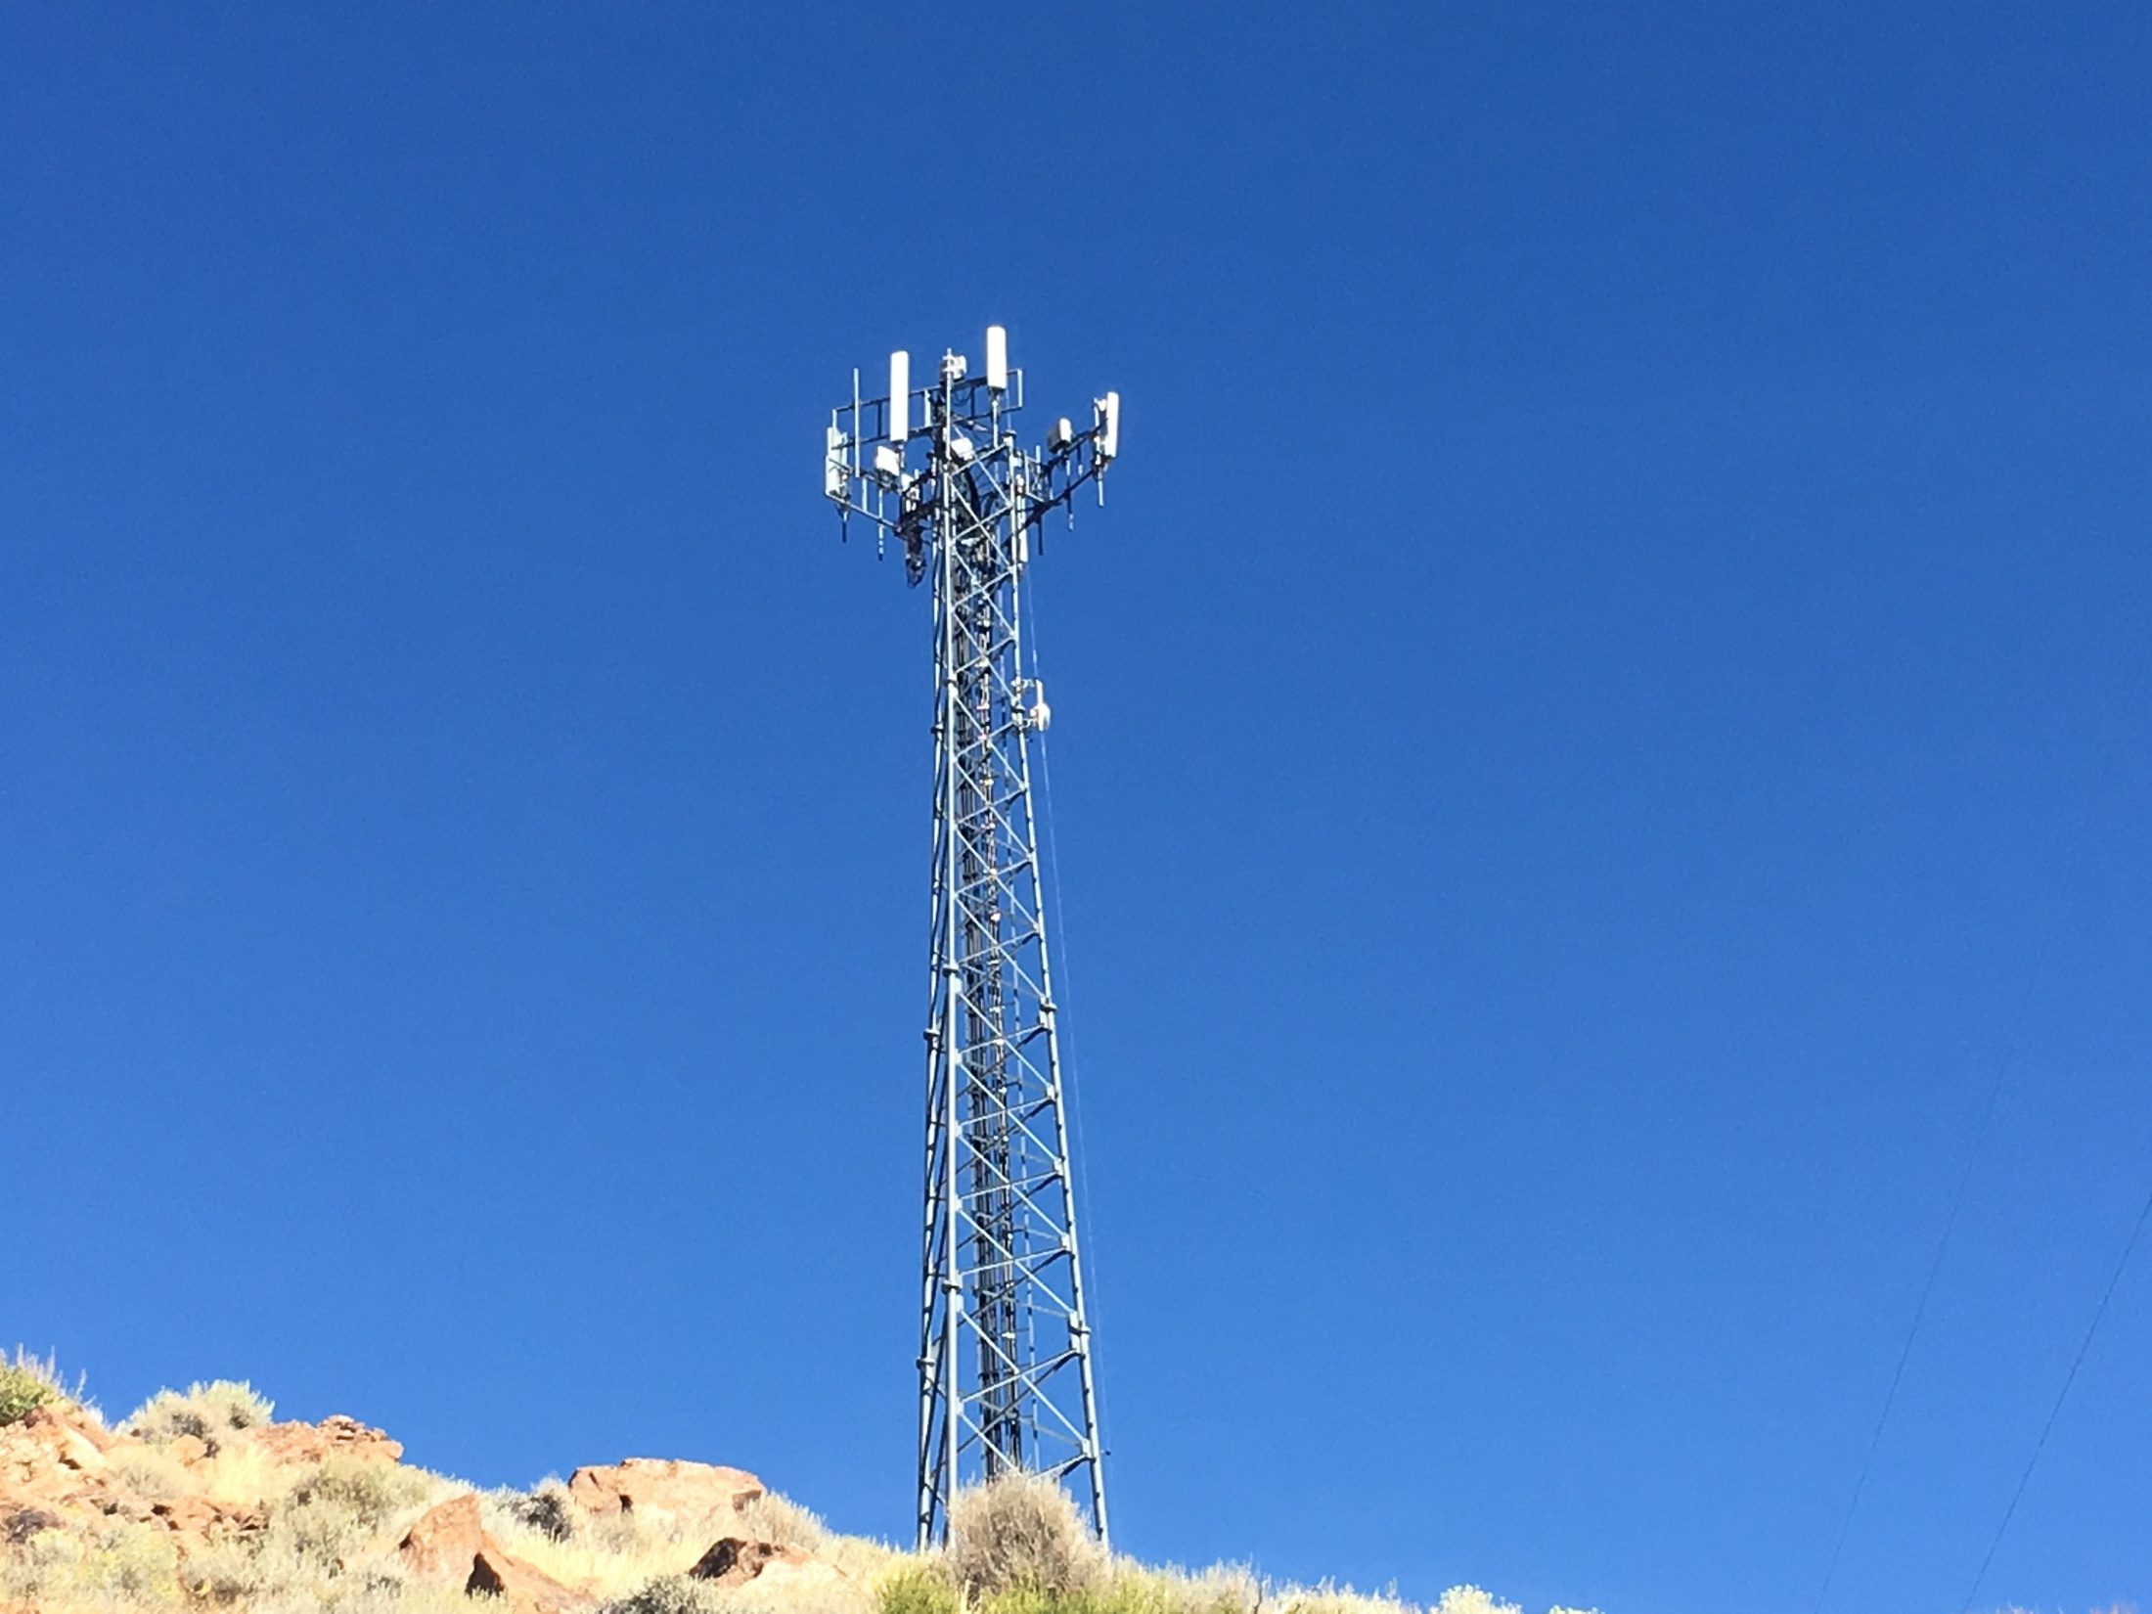

Slide 41
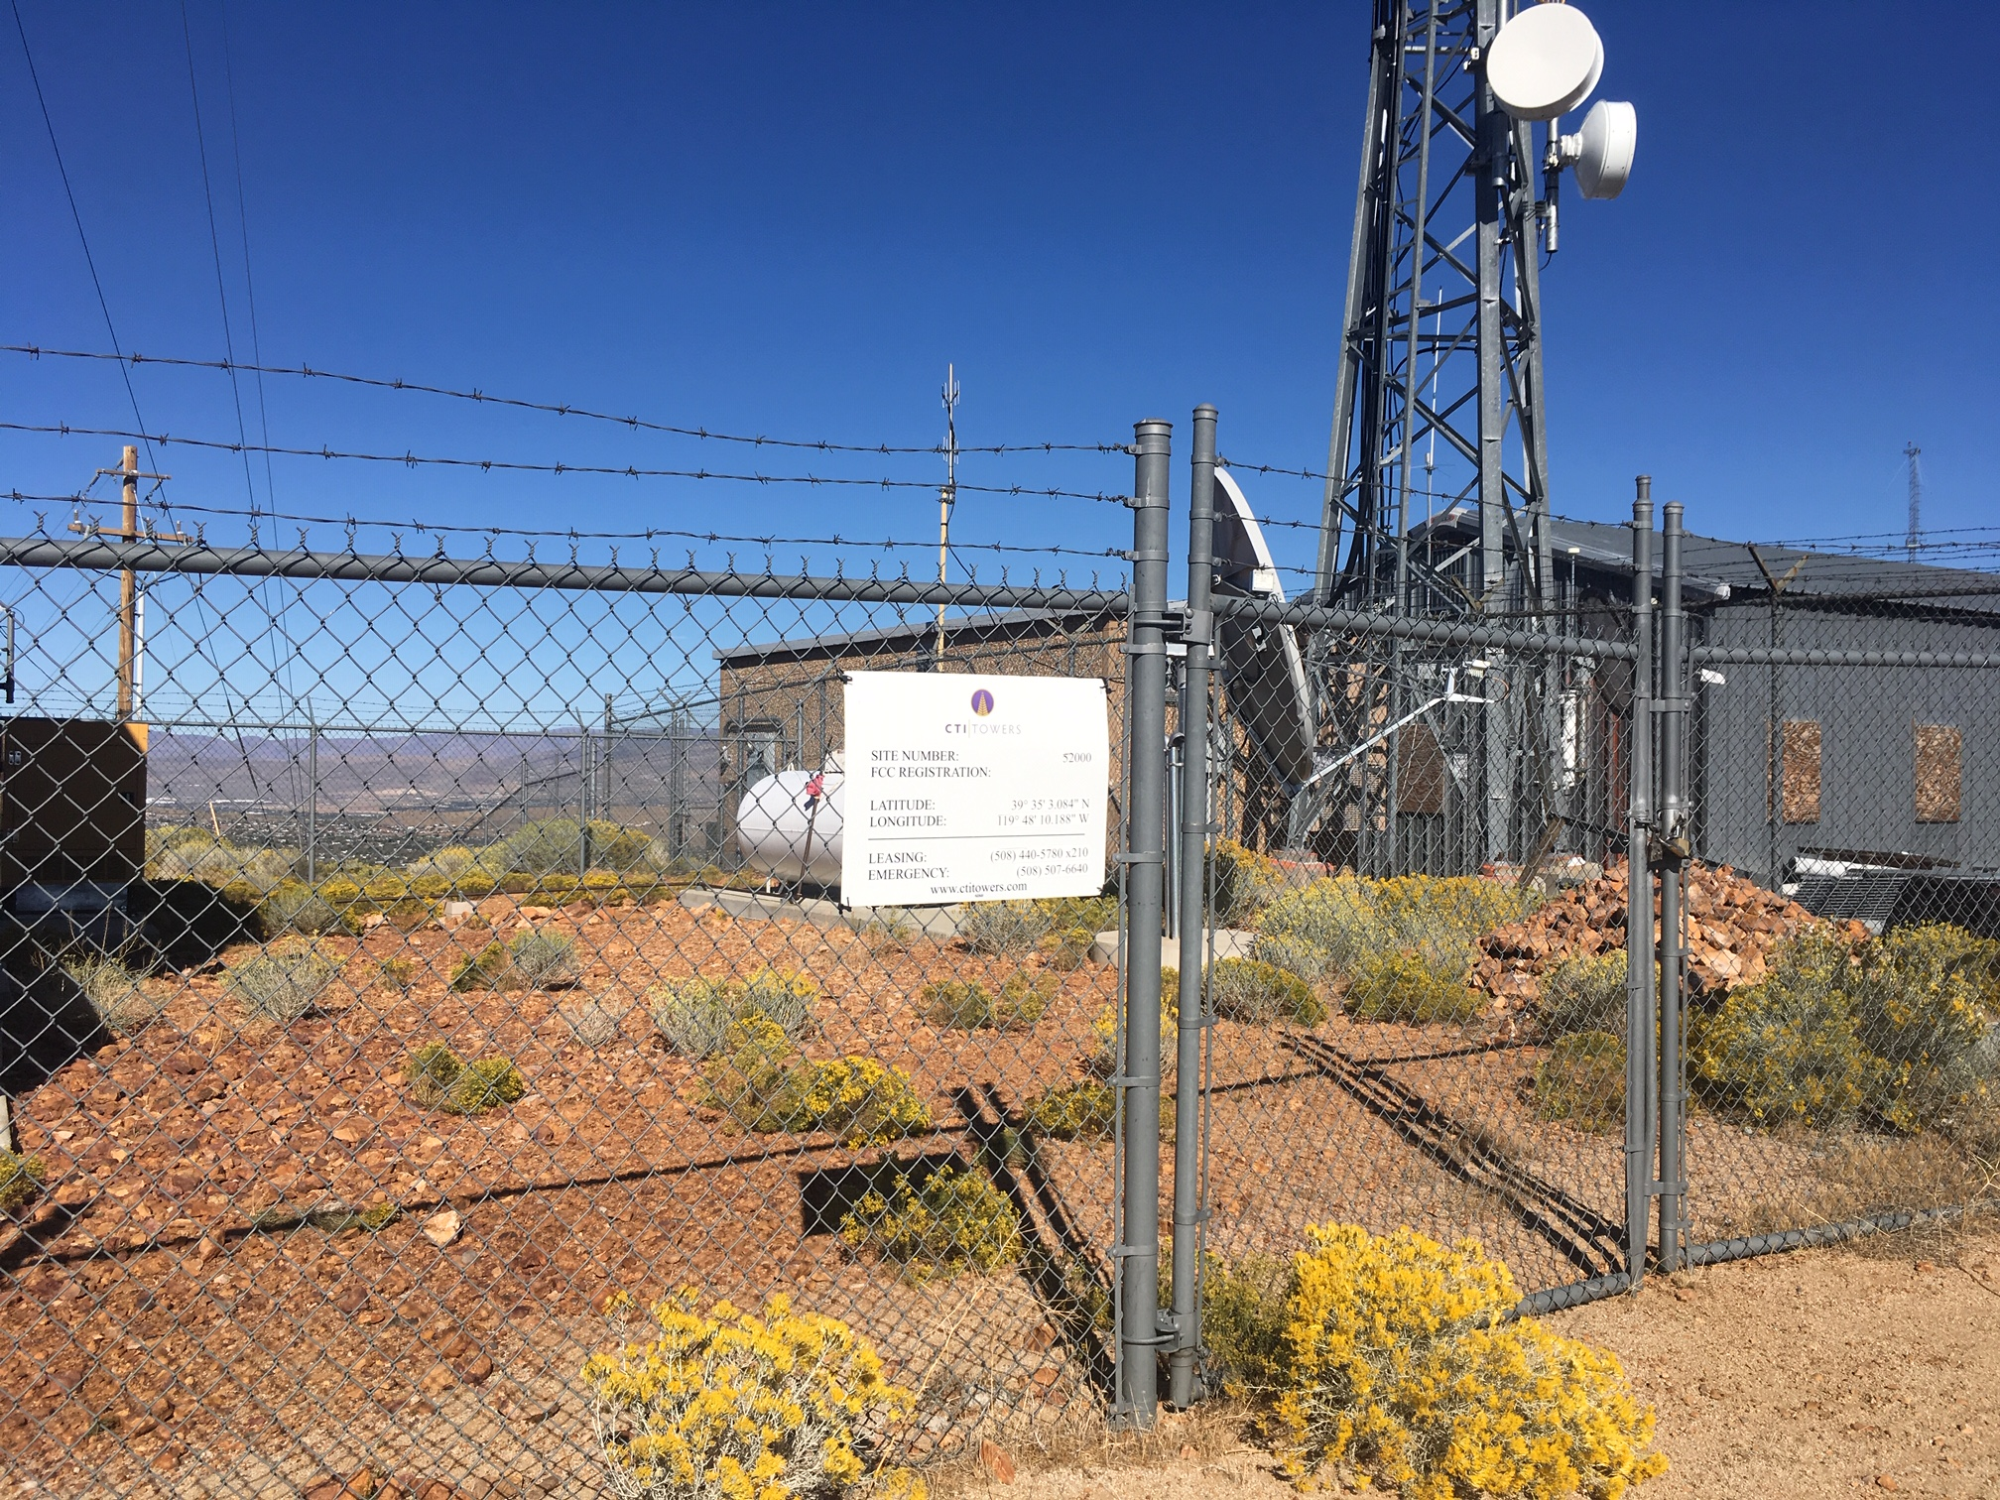

Slide 42
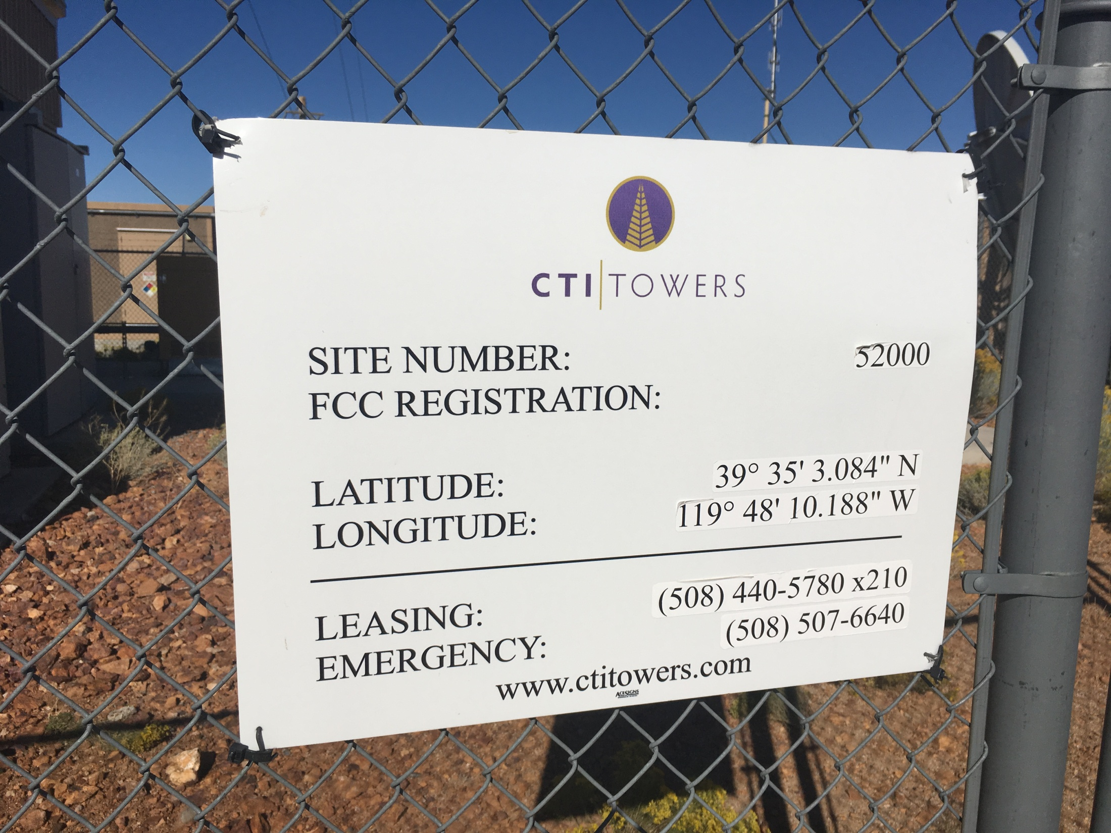

Slide 43


Slide 44


Slide 45
ETHICS
In a nutshell, you must be:
Honorable
Honest
Just
Responsible
Work within the law
Fair

Slide 46
Certifications
International Information Systems Security Certification Consortum (ISC)²: CISSP and CCFP
Global Information Assurance Certification (GIAC): Various certs in Security Admin, Forensics, Management, Legal, Software Security. Can challenge tests, but SANS training suggested

Slide 47
Certifications
International Association of Computer Investigative Specialists – IACIS:
Certified Forensic Computer Examiner – CFCE
This is probably the most respected among LE professionals due to the intensity of the certification process.

Slide 48
CFCE
Peer Review Phase: 4 practicals, 30 days for each, assigned a coach, must pass all 4 to move on to Cert phase
Cert. Phase: HDD practical problem - 40 days to complete, 100 Questions knowledge Based objective test – 14 days to complete (T/F, Multi-choice, short essay, matching)
80% to earn cert

Slide 49
ISFCE
International Society of Forensic Computer Examiners (ISFCE)
Certified Computer Examiner CCE
Online written
3 Practical Exams (90 Days)
If you pass, ISFCE Board must still review and approve before cert is awarded

Slide 50
EC-Council
CEH (Ethical Hacker)
CHFI (Hacking Investigator)
LPT (Pen-Testing)
ENSA (Network Security Admin)
CNDA (Network Defense Architect)
ECSP (Secure Programmer)
And several others

Slide 51
Tool Specific
ACE (FTK)
ENCE (EnCase)
CCLO, CCPA, CCME (Cellebrite)
Various Magnet Certs
XWAYS Forensics
Many others

Slide 52
QUESTIONS/DISCUSSION
Josh Watson
jwatson2@unr.edu

