Slide 1
University of Nevada – Reno
Computer Science & Engineering Department
Fall 2025
Network Security
Guest Lecture
Prof. Shamik Sengupta
http://www.cse.unr.edu/~shamik/

Slide 2
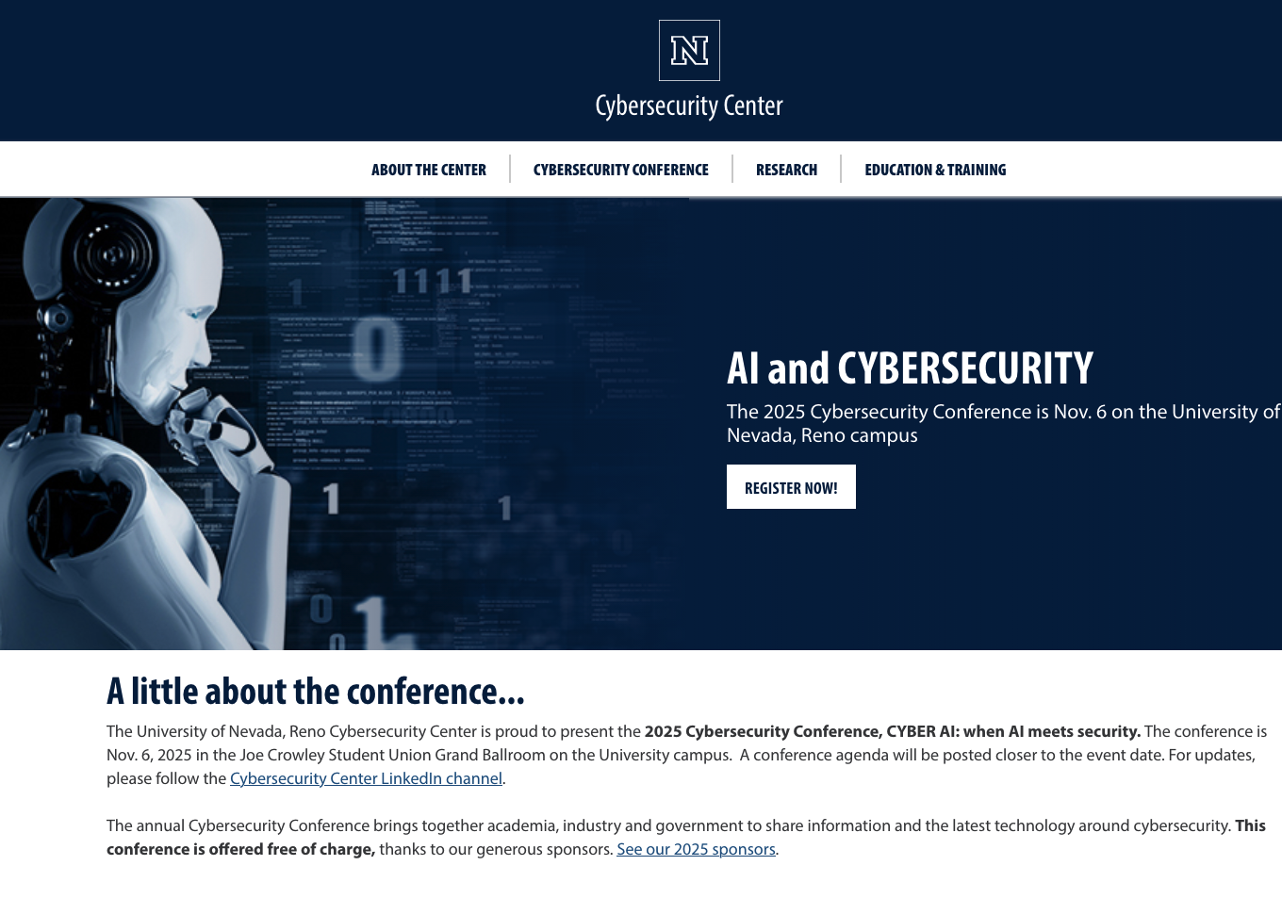
https://www.unr.edu/cybersecurity/conference

Slide 3

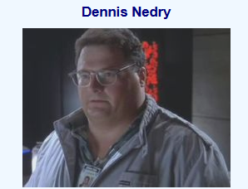

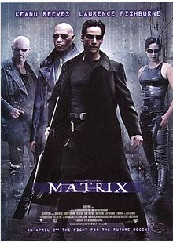


Slide 4
Network security
field of network security:
  how bad guys can attack computer networks
  how we can defend networks against attacks
  how to design architectures that are immune to attacks
Internet not originally designed with (much) security in mind
  original vision: “a group of mutually trusting users attached to a transparent network” ☺
  Internet protocol designers playing “catch-up”
  security vulnerabilities in all layers!

Slide 5
Security: Definition
Security is a state of well‐being of information and infrastructures in which the possibility of theft, tampering, and disruption of information and services is kept low or tolerable

Slide 6



The Cast of Characters
Alice and Bob are the good guys
Trudy/Mallory is the bad guy
Trudy is our generic “intruder”
Who might Alice, Bob be?
  … well,
  Web browser/server for electronic transactions
  on-line banking client/server
  DNS servers
  routers exchanging routing table updates

Slide 7
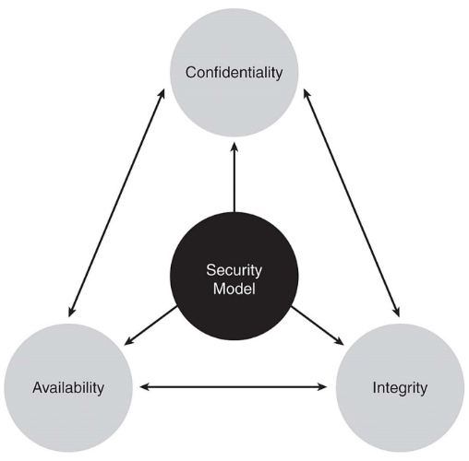
Alice’s Online Bank
Alice opens Alice’s Online Bank (AOB)
AOB must prevent Trudy from learning Bob’s balance
  Confidentiality (prevent unauthorized reading of information)
Trudy must not be able to change Bob’s balance
Bob must not be able to improperly change his own account balance
  Integrity (prevent unauthorized writing of information)
AOB’s information must be available when needed
  Availability (data is available in a timely manner when needed)
Notes:
What are Alice’s security concerns?
If Bob is a customer of AOB, what are his security concerns?
How are Alice and Bob concerns similar? How are they different?
How does Trudy view the situation?
Confidentiality: Prevent unauthorized reading of information
Integrity : prevent unauthorized writing of information
Availability: Data is available in a timely manner when needed

Slide 8
Alice’s Online Bank
How does Bob’s computer know that “Bob” is really Bob and not Trudy?
When Bob logs into AOB, how does AOB know that “Bob” is really Bob?
  Authentication (assurance that other party is the claimed one)
Bob can’t view someone else’s account info
Bob can’t install new software, etc.
  Authorization (allowing access only to permitted resources)
Bob can’t deny a transaction he requested
  Non-repudiation (protection against denial by one of the parties in a communication)

Slide 9
Terminology: Security Threats and Attacks
A threat is a potential violation of security
  Flaws in design, implementation, and operation
An attack is any action that violates security
  Active vs. passive attacks
Security Services
  Enhance the security of data processing systems and information transfers of an organization
  Designed to prevent, detect or recover from a security attack.
    Firewall, IDS, Digital Forensics

Slide 10
What can the attackers do:
Put malware into hosts via Internet
malware can get in host from:
  virus: self-replicating infection by receiving & executing object (e.g., e-mail attachment)
  worm: self-replicating infection by passively receiving object that gets itself executed
spyware malware can record keystrokes, websites visited, upload info to collection site
infected host can be enrolled in botnet, used for spam, DDoS attacks

Slide 11
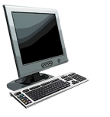

What can the attackers do:
Denial of Service (DoS): attackers make resources (server, bandwidth) unavailable to legitimate traffic by overwhelming resource with bogus traffic
1. select target
2. break into hosts around the network (see botnet)
3. send packets to target from compromised hosts
target

Slide 12
Attacker can sniff packets
packet “sniffing”:
  broadcast media (shared ethernet, wireless)
  promiscuous network interface reads/records all packets (e.g., including passwords!) passing by
A
C
src:B dest:A payload
B
  wireshark software used for labs is a (free) packet-sniffer

Slide 13
Attacker can use fake addresses
IP spoofing: send packet with false source address
A
C
src:B dest:A payload
B

Slide 14
Defending Against Network Security Attacks
Well, those all sound pretty terrible!!
So what do I do to keep my networks safe from security attacks?
How would I even go about starting to defend myself and others from variations of attacks?

Slide 15
Some network security mechanisms terminology

Slide 16



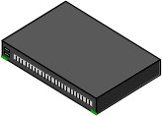

Firewalls
Idea: separate local network from the Internet
Trusted hosts and networks
Firewall
My Network
Router

Slide 17
Firewall Characteristics
Four general techniques mostly used
Service Control: Determines the types of Internet services that can be accessed
Direction control: Determines the direction in which particular service requests may be initiated and allowed to flow through the firewall
  inbound or outbound

Slide 18
Firewall Characteristics (contd.)
User control: Controls access to a service according to which user is attempting to access it
  Typically applied to users inside the firewall perimeter
Behavior control: Controls how particular services are used

Slide 19
Firewall Locations
Where to filter/ place firewall?
Balance between risk and costs
While placing firewall, remember:
Always a higher layer that is hard to filter
  Humans

Slide 20
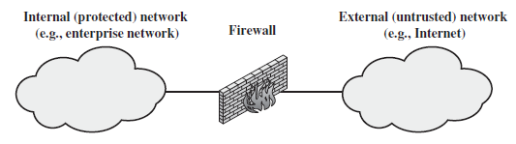
Firewall Locations (2)
Typically a firewall is positioned to provide a protective barrier between an external, potentially untrusted source of traffic and an internal network

Slide 21
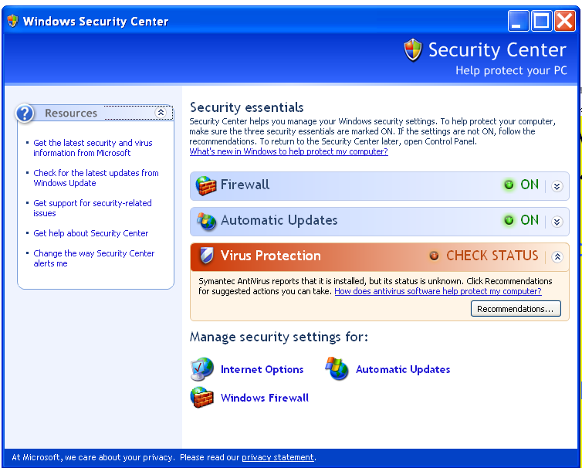
Firewall Popular Locations
Between internal LAN and external network
At the gateways of sensitive subnetworks within the organizational LAN
  Payroll’s network must be protected separately within the corporate network
On end-user machines
  “Personal firewall”

Slide 22
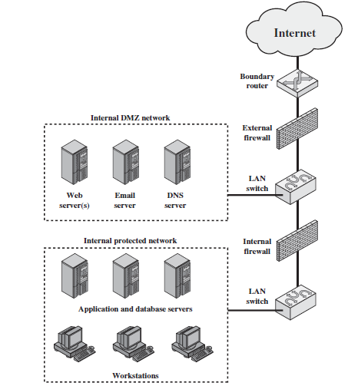
Firewall Locations – intro of DMZ
DMZ (demilitarized zone) network

Slide 23
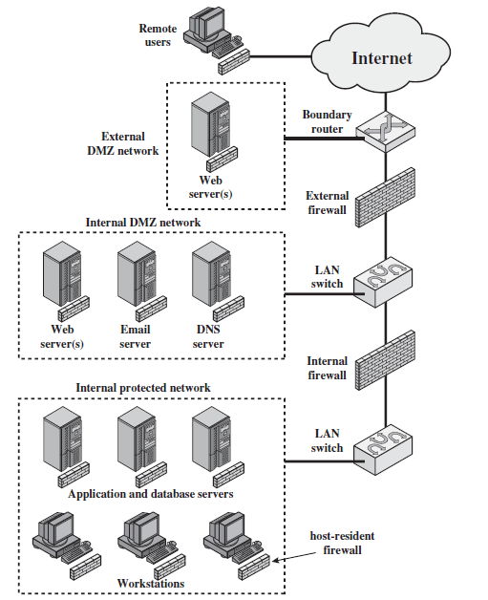
Distributed Firewall Configuration

Slide 24


Intrusion Detection System (IDS)
The implementation of IDS and its correctness is important
  Equally important is its placement in the network topology
Depends on what type of activities you want to detect
  Internal,
  External or
  Both
Trusted hosts and networks
Firewall
My Network
Router

Slide 25
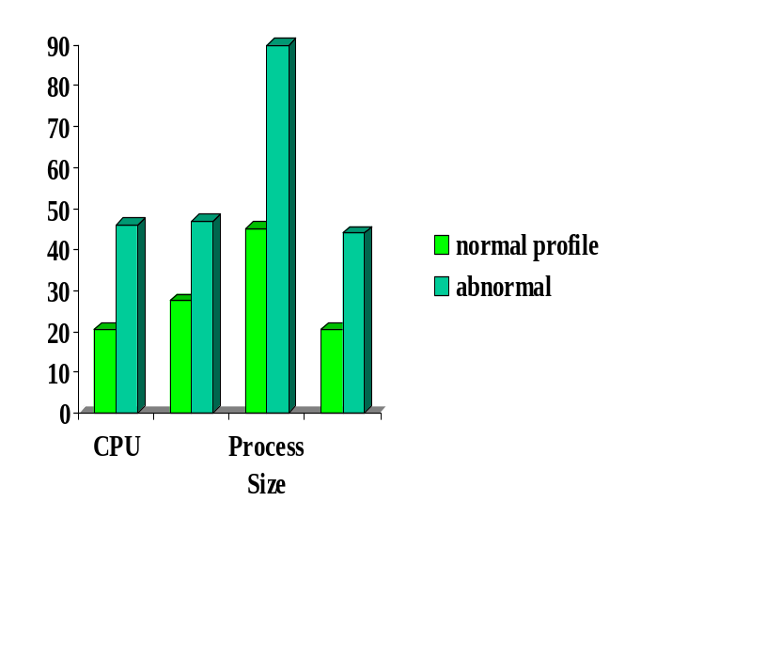

Intrusion Detection Approaches
Statistical Anomaly Detection
  Attempt to define normal or expected behavior by using statistical data and then detect intrusion
Rule-Based Detection
  Attempt to define proper behavior by using a set of rules and then detect intrusion
Intrusion
activity measures
pattern matching
Intrusion Patterns
Intrusion
activities

Slide 26
Summary
What is the field of network security
How attackers attack
Quick overview into defense mechanisms
History: Reading for home

Slide 27
  Reading for home
  History: Did you know?

Slide 28

Internet history
1961-1972: Early packet-switching principles
1961: Kleinrock - queueing theory shows effectiveness of packet-switching
1964: Baran - packet-switching in military nets
1967: ARPAnet conceived by Advanced Research Projects Agency
1969: first ARPAnet node operational
1972:
  ARPAnet public demo
  NCP (Network Control Protocol) first host-host protocol
  first e-mail program
  ARPAnet has 15 nodes

Slide 29
Internet history
1972-1980: Internetworking, new and proprietary nets
1970: ALOHAnet satellite network in Hawaii
1974: Cerf and Kahn - architecture for interconnecting networks
1976: Ethernet at Xerox PARC
late70’s: proprietary architectures: DECnet, SNA, XNA
late 70’s: switching fixed length packets (ATM precursor)
1979: ARPAnet has 200 nodes
Cerf and Kahn’s internetworking principles:
  minimalism, autonomy - no internal changes required to interconnect networks
  best effort service model
  stateless routers
  decentralized control
define today’s Internet architecture

Slide 30
Internet history
1980-1990: new protocols, a proliferation of networks
1982: smtp e-mail protocol defined
1983: deployment of TCP/IP
1983: DNS defined for name-to-IP-address translation
1985: ftp protocol defined
1988: TCP congestion control
new national networks: Csnet, BITnet, NSFnet, Minitel
100,000 hosts connected to confederation of networks

Slide 31
Internet history
1990, 2000’s: commercialization, the Web, new apps
early 1990’s: ARPAnet decommissioned
1991: NSF lifts restrictions on commercial use of NSFnet (decommissioned, 1995)
early 1990s: Web
  hypertext [Bush, Nelson]
  HTML, HTTP [Berners-Lee]
  1994: Mosaic, later Netscape
  late 1990’s: commercialization of the Web
late 1990’s – 2000’s:
more killer apps: instant messaging, P2P file sharing
network security to forefront
est. 50 million host, 100 million+ users
backbone links running at Gbps

Slide 32
Internet history
2005-present
~750 million hosts
  Smartphones and tablets
Aggressive deployment of broadband access
Increasing ubiquity of high-speed wireless access
Emergence of online social networks:
  Facebook: one billion users
Service providers (Google, Microsoft) create their own networks
  Bypass Internet, providing “instantaneous” access to search, emai, etc.
E-commerce, universities, enterprises running their services in “cloud” (eg, Amazon EC2)

Slide 33
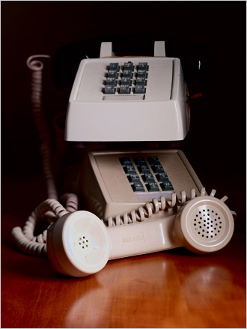

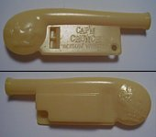

Early Hacking – Phreaking
In1957, a blind seven-year old, Joe Engressia Joybubbles, discovered a whistling tone that resets trunk lines
  Blow into receiver – free phone calls
Cap’n Crunch cereal prize
  Giveaway whistle produces 2600 MHz tone

Slide 34
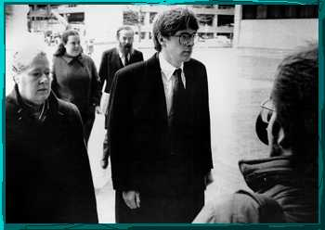
The Eighties
Robert Morris worm - 1988
  Developed to measure the size of the Internet
    However, a computer could be infected multiple times
  Brought down a large fraction of the Internet
    ~ 6K computers
  Academic interest in network security

Slide 35
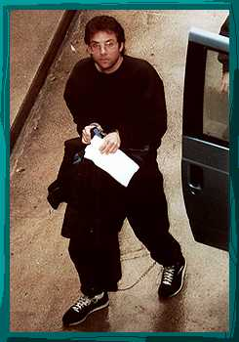
The Nineties
Kevin Mitnick
  First hacker on FBI’s Most Wanted list
  Hacked into many networks
    including FBI
  Stole intellectual property
    including 20K credit card numbers
  In 1995, caught 2nd time
    served five years in prison

Slide 36
The Twenties
Code Red worm
  Jul 19, 2001: infected more than 359K computers in less than 14 hours
Sapphire worm
  Jan 31, 2003: infected more than 75K computers (most in 10 minutes)
DoS attack on sco.com
  Dec 11, 2003: SYN flood of 50K packet-per-second
Nyxem/Blackworm virus
  Jan 15, 2006: infected about 1M computers within two weeks
Notes:
CAIDA

