Slide 1

University of Nevada – Reno
Computer Science & Engineering Department
CS454/654 Reliability and Security of Computing Systems - Fall 2024

Slide 2
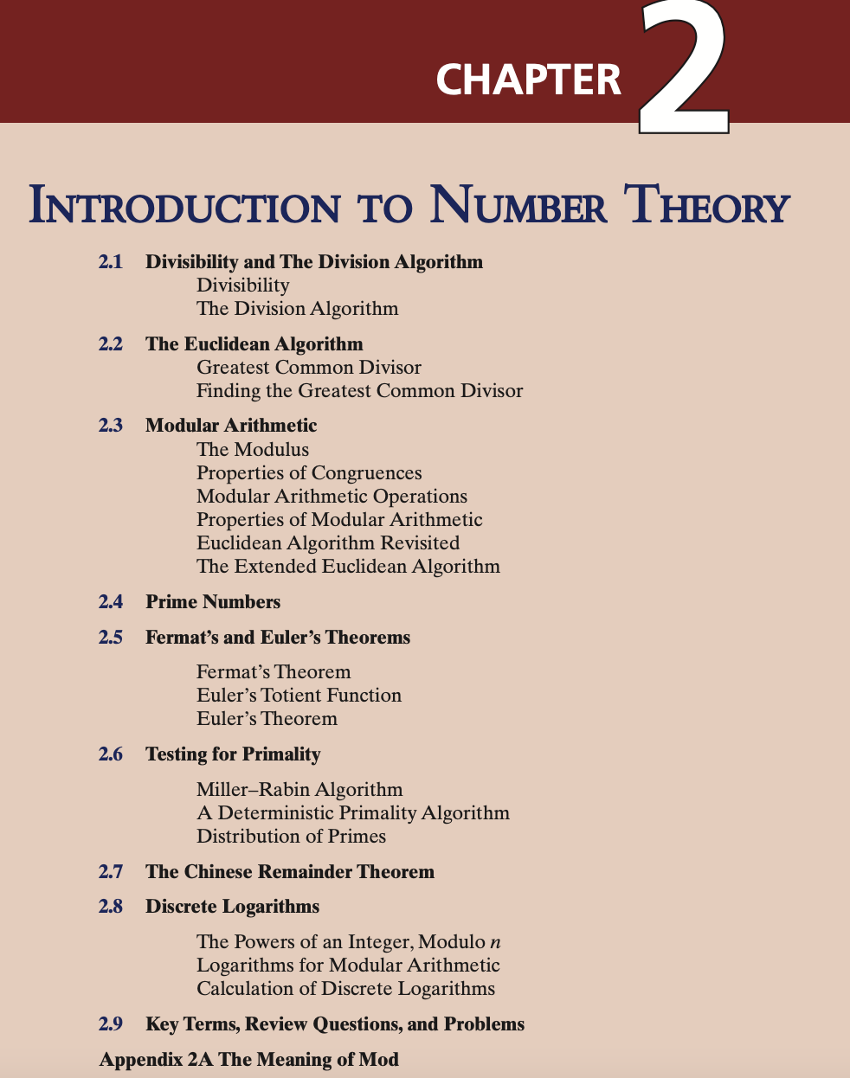

Slide 3
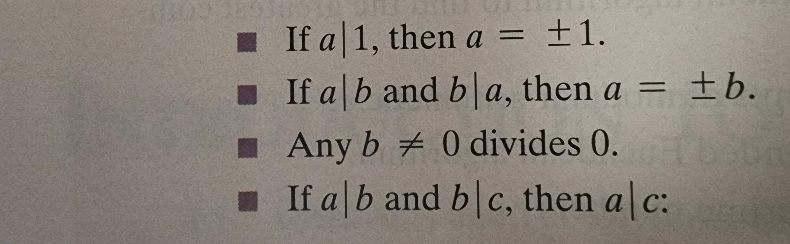
Divisibility
Nonzero b divides a if a= mb for some m, where a, b and m are
integers. b divides a if there is no remainder on division.
Notation: b | a or b is a divisor of a.
Positive divisors of 24 are 1, 2, 3, 4, 6, 8, 12, 24
Properties:
11 | 66 and 66 | 198 ➔ 11 | 198

Slide 4
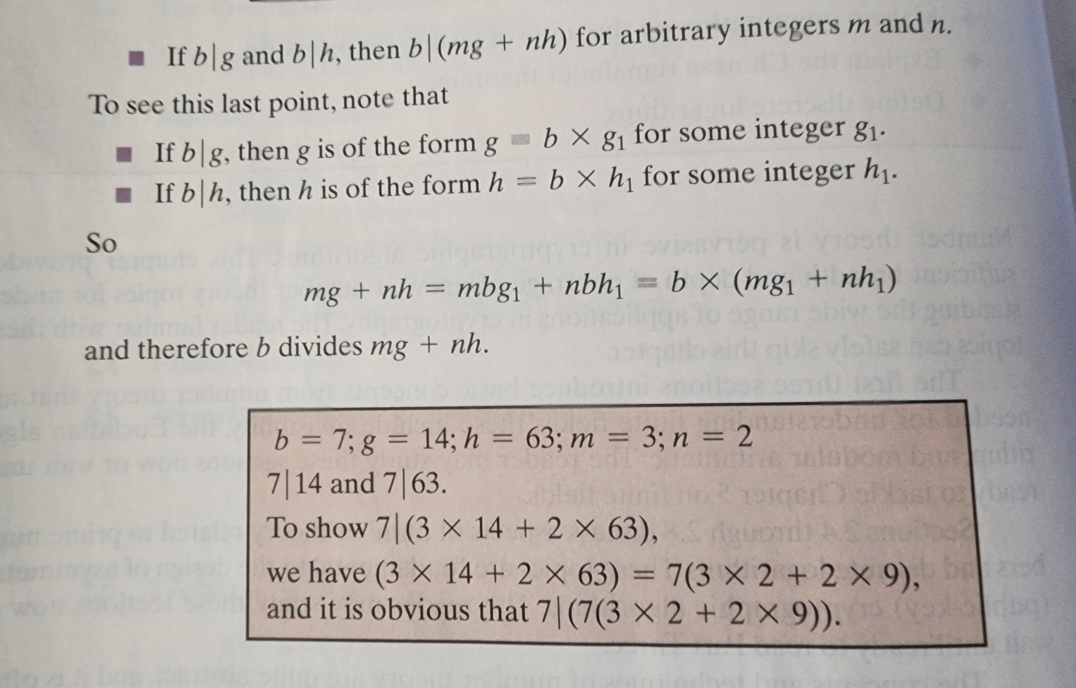
Divisibility
Properties Continued :

Slide 5
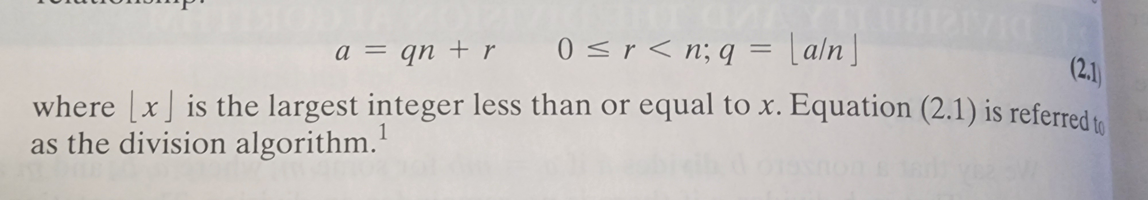
Division Algorithm
Given any positive integer n and any nonnegative integer a, if we divide a by n, we get any integer quotient q and an integer remainder r that follow the following relationship:

Slide 6
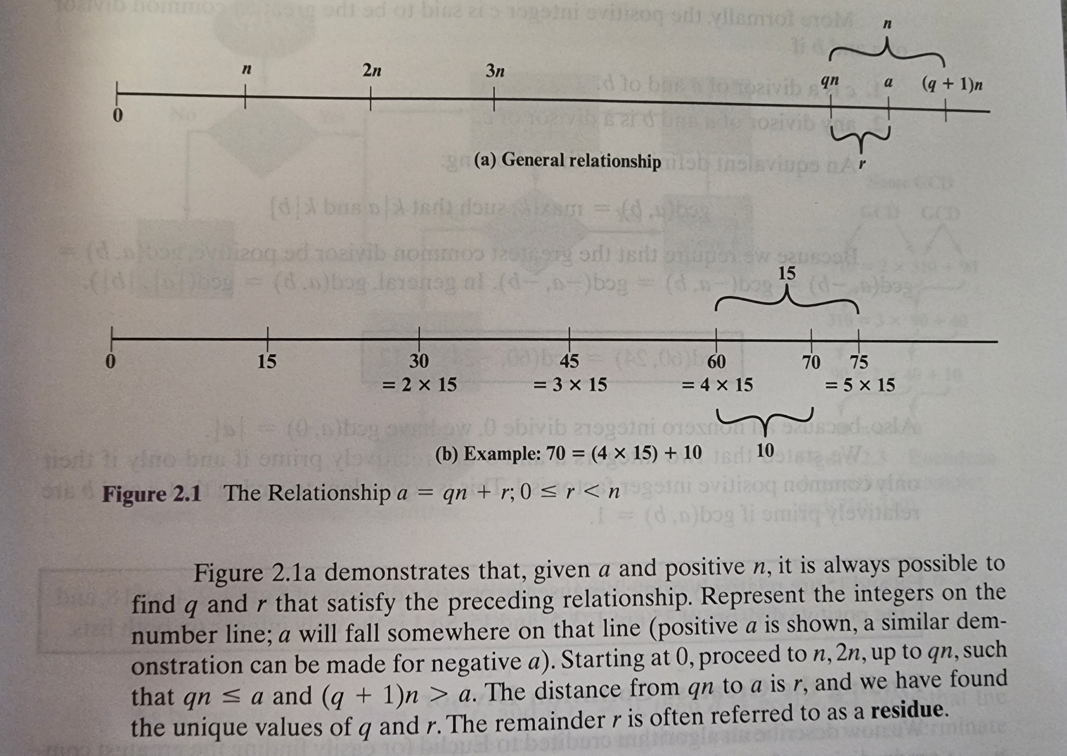
Division Algorithm

Slide 7
Euclidean Algorithm
Procedure to determine the greatest common divisor of two positive integers.
Two integers are relatively prime if and only if their only common positive integer factor is 1.
Greatest Common Divisor (GCD):
Largest integer that divides both a and b; gcd (0, 0) = 0.

Slide 8
Euclidean Algorithm
Positive integer c is said to be the greatest common divisor of a and b if
1. c is a divisor of a and of b.
2. Any divisor of a and b is a divisor of c.
Equivalent: gcd (a, b) = max [k, such that k | a and k | b]
We gcd to be positive, hence:
gcd (a, b) = gcd (a, -b) = gcd(-a, b) = gcd (-a, -b) ➔ gcd (| a |, | b |).

Slide 9
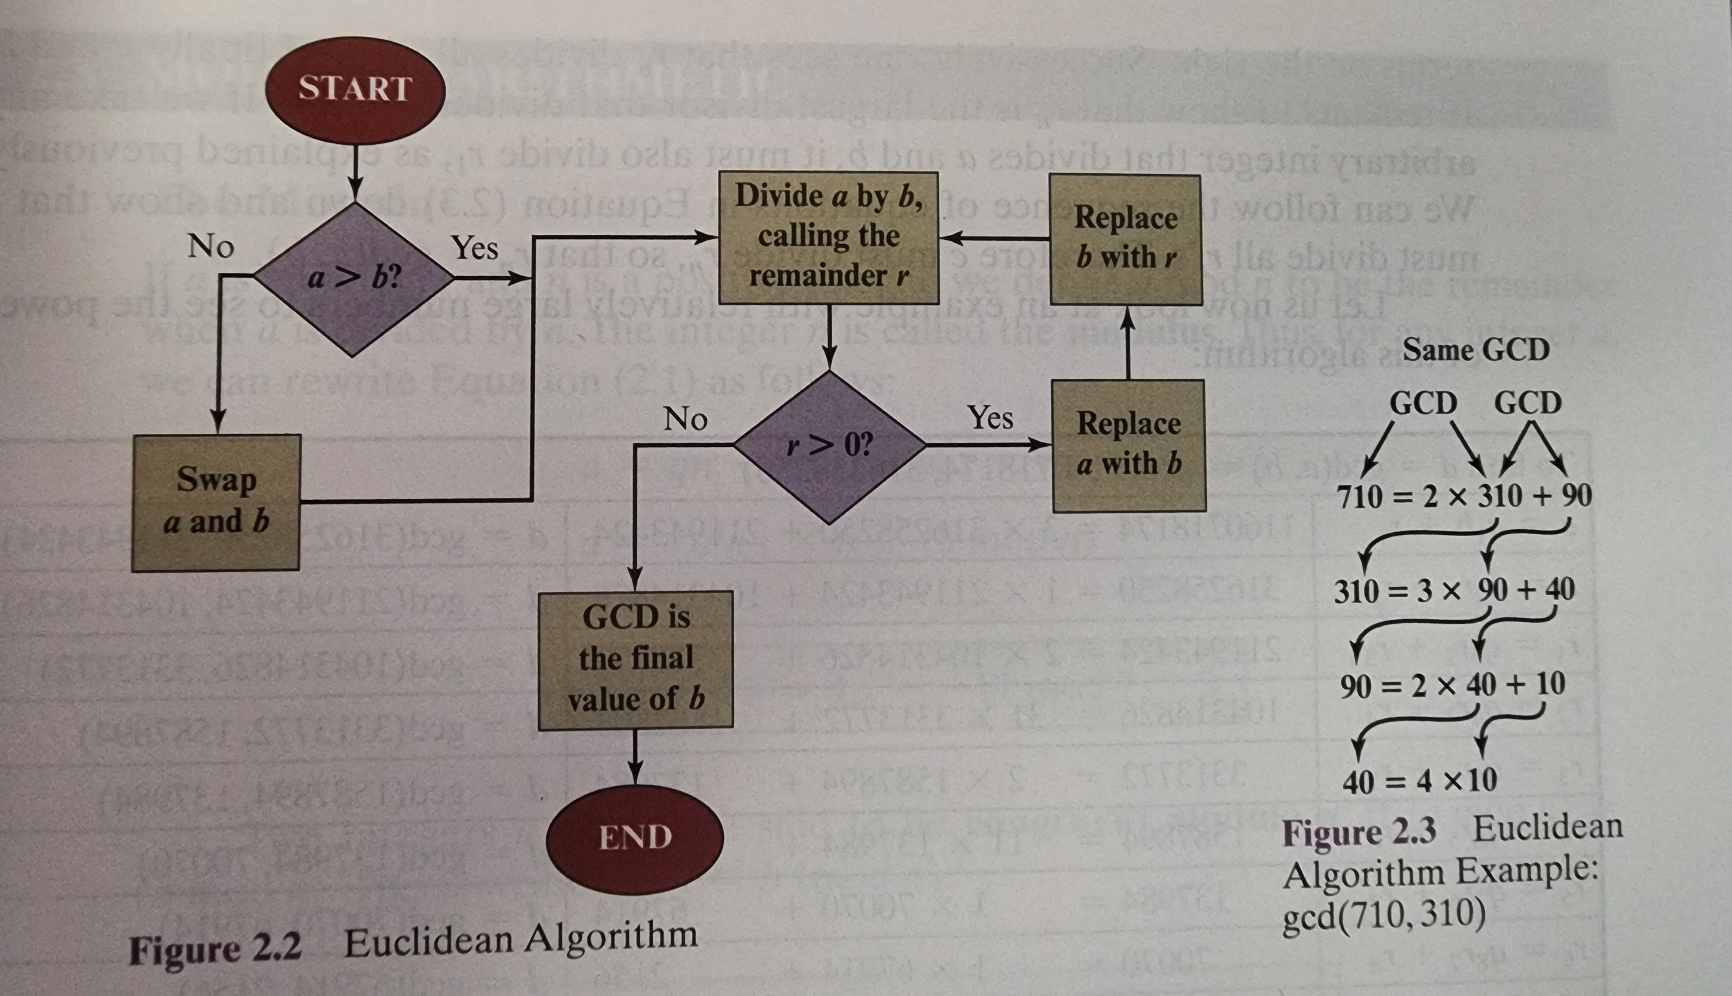
Finding GCD

Slide 10
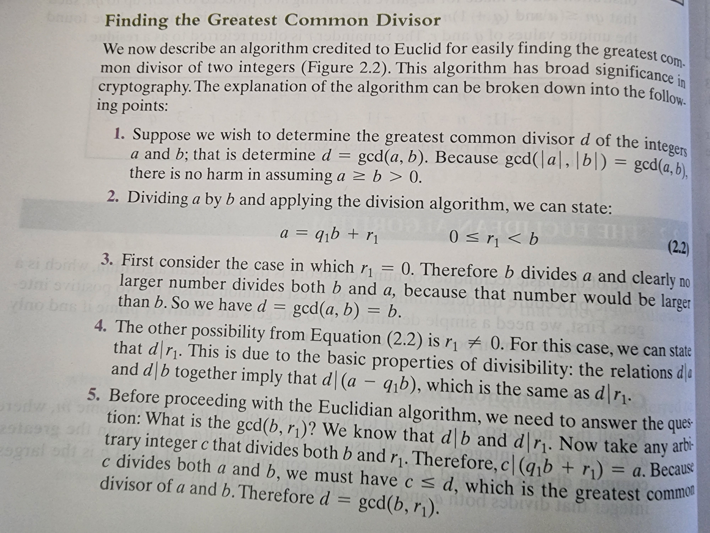
Finding GCD

Slide 11
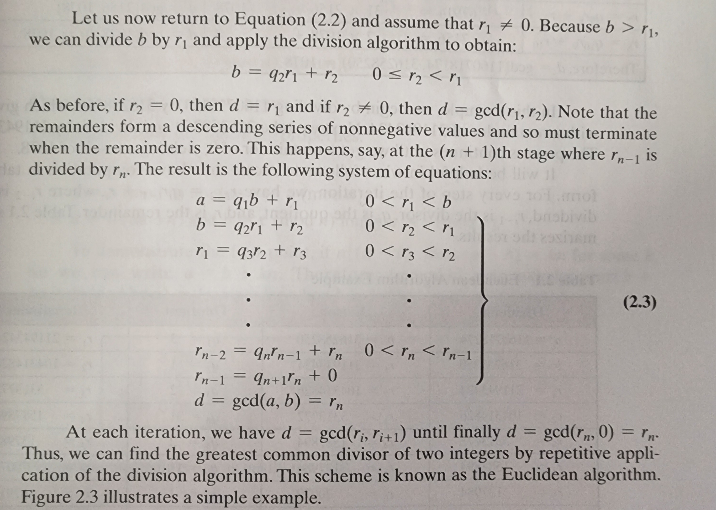
Finding GCD

Slide 12
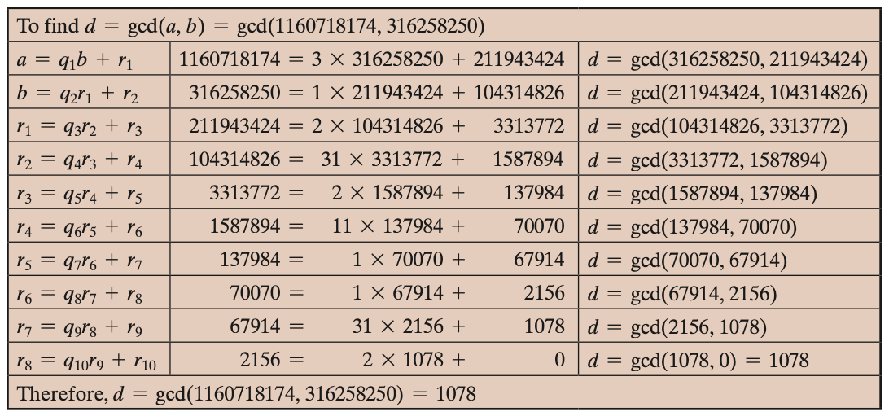
Euclidian algorithm for GCD
d=gcd(a, b) where a >= b >0 a=q₁ * b + r₁ 0 <= r₁ < b
If r₁==0 b divides a and d=gcd(a, b) =b
Else gcd(a, b)== gcd(b, r₁ ) ==d
If d divides a and b, it must also divide any linear combination of a and b (r=a-bq)
Similarly, if d divides b and r, it must also divide any linear combination of b and r, particularly a=bq+r
if gcd(A, B) = 1 then A and B are relatively prime A=15 and B=8
Notes:
d | r₁ (d divides r₁ )
because: if d|a and d|b then d| (a - q₁ * b ) = d|a – d|(q₁ * b)
r₁ = a - q₁ * b

Slide 13

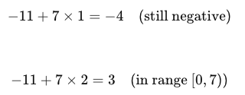
Modular Arithmetic
The modulus
If a is an integer and n is a positive integer, we define a mod n to be the remainder when a is divided by n; the integer n is called the modulus
Thus, for any integer a:
a = qn + r 0 ≤ r < n; q = [a/ n]
11 mod 7 = 4
-11 mod 7 = 3

Slide 14

Modular Arithmetic
Congruent modulo n
Two integers a and b are said to be congruent modulo n if (a mod n) = (b mod n)
This is written as a = b(mod n)
Note that if a = 0(mod n), then n | a

Slide 15
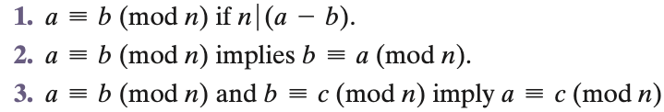
Properties of Congruences
Congruences have the following properties:
To demonstrate the first point, if n | (a - b), then (a - b) = kn for some k
So we can write a = b + kn
Therefore, (a mod n) = (remainder when b + kn is divided by n) = (remainder when b is divided by n) = (b mod n)

Slide 16
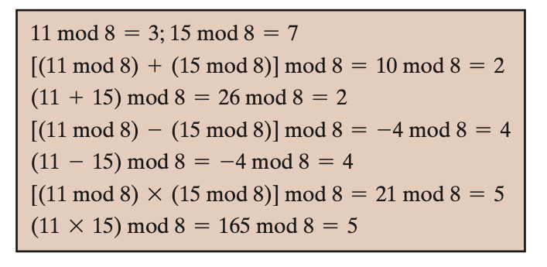
Modular Arithmetic
Modular arithmetic exhibits the following properties:
1. [(a mod n) + (b mod n)] mod n = (a + b) mod n
2. [(a mod n) - (b mod n)] mod n = (a - b) mod n
3. [(a mod n) * (b mod n)] mod n = (a * b) mod n

Slide 17
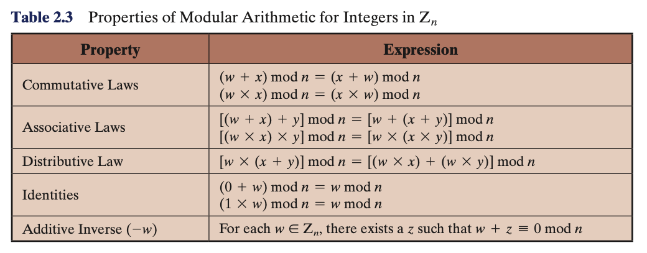
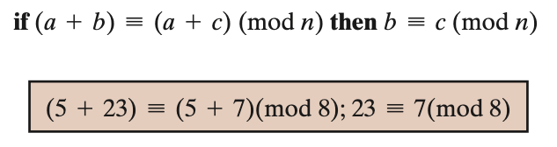

Notes:
\

Slide 18
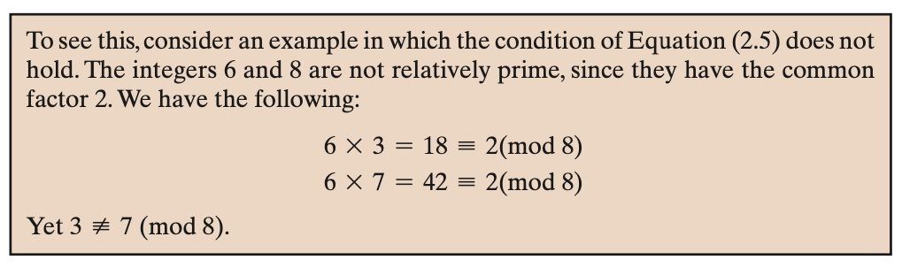
Notes:
\

Slide 19
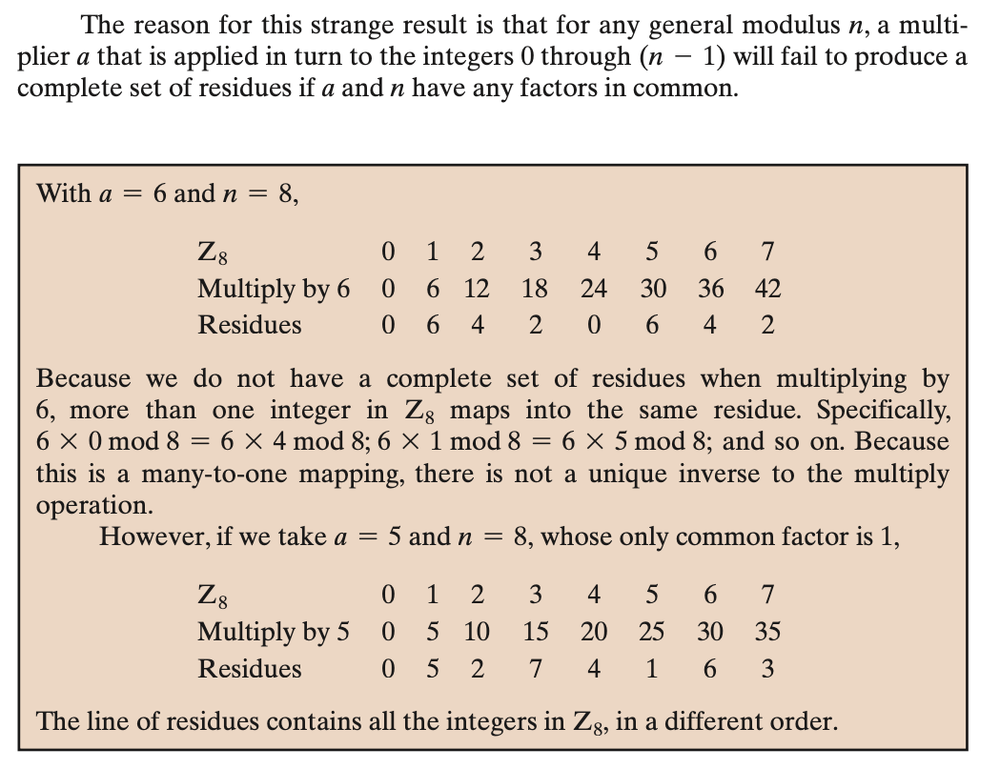
Residue classes of (mod n) is [0], [1], [2], … , [n - 1]
Notes:
\

Slide 20
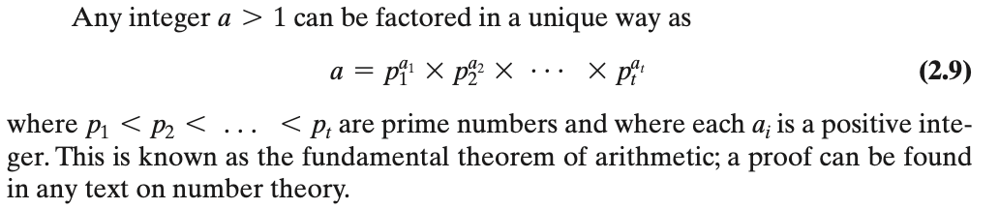

Prime Numbers
Prime number: any integer p>1 for which only divisors are +1, -1, +p, -p.
All the numbers other than +1, -1, and the prime numbers are composite numbers.
Composite numbers are product of at least two prime numbers.
91 = 7 x 13
3600 = 2^4 x 3^2 x 5^2

Slide 21
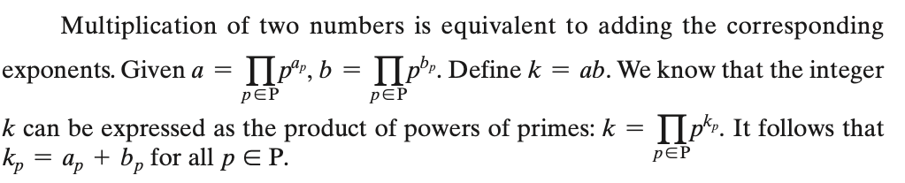
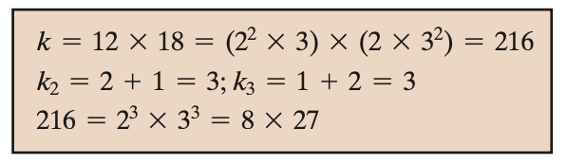
Prime Numbers

Slide 22
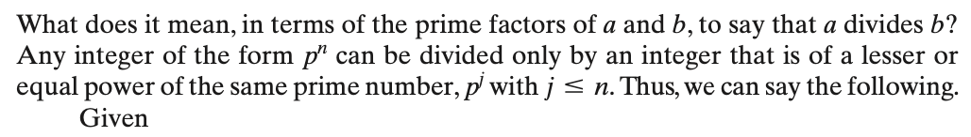
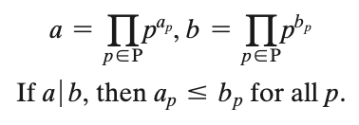
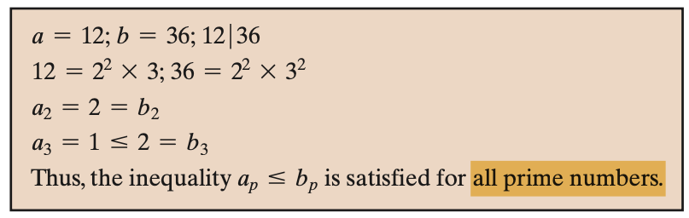
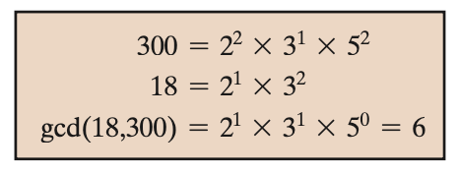
Prime Numbers

Slide 23


Fermat's Theorem
If p is prime and a is a positive integer not divisible by p, then
Alternative form of Fermat’s theorem is also useful: If p is prime and a is just a positive integer, then

Slide 24
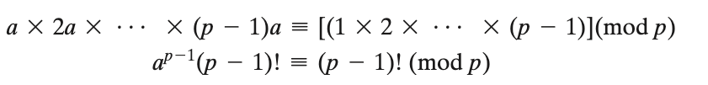
Fermat's Theorem
If p is prime and a is a positive integer not divisible by p, then
Consider the set of positive integers less than p: {1, 2, … , p - 1} and multiply each element by a, modulo p, to get the set X = {a mod p, 2a mod p, …, (p - 1)a mod p}.
The (p - 1) elements of X are all positive integers with no two elements equal and the X consists of the set of integers {1, 2, ,.. , p - 1} in some order.
Multiplying the numbers in both sets (p and X) and taking the result mod p yields
We can cancel the (p - 1)! term because it is relatively prime to p.

Slide 25
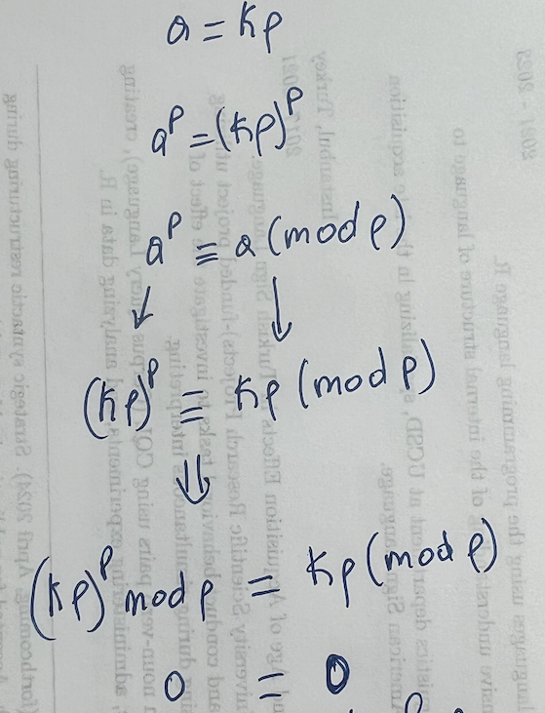
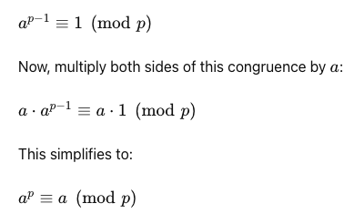
Alternative Fermat's Theorem
If p is prime and a is a positive integer not divisible by p, then
Alternative form of Fermat’s theorem is also useful: If p is prime and a is just a positive integer, then
Since both sides contain p
If a is not divisible by p
If a is divisible by p

Slide 26
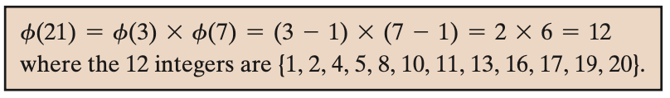
Euler’s Totient Function ø(n)
ø(n) is defined as the number of positive integers less than n and relatively prime to n
ø(1) = 1
For prime number p: ø(p)=p-1
For number n: create prime factorization
n=p^{e1} q^{e2} k^{e3} … => ø(n)=ø(p) ø(q) ø(k)…=(p-1)(q-1)(k-1)…

Slide 27
Euler's Theorem
States that for every a and n that are relatively prime:
a^{ø(n)} = 1(mod n)
An alternative form is:
a^{ø(n)+1} = a(mod n)
If n is prime, then ø(n)=n-1 and it becomes Fermat’s theorem.

Slide 28
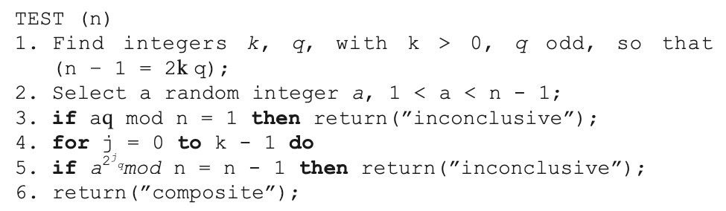
Miller-Rabin Algorithm
Miller-Rabin algorithm is a probabilistic primality test used to determine whether a given number is prime.
Line 1: n-1=2^{k} q Line 5: a^{(2^j) q} mod n Line 3: a^{q}
Composite: definitely not prime
Inconclusive: we don’t know if it is prime or not

Slide 29
Line 1: n-1=2^{k} q Line 5: a^{(2^j) q} mod n Line 3: a^{q}
Line1: n= 29 =>n-1=28 => 28=2² 7 =>k=2 q=7
Line2: 1<a<n-1 a=10
Line3: 10⁷ mod 29 = 17
Line5 just for j=1: 10 ^{2*7} mod 29 = 28 return ”inconclusive”
We can try all integers 1<a<n-1 and we will get ”inconclusive” thus n=29 has high probability of being prime number.
Notes:
\

Slide 30
Line 1: n-1=2^{k} q Line 5: a^{(2^j) q} mod n Line 3: a^{q}
Line1: n= 221=13*17 =>n-1=220 => 220=2² 55 =>k=2 q=55
Line2: 1<a<n-1 a=5
Line3: 5⁵⁵ mod 221 = 112
Line4: both j=0, j=1 return “composite”
Thus n=221 is not prime, but if we try a=21 test returns ”inconclusive”.
Notes:
\

Slide 31
For odd number n that is not prime and randomly chosen a, 1<a<n-1 the probability that TEST will return inconclusive (i.e., fail to detect that n is not prime) is less than 1/4.
Thus, if we try t different values of a, then probability becomes (1/4)^{t}
If t=10, we tried 10 different values for a, the probability of non prime number passing test is less than (1/4)^{t} = 10⁻⁶
In 2002 (announced in 2002, published in 2004), Agrawal, Kayal, and Saxena developed a relatively simple deterministic algorithm that efficiently determines whether a given large number is a prime.
The algorithm, known as the AKS algorithm, does not appear to be as efficient as the Miller–Rabin algorithm.
Thus far, AKS has not supplanted this older, probabilistic technique Miller–Rabin algorithm.
Notes:
\

