Slide 1

University of Nevada – Reno
Computer Science & Engineering Department
CS454/654 Reliability and Security of Computing Systems - Fall 2024

Slide 2
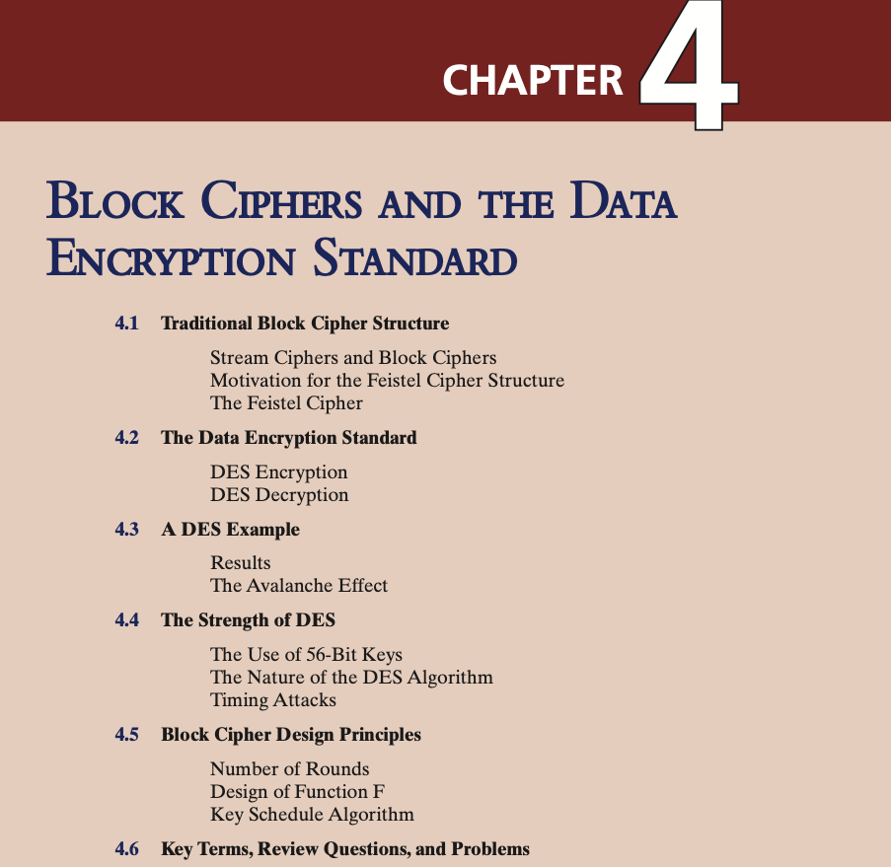

Slide 3
Stream Cipher
A stream cipher is one that encrypts a digital data stream one bit or one byte at a time. Example of stream cipher is Vernam or Vigenère cipher.
If the cryptographic keystream is random, then this cipher is unbreakable by any means other than acquiring the keystream.
Sharing the keystream introduces complexities such as extra traffic, transferring keystream over secure channel.
For practical reasons bit-stream generator must be used (some kind of function or algorithm).

Slide 4
Block Cipher
A block of plaintext is treated as a whole and used to produce a ciphertext block of equal length
Typically a block size of 64 or 128 bits is used
As with a stream cipher, the two users share a symmetric encryption key
The majority of network-based symmetric cryptographic applications make use of block ciphers

Slide 5
Notes:
Examples of stream and block ciphers.

Slide 6
A block cipher operates on a plaintext block of n bits to produce a cipher- text block of n bits.
There are 2^{n} possible different plaintext blocks and, for the encryption to be reversible (i.e., for decryption to be possible), each must produce a unique ciphertext block.
If we limit ourselves to reversible mappings, the number of different transformations is 2^n!
2^{n}! For the 1st plaintext, we can choose any of 2^{n} ciphertext blocks. For the 2nd plaintext, we choose from among 2^{n} - 1 remaining ciphertext blocks, and so on.
Notes:
Examples of stream and block ciphers.

Slide 7
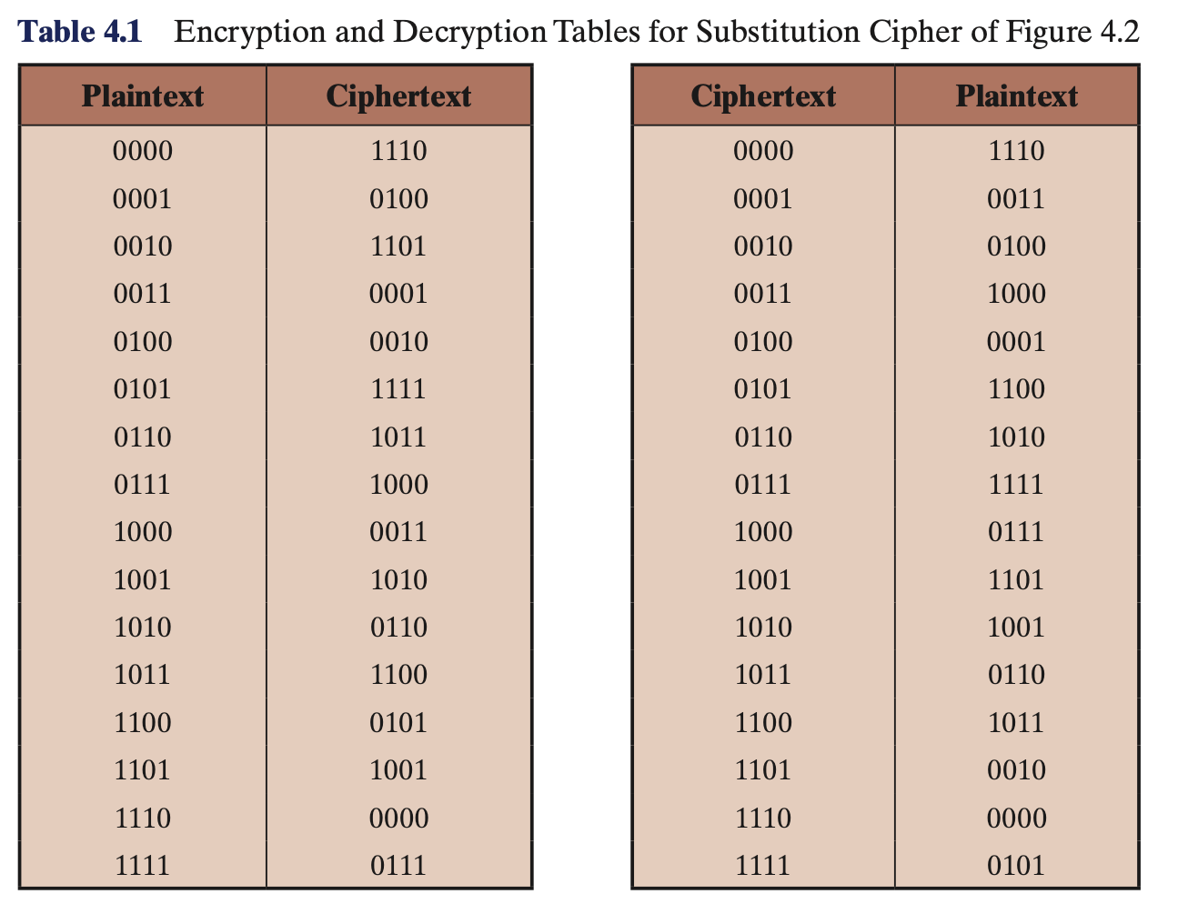
If block size is small, then the system is equivalent to a classical substitution cipher and vulnerable to a statistical analysis of the plaintext. Thus, n should be large to prevent cryptanalysis.
A reversible substitution for a large block size is not practical. Assume n=4.
The required key length is (4 bits) * (16 rows) = 64 bits
For a 64-bit block, which is a desirable length to prevent statistical attacks, the required key length is 64 * 2⁶⁴ = 2⁷⁰ ≈ 10²¹ bits.

Slide 8
Feistel Cipher
Is a practical application of a proposal (1945) by Claude Shannon to develop a product cipher that alternates Substitution and Permutation functions.
Claude Shannon, often regarded as the father of information theory, introduced the concepts of confusion and diffusion in the context of cryptography to describe essential properties of a secure cipher.
The structure of Fiestel Cipher is used by many significant symmetric block ciphers currently in use.
Camellia block cipher is a Feistel structure; it is used as one of the symmetric ciphers in TLS.

Slide 9
Claude Shannon confusion and diffusion
Shannon’s concern was to prevent cryptanalysis based on statistical analysis.
The goal of confusion is to obscure the connection between the key and the ciphertext, making it difficult for an attacker to determine the key even if they have several pairs of plaintext and corresponding ciphertext. Achieved Through: Substitution.
The mechanism of diffusion seeks to make the statistical relationship between the plaintext and ciphertext as complex as possible in order to prevent attempts to deduce the key.

Slide 10
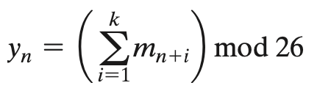
Claude Shannon confusion and diffusion
In diffusion, each plaintext digit affect the value of many ciphertext digits; generally, this is equivalent to having each ciphertext digit be affected by many plaintext digits.
An example of diffusion is to encrypt a message M = m1, m2, m3, … of characters with an averaging operation adding k successive letters to get a ciphertext letter y_{n}.

Slide 11
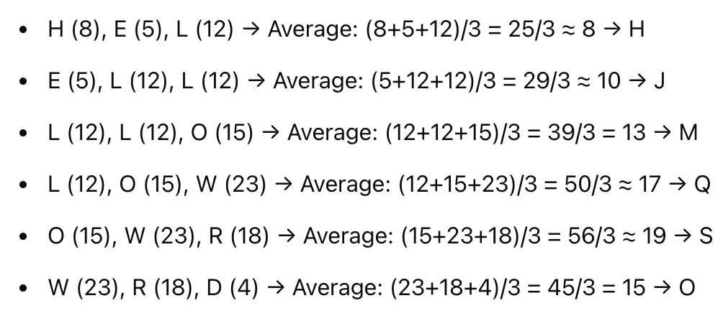
Claude Shannon confusion and diffusion
With diffusion the distribution of how often each letter appears in the ciphertext will be more uniform compared to their distribution in the plaintext. Helps to prevent statistical crypto analysis with frequency distribution.
Example: plain text = HELLO WORLD
Distribution is H: 1, E: 1, L: 3, O: 2, W: 1, R: 1, D: 1
Encrypted HJMQSO
Distribution: H:1, J:1, M:1, Q:1, S:1, O:1
More uniform

Slide 12

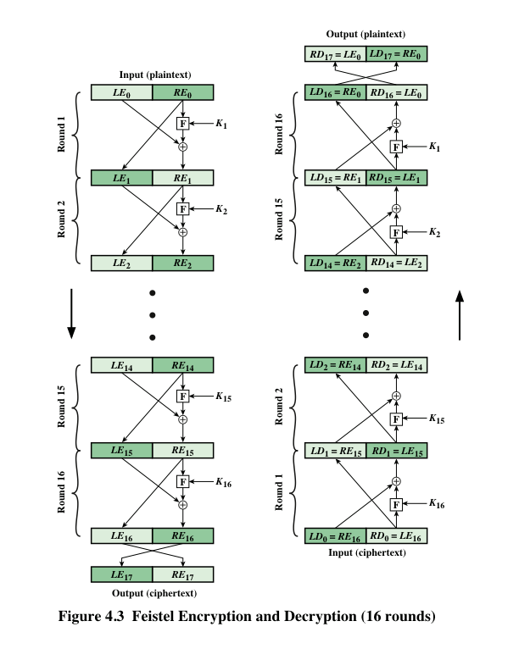
Feistel Cipher
Feistel proposed the use of a cipher that alternates substitutions (Confusion) and permutations (Diffusion).
Permutation: No elements are added or deleted or replaced in the sequence, rather the order in which the elements appear in the sequence is changed

Slide 13
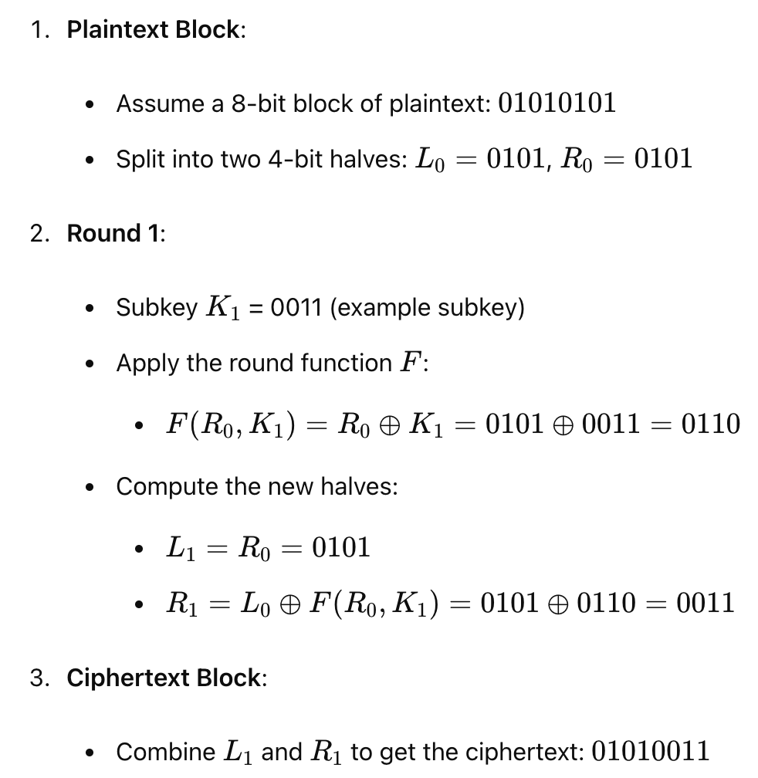

Slide 14
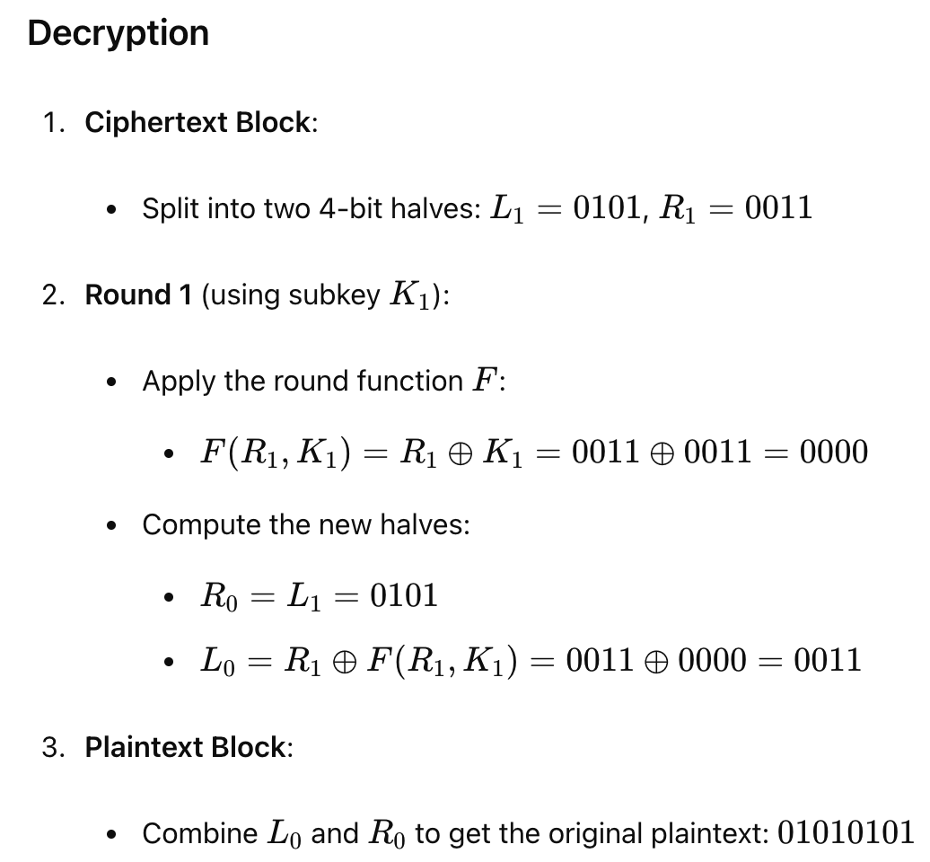
Note: K_{i} in reverse order. That is, use K_{n} in the first round, K_{n-1} in the second round, and so on, until K₁ is used in the last round.

Slide 15
Feistel Cipher Design Features
Block/key size: Larger block/key sizes mean greater security but reduced encryption/decryption speed for a given algorithm
Number of rounds: The essence of the Feistel cipher is that a single round offers inadequate security but that multiple rounds offer increasing security.
Subkey generation algorithm: Greater complexity in this algorithm should lead to greater difficulty of cryptanalysis.
Round function F: Greater complexity generally means greater resistance to cryptanalysis.

Slide 17
Data Encryption Standard (DES)
Issued in 1977 by the National Bureau of Standards (now NIST) as Federal Information Processing Standard.
Was the most widely used encryption scheme until the introduction of the Advanced Encryption Standard (AES) in 2001.
Algorithm itself is referred to as the Data Encryption Algorithm (DEA).
Data are encrypted in 64-bit blocks using a 56-bit key.
The algorithm transforms 64-bit input in a series of steps into a 64-bit output.
The same steps, with the same key, are used to reverse the encryption.

Slide 18
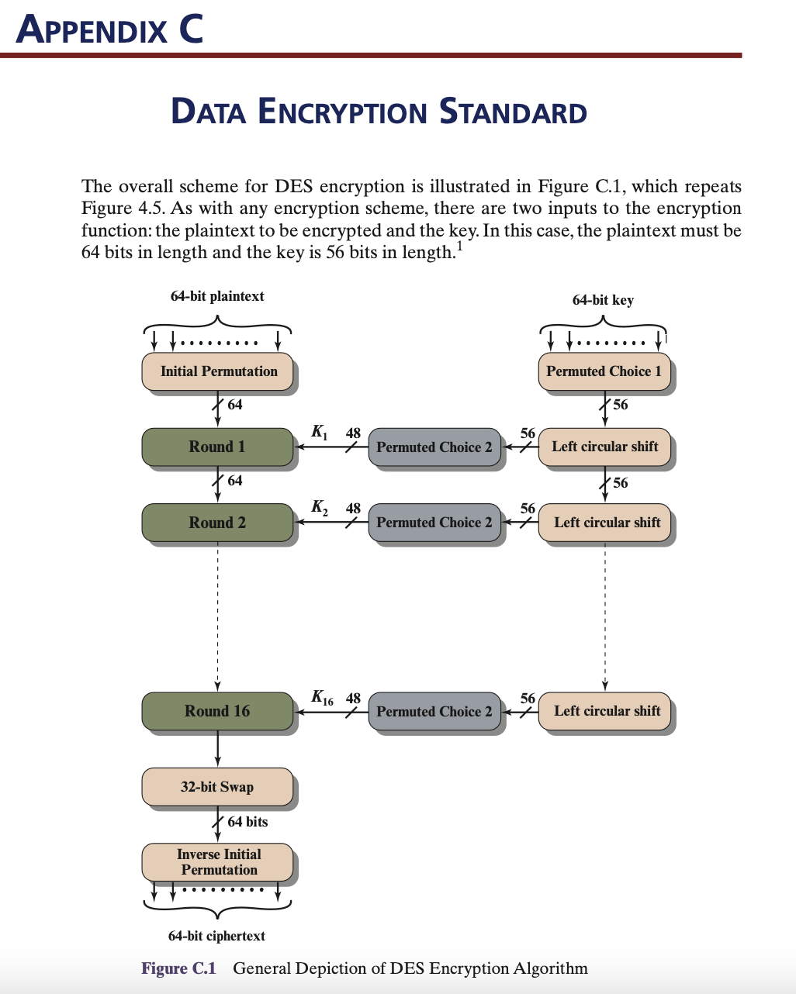
Data Encryption Standard (DES)
https://page.math.tu-berlin.de/~kant/teaching/hess/krypto-ws2006/des.htm

Slide 19
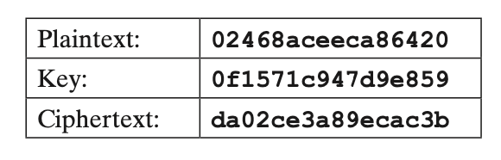
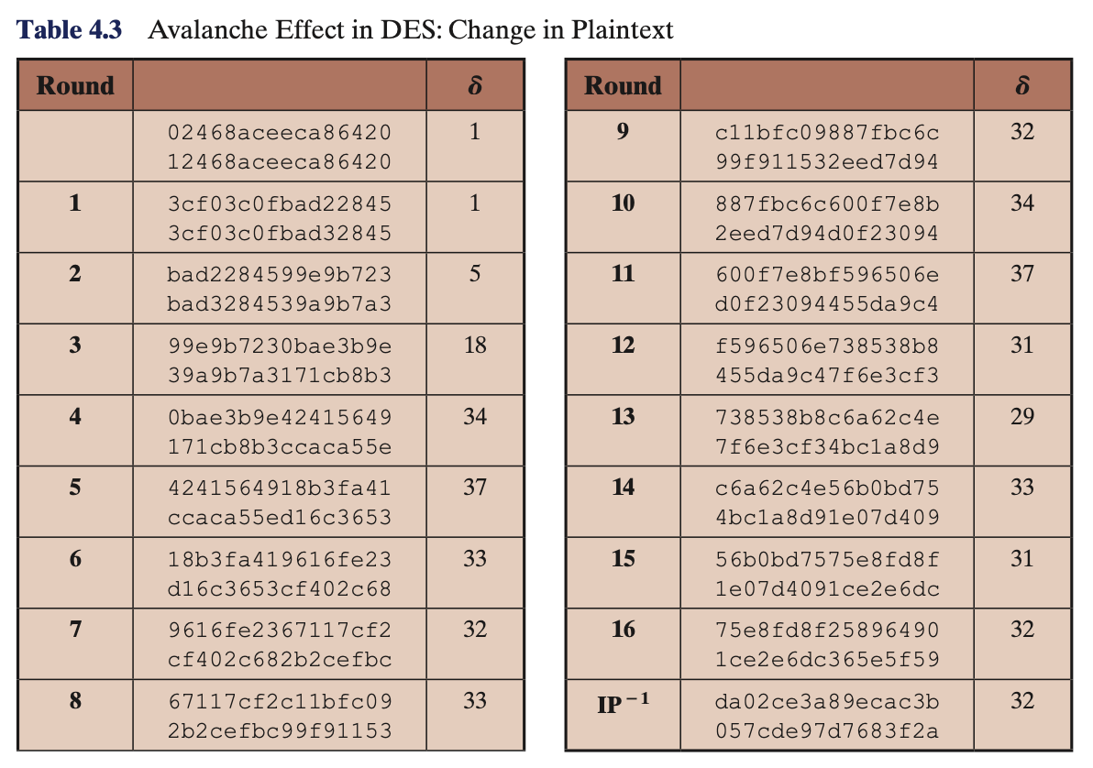
Avalanche effect: a change in one bit of the plaintext or one bit of the key should produce a change in many bits of the ciphertext.
We change single bit in plaintext and input becomes 12468aceeca86420
The 2nd column of the table shows the intermediate 64-bit values at the end of each round for the two plaintexts.
The 3rd column shows the number of bits that differ between the two intermediate values.
Notes:
https://page.math.tu-berlin.de/~kant/teaching/hess/krypto-ws2006/des.htm

Slide 20
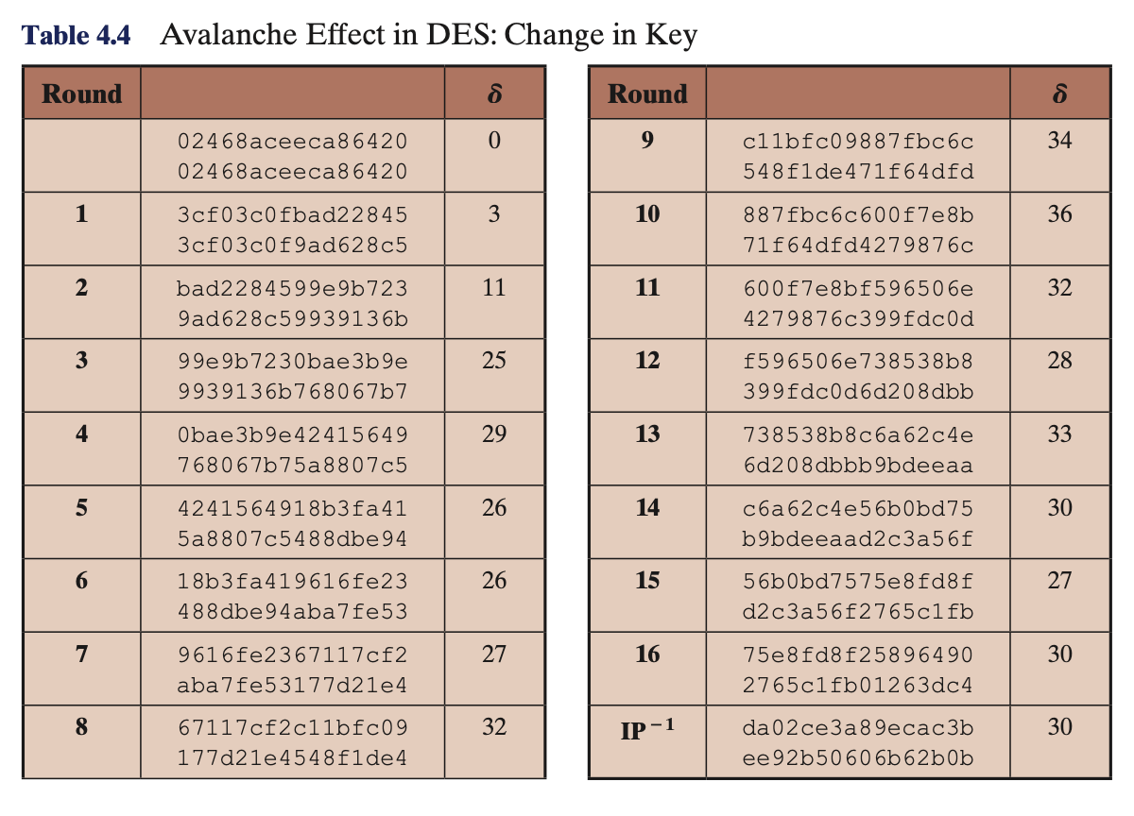
Avalanche effect: a change in one bit of the plaintext or one bit of the key should produce a change in many bits of the ciphertext.
We change single bit in key and key becomes 1f1571c947d9e859
Notes:
https://page.math.tu-berlin.de/~kant/teaching/hess/krypto-ws2006/des.htm

Slide 22
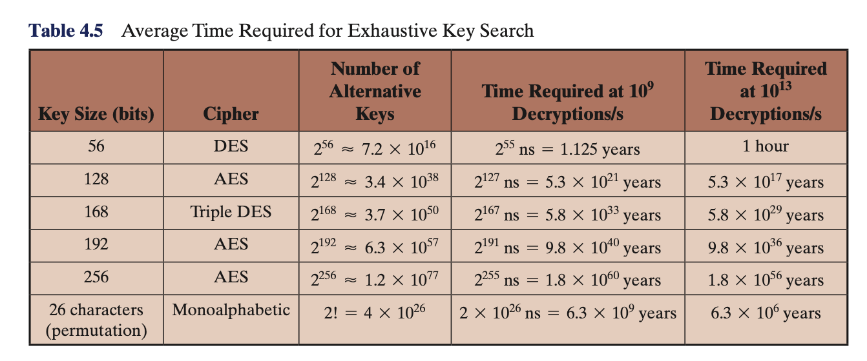
THE STRENGTH OF DES
Two concerns: key size and the nature of the algorithm.
A single PC can break DES in about a year; if multiple PCs work in parallel, the time is drastically shortened.
Today’s supercomputers should be able to find a key in about an hour.
Fortunately, there are a number of alternatives to DES, the most important of which are AES and triple DES, discussed in Chapters 6 and 7, respectively.

Slide 23
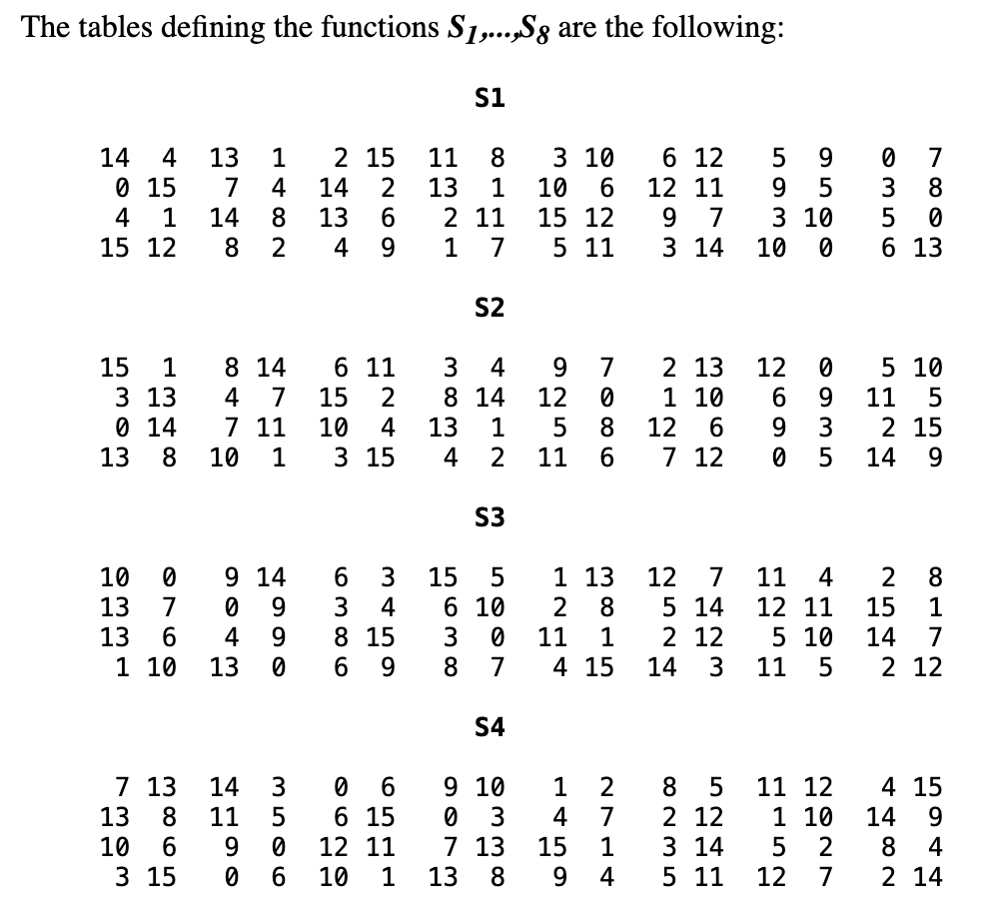
THE STRENGTH OF DES
Two concerns: key size and the nature of the algorithm.
Nature of the algorithm
The design criteria for the S-boxes were not made public when DES was first introduced. This lack of transparency has led to suspicion and concern within the cryptographic community.
Over the years, researchers have discovered certain patterns and behaviors in the S-boxes that were not initially expected.
Despite this, no one has so far succeeded in discovering the supposed fatal weaknesses in the S-boxes.

Slide 24
Example
generate 1 round version of DES
Hexadecimal notation : 0123456789ABCDEF
Binary Notation: 0000 0001 0010 0011 0100 0101 0110 0111 1000 1001 1010 1011 1100 1101 1110 1111

Slide 25
Example
Step 1: Initial Permutation (IP)
The 64-bit plaintext block is permuted according to a fixed table (IP table).
The first bit of the output is the 58th bit of the input, the second is the 50th, and so on.
The purpose of this step is to rearrange the bits of the plaintext before the main encryption rounds begin.

Slide 26
Example
Step 2: Key Generation
A 64-bit key is provided as input, but only 56 bits are used (the 8th, 16th, 24th, etc., bits are parity bits).
First, the 56 bits are selected and permuted according to a fixed table (PC-1).
The result is split into two 28-bit halves, C0​ and D0​.
For each of the 16 rounds of DES, a different 48-bit subkey is generated.
For Round 1, C0​ and D0​ are each cyclically left-shifted by one bit to create C1​ and D1​.
C1​ and D1​ are then concatenated to form a 56-bit block.
Finally, this 56-bit block is permutated and 8 bits are dropped to produce the 48-bit subkey K1​ (using the PC-2 table).

Slide 27
Example
Step 3: Round 1 (Feistel Function)
The 64-bit block (the output of the IP step) is split into two 32-bit halves: a left half () and a right half ().
The core of the DES algorithm is the Feistel function, which is applied to the right half .
The new left half is simply the old right half .
The new right half is calculated as , where is the XOR operation and is the Feistel function.

Slide 28
Example
Step 3a: Feistel Function
Expansion Permutation (E): The 32-bit right half is expanded to 48 bits. The expansion table repeats certain bits of the 32-bit input to create the 48-bit output.
XOR with Subkey: The expanded 48-bit block is XORed with the 48-bit subkey (generated in Step 2).
S-Box Substitution: The 48-bit result is divided into eight 6-bit blocks. Each 6-bit block is fed into a different substitution box (S-box). An S-box is a non-linear lookup table that transforms a 6-bit input into a 4-bit output. The purpose of this step is to introduce confusion into the cipher.
Permutation (P): The eight 4-bit outputs from the S-boxes are combined to form a 32-bit block, which is then permuted according to a fixed table (P table). This step provides diffusion, spreading the influence of each input bit over many output bits.

Slide 29
Example
Step 3b: Combining the Halves
The final 32-bit output of the Feistel function is XORed with the original 32-bit left half (). This result becomes the new right half ().
The original right half () becomes the new left half ().
The new left and right halves ( and ) are concatenated to form the 64-bit output of Round 1. This output becomes the input for Round 2.

