Slide 1
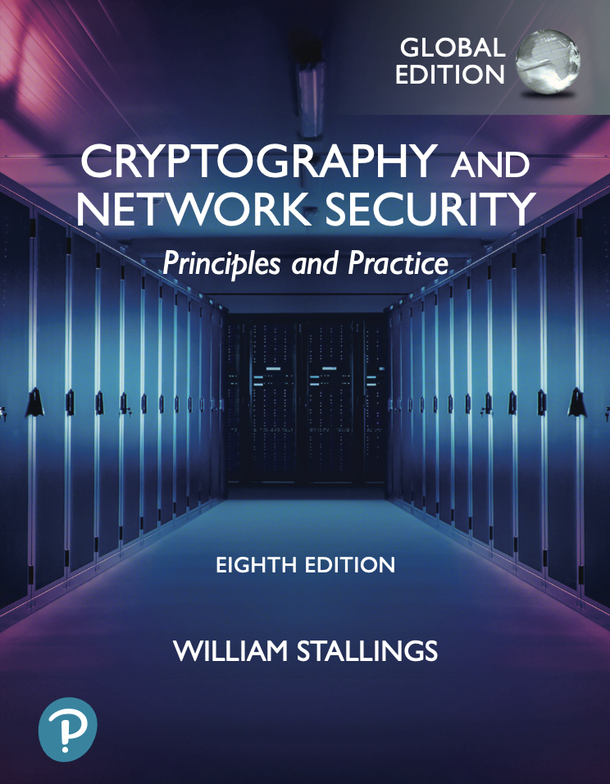
University of Nevada – Reno
Computer Science & Engineering Department
CS454/654 Reliability and Security of Computing Systems - Fall 2024

Slide 2
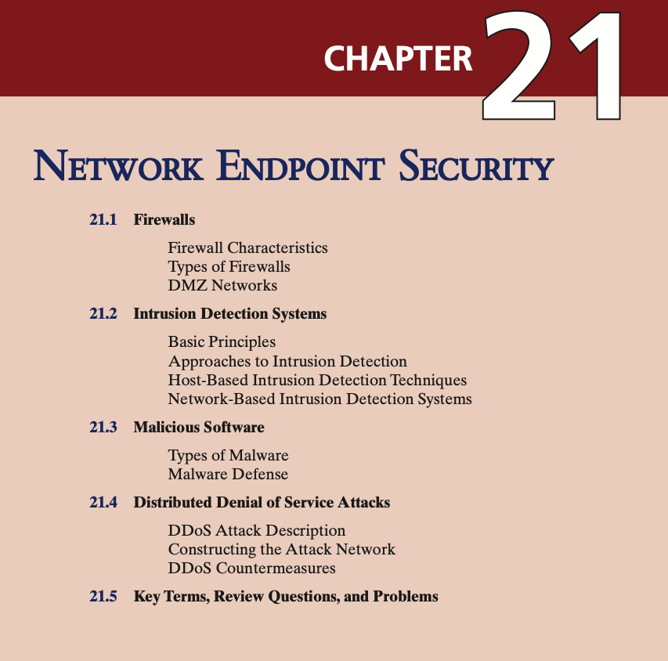

Slide 3
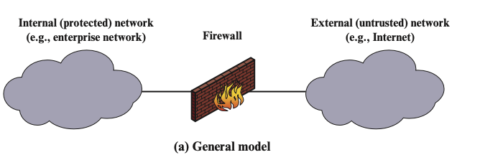
Firewalls
Deployed on outer perimeter of the network infrastructure
Also deployed in inner network to segregate portions of the network.
Enforces access policy.
Four techniques that firewalls use to control access
Service control: What type of services can be accessed
Direction control: What should be the direction of the traffic for service
User control: Tailoring the access depending on user.
Behavioral control: How particular service can be used.

Slide 4
Firewalls
Firewall enables
Traffic monitoring.
Network address translation (NAT) and logging internet usage.
Facilitate Virtual Private Networks (VPN)
However, firewall can not protect internal threats.
Types of Firewalls
Packet Filtering
Stateful Inspection Firewalls
Application Level Gateway
Circuit-level gateway

Slide 5
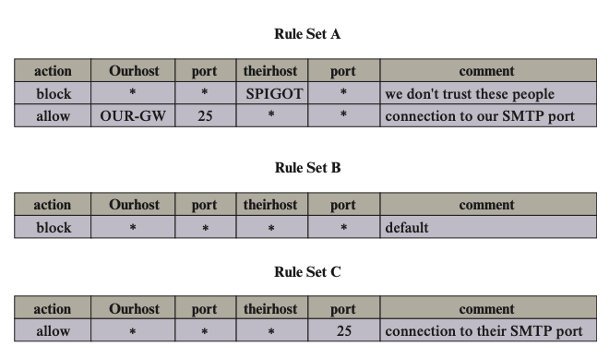
Packet Filtering
Apply filtering to traffic based on source/destination IP, protocol, and port number.
Examine each individual packet and apply predefined rules.
Cisco ASA 5500-X Series Firewalls - Supports simple packet filtering https://www.cisco.com/c/en/us/support/security/asa-5500-series-next-generation-firewalls/series.html

Slide 6
Packet Filtering Attacks & Countermeasures
1. IP address spoofing. Spoofed IP address belongs to an internal host.
Countermeasure: discard packets with an inside source IP address if the packet arrives on an external interface (typically implemented on a router external to the firewall).
2. Source Routing Attacks. It attempts to specify the route (path on the Internet) in hopes that it will bypass security measures that do not analyze the source routing information.
Countermeasure: discard all packets that use this option.
3. Tiny fragment attacks. Attempt to use IP fragmentation option to create extremely small fragments and force TCP header information into a separate packet fragment. IT attempts to circumvent the filtering rules that depend on TCP header information.
Countermeasure: enforcing the rule that the first fragment of a packet must contain a predefined minimum amount of the transport header. If the first fragment is rejected, then the filter can remember the packet and discard all subsequent fragments.

Slide 7
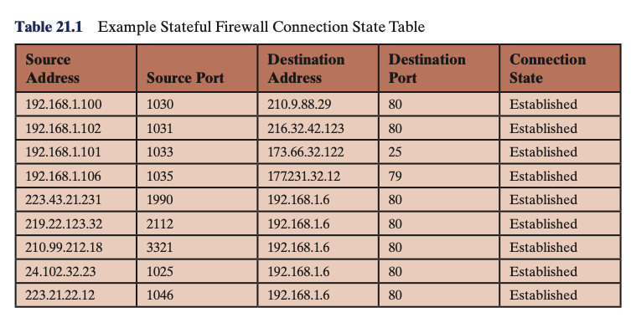
Stateful Inspection Firewalls
A stateful packet inspection firewall reviews the same packet information as a packet filtering firewall, but also records information about TCP connections.
The firewall compares incoming packets with a state table that contains information about current TCP connections.

Slide 8
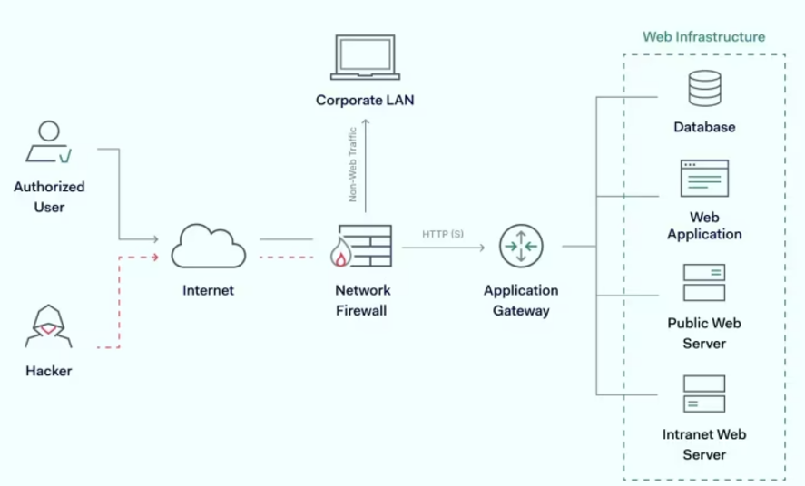
Application-Level Gateway (Proxy Firewall)
An application-level gateway, also known as an application proxy, operates as a relay for application-level traffic, here how it works
Client Interaction: The user initiates a connection using a TCP/IP protocol using an application (like Telnet or FTP) and contacts the firewall gateway.
Authentication: Upon connection, the gateway asks the user for information such as the remote host's name, user ID, and authentication credentials.
Relaying Traffic: The gateway then contacts the application on the remote host, forwarding the application data between the client and the server.
Application-Specific Proxy: The gateway only relays traffic for applications it has been specifically configured to handle.
Feature Control: Administrators can configure the gateway to allow only certain features of an application.
Prime disadvantage: the additional processing overhead on each connection gateway must examine all traffic in both directions.

Slide 9
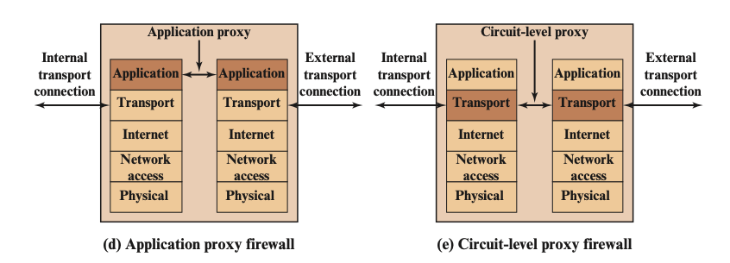
Circuit-level gateway
Circuit-level gateway does not permit direct TCP connections;
The circuit-level gateway establishes two separate TCP connections: from client (external) to firewall, and from firewall to server (internal). Then it acts as a relay.
It simply forwards TCP segments (i.e., packets) from one connection to the other without inspecting the contents of the traffic.
A typical use case for a circuit-level gateway is when a network administrator trusts the external users but wants to control the connections that are established from the internal network to the external network (and vice versa).

Slide 10
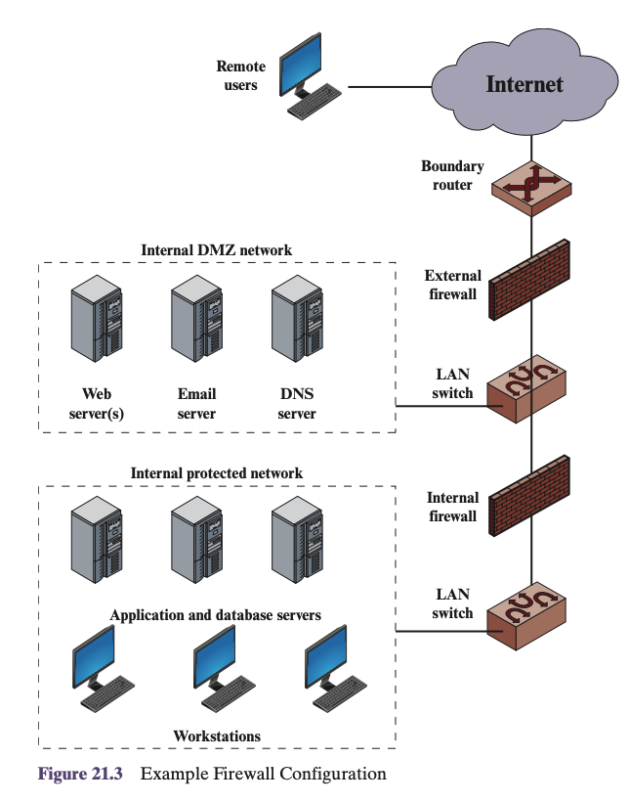
Demilitarized Zone (DMZ)
Positioned between external and internal firewalls.
The DMZ hosts publicly accessible systems like web servers, email servers, and DNS servers. These systems require external connectivity (e.g., to the internet) but also need protection from the internet.
External Firewall: Provides basic protection and access control for the DMZ and the enterprise network from the external network.
Internal Firewalls: Offer more detailed filtering and protect both the core network and the DMZ, ensuring that internal systems are protected from external attacks
Common practice: place the DMZ on a different network interface on the external firewall from that used to access the internal networks.
Benefits
Layered defense
Controlled exposure
Internal Segmentation

Slide 11
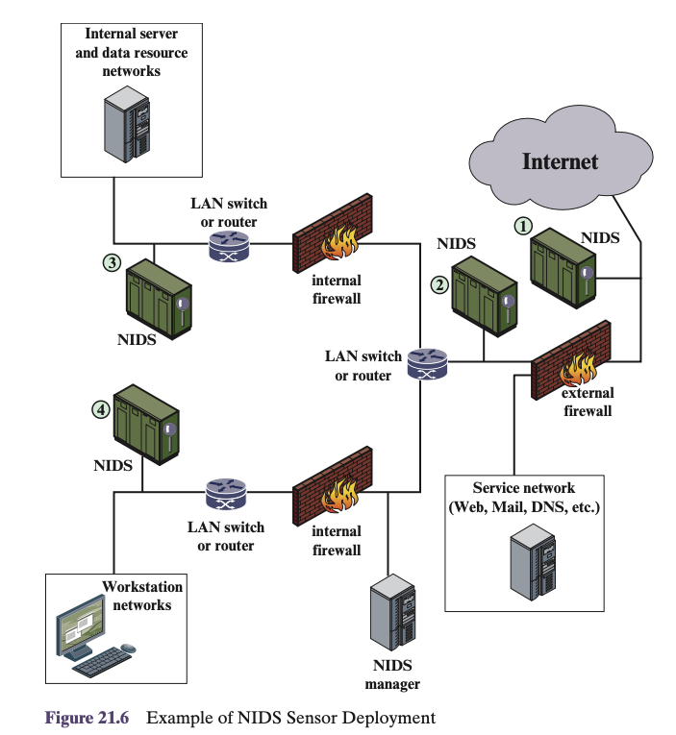
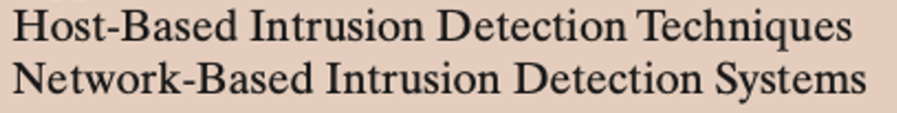
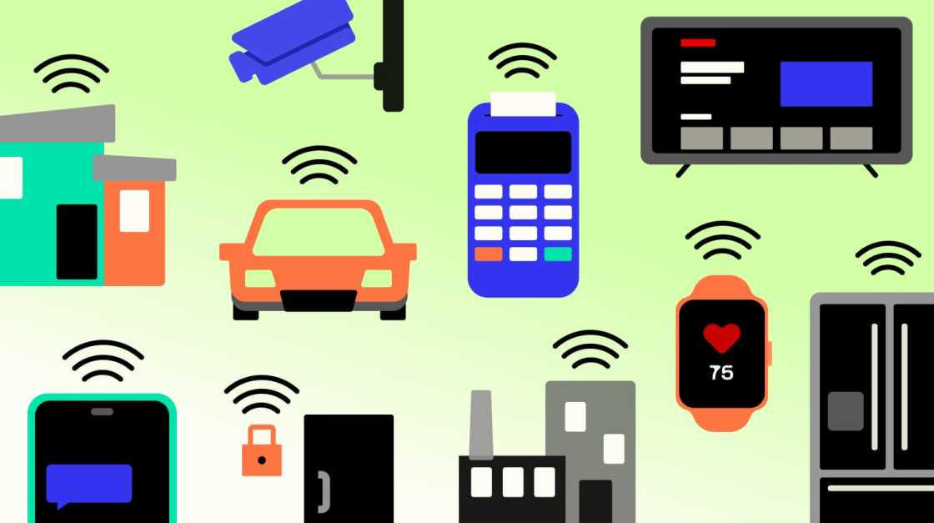

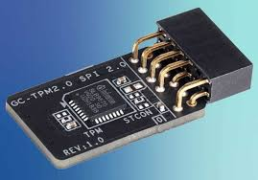
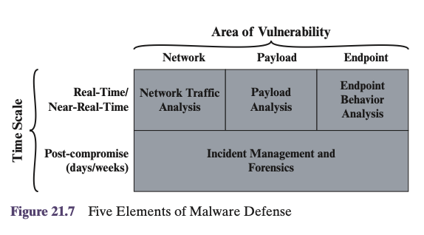
Intrusion Detection Systems (IDS)

Slide 12
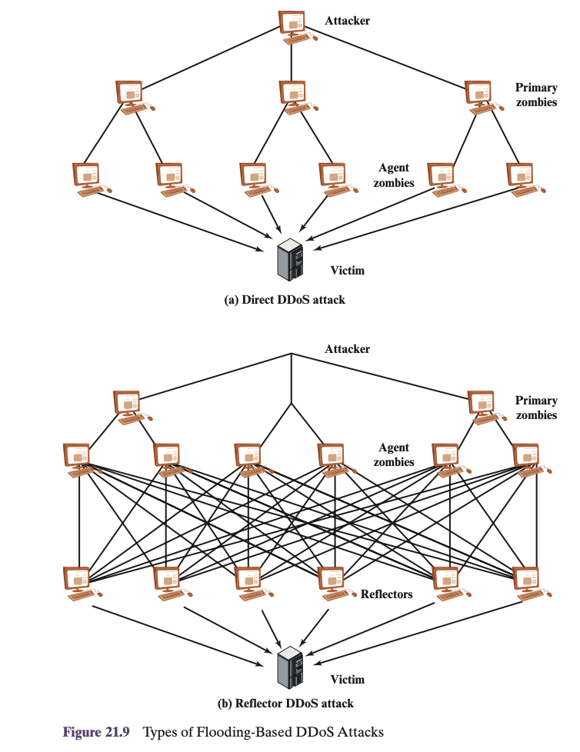
Denial of Service Attacks (DDoS)

Slide 13
