Slide 1

Mandovi River Eye — Feature Highlights
A bright overview of the key Digital Twin capabilities — Water Quality, ships, silt, layers, and live river intelligence.
PLANET EYE AI · RIVER.EYE · Mandovi

Slide 2
What’s Inside
Each slide covers one important submenu / feature with a short description.
1
3D Mandovi Digital Twin
2
Live BOD & COD
3
Water Quality Suite
4
Salinity (Smoothed Classes)
5
Layers Control
6
Geology & Bathymetry
7
Casino Ships & AIS
8
Silt Analysis
9
Joining Streams
10
Live Weather

Slide 3
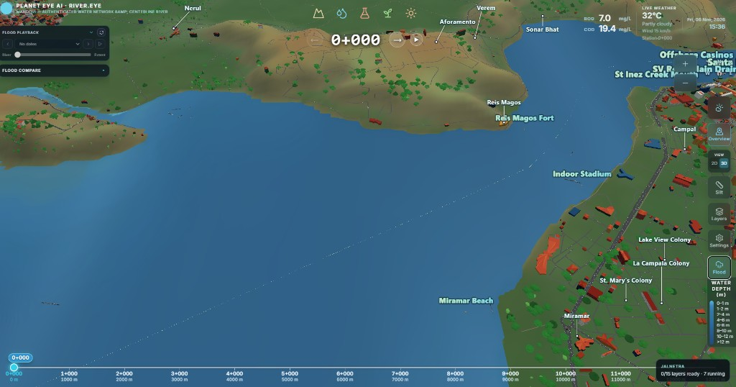
1. 3D Mandovi Digital Twin
Live 3D twin of the Mandovi estuary with terrain, river, and settlements.
Navigate chainage, overview, and local river views in one workspace.
Mandovi River Eye · Bright feature brief

Slide 4
2. Live BOD & COD
Always-on BOD and COD values beside live weather.
Updates with chainage click and joining-stream lat/long.
Mandovi River Eye · Bright feature brief

Slide 5
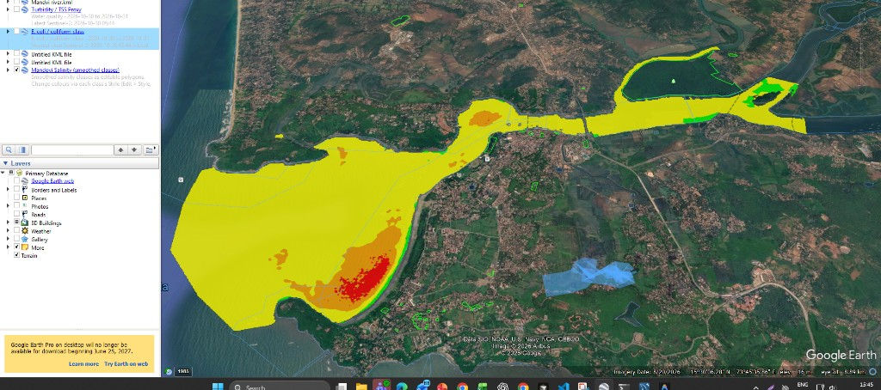
3. Water Quality Suite
Subpoints: TSS, Chlorophyll (NDCI), Salinity, and Coliform.
Click a metric to paint the river with class colours and legend chips.
Mandovi River Eye · Bright feature brief

Slide 6
4. Salinity (Smoothed Classes)
Mandovi salinity classes from smoothed KML — green to red PSU bands.
Shows on the water sheet like Google Earth class polygons.
Mandovi River Eye · Bright feature brief

Slide 7
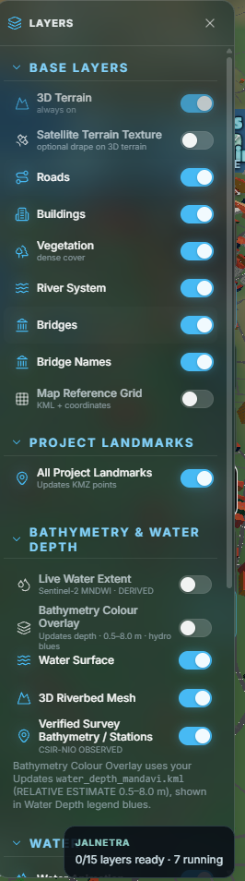
5. Layers Control
Base layers, landmarks, bathymetry, and water animation in one panel.
Buildings and vegetation stay on; clutter toggles removed.
Mandovi River Eye · Bright feature brief

Slide 8
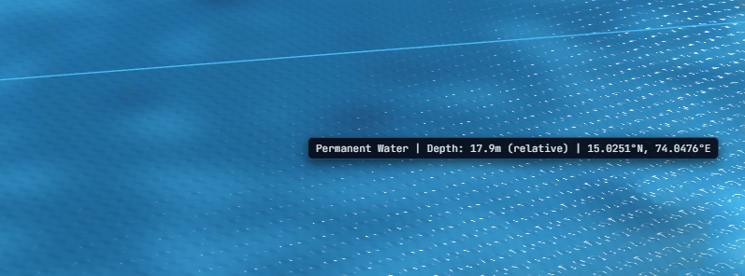
6. Geology & Bathymetry
Bathymetry colour overlay and survey stations under Geology.
Depth classes read clearly without leaving the 3D scene.
Mandovi River Eye · Bright feature brief

Slide 9
7. Casino Ships & AIS
Real casino vessels placed from KML with AIS LOA × beam sizes.
Click a ship for a sticky card; Ships toggle keeps them on in submenus.
Mandovi River Eye · Bright feature brief

Slide 10
8. Silt Analysis
Draw an area to see silt class and volume with period controls.
Cutaway view shows low / moderate / high silt from bed to surface.
Mandovi River Eye · Bright feature brief

Slide 11
9. Joining Streams
Select joining channels with BOD/COD for that outlet lat/long.
Camera stays where you are — no forced full-KML zoom.
Mandovi River Eye · Bright feature brief

Slide 12
10. Live Weather
Temperature, condition, and wind beside the river twin.
Opens detailed Open-Meteo graphs from the weather icon.
Mandovi River Eye · Bright feature brief

Slide 13
Ready for demos & reviews
All highlighted features stay in your current camera view.
Ships remain visible by default in every submenu.
Thank you

