Slide 1
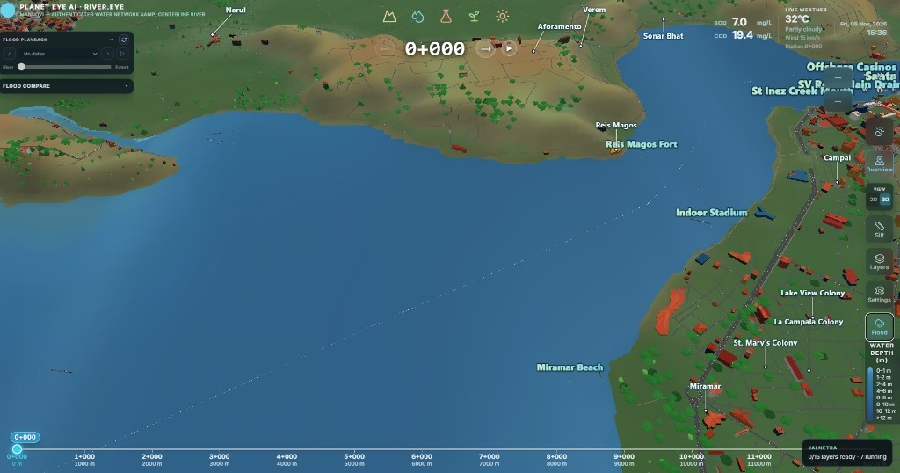

Mandovi River Eye
Feature Highlights
3D twin · Ships · BOD/COD · Salinity · Chlorophyll · Coliform
Nitrogen · Eutrophication · Silt · Live Weather

Slide 2
3D Mandovi Digital Twin
Full 3D twin of the Mandovi estuary — terrain, river, bridges, and settlements.
Navigate chainage live while staying in your current camera view.

Slide 3
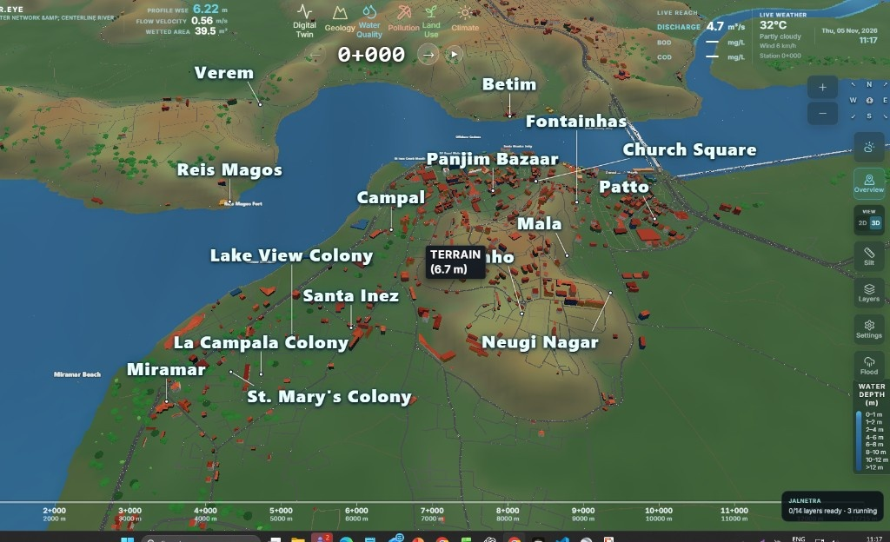
Casino Ships & Boats
Casino and river vessels rendered in 3D with real AIS LOA × beam sizes.
Ships stay visible by default in every submenu — toggle On/Off from the left.

Slide 4
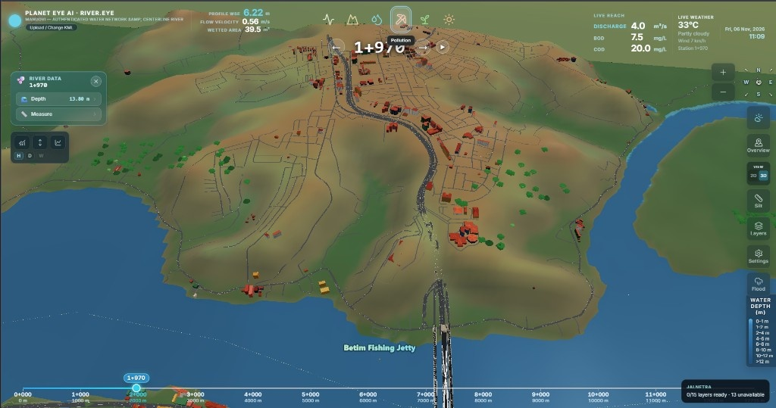
Live BOD & COD
Always-on BOD and COD (mg/L) beside live weather on the twin.
Updates with chainage click and joining-stream outlet lat/long.

Slide 5
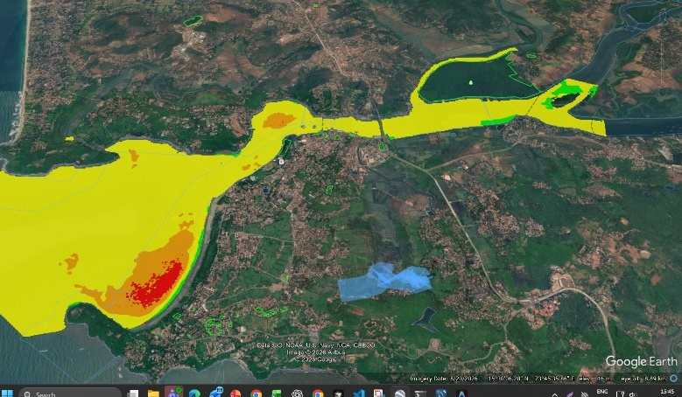
Salinity — Smoothed Classes
Mandovi salinity classes painted on the river — green → yellow → orange → red PSU bands.
Same smoothed-class product as Google Earth, shown in the 3D twin.

Slide 6
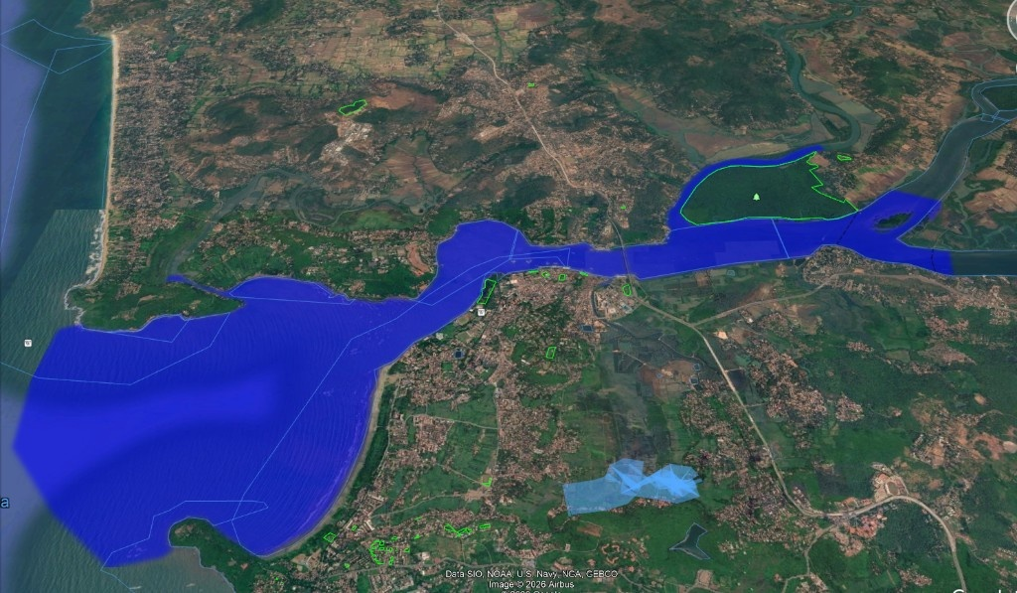
Chlorophyll-a (NDCI)
Chlorophyll / NDCI water-quality paint for Mandovi water pixels.
One click in Water Quality shows class colours with a compact legend.

Slide 7
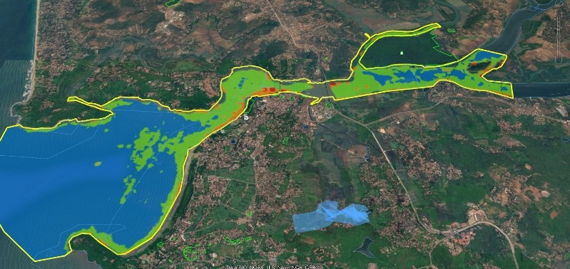
Coliform (E. coli Class)
Coliform / E. coli class overlay for bathing-water risk bands.
Blue → green → orange class map across the estuary reach.

Slide 8
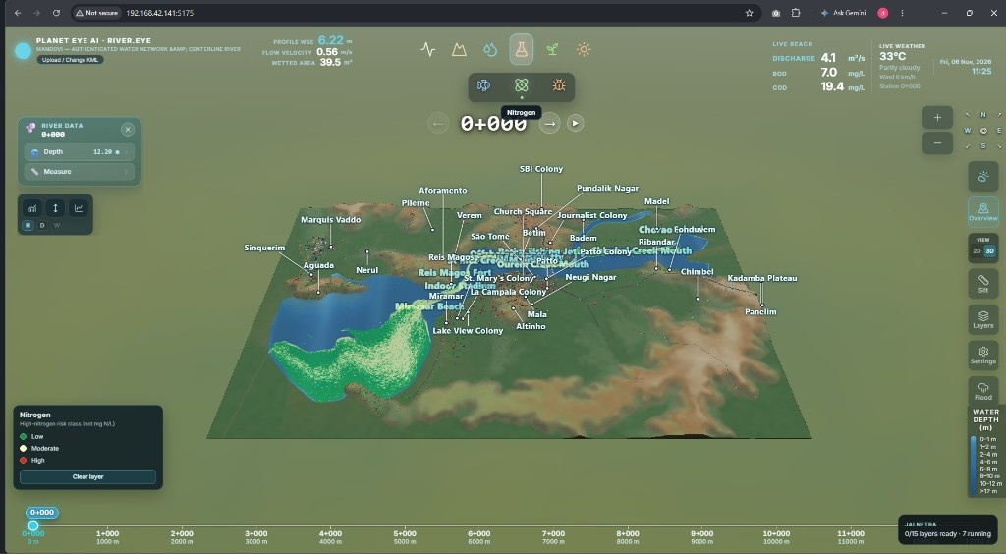
Nitrogen Risk
Nitrogen high-risk class layer under Pollution — Low / Moderate / High.
Reads on the 3D river with live BOD·COD and weather still visible.

Slide 9
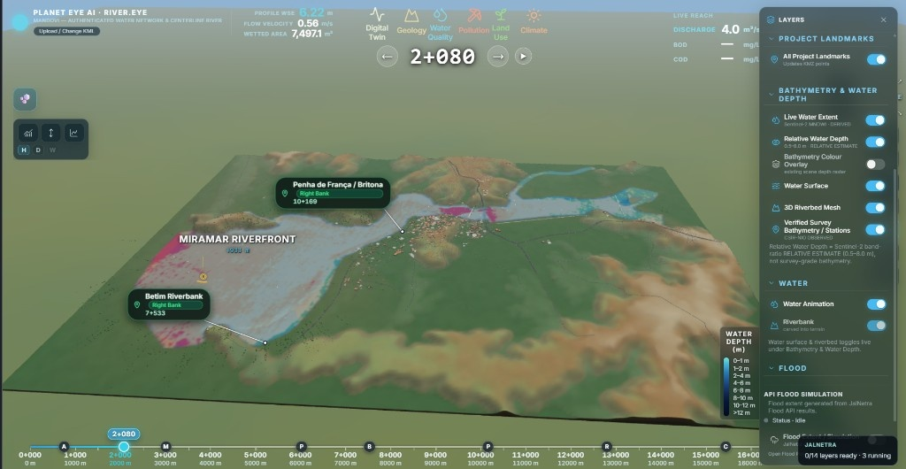
Eutrophication
Eutrophication trophic-class paint for Mandovi water quality.
Spot oligotrophic to hypereutrophic bands without leaving the twin.

Slide 10
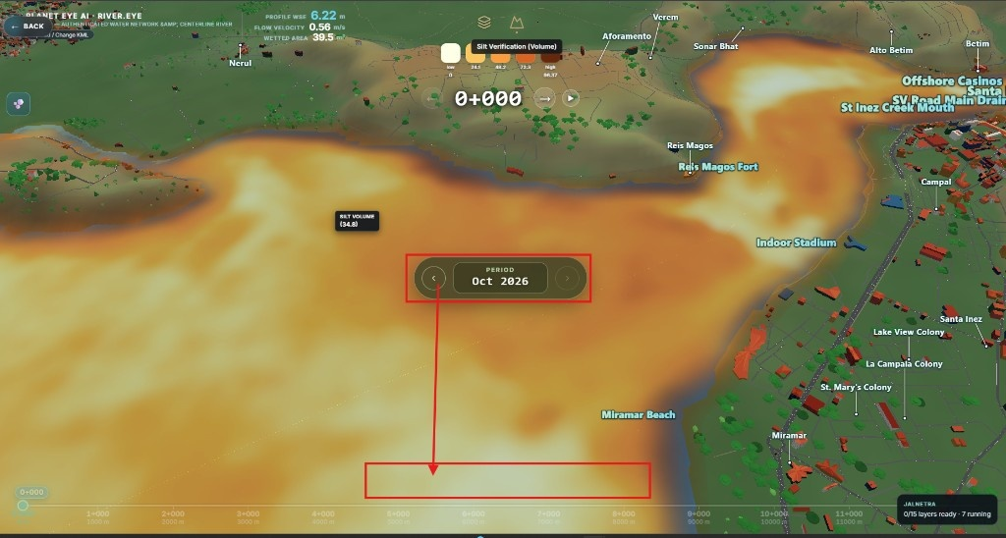
Silt Analysis
Silt classification & volume on the river — period picker and colour ramp.
Draw an area for Surface / Cutaway silt prism from bed to surface.

Slide 11
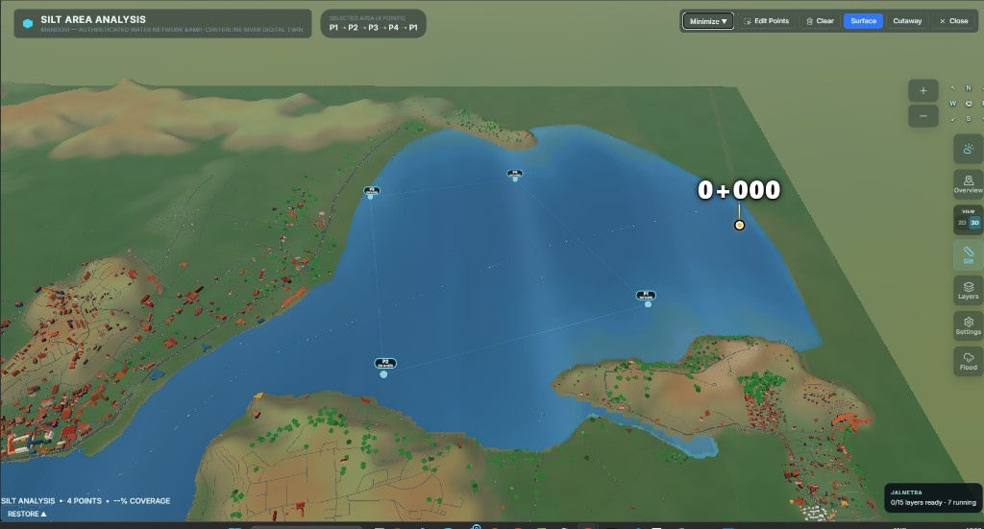
Silt Area Selection
Pick P1–P4 on the water to run silt area analysis in 3D.
Surface and Cutaway modes for the selected prism.

Slide 12
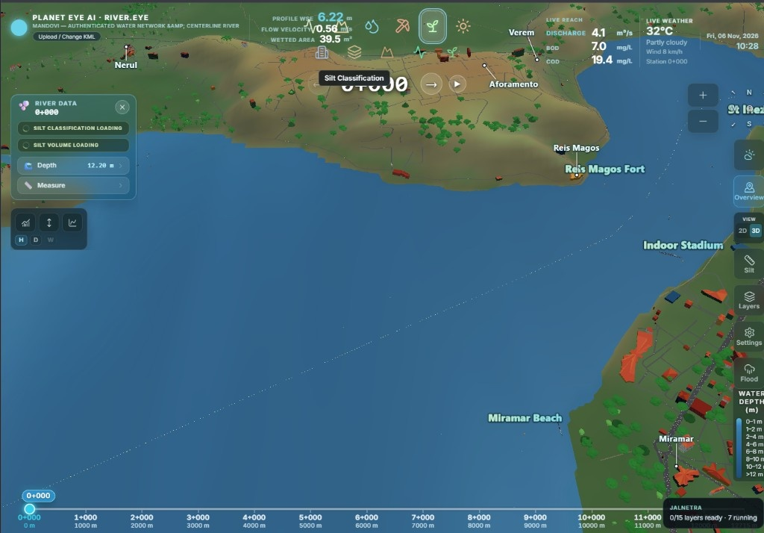
Live Weather Details
Live temperature, condition, and wind next to the twin.
Open the weather icon for past/future Open-Meteo detail graphs.

Slide 13
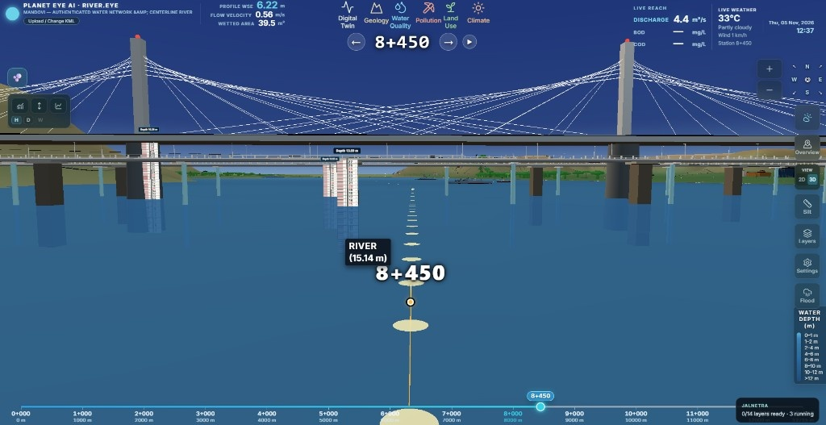
All key Mandovi twin features covered
Ships on by default · camera stays where you are · live BOD·COD & weather
Thank you

