Slide 1
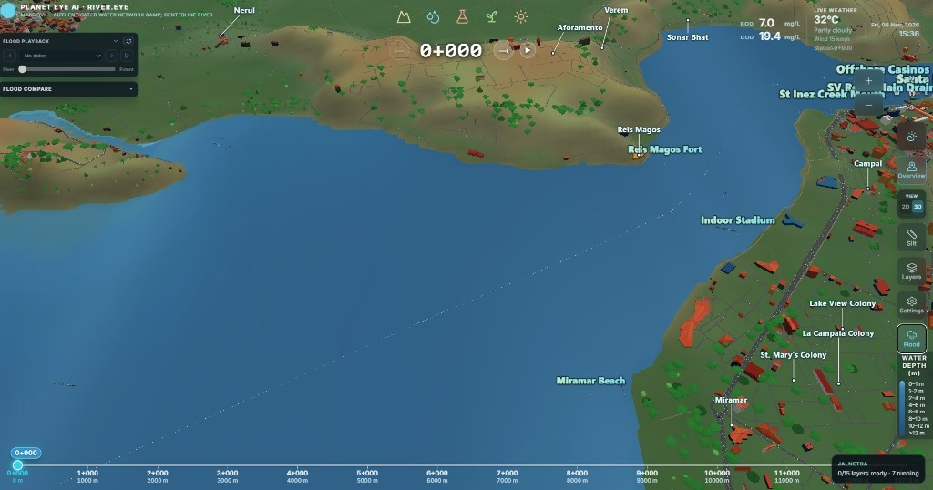

Mandovi River Eye
Feature Highlights — Updated Project
3D Twin · Ships · BOD/COD · Salinity · Chlorophyll · Coliform
Nitrogen · Eutrophication · Silt (Points → Underwater) · Weather

Slide 2
3D Mandovi Digital Twin
Full 3D twin of the Mandovi estuary — terrain, river, bridges, and settlements.
Navigate chainage live while the camera stays where you left it.

Slide 3
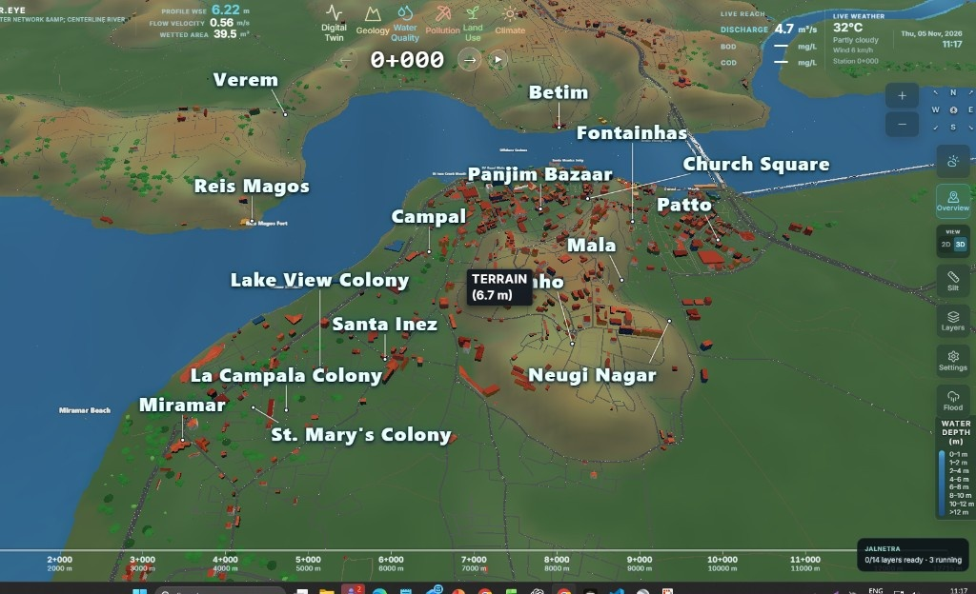
Casino Ships & Boats
Casino and river vessels in 3D with real AIS LOA × beam sizes.
Ships stay ON by default in every submenu — toggle from the left Ships control.

Slide 4
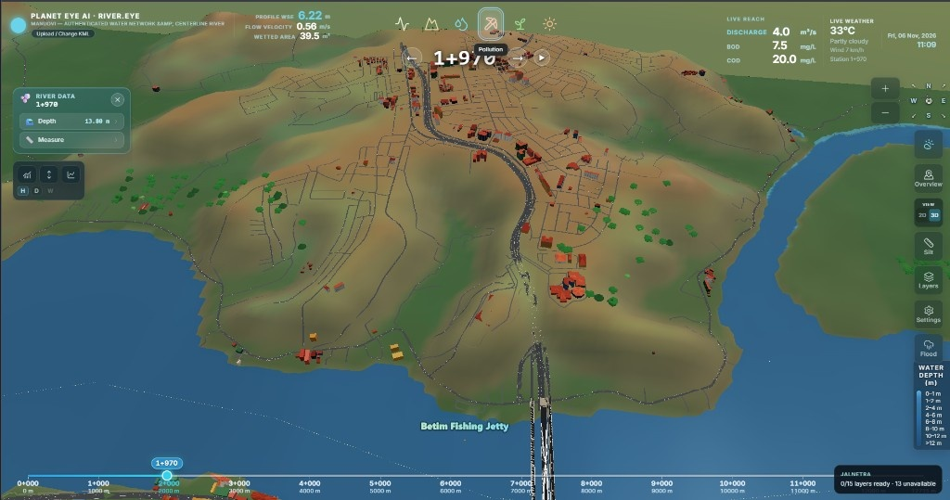
Live BOD & COD
Always-on BOD and COD (mg/L) beside live weather on the twin.
Updates with chainage click and joining-stream outlet lat/long.

Slide 5
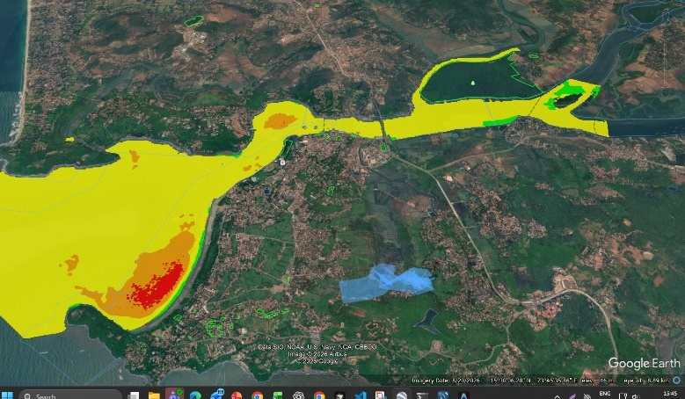
Salinity — Smoothed Classes
Mandovi salinity classes on the river — green → yellow → orange → red PSU bands.
Same smoothed-class product as Google Earth, shown in the 3D twin.

Slide 6
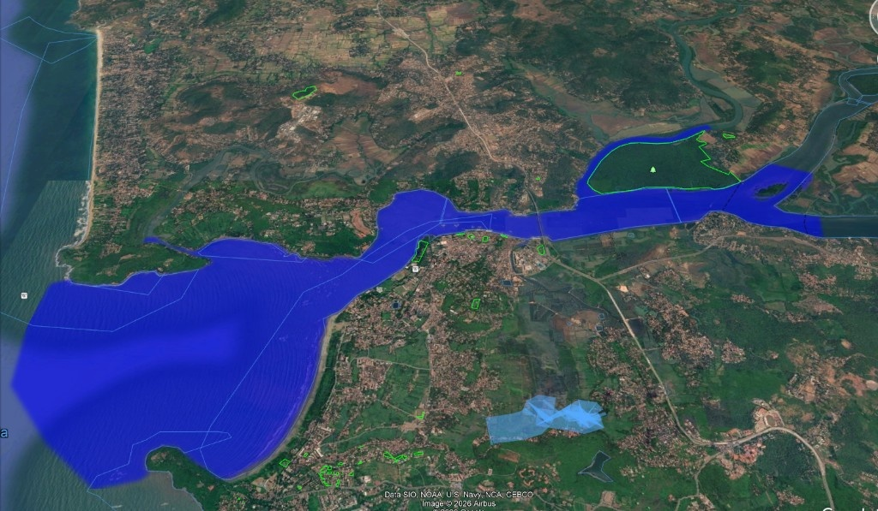
Chlorophyll-a (NDCI)
Chlorophyll / NDCI water-quality paint for Mandovi water pixels.
One click in Water Quality shows class colours with a compact legend.

Slide 7
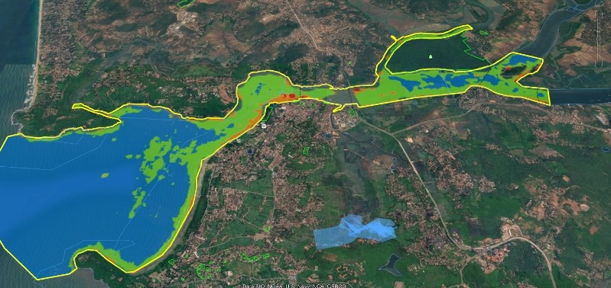
Coliform (E. coli Class)
Coliform / E. coli class overlay for bathing-water risk bands.
Blue → green → orange class map across the estuary reach.

Slide 8
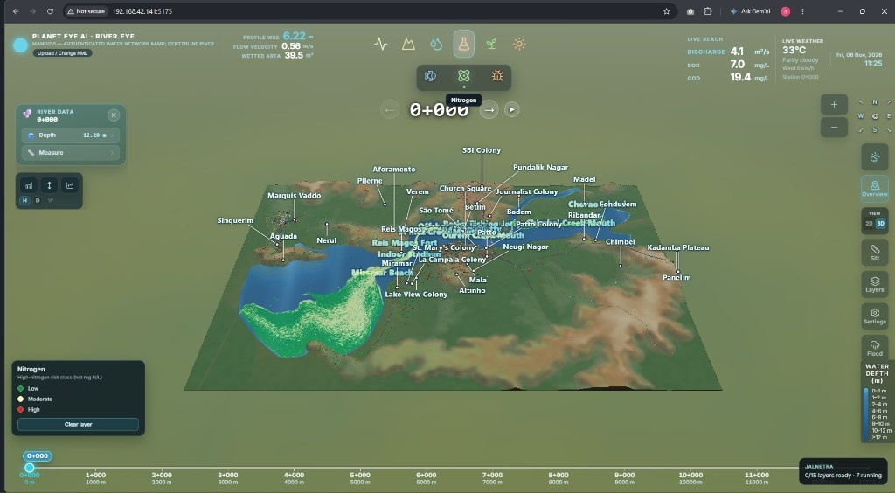
Nitrogen Risk
Nitrogen high-risk class layer — Low / Moderate / High.
Reads on the 3D river with live BOD·COD and weather still visible.

Slide 9
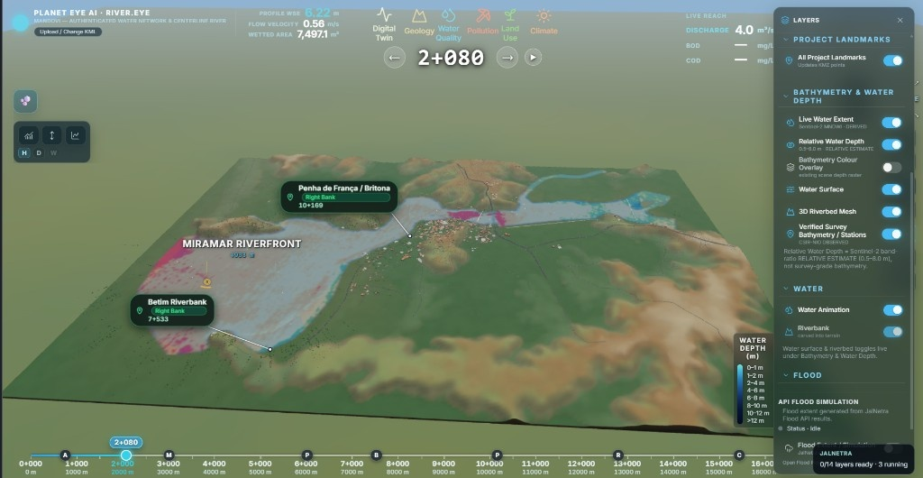
Eutrophication
Eutrophication trophic-class paint for Mandovi water quality.
Spot oligotrophic to hypereutrophic bands without leaving the twin.

Slide 10
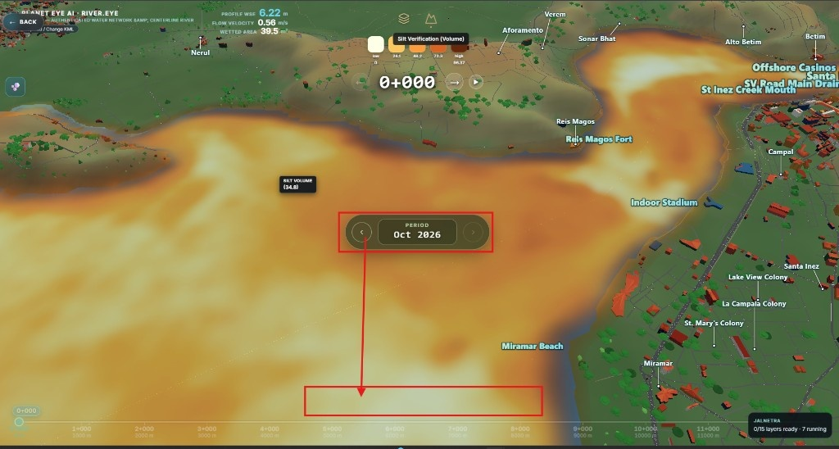
Silt Classification & Volume
River-wide silt classification and volume with period picker (e.g. Oct 2026).
Colour ramp shows deposition intensity across the Mandovi reach.

Slide 11
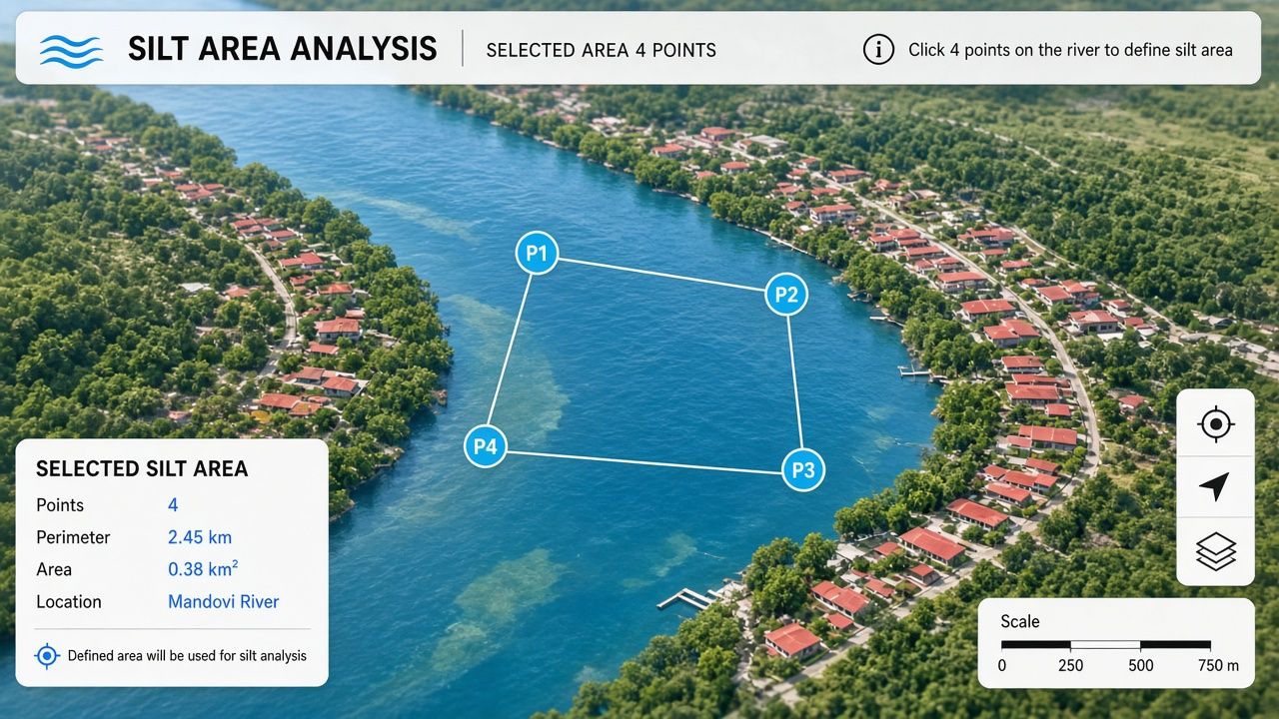
Silt Step 1 — Place 4 Points
Open Silt Area Analysis and click P1 → P2 → P3 → P4 on the water.
The polygon closes automatically — then silt analysis runs for that area.

Slide 12
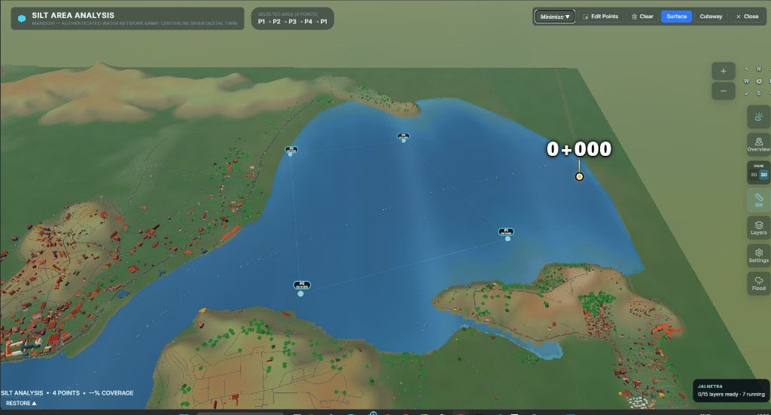
Silt Step 2 — Area Locked
Selected area shows Surface / Underwater modes after the 4 points are set.
Edit, clear, or minimize while the prism stays on the twin.

Slide 13
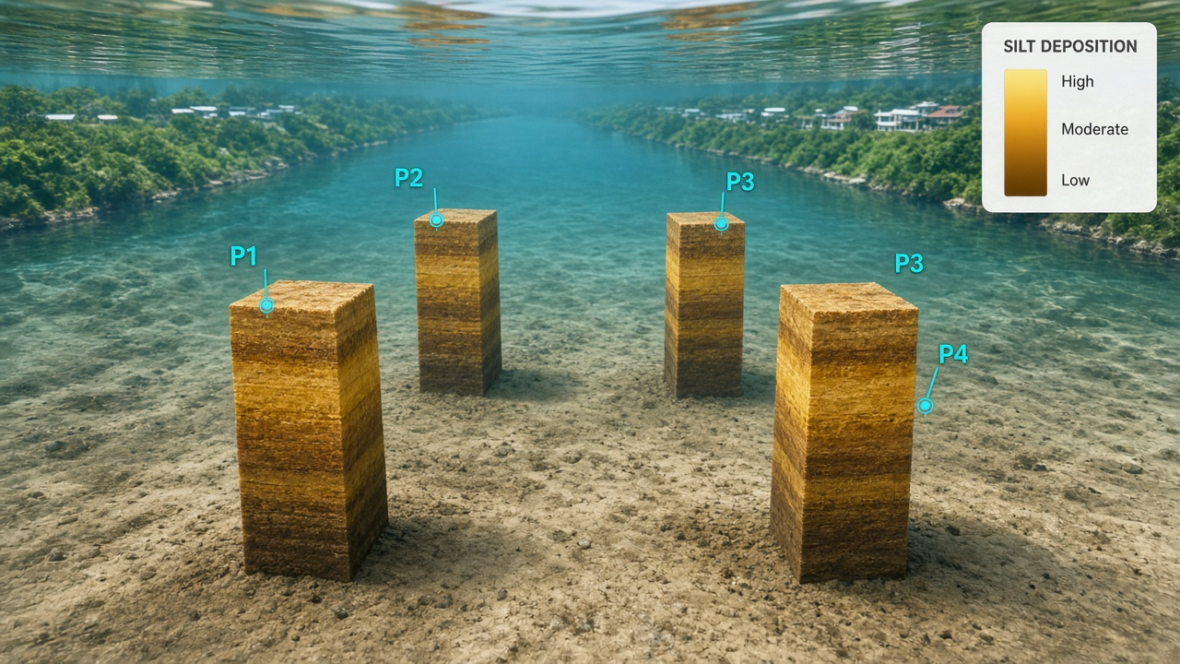
Silt Step 3 — Inner Water Simulated View
Switch to Underwater (Cutaway) — camera dives into the water column.
See simulated silt from bed to surface inside the selected prism — clearly visible.

Slide 14
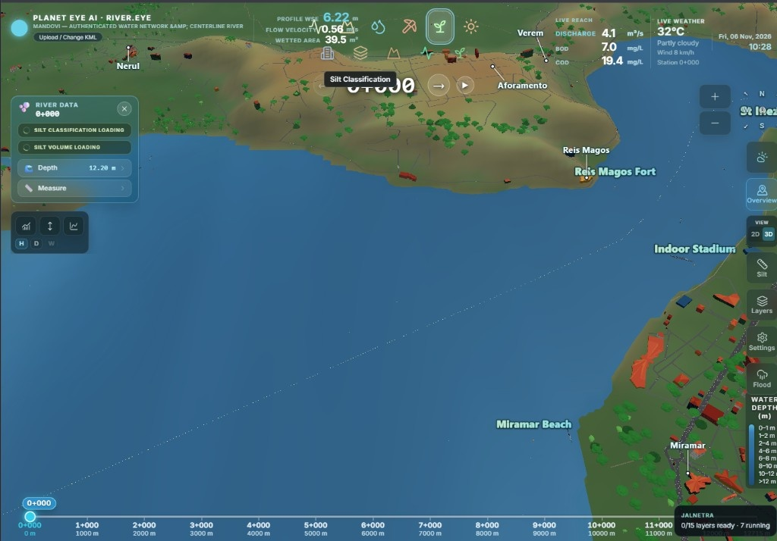
Live Weather Details
Live temperature, condition, and wind next to the twin.
Open the weather icon for past/future Open-Meteo detail graphs.

Slide 15
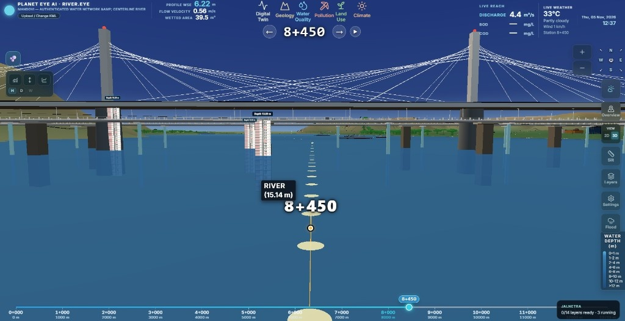
All Mandovi twin features covered
Silt flow: place 4 points → lock area → underwater simulated silt view
Ships on by default · camera stays · live BOD·COD & weather
Thank you

