Slide 1

Secure boot on risc-v dual core
BY Boris bukCHIN, SERGEY MASHKIN
Instructor: avi Mendelson
Winter 2022
Project id: 7040
Final
presentation

Slide 2

Introduction

Slide 3
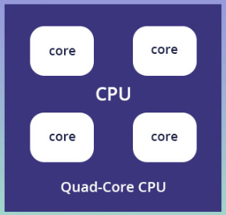


Background-multi core boot
ROM: Small executable to initialize boot sequence
Flash: Boot services, load kernel code
Flash: Kernel boot code
Further stages
Notes:
Modern secure multi core systems use single core to run boot sequence.
All cores start working.
Operating system code is validated with crypto signature and starts on all cores.

Slide 4
Background-Secure boot
Check code signature
ROM: Small executable to initialize boot sequence
Check code signature
Flash: Boot services, load kernel code
Check code signature
Flash: Kernel boot code
Further stages
Notes:
Modern secure multi core systems use single core to run boot sequence.
All cores start working.
Operating system code is validated with crypto signature and starts on all cores.

Slide 5


Motivation-fault injection
Check code signature
ROM: Small executable to initialize boot sequence
ROM: Small executable to initialize boot sequence
Check code signature
Flash: Boot services, load kernel code
Check code signature
Flash: Kernel boot code
Further stages
Notes:
Current boot sequence is vulnerable to fault injection attacks.
Current systems aren’t secure from attacks after cryptographic validation.

Slide 6
Motivation-Dual core secure boot
Check code signature
ROM: Small executable to initialize boot sequence
Check code signature
Flash: Boot services, load kernel code
Check code signature
Flash: Kernel boot code
Further stages
Notes:
Try new method to preform a more secure way to boot muti core systems.
Under assumption of single fault injection.
Fault detection + system recovery.

Slide 7
Goals
Understand all relevant aspects of current secure boot sequence.
Try using dual core to run boot sequence and compare execution traces to validate code authenticity.
Main core recovery after a fault detected.
Simulate the system and validate working dual core secure boot.
Prove protection against fault injection in new system.

Slide 8
Tools
Secure boot system using “OpenTitan” architecture.
Simulation environment for the system using Verilator.
SystemVerilog development environment - VScode.
Boot sequence development environment – C code.

Slide 9
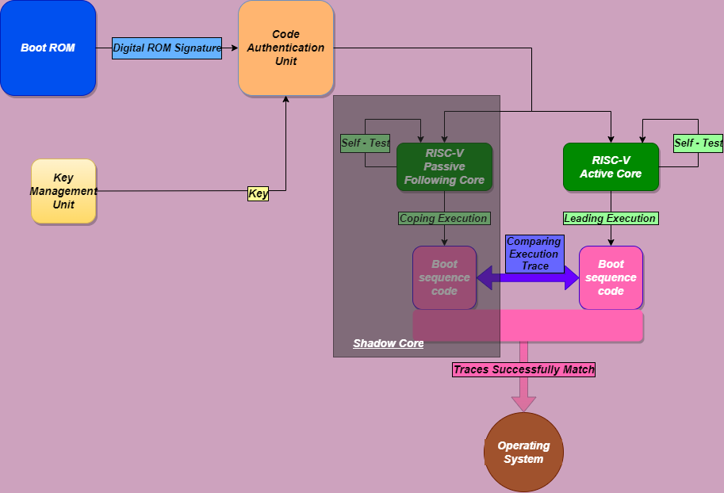
Block diagram

Slide 10
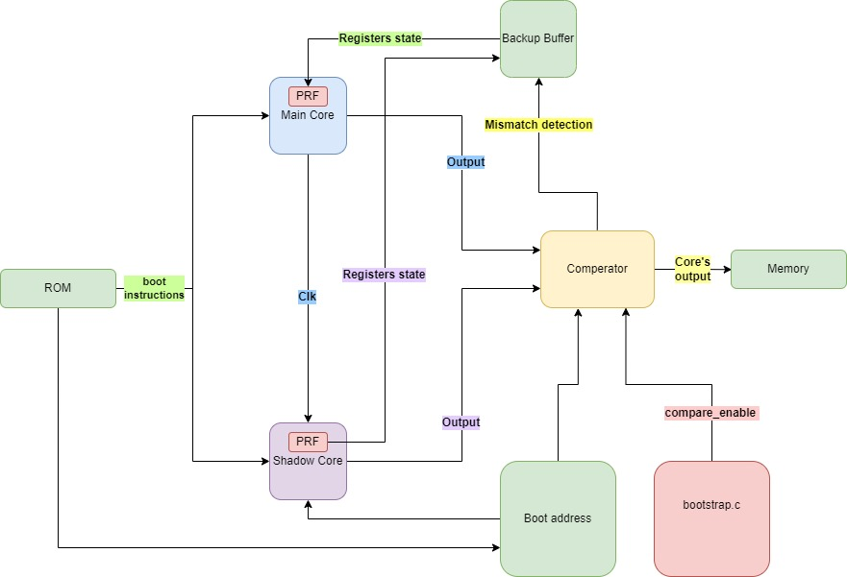
Block diagram

Slide 11
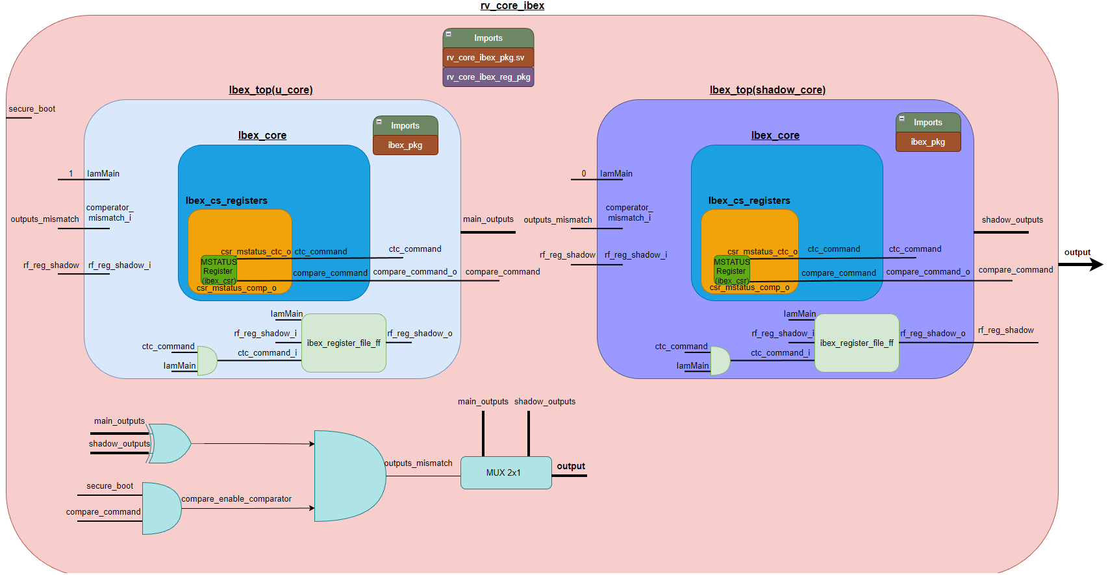

Slide 12

Hardware modifications

Slide 13
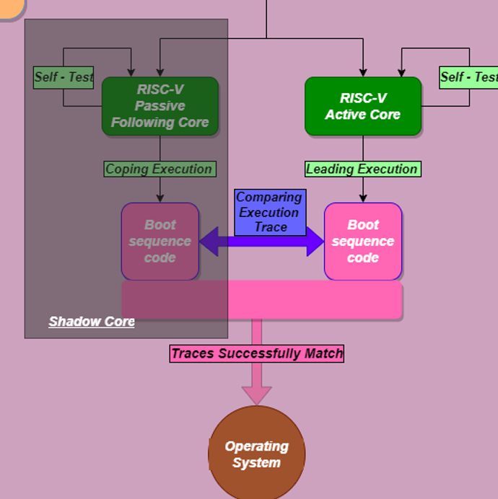
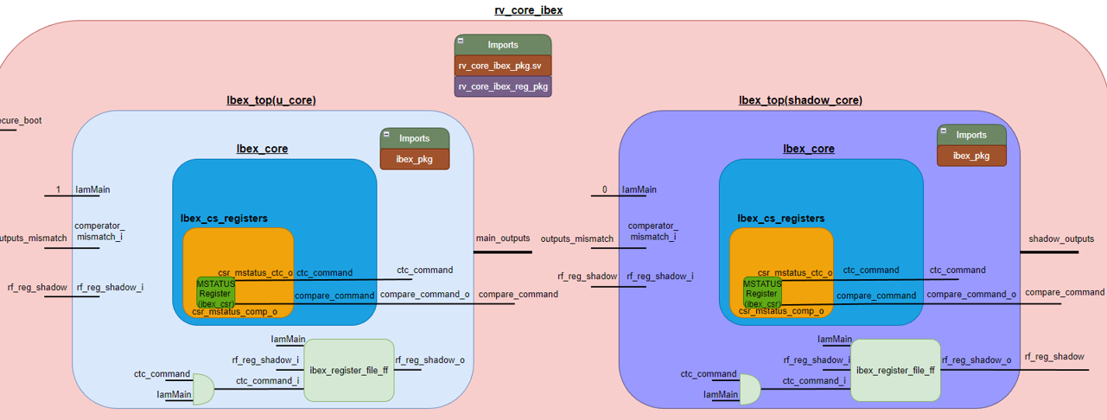
Shadow core
Add additional core which will run simultaneously with the main core.
The shadow core receives same inputs as the main core.
The shadow core will execute the same commands as the main one, without altering the main core output.
The output of the shadow core will go to the comparator for comparison with the main core output.
Notice: shadow core uses a copy of the original set of registers.

Slide 14
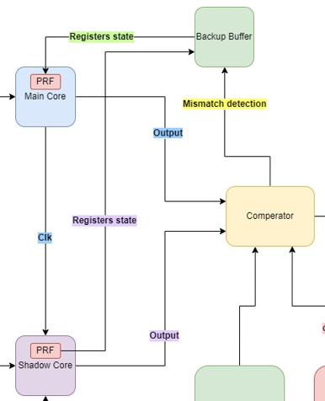
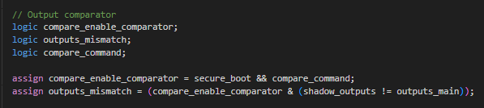
Output comparator
The comparator receives outputs from 2 cores and enable signal and compares the outputs.
In a case of a mismatch, it raises a flag a transfers control to a mismatch handler (recovery)

Slide 15
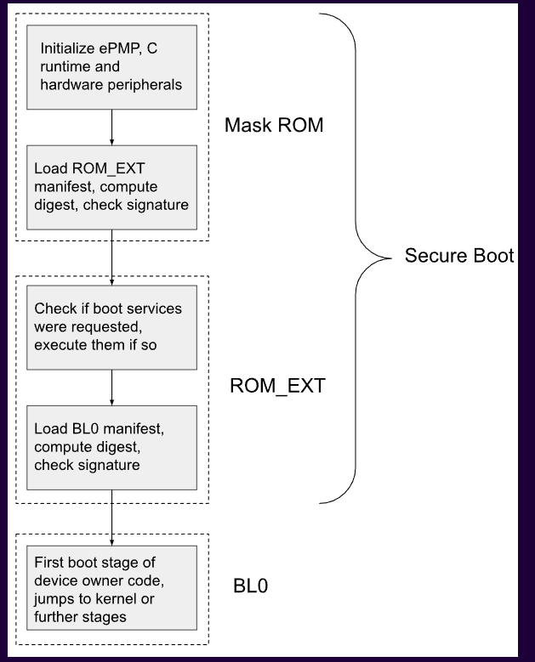
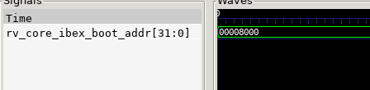
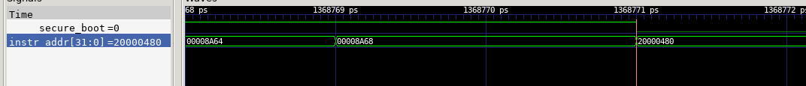
Boot Identifier
ROM start address: 0x8000
ROM finish address: 0x8A68

Slide 16
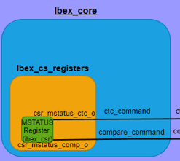
Control status registers (CSR)
Allows activation of output comparator as software instruction in desired code areas.
Allows error injection as software instruction for validation proposes.
Error injection signal is named CTC – “Check The Checker”.
Register name | Bits | Description | Permissions
CSR_REG_MSTATUS | [4:4] | Enable output comparator | R/W
CSR_REG_MSTATUS | [5:5] | Inject error in main core | R/W

Slide 17
Control status registers (CSR)
Output comparator is activated through software command during the boot process:
The comparator is disabled also through software command as a temporarily solution, in the future it will be deactivated right after finishing the boot process.

Slide 18
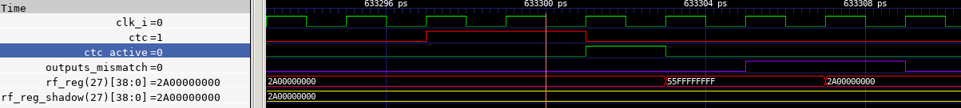
Control status registers (CSR)
CTC is activated through software command during the boot process:
It remains active for only two clock cycles, which is sufficient to inject an error into the main core.
As a temporarily solution, the error injection process negates the values of all registers in the main core.
In a future the injection will happen at random bits within the core’s registers, which will simulate more accurate attack scenario.

Slide 19
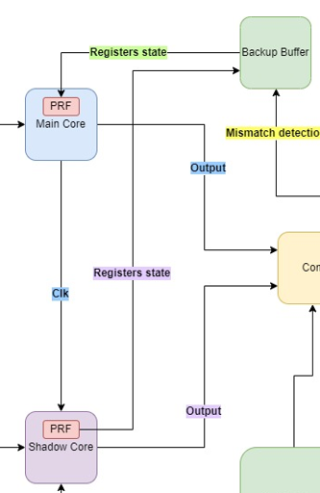

System recovery
Under the assumption that the attack is executed only on the main core, the simulation steps are:
Error injected in simulation.
Register 27 value in main core changes from correct value to faulty value.
Wrong register values causing output mismatch between two cores , the mismatch is detected by the comparator.
Restore system pushes the correct values from shadow core to main core.
Outputs from both cores return to being equal.

Slide 20
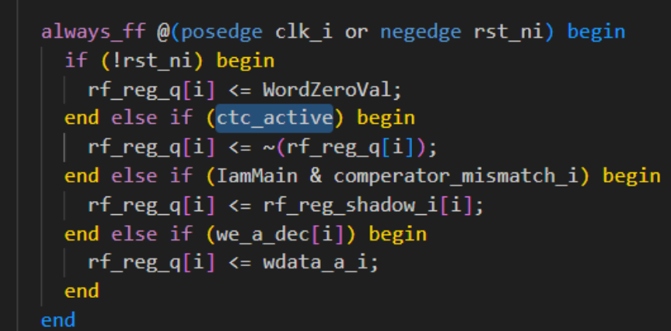
System recovery
Main core’s register file modification.
Main core’s registers are recovered by shadow core’s registers.
Select | Write data | Cores supported
reset | 32’b0 | both
ctc_active | Data flip | Main core
Comparator mismatch | Data from shadow core | Main core
Write to register | Wdata | both

Slide 21
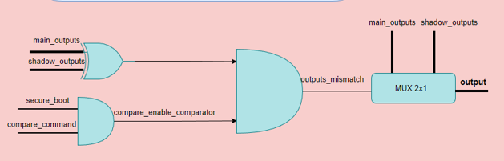
System recovery
In order to maintain uninterrupted operation during the recovery of the main core, the shadow core will be employed as the primary core.
Once the main core fully recovered, it will regain control, and its output will be utilized for further execution until the next mismatch occurs.
This is a temporary solution; in the future, our plan is to implement a more comprehensive recovery mechanism that is better suited for real systems.

Slide 22

Software modifications

Slide 23
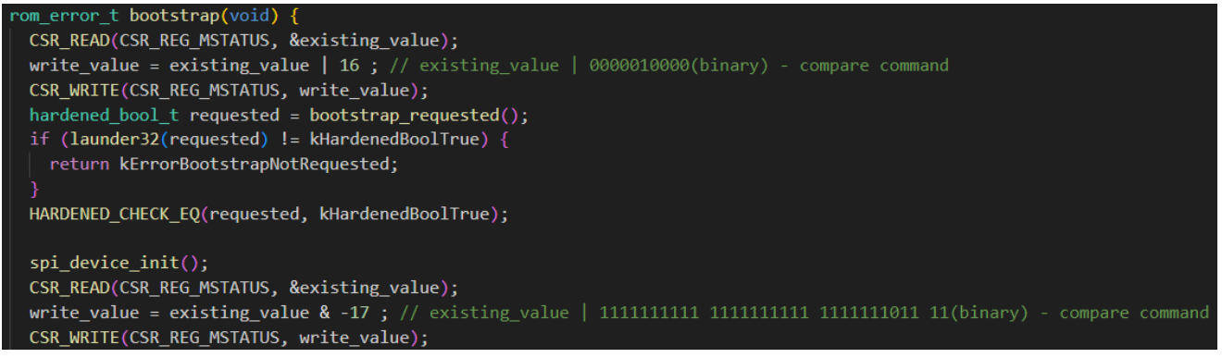
Compare command
Using CSR_WRITE() to enable/disable comparisons.
Can be implemented for desired stages during boot ROM code.
Before CSR_WRITE(0 we use CSR_READ() to keep the original values of MSTATUS register unmodified except for the desired bits.

Slide 24

validation

Slide 25
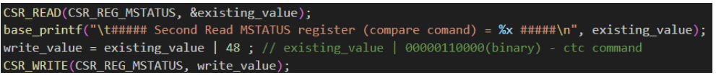
Validation – error injection
The idea is to inject an error – bit flips in main core’s registers to cause a wrong output in the main core.
We look at the waveforms and check that the output mismatch was detected and that the registers recovery is working.
Requires additional hardware support.

Slide 26
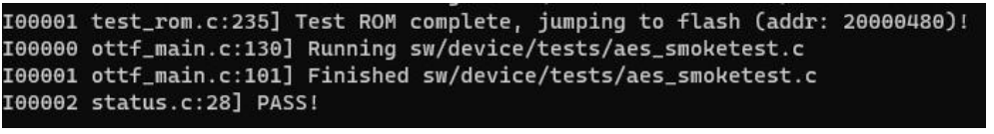
Validation – open titan
We used OpenTitan’s Functional Validation environment and tests to ensure our modifications didn’t break existing code.
ROM tests | Results
No comparisons | Pass
With comparisons | Pass
With error injections | pass

Slide 27

conclusions

Slide 28
Learnings
OpenTitan project
RISC-V Ibex core
Secure boot
Fault injection attacks

Slide 29
Future research
System implementation on FPGA
Performance evaluation (power/area)
Mechanism to decide which core is correct in case of mismatch
Improvements to recovery system
Improve validation for fault injection
Skew in timing between both cores’ execution

Slide 30
summary
Dual core secure boot as fault injection attack mitigation
Software controlled mitigation
System recovery after attack
System validation
Validation with error injection
Boris Bukchin buboris@campus.technion.ac.il
Sergey Mashkin sergeymas@campus.technion.ac.il
Avi Mendelson mendlson@technion.ac.il
https://github.com/planetofwar/SecureBoot

