Slide 1

Secure Boot on risc-v dual core
BY Boris bukCHIN, SERGEY MASHKIN
Instructor: avi Mendelson
Winter 2022
Project id: 7040
midterm presentation

Slide 2
background
Modern secure multi core systems use single core to run boot sequence.
The boot sequence code is checked against cryptographic signature to validate it’s authenticity on dedicated hardware.
Checked boot sequence preformed on a single core.
All cores start working.
Operating system code is validated with crypto signature and starts on all cores.

Slide 3
Motivation
Current boot sequence is vulnerable to fault injection attacks.
Current systems aren’t secure from attacks after cryptographic validation.
Try new method to preform a more secure way to boot muti core systems.
Under assumption of single fault injection.

Slide 4
Goals
Understand all aspects of current secure boot sequence.
Try using dual core to run boot sequence and compare execution traces to validate code authenticity.
Roll cores back to safe execution after a fault detected.
Simulate the system and validate working secure boot.
Prove protection against fault injection in new system.
Measure Performance impact.

Slide 5
Tools
Secure boot system using “Open Titan” architecture.
Simulation environment for the system using Verilator.
Verilog development environment - Gvim.
Boot sequence development environment – C code.

Slide 6
Midterm goal
Characterization of current secure boot system.
Working simulation for secure boot.
Dual core secure boot hardware architecture specification.
Design review.

Slide 7
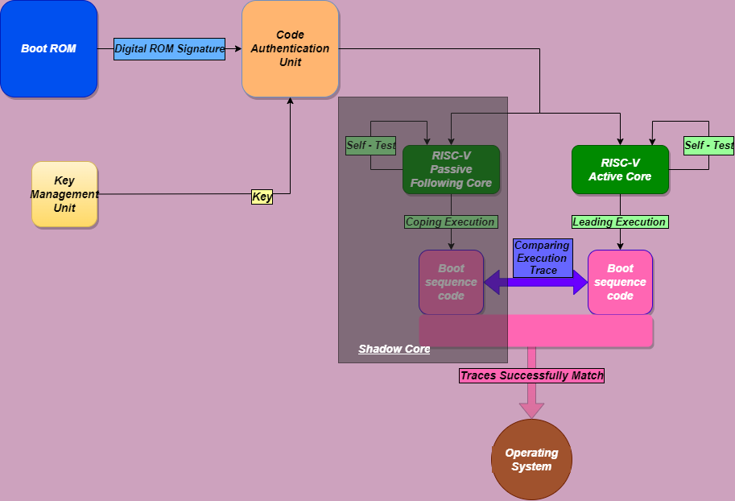
Block diagram

Slide 8
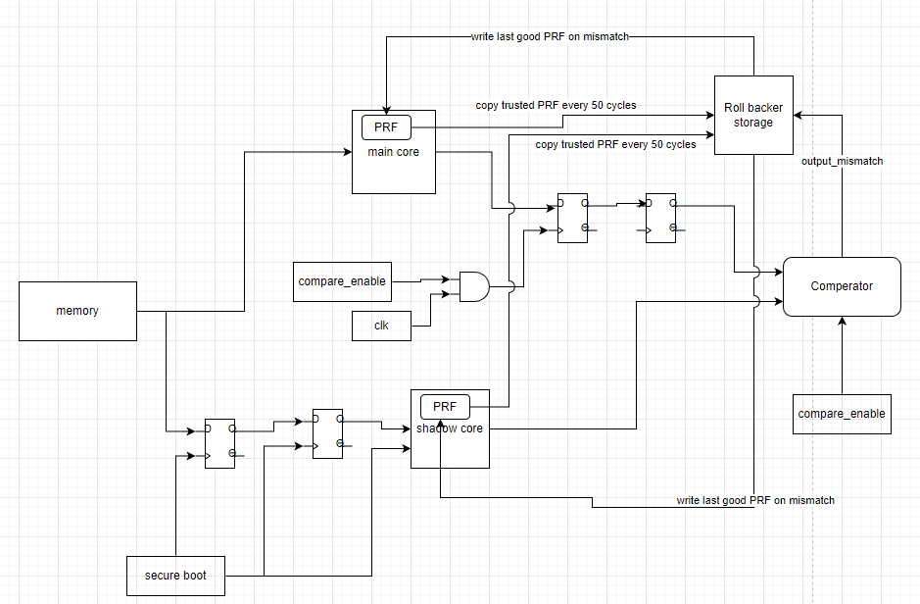
Block diagram

Slide 9
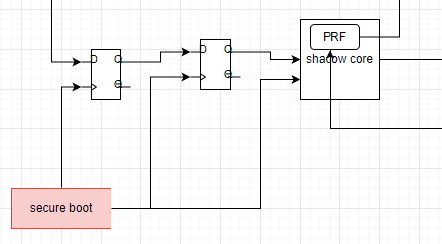
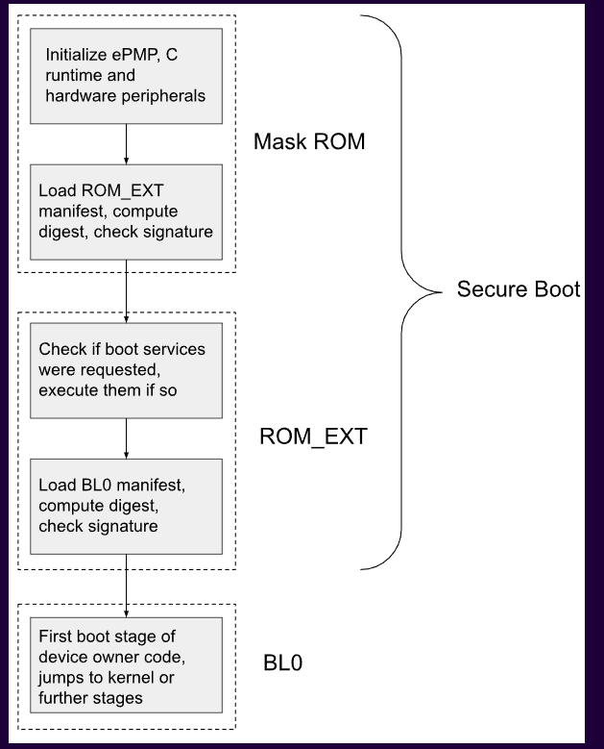
Boot Identifier
Start: Detecting request to start of read from ROM
End: Specific instruction in rom.c

Slide 10
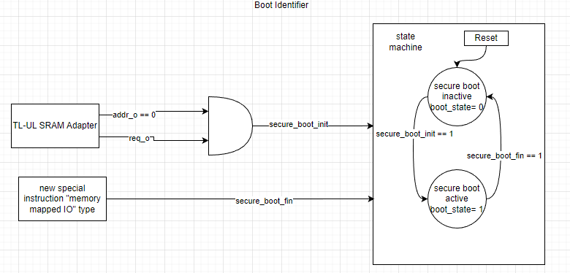
Boot Identifier
ROM accesses are requested over the TL-UL bus.
These come in through the TL-UL SRAM adapter.
At the end of the code, new instruction to force secure_boot_fin to 1 for one cycle.
Only when boot_state signal is 1 we’ll use the redundant core and output cooperator.

Slide 11
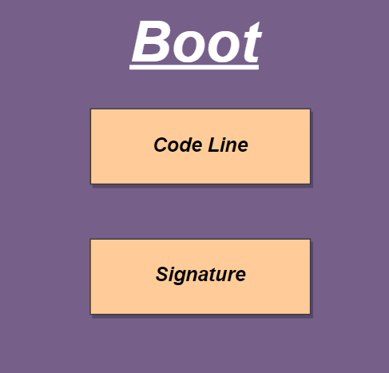
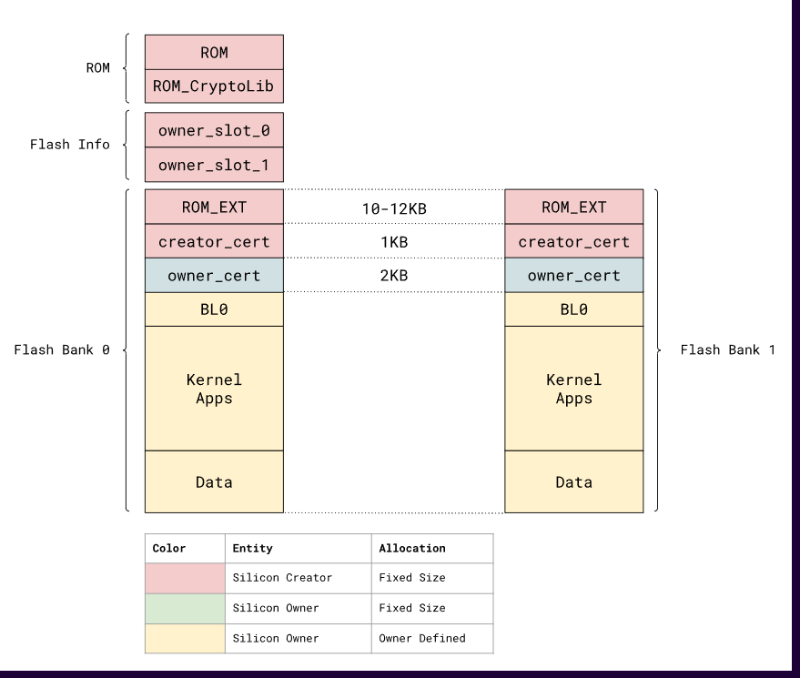
Boot rom/rom_ext
First stage in ROM.
Second stage in Flash.
Contains small secure executable code to initialize boot sequence.
Contains cryptographic signature.
Software modifications:
Instructions in code to compare specific outputs
Instruction to end secure boot phase.

Slide 12
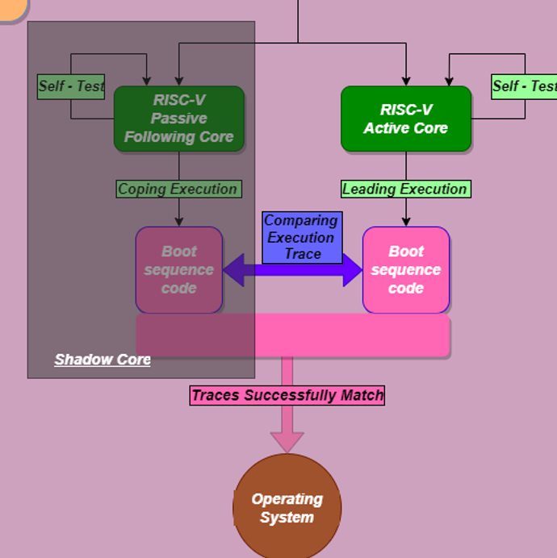
Shadow Core
Add additional core which will run simultaneously with the main core.
The shadow core receives same inputs as the main one but with some skew.
The shadow core will execute the same commands as the main one, without altering the main core output.
The output of the shadow core will go to the comparator for a validation with the main core output.

Slide 13
Shadow Core
Hardware requirements:
Instantiation of additional core.
Ibex wrapper adjustment to suit the shadow core.
Ensure that shadow core uses a different set of registers.

Slide 14
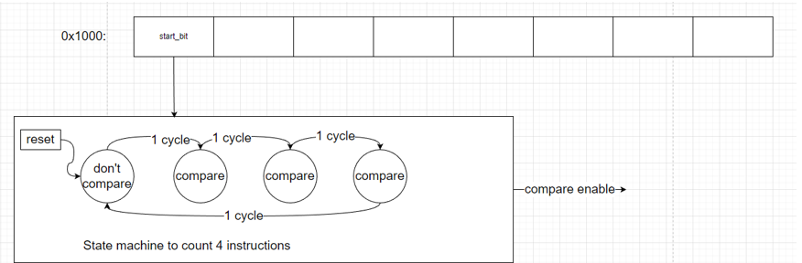
comparator
Comparator receives outputs from 2 cores and enable signal and compares the outputs.
In a case of a mismatch, it raises a flag a transfers control to a mismatch handler (Roll backer)
In order to speed up the process, comparison will be executed after every certain amount of instructions

Slide 15
comparator
Hardware requirements:
Instantiation of the comparator.
Software requirements:
Add a memory mapped IO instruction in in ROM/ ROM_EXT

Slide 16
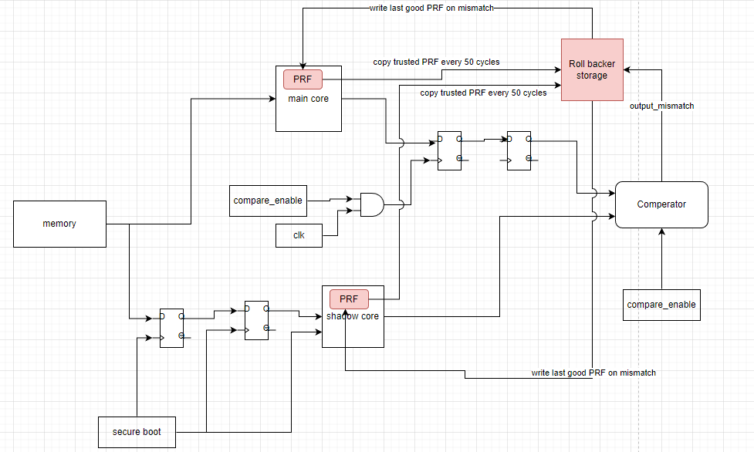
roll backer
Every X cycles store states.
Mismatch detected.
Cores load last trusted state

Slide 17
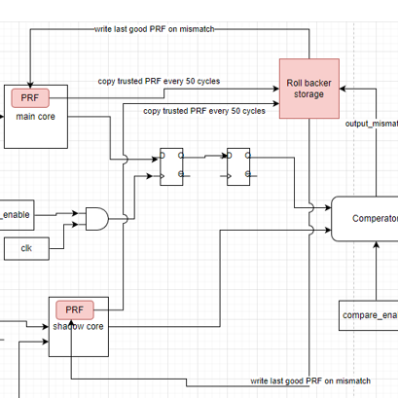
roll backer
Every X cycles copy_good_status will rise if no mismatch detected in this cycle.
Registers, PC and branch prediction tables will be copied.
When output_mismatch == 1:
Override the reg file of the main core and shadow core with the reg file saved in storage as last trusted.
Same with PC and BP.

Slide 18
Validation
No Harm
Correct work without software changes (rom/rom_ext)
Correct work with software changes, without injected faults.
Error Detection
Correct roll back in case of one fault.
Correct roll back in case of random number of faults in random time.
Comparison to unmodified system functional behavior.
Performance
Measure performance penalty.
Measure performance of roll back to reboot alternative.
Evaluate speedup of 3rd core for future work.

Slide 19
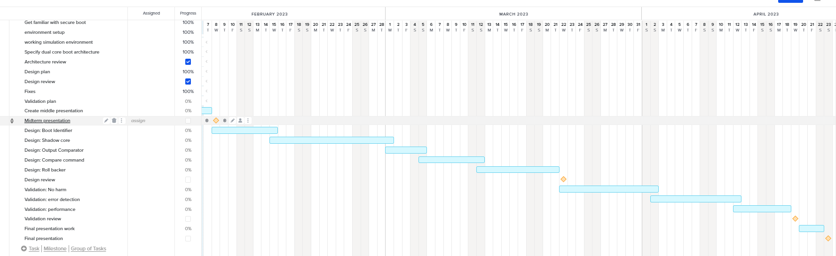
Gantt chart

