Slide 1

Secure Boot on risc-v dual core
BY Boris bukCHIN, SERGEY MASHKIN
Instructor: avi Mendelson
Winter 2022
Project id: 7040
Characterization presentation

Slide 2
background
Modern secure multi core systems use single core to run boot sequence.
The boot sequence code is checked against cryptographic signature to validate it’s authenticity on dedicated hardware.
Checked boot sequence preformed on a single core.
All cores start working.
Operating system code is validated with crypto signature and starts on all cores.

Slide 3
Motivation
Current boot sequence is vulnerable to fault injection attacks.
Current systems aren’t secure from attacks after cryptographic validation.
Try new method to preform a more secure way to boot muti core systems.
Under assumption of single fault injection.

Slide 4
Goals
Understand all aspects of current secure boot sequence.
Try using dual core to run boot sequence and compare execution traces to validate code authenticity.
Simulate the system and validate working secure boot.
Prove protection against fault injection in new system.
Using simulation of a simple attack.

Slide 5
Tools
Secure boot system using “Open Titan” architecture.
Simulation environment for the system.
Verilog development environment.
Boot sequence development environment.

Slide 6
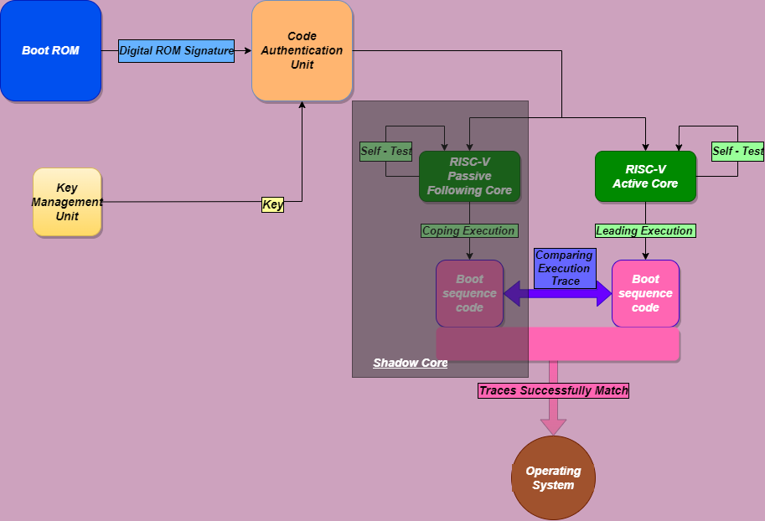
Block diagram

Slide 7
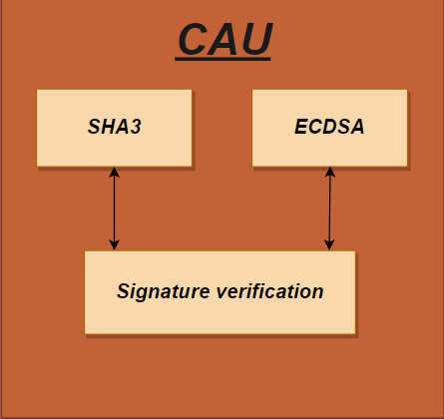
CAU
A hardware component called Code Authentication Unit.
cryptographically verifies the signature of each trusted code that will be running on the processor using Elliptic Curve Digital Signature Algorithm.
CAU verifies each software code that is to be executed, starting from the first boot up to the applications.

Slide 8
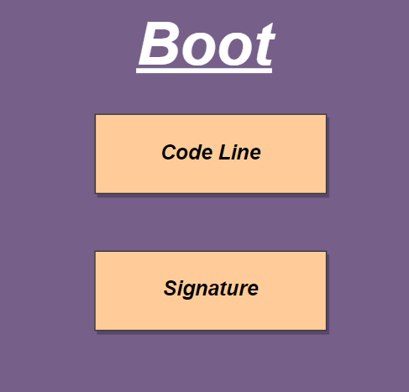
Boot rom
Read only memory.
Contains small secure executable code to initialize boot sequence.
Contains cryptographic signature.

Slide 9
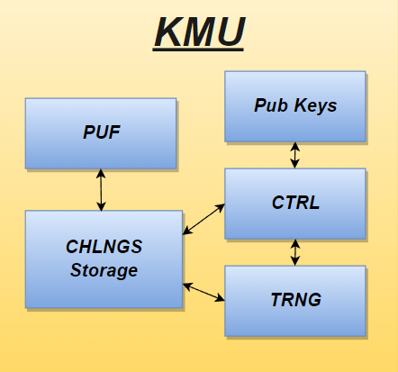
KMU
The Key Management Unit (KMU) is responsible for the generation and distribution of symmetric and asymmetric encryption keys.
it consists of True Random Number Generator (TRNG), Physical Unclonable Function (PUF), Challenges Storage and One-Time Programmable (OTP) memory.

Slide 10
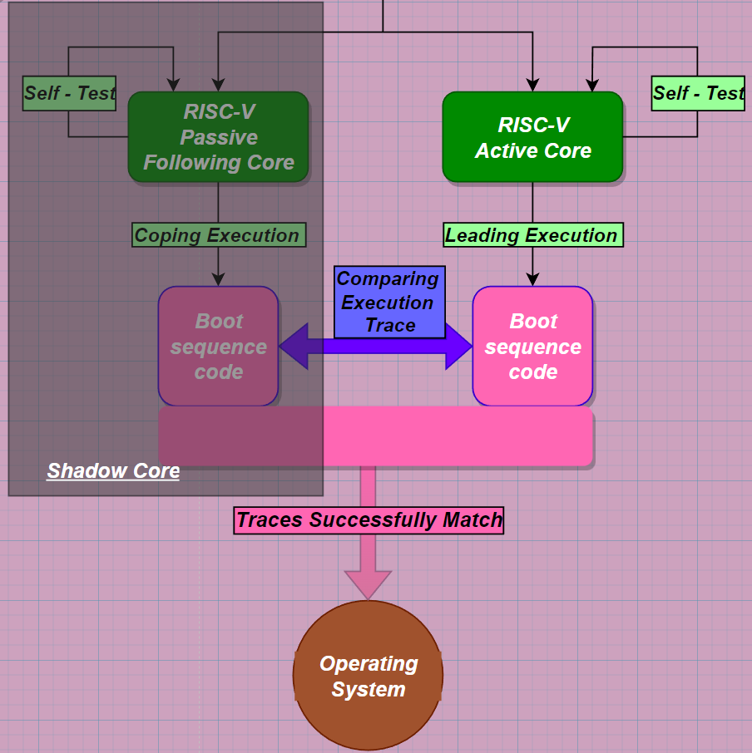
Dual core secure
Two risc-v cores executing boot sequence.
Active core booting system.
Passive core validates right code execution on active core.
Trace comparison unit allows operating system to boot only if traces are identical on both cores.

Slide 11
Midterm goal
Characterization of current secure boot system.
Working simulation for secure boot.
Dual core secure boot hardware architecture specification.
Design review.

Slide 12

Gantt chart

