Slide 1

Edit a Zoomin Page

Slide 2
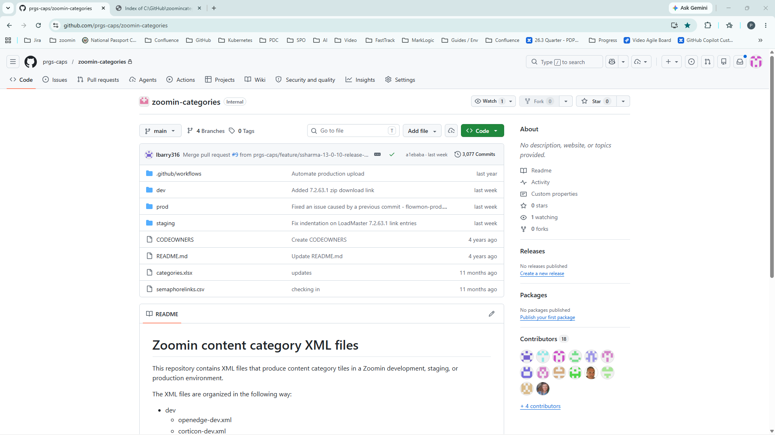
Notes:
Step 1: [Add narration for this step]\nImage path: D:\GitHub\Video Production Apps\screenshot automater\screenshotautomation\screenshots\20260616_113437_0001.png

Slide 3
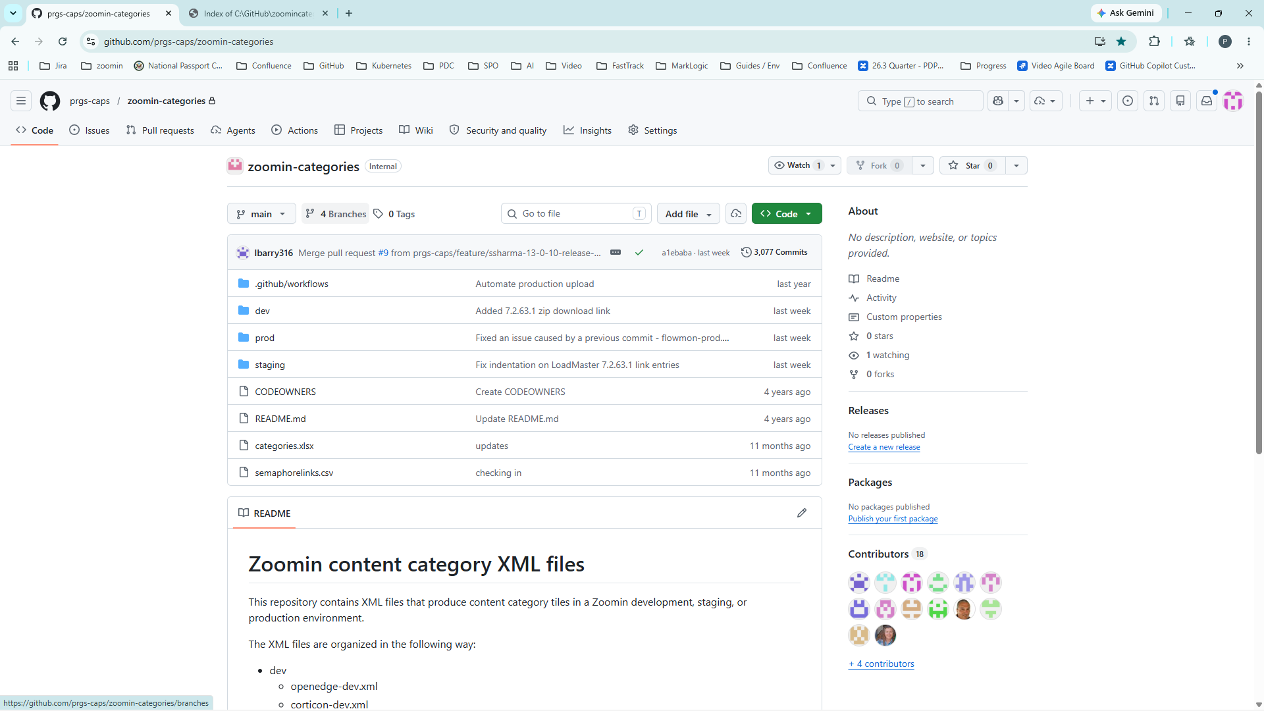
Notes:
Step 2: [Add narration for this step]\nImage path: D:\GitHub\Video Production Apps\screenshot automater\screenshotautomation\screenshots\20260616_113443_0002.png

Slide 4
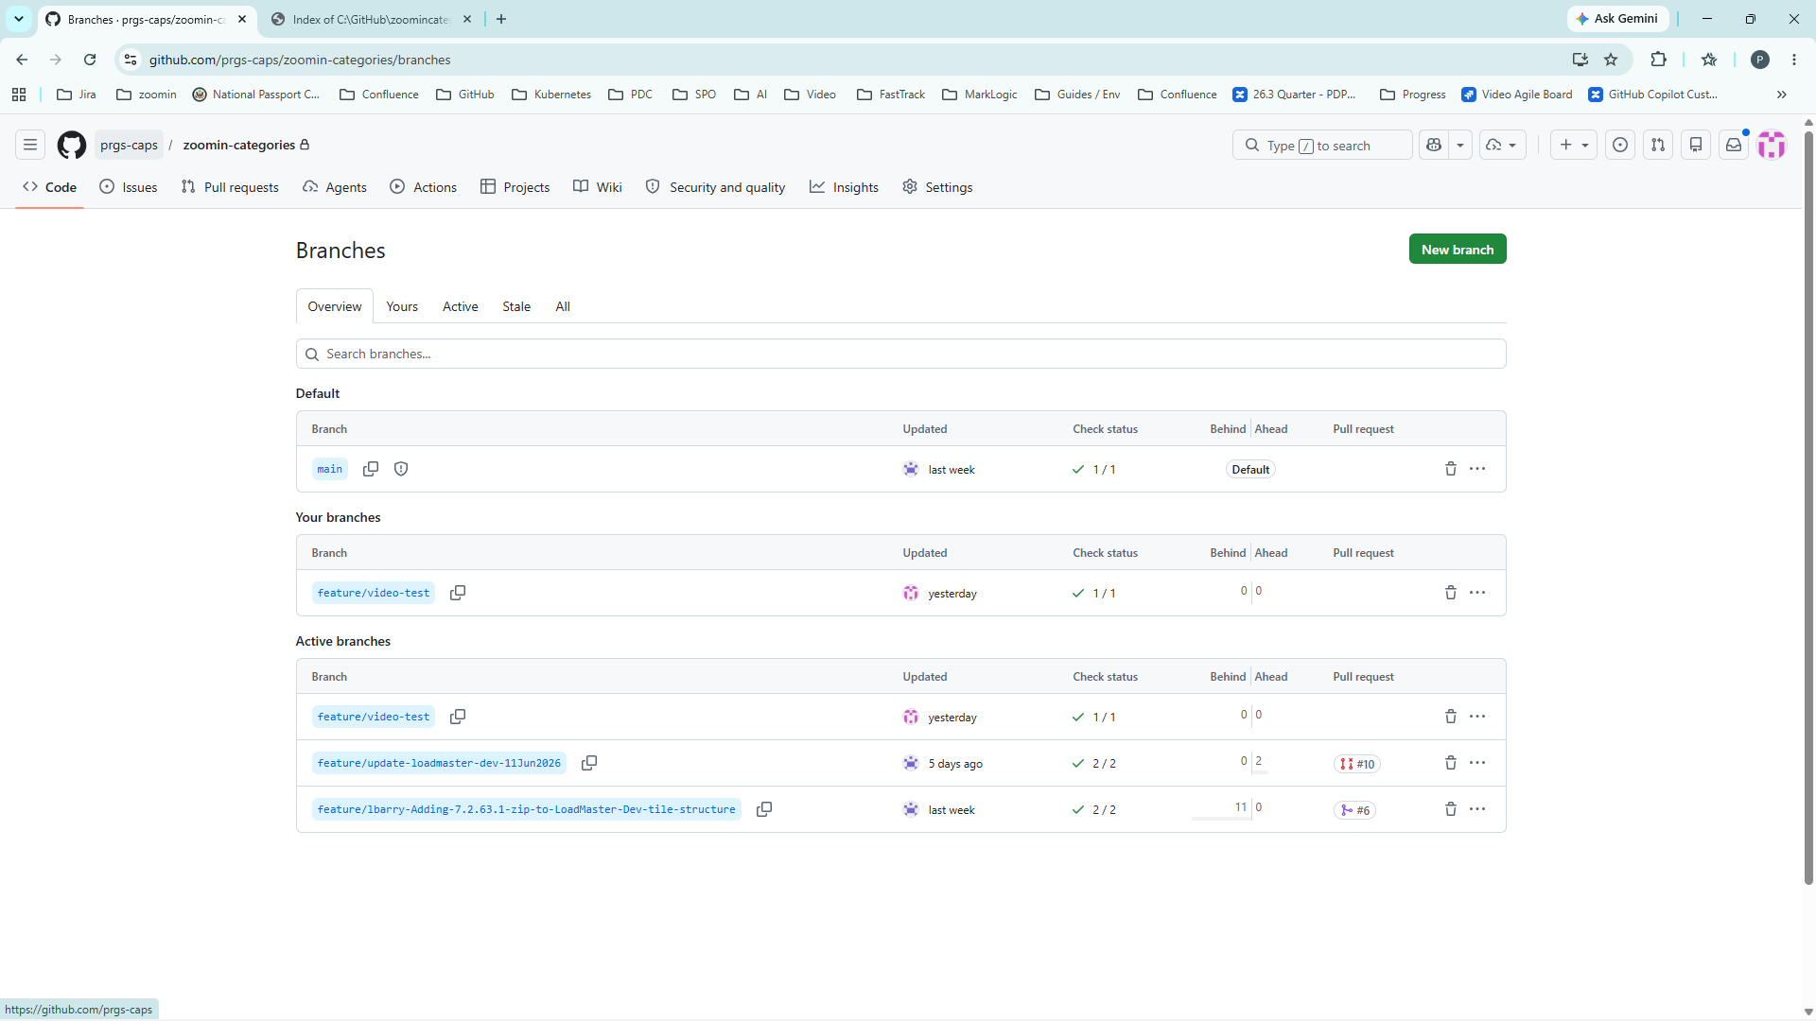
Notes:
Step 3: [Add narration for this step]\nImage path: D:\GitHub\Video Production Apps\screenshot automater\screenshotautomation\screenshots\20260616_113448_0003.png

Slide 5
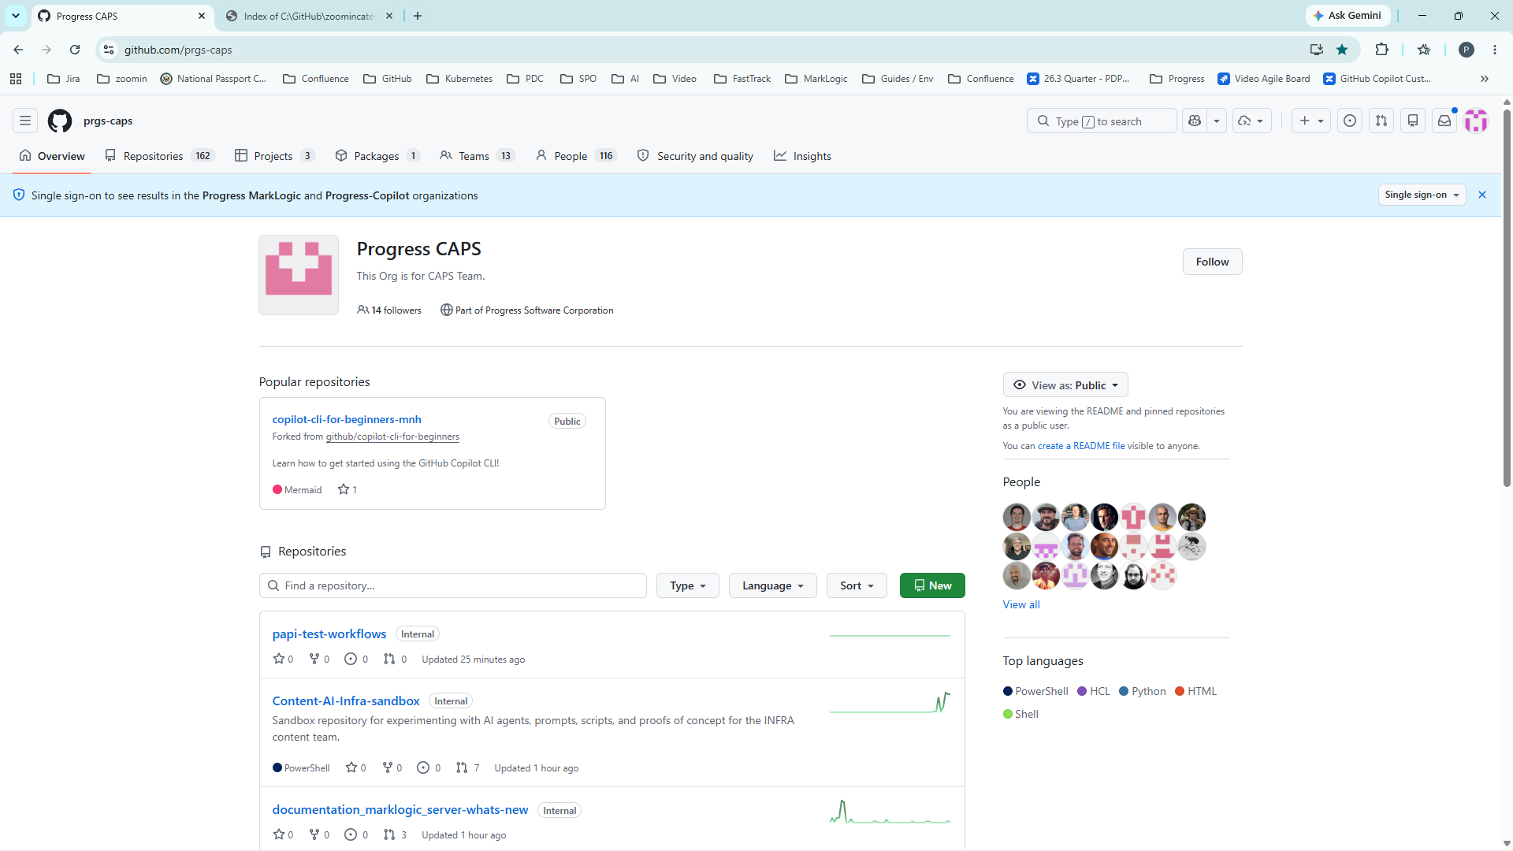
Notes:
Step 4: [Add narration for this step]\nImage path: D:\GitHub\Video Production Apps\screenshot automater\screenshotautomation\screenshots\20260616_113452_0004.png

