Slide 1
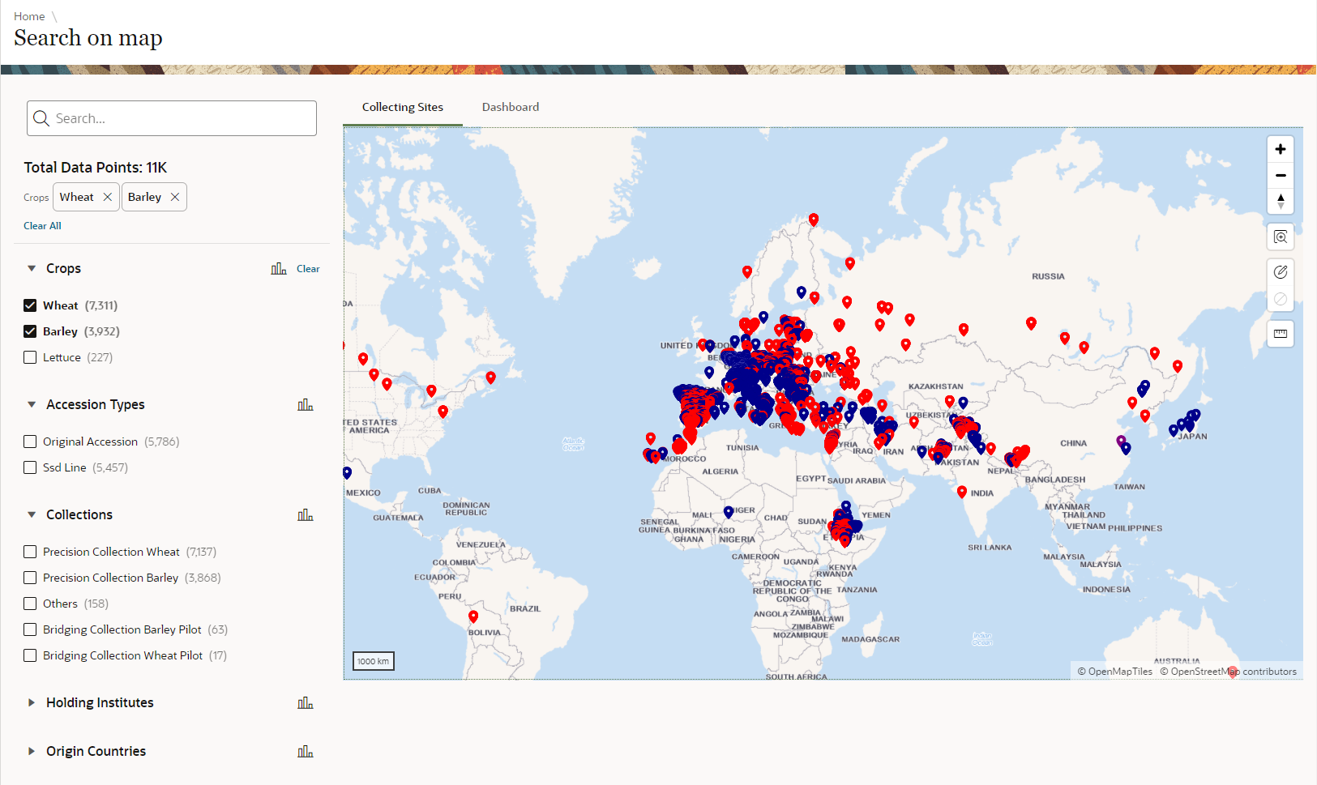








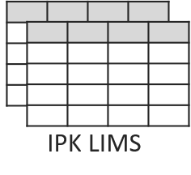
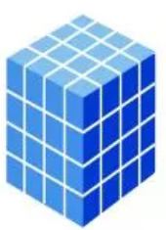
Frontend
Backend
AGENT native
Barley
Wheat
IPK Database Server
IPK DivBrowse Server
Tabular Phenotypic Data
Multidimensional Genotypic Data

Slide 2
