Slide 1
Agenda
Review of how OAuth/OIDC works
Demo
Questions / Work through specific scenarios

Slide 2
OAuth Components
Auth Server
User
Browser
BrAPI
Data Server
Client App Server

Slide 3
OAuth Flows (Grant Types)
Authorization Code Grant
Implicit Grant
Client Credentials Grant
Resource Owner Password Credentials Grant

Slide 4
Implicit Grant Flow
GET Login Page
Auth Server
User
Login
Pass
User
Browser
BrAPI
Data Server
Client App Server
GET website

Slide 5
Implicit Grant Flow
POST Credentials
Auth Server
301 Redirect
With Token
GET
Data
GET Website
With Token
User
Browser
BrAPI
Data Server
GET Website
With Token
Client App Server

Slide 6
Implicit Grant Flow
Auth Server
GET Data
With Token
User
Browser
BrAPI
Data Server
Client App Server
GET Data
With Token

Slide 7
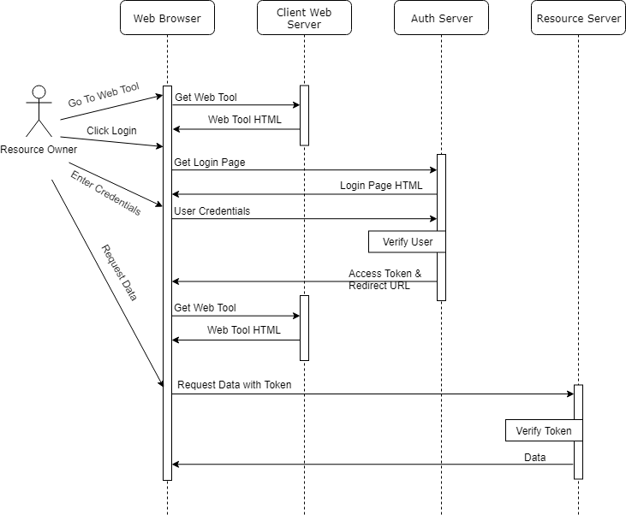
Implicit Grant Flow

Slide 8
OIDC
Open ID Connect adds an extra layer of functionality on top of OAuth2 designed to facilitate user identity and permissions.
In practice, this means an additional token called and ID Token which represents the users identity and is passed with the Access Token.
For most BrAPI purposes the ID Token is not required.
So why do we care about OIDC?

Slide 9
OIDC Discovery
OIDC Discovery is a feature of OIDC. It provides a public JSON file at a well known location that contains all the URLs and acceptable parameters to connect to a given Auth server. This is extremely useful when dealing with multiple Auth servers and having a standard way to import settings
{
"issuer": "https://brapi.org/brapi",
"authorization_endpoint": "https://brapi.org/brapi/oidc/auth",
"jwks_uri": "https://brapi.org/brapi/oidc/certs",
"token_endpoint": "https://brapi.org/brapi/oidc/token",
"grant_types_supported": ["implicit", "authorization_code"],
"response_types_supported": ["token", "code", "id_token"],
...
}

Slide 10
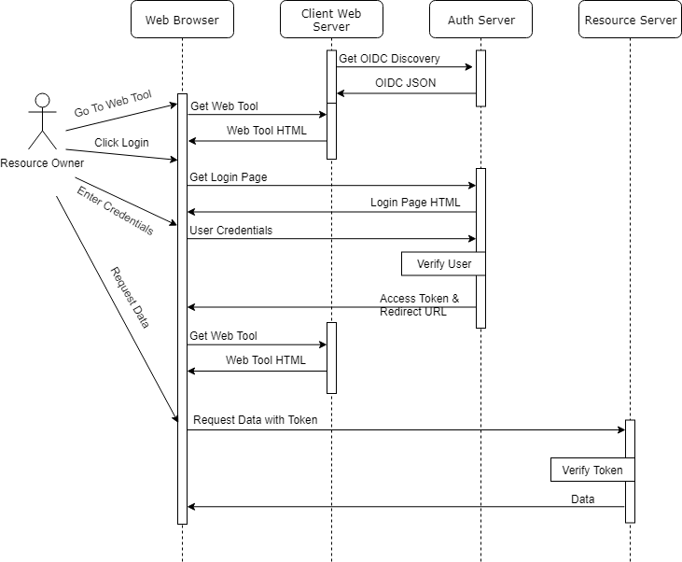
Implicit Grant Flow

Slide 11
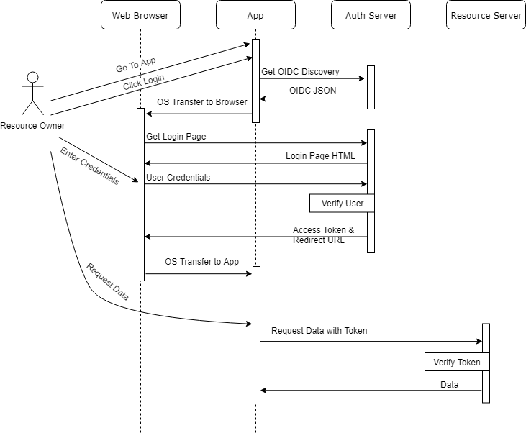
Implicit Grant Flow
With Field Book

Slide 12
Examples
OIDC Discovery Examples
https://brapi.org/json/oidc-min.json
https://test-server.brapi.org/.well-known/openid-configuration
Implicit Grant Flow Example
https://brapi.org/oauth

Slide 13
Future Recommendations
“Don’t roll your own crypto” - Gary McGraw
Find a library or service that handles the OAuth/OIDC handshake
Support full OAuth/OIDC functionality
Use JWT tokens
Key Cloak – Standalone user management service
ORY Hydra – Customizable plugin to existing user management
WS02, Apigee, Mulesoft – API managers w/ security
External Provider – ORCID, Google, Github, etc

