Slide 1
OAuth 2.0 for BrAPI
Los Banos Hackathon, June 2025

Slide 2
Agenda
OAuth Conceptual Components
OAuth Flows
OIDC
Live Demo
Resources and general recommendations
Questions and specific use cases

Slide 3
OAuth Components
Auth Server
User
Browser
BrAPI
Data Server
Client App Server

Slide 4
OAuth Flows (Grant Types)
Authorization Code Grant
Implicit Grant
Client Credentials Grant
Resource Owner Password Credentials Grant

Slide 5
Implicit Grant Flow
GET Login Page
Auth Server
User
Login
Pass
User
Browser
BrAPI
Data Server
Client App Server
GET website

Slide 6
Implicit Grant Flow
POST Credentials
Auth Server
301 Redirect
With Token
GET
Data
GET Website
With Token
User
Browser
BrAPI
Data Server
GET Website
With Token
Client App Server

Slide 7
Implicit Grant Flow
Auth Server
GET Data
With Token
User
Browser
BrAPI
Data Server
Client App Server
GET Data
With Token

Slide 8
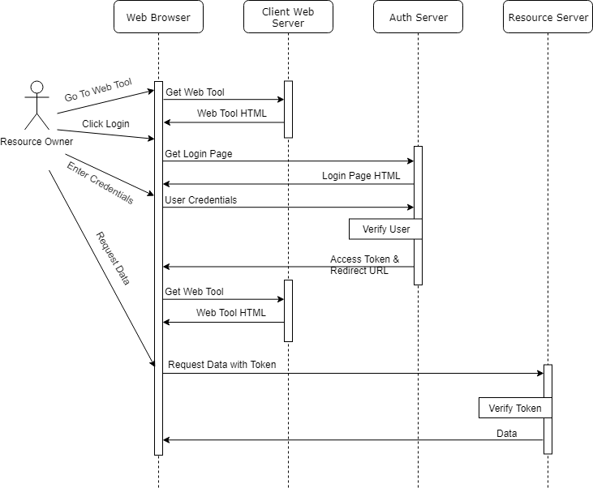
Implicit Grant Flow

Slide 9
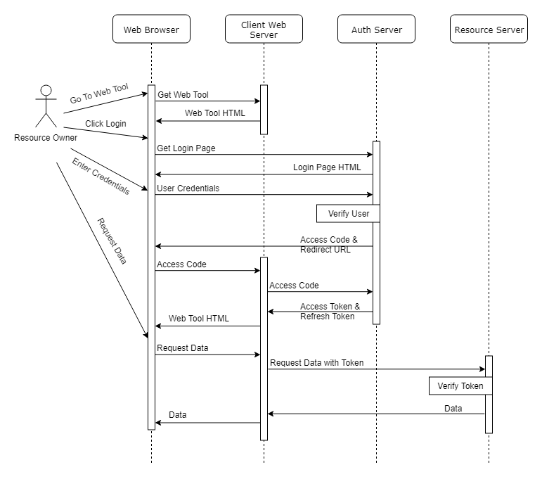
Authorization Code
Grant Flow

Slide 10
OIDC
Open ID Connect adds an extra layer of functionality on top of OAuth2 designed to facilitate user identity and permissions.
In practice, this means an additional token called and ID Token which represents the users identity and is passed with the Access Token.
For most BrAPI purposes the ID Token is not required.
So why do we care about OIDC?

Slide 11
OIDC Discovery
OIDC Discovery is a feature of OIDC. It provides a public JSON file at a well-known location that contains all the URLs and acceptable parameters to connect to a given Auth server. This is extremely useful when dealing with multiple Auth servers and having a standard way to import settings
{
"issuer": "https://brapi.org/brapi",
"authorization_endpoint": "https://brapi.org/brapi/oidc/auth",
"jwks_uri": "https://brapi.org/brapi/oidc/certs",
"token_endpoint": "https://brapi.org/brapi/oidc/token",
"grant_types_supported": ["implicit", "authorization_code"],
"response_types_supported": ["token", "code", "id_token"],
...
}

Slide 12
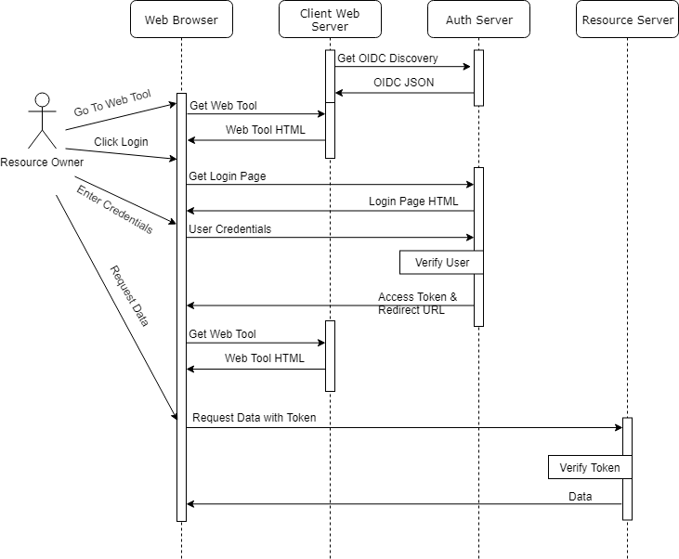
Implicit Grant Flow

Slide 13
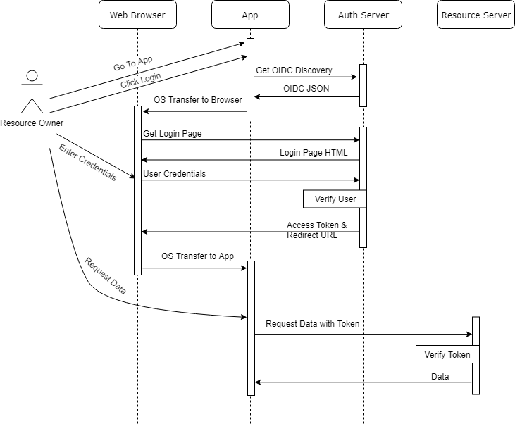
Implicit Grant Flow
With Field Book

Slide 14
Resources
OIDC Discovery Examples
https://brapi.org/json/oidc-min.json
https://test-server.brapi.org/.well-known/openid-configuration
Authorization Code Flow Example
https://brapi.org/oauth

Slide 15
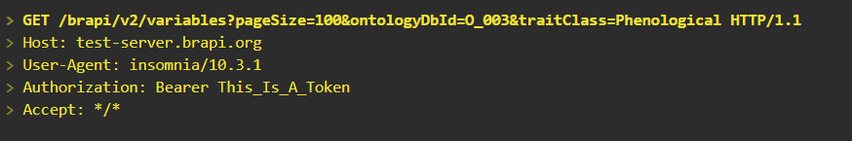
Auth and BrAPI
The spec supports the HTTP Header Authorization where the value is a token of some kind the server can use to validate the request
The BrAPI Spec doesn’t care what authentication you use…

Slide 16
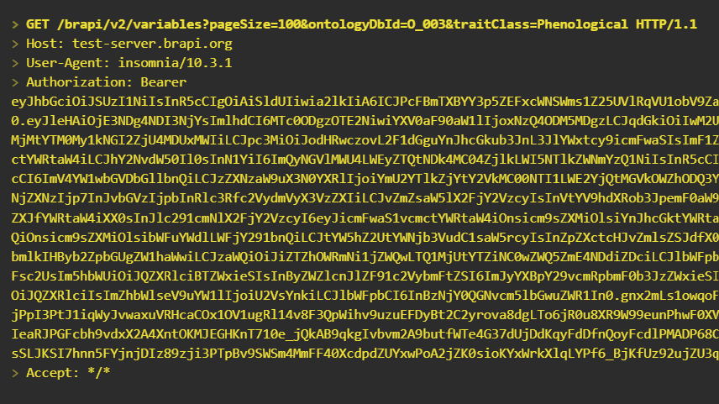
Auth and BrAPI
… but the BrAPI community does care!
Using standard authorization schemes, like OAuth2, make it easier to provide interoperability between tools and data.

Slide 17
Auth and BrAPI
Coming Soon:
Authorization information embedded in the BrAPI Server Info for easy access.
https://github.com/plantbreeding/BrAPI/issues/552

Slide 18
Recommendations
Do:
Find a library or service that handles the OAuth/OIDC handshake
Support full OAuth/OIDC functionality
Use JWT tokens
Don’t:
“Don't write your own authentication code.” – Remy Porter
Don’t use the old “/brapi/v1/token” endpoints. These are not secure or correct.

Slide 19
Recommendations
Key Cloak – Standalone user management service
ORY Hydra, Spring Security – Customizable plugin to existing user management
WS02, Apigee, Mulesoft – API managers w/ security
External Providers
OpenID Connect, University SSO, ORCID, Github, Google, Facebook, Twitter, etc
Search for any of these plus “alternative” to find something that works for you.

