Slide 1

Bioflow
The CGIAR Breeding Analytics Pipeline
Khaled Al-Shamaa
BrAPI Hackathon
3 June 2025

Slide 2







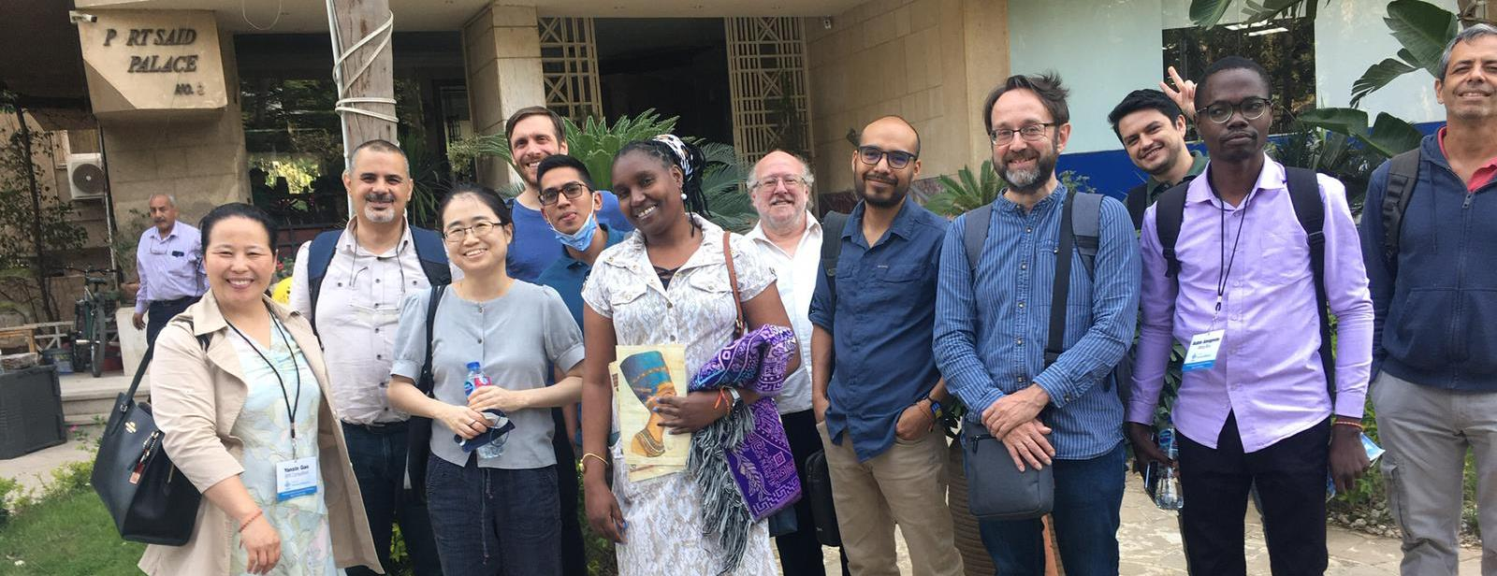
Who is Involved in the Bioflow Initiative?
F2F CGIAR Breeding Analytics Technical Workshop, 15-19 May 2023, Cairo

Slide 3
Bioflow’s Main Goals
Instant access to cutting-edge methods and one-stop breeding analysis for CGIAR centers breeding programs and NARES.
Standardize data analysis pipelines across CGIAR centers breeding programs and NARES.
Faster breeding decisions and less human error.
Reduce reliance on manual time-consuming inquiries.
Quick and easy access to breeding data and metrics for evaluation of breeding program performance giving scientists more time to focus on new methods.

Slide 4
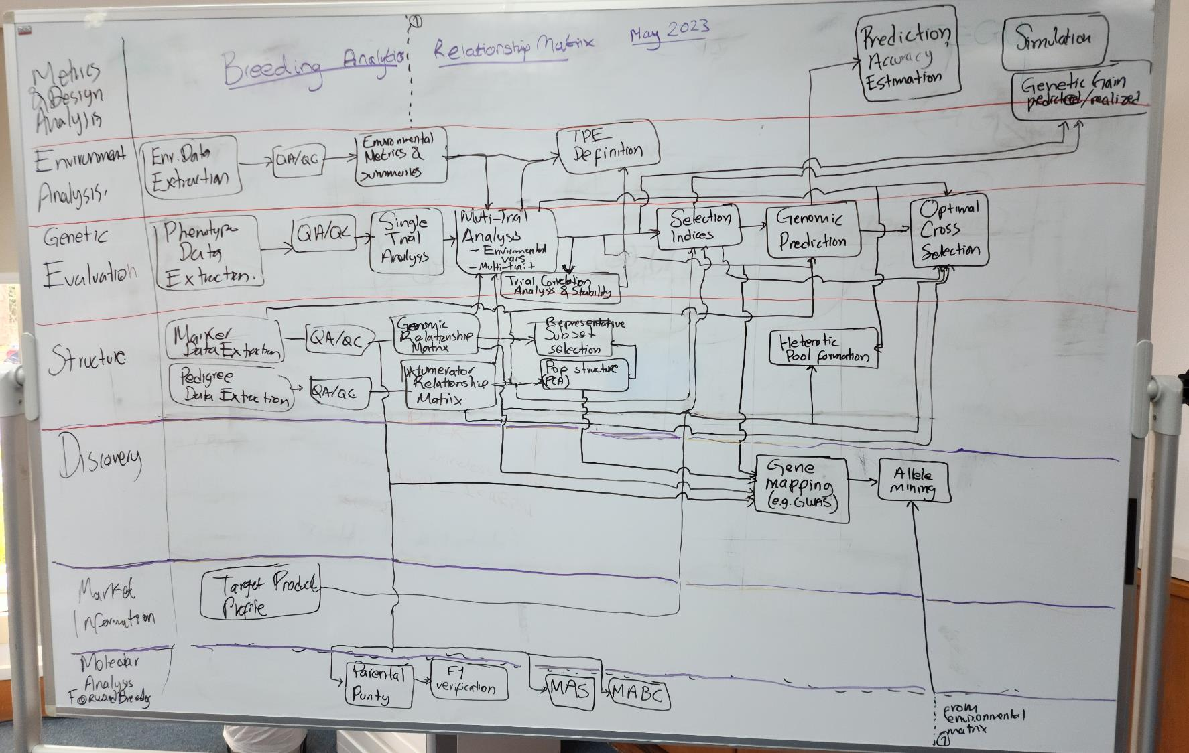
The Spark: From Concept to Vision

Slide 5
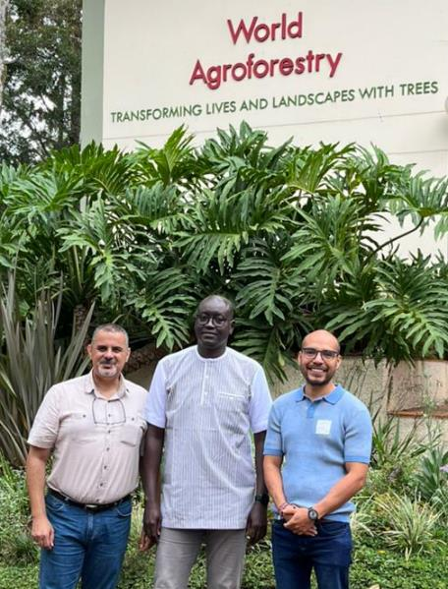
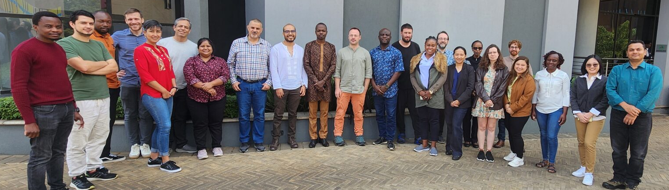
Project Kick-Off: Turning Vision into Action
In late 2023, Breeding Resources commissioned a fast-track team of biometricians, including Giovanny Covarrubias (IRRI), Ibnou Dieng (IITA) and Khaled Al-Shamaa (ICARDA), to spearhead the analytical pipeline, under
the endorsement of Genetic Innovation leadership.
1st Bioflow Hackathon, 12-16 Feb 2024, Nairobi
2nd Bioflow Hackathon, 11-14 Nov 2024, Nairobi
Fast-Track Team
1-5 Nov 2023, Nairobi

Slide 6





















TPE
Env
SI
Output Results
Input Data
QC
MET
Predictions
Selection Indices
Genetic Gain
Optimal Cross
Allele Mining
etc.
Phenotypic
Marker
Pedigree
Environment
etc.
STA
GS
A
GWAS
G
etc.
K
Backend Modular Analysis Pipeline (Batch Mode)

Slide 7
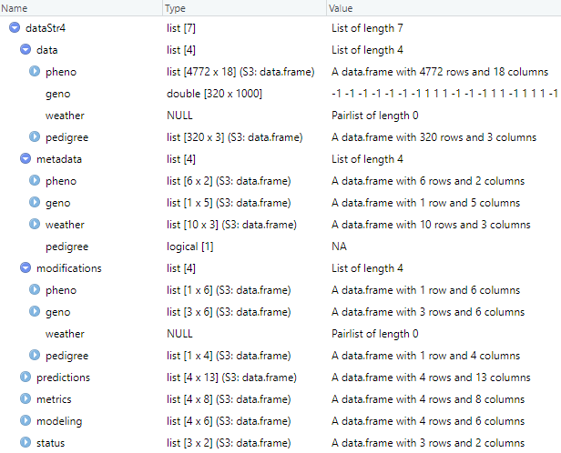

Isolated Modular Structure
Data-Centric Architecture
Load
QA
Data Obj.
STA
MTA

Slide 8





Status
Modeling
Module Outputs
Module | Analysis ID
QA | 1700032726
QA | 1700040274
STA | 1700053491
Parameter | Value
Fixed Formula | ~geno
Random Formula | ~env+geno.env
h2 Upper Bound | 0.2
(timestamp <- as.numeric(Sys.time()))
as.POSIXct(timestamp, origin="1970-01-01", tz="GMT")
Metrics
Common Analysis Signature
Parameter | Method | Value | stdError
h2 | vg/(vg+ve) | 0.28 | 0.07
CV% | SD/mean | 0.12
Module | Analysis ID | Trait | Env
STA | 1700053491 | GY | ABC_2023
Predictions
Data Obj.
Designation | Predicted Value | stdError | Reliability
XYZ001 | 1026.4 | 28.7 | 0.993
XYZ002 | 879.3 | 43.6 | 0.978

Slide 9
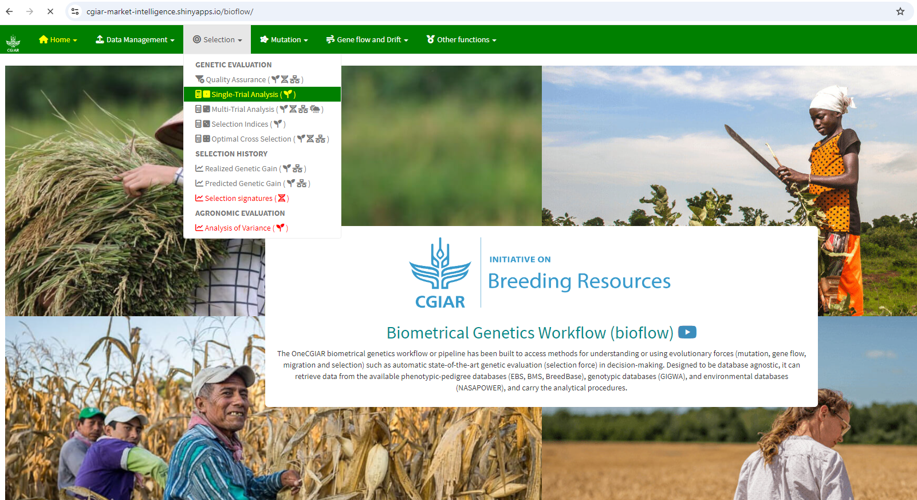
Quick Live Demo
Sandbox Demo: https://cgiar-market-intelligence.shinyapps.io/bioflow (no credentials required).
Production Server: https://bioflow.ebsproject.org (required registration at the CGIAR Service Portal).

Slide 10
Additional Resources
Breeding Analytics Pipeline page at the CGIAR Breeding Resources Initiative solutions list.
Launch webinar: CGIAR Biometrical Genetics Workflow or Breeding Analytics Pipeline.
Breeding Analytics Pipeline video tutorials.
CGIAR BRI announce the soft launch of CGIAR Breeding Analytics Pipeline enables complex quantitative genetic analyses for CGIAR crop breeders.
Strengthening global plant breeding: the innovation journey of CGIAR Breeding Analytics Pipeline (1st Bioflow hackathon).
CGIAR experts convene in Nairobi for Breeding Analytics Pipeline Hackathon (link).
Bioflow gets smarter with new modules and cloud features (link).

Slide 11
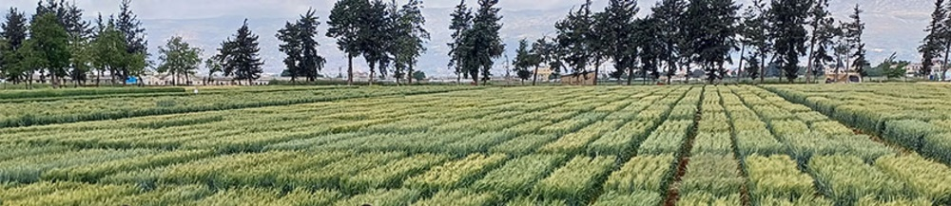

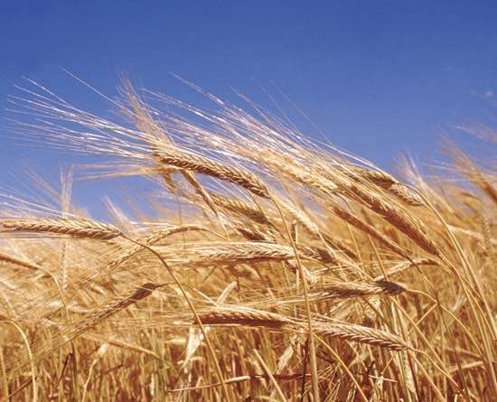
Thank You
Questions?

