Slide 1
Agenda
Review of how OAuth/OIDC works in general (30-mins)
Demo of the new Field Book code (30-mins)
Review the instructions going from old Field Book auth to new Field Book auth (15 mins)
Develop and test new auth flows in all participating groups (As much time as needed)

Slide 2
OAuth Components
Auth Server
User
Browser
BrAPI
Data Server
Client App Server

Slide 3
OAuth Flows (Grant Types)
Authorization Code Grant
Implicit Grant
Client Credentials Grant
Resource Owner Password Credentials Grant

Slide 4
Implicit Grant Flow
GET Login Page
Auth Server
User
Login
Pass
User
Browser
BrAPI
Data Server
Client App Server
GET website

Slide 5
Implicit Grant Flow
POST Credentials
Auth Server
301 Redirect
With Token
GET
Data
GET Website
With Token
User
Browser
BrAPI
Data Server
GET Website
With Token
Client App Server

Slide 6
Implicit Grant Flow
Auth Server
GET Data
With Token
User
Browser
BrAPI
Data Server
Client App Server
GET Data
With Token

Slide 7
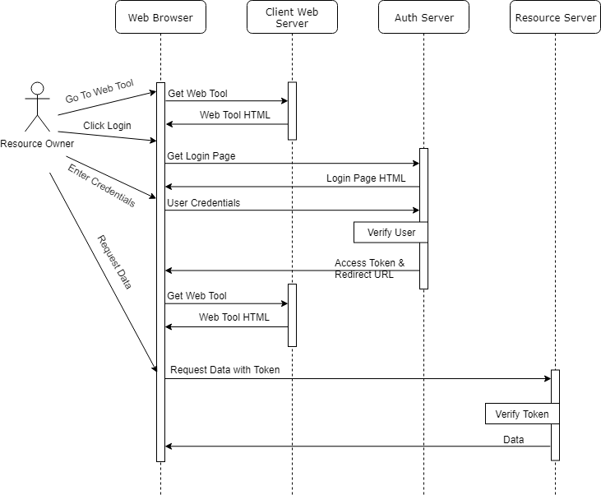
Implicit Grant Flow

Slide 8
OIDC
Open ID Connect adds a thin layer of functionality on top of OAuth2 designed to facilitate user identity and permissions.
In practice, this means an additional token called and ID Token which represents the users identity and is passed with the Access Token
Field Book does not currently use the ID Token, so full OIDC compliance is not required… yet…

Slide 9
OIDC Discovery
OIDC Discovery is a feature of OIDC. It provides a public JSON file at a well known location that contains all the URLs and acceptable parameters to connect to a given Auth server. This is extremely useful when dealing with multiple Auth servers and having a standard way to import settings
{
"issuer": "https://brapi.org/brapi",
"authorization_endpoint": "https://brapi.org/brapi/oidc/auth",
"jwks_uri": "https://brapi.org/brapi/oidc/certs",
"token_endpoint": "https://brapi.org/brapi/oidc/token",
"grant_types_supported": ["implicit", "authorization_code"],
"response_types_supported": ["token", "code", "id_token"],
...
}

Slide 10
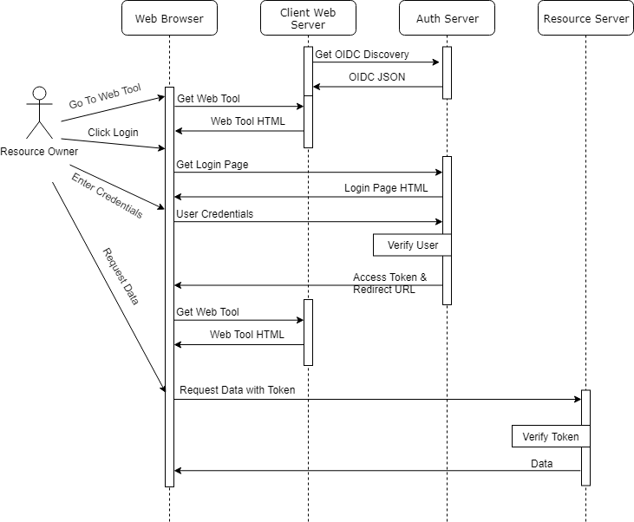
Implicit Grant Flow

Slide 11
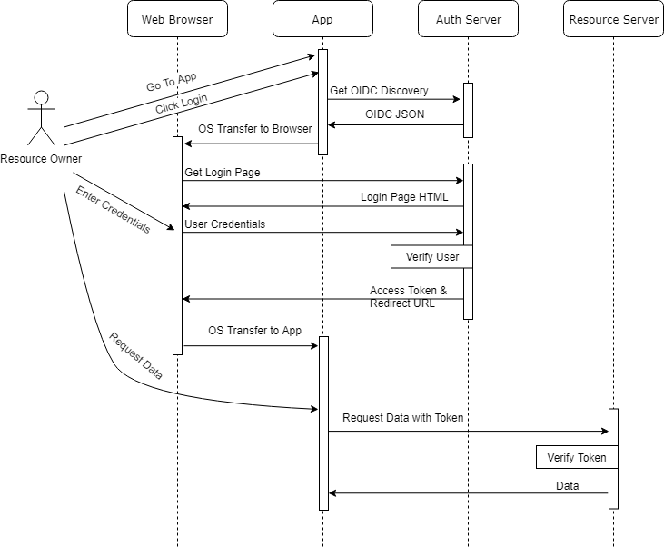
Implicit Grant Flow
With Field Book

Slide 12
Examples
OIDC Discovery Examples
https://brapi.org/json/oidc-min.json
https://test-server.brapi.org/.well-known/openid-configuration
Implicit Grant Flow Example
https://brapi.org/oauth

Slide 13
Today’s Objectives
Minimum Implicit Grant functionality
Minimum OIDC discovery file
Instructions to move from old FB auth flow to new OAuth2 flow
https://docs.google.com/document/d/1hFsw6PgZA5DpM1aPP1L58P5qF2PRiO7DgsY9nNDefpc

Slide 14
Future Recommendations
“Don’t roll your own crypto”
Find a library or service that handles the OAuth/OIDC handshake
Support full OAuth/OIDC functionality
Use JWT tokens
Key Cloak – Standalone user management service
ORY Hydra – Customizable plugin to existing user management
WS02, Apigee, Mulesoft – API managers w/ security
External Provider – ORCID, Google, Github, etc

