Slide 1
BrAPI 101
A Beginners Guide

Slide 2
What is BrAPI?
BrAPI is a …
Standardized
RESTful
Web Service
API
Specification
…for communicating plant breeding data

Slide 3


API – Application Programing Interface
User Interface
GUI
CMD
Hardware
Application Programing Interface
Web Service
Local Messaging Service
Job Queue
Language Library

Slide 4
Web Service
Service Consumer
Request
Response
Sends
2 and 3
Gets
5
A Service Provider contains some Service with well defined Inputs and Outputs
A Service Consumer sends a request to the Service Provider with the Input data, and waits for a response
The Service performs some Function on the Input data
The Service Provider sends the Output data as a Response back to the Service Consumer
Network
Service Provider
Service
X
Function
X + Y = Z
Z
Y
Inputs
Output

Slide 5
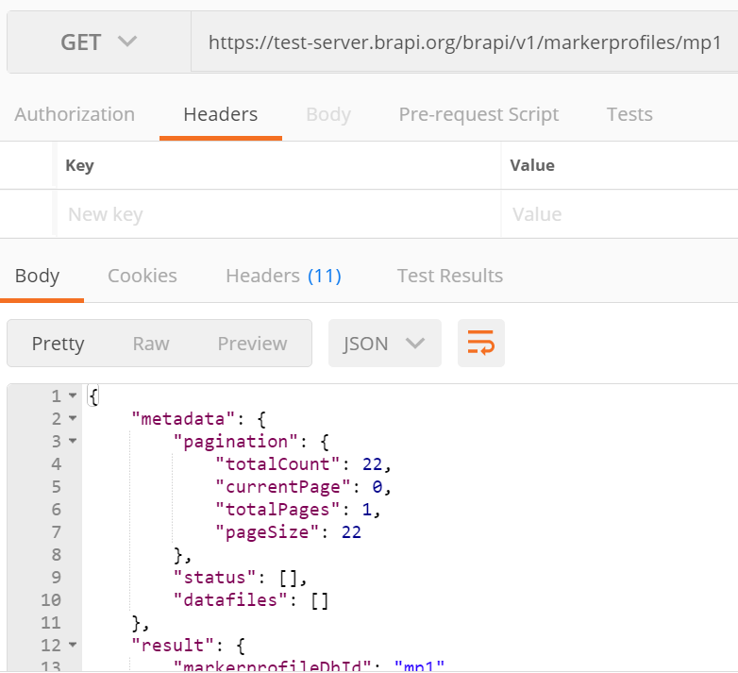
REST - Representational State Transfer
REST is an architecture design for creating Web Services using the well known HTTP standard
Requests are made with URLs
Data is represented with JSON

Slide 6
Standardized Specification
BrAPI has defined a Standardized set of data model structures to communicate the basic information of plant breeding
BrAPI is a technical Specification which software developers can easily turn into code which communicates using the Standard.

Slide 7


Slide 8
BrAPI Domains
BrAPI-Core
Programs, Trials, Studies, Locations, People, and Lists
BrAPI-Germplasm
Germplasm, Germplasm Attributes, Seed Lots, Crosses, Pedigree, and Progeny
BrAPI-Phenotyping
Observation Units, Observations, Observation Variables, Traits, Scales, Methods, and Images
BrAPI-Genotyping
Samples, Markers, Variant Sets, Variants, Call Sets, Calls, References, Reads, and Vendor Orders

Slide 9
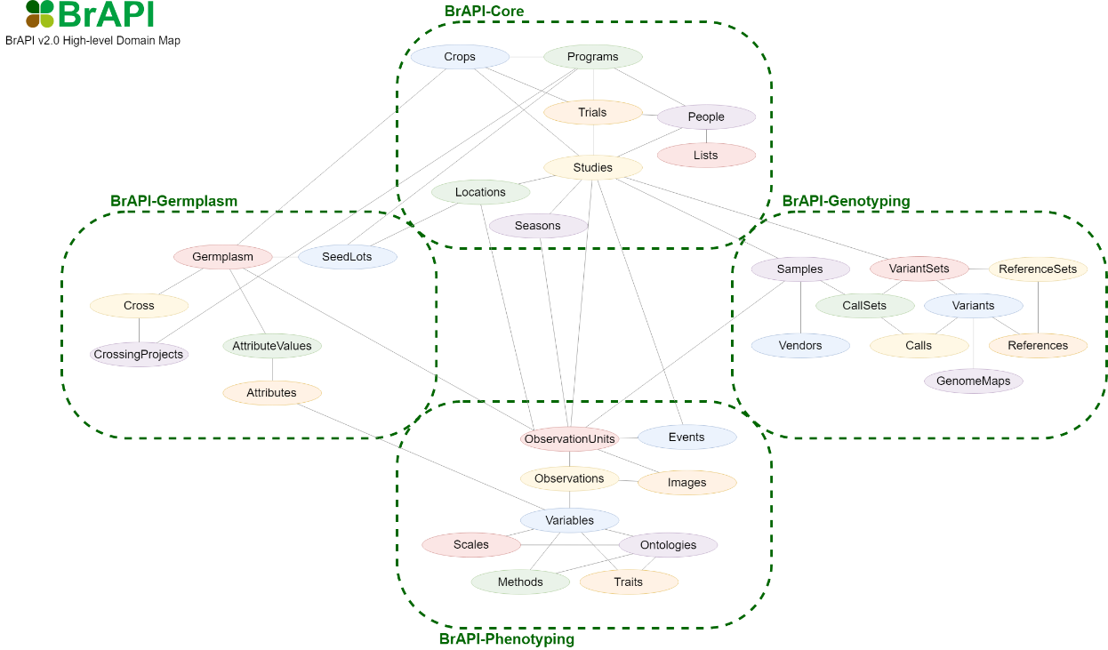

Slide 10
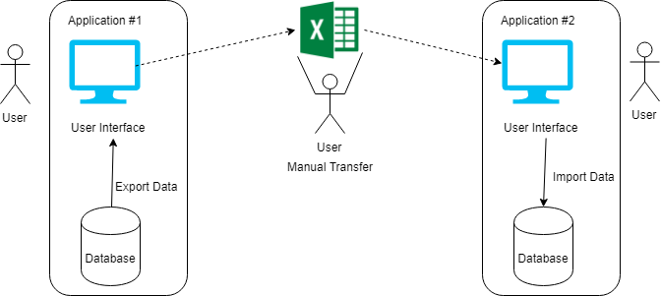
Manual Data Transfer

Slide 11
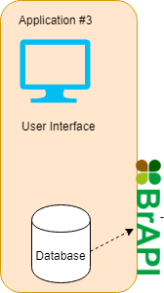
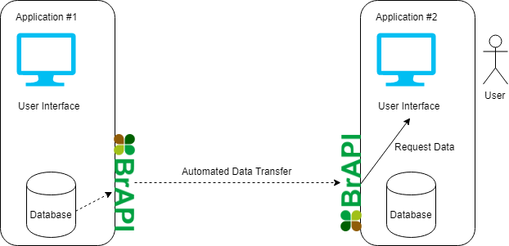
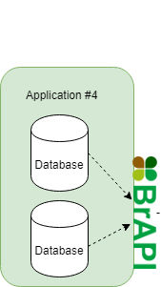
Automated Data Transfer

Slide 12
URLs
https://<server>/brapi/v2/<call>
Examples:
GET https://test-server.brapi.org/brapi/v2/studies/2939
GET https://test-server.brapi.org/cornell/cals/wheatdb/brapi/v2/programs/65238894
GET https://test-server.brapi.org/brapi/v2/germplasm/13ef2839-18ae-4231-a83a-20a2d6d2714c

Slide 13
Types of BrAPI Calls
Retrieve a Single Object by DbId or a Filtered List
GET https://test-server.brapi.org/brapi/v2/studies/3d39af43
GET https://test-server.brapi.org/brapi/v2/studies?germplasmDbId=2d30af45&active=true
Search with Complex Parameters
POST https://test-server.brapi.org/brapi/v2/search/studies
GET https://test-server.brapi.org/brapi/v2/search/studies/5a00af65
Add New Objects
POST https://test-server.brapi.org/brapi/v2/studies
Update Existing Object
PUT https://test-server.brapi.org/brapi/v2/studies/7b3a6f48

Slide 14
Standard Response
Every BrAPI JSON response object has 2 keys
“metadata” key contains information about the call
“result” contains the business data requested by the caller
{
“metadata”: {
“pagination” : {}
...
},
“result”: {
“data”: []
...
}
}

Slide 15
Standard Response - Metadata
“pagination” When the data returned contains a large list, it is often necessary to paginate that list and only retrieve a subset (aka a page). The Pagination object contains meta information about the current paging status, and how many total records and pages are available.
“status” The status key contains an array of Status objects. This allows the server to provide human readable messages which explain what has happened during a particular request.
“datafiles” The datafiles key contains an array of string values. Each string should reference a URI for a data file related to the returned data. These could be things like reference documentation, images, or raw data files.
"metadata": {
"pagination" : {
"totalCount" : 1234,
"pageSize" : 200,
"totalPages" : 7,
"currentPage" : 2
},
"status" : [ {
"code" : "Info",
"message" : "Success"
} ],
"datafiles" : [
"brapi.org/mnt/local/appendix_01.csv",
"brapi.org/mnt/local/appendix_02.csv"
]
} ...

Slide 16
Standard Response - Result
Single Entity Response In this type of response, the "result" key consists of arbitrary properties , and no "data" key (pagination does not apply).
List Response In this type of response, the "result" element only contains the "data" key, which is an arbitrarily long array of objects of the same type. (pagination applies)
Single Entity Response
"metadata" : {
"pagination" : null
...
},
"result" : {
"key0": "master",
"key1": 20,
"key2": [ "foo", "bar", "baz" ]
...
}
List Response
"metadata" : {
"pagination" : {
"page" : 1,
"pageSize" : 2,
"totalCount" : 4,
"totalPages" : 2,
...
},
"result" : {
"data" : [
{
"detailKey0" : "detail0",
"detailKey1" : [ "foo", "bar" ]
},
{
"detailKey0" : "detail1",
"detailKey1" : [ "bar", "baz" ]
},
]
}

Slide 17
Resources
BrAPI Specification
https://brapi.org/specification
BrAPI Wiki
https://wiki.brapi.org/index.php/BrAPI
BrAPI Code Libraries
https://brapi.org/libraries
BRAPPS List
https://brapi.org/brapps
BrAPI Server List
https://brapi.org/servers
Testing Tools
https://webapps.ipk-gatersleben.de/brapivalidator/
https://test-server.brapi.org/brapi/v2/

