Slide 1
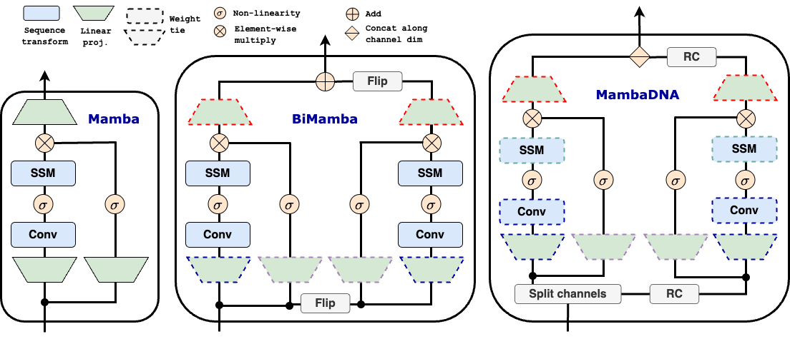
Leveraging the original Mamba module takes advantage of the improved long-range sequence modeling of this architecture
Sharing weights for forward and backward projections enables memory-efficient bi-directional sequence modeling
⛗
Using parameter-sharing and running modules on sequences and their RC versions enables RC-equivariance
🔭
🧬
⛗
🔭
🧬

