Slide 1
Thread Scheduling Algorithms
Henry Plante

Slide 2
Shortest Job First and Longest Job First
Always pick the thread with shortest or longest execution time
Decreases average wait time / turnaround time
TCB contains variable predTime
thread(int predTime, T work)
Replaced ReadyQ with ReadyHeap (min / max)
Random Priority and Random Choice
Idea is to pick a random thread to run
Replaced ReadyQ with ReadyHeap
Random Choice:
random thread picked every time
Random Priority:
Shortest Job First logic but predicted job length is randomly assigned
Random value found using rdrand (rdseed)

Slide 3
Priority Queue and Round Robin
Round Robin:
Our original implementation
Priority Queue:
Four priorities / queues
thread(int priority, T work)
TCB contains variable priority
Highest priority thread gets to run

Slide 4
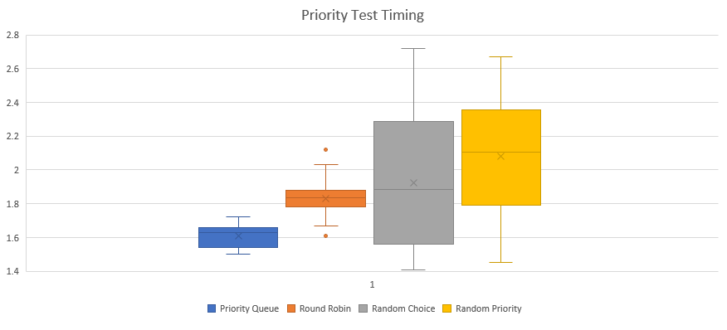
Testing
Test1 (priority test):
600 threads doing lots of dummy work – priority levels 2-4
1 thread that that prints “done” and calls shutdown created last – priority level 1

Slide 5
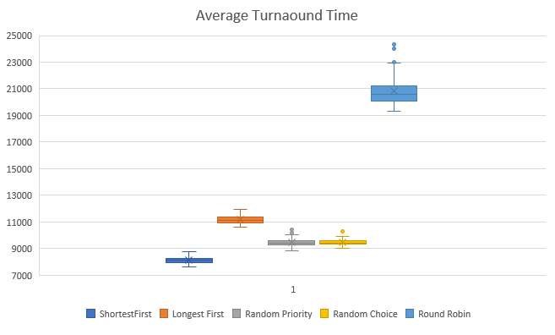
Testing
Test2 (Average Turnaound Time):
Global counter incremented in apithandler
Create 600 threads with each doing a decreasing amount of work

