Slide 1


Web Tracking Technologies and Protection Mechanisms Browser fingerprinting
Pierre Laperdrix
WWW Tutorial
April 24th, 2018

Slide 2

Outline
What is browser fingerprinting?
Defenses against browser fingerprinting
= Experiment: Try with your own device

Slide 3

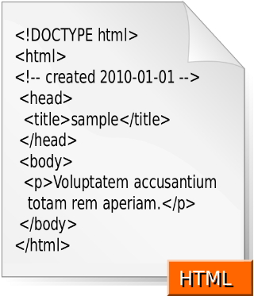
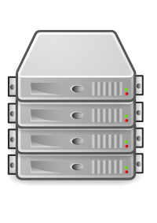
I. Internet and web browsers
Header
Navigation
Browser
Sidebar
Main content
Text
Image
Footer

Slide 4
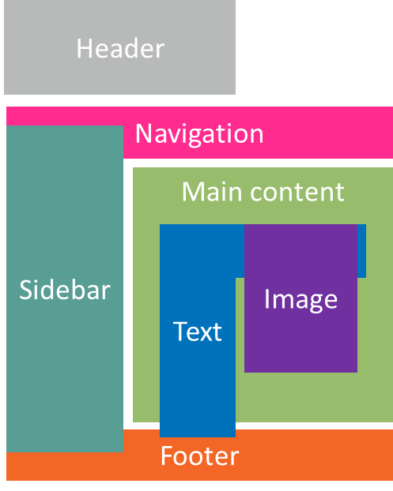
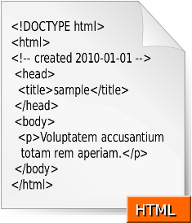



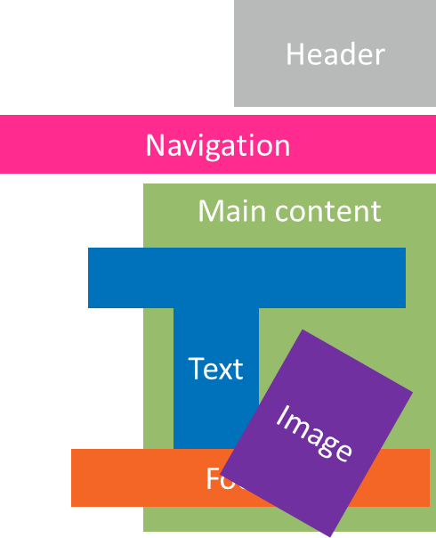


I. Internet in 1995
Header
HTTP User agent
Navigation
NCSA_Mosaic/2.0 (Windows 3.1)
Sidebar
Main content
I am
Browsers send device-specific information to servers to improve user experience on the web.
Text
I am
Mozilla/1.22 (compatible; MSIE 2.0; Windows 95)
Image
Footer

Slide 5





















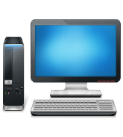



































I. Internet in 2017
A bigger and richer web
Browser
1995 | 2017
Browser: Netscape Language: Fr | Browser: Chrome v53 OS: Linux Screen: 1920x1080 Language: Fr Timezone: GMT+1 Graphic card: GTX 1080Ti …
Audio
Video
3D rendering
Real-time communications
Web payments
Virtual reality
…
What happens when we start collecting all the information available in a web browser?

Slide 6
I. Definition of browser fingerprinting
Definitions
A browser fingerprint is a set of information related to a user’s device from the hardware to the operating system to the browser and its configuration.
Browser fingerprinting refers to the process of collecting information through a web browser to build a fingerprint of a device.

Slide 7
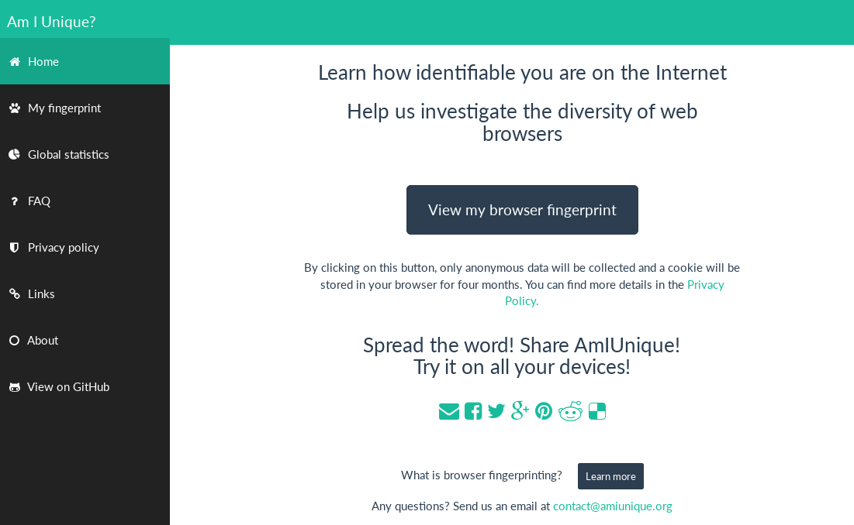
I. See your own fingerprint
https://amiunique.org (Am I Unique)
Website launched in November 2014
Collected 660,000+ fingerprints so far
Browser extension available to see the evolution of your own browser fingerprint

Slide 8
I. Example of values collected on AmIUnique
Some user-agents
Mozilla/5.0 (Windows NT 6.1; WOW64; rv:34.0) Gecko/20100101 Firefox/34.0
Mozilla/5.0 (iPhone; CPU iPhone OS 8_1_2 like Mac OS X) AppleWebKit/600.1.4 (KHTML, like Gecko) Version/8.0 Mobile/12B440 Safari/600.1.4
Mozilla/5.0 (Android; Mobile; rv:27.0) Gecko/27.0 Firefox/27.0
Mozilla/5.0 (Macintosh; Intel Mac OS X 10_10_2) AppleWebKit/537.36 (KHTML, like Gecko) Chrome/39.0.2171.95 Safari/537.36
Mozilla/5.0 (X11; Ubuntu; Linux i686; rv:34.0) Gecko/20100101 Firefox/34.0

Slide 9
I. Example of values collected on AmIUnique
Other custom user-agents
godzilla/5.0 (X122; BSD; rv:500.0) Gecko/20100101
pouet
“54. When a warlike prince attacks a powerful state, his generalship shows itself in preventing the concentration of the enemy's forces. He overawes his opponents, and their allies are prevented from joining against him.”
Deepnet Explorer 1.5.3; Smart 2x2; Avant Browser; .NET CLR 2.0.50727; InfoPath.1)
NSA
Game Boy Advance
eat it

Slide 10
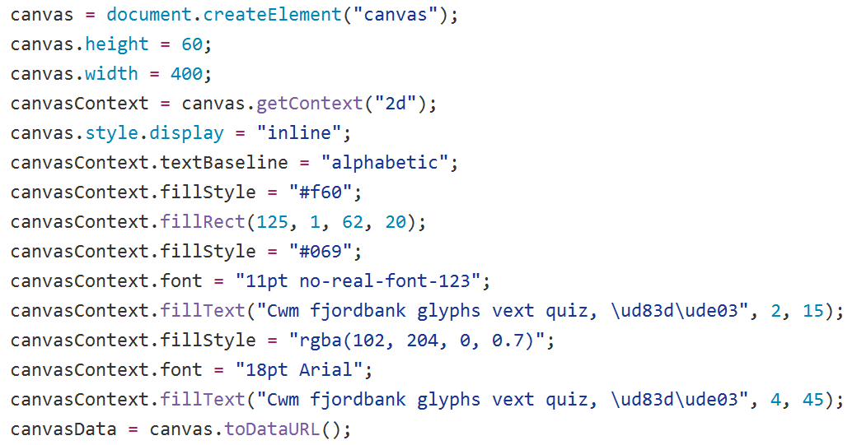
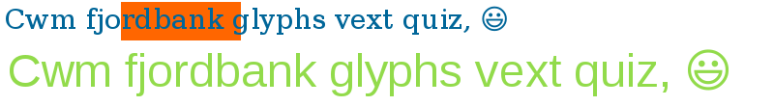
I. Example of values collected on AmIUnique
Canvas fingerprinting
1
2
3

Slide 11







I. Plugins VS Browser extensions
Plugins were created to display content not supported by the browser
Flash Java Silverlight
All installed plugins are accessible via the navigator.plugins JavaScript object
Extensions extend or modify default behavior of a browser
AdBlockPlus, LastPass, Ghostery, Pinterest
There is no API that webpages can use to detect all installed extensions

Slide 12
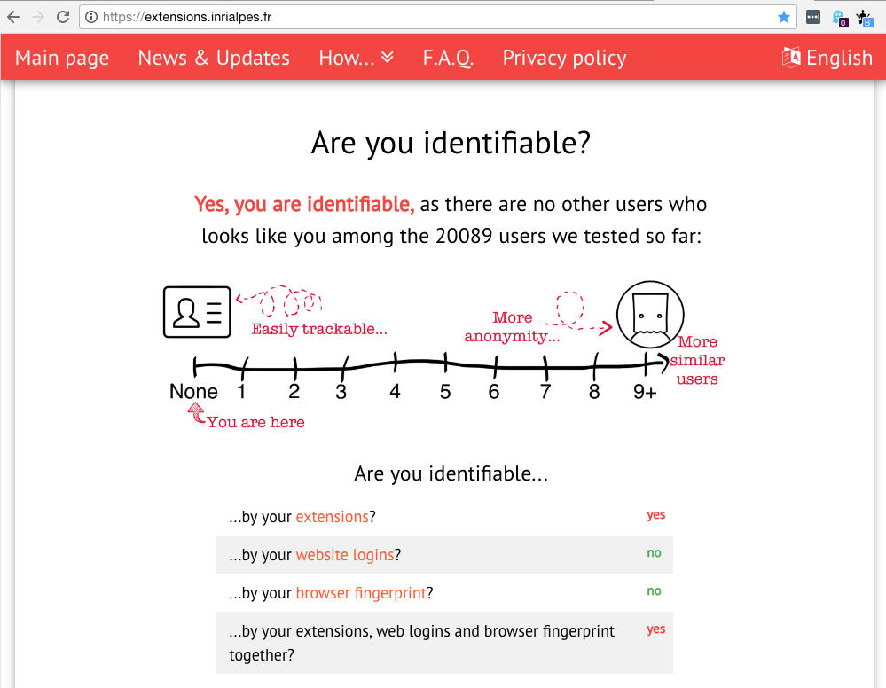
















I. Detecting browser extensions
https://extensions.inrialpes.fr
Website launched in March 2017
More than 21,000 browsers tested so far
Detection of ~13 000 extensions (28% of all free Chrome extensions )

Slide 13
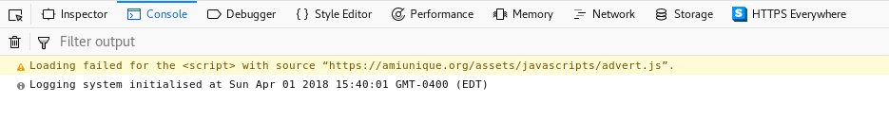
I. Impact on privacy
We saw we can detect a wide range of information in the browser.
What makes fingerprinting a threat to online privacy?
It is really easy to collect all this data. No need for extra permissions.
Playing with the JavaScript console
To access the console, two options:
push ‘F12’ or right
Right click on an element + ‘Inspect element’

Slide 14



I. Impact on privacy
What makes fingerprinting a threat to online privacy?
Two studies have investigated the diversity of browser fingerprints.
470,161 fingerprints
94.2% were unique
Tracking is possible
118,934 fingerprints
89.4% were unique

Slide 15
I. Summary
Servers can easily collect information about a device to form what is called a browser fingerprint.
There is so much diversity that users can be tracked online if their fingerprint is unique.
Test your device on
https://amiunique.org and https://extensions.inrialpes.fr

Slide 16
I. Summary
How effective is fingerprinting at large scale?
2M fingerprints
33% are unique
Is tracking still possible ?
Presentation of the paper
“Hiding in the crowd: an analysis of the effectiveness of browser fingerprinting at large scale”
Thursday April 26th
11:00am
Salon Tête d’Or

Slide 17
Outline
What is browser fingerprinting?
Defenses against browser fingerprinting

Slide 18
II. Defending against fingerprinting
Goal: to protect users against browser fingerprinting, i.e. to prevent them from being tracked online
Fingerprinting script
Loaded webpage
JavaScript engine
Browser
OS
Hardware

Slide 19
II. Blocking scripts
The fingerprinting script is simply not executed.
Fingerprinting script
Loaded webpage
JavaScript engine
Browser
OS
Hardware

Slide 20





II. Blocking scripts
Browser extensions or built-in in the browser
Pros: Easy to install and to use. Transparent to the user.
Cons: This technique revolves around up-to-date blacklists. User is vulnerable if the fingerprinting script is not in the database.
uBlock
Ghostery
Disconnect
Brave
Firefox (by default in private mode)

Slide 21
II. Blocking browser APIs
The fingerprinting script will collect less information.
Fingerprinting script
Loaded webpage
JavaScript engine
Browser
OS
Hardware

Slide 22

II. Blocking browser APIs
Browser extensions or built-in in the browser
Pros: Easy to install and to use. Transparent to the user.
Cons: Only limits the amount of collected information.
CanvasBlocker
Brave

Slide 23
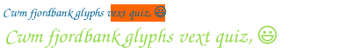
II. Injecting JavaScript
The injection of JavaScript overwrites the default methods of the JavaScript engine.
Can change values
“navigator.platform”
Default: “Win64”
New value: “Linux x86_64”
Can inject noise
Fingerprinting script
Loaded webpage
JavaScript engine
Browser
OS
Hardware

Slide 24



II. Injecting JavaScript
Browser extensions
Detection of Canvas Defender
Pros: Easy to install and to use. Transparent to the user.
Cons: Can easily be detected and creates inconsistencies.
Canvas Defender
Random Agent Spoofer
User-Agent Switcher

Slide 25
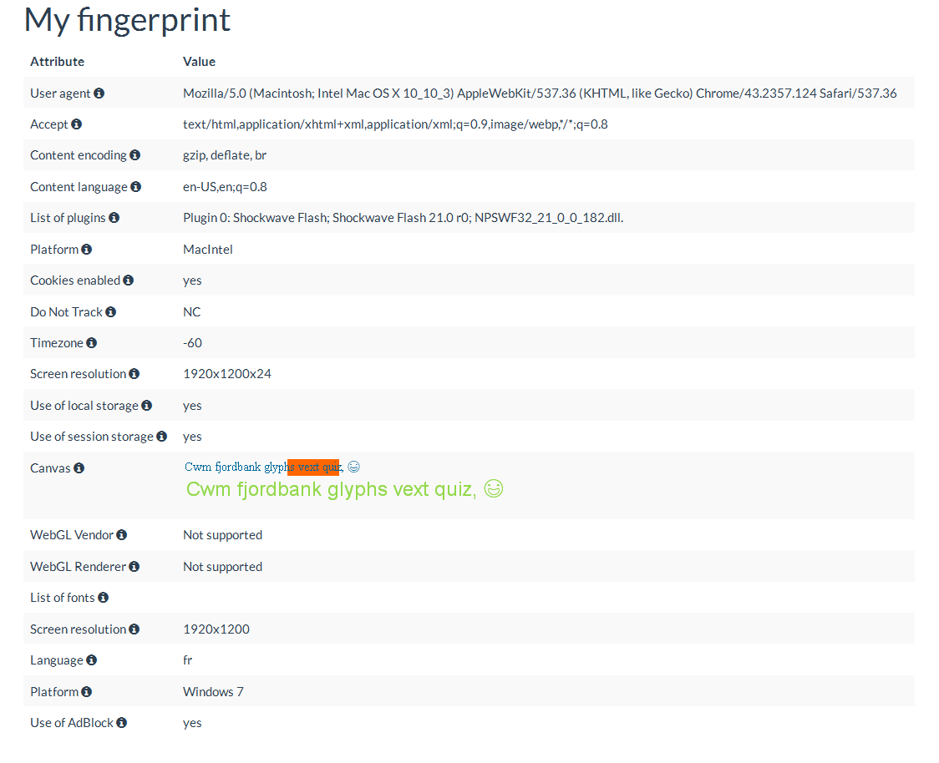
II. The problem of inconsistencies

Slide 26
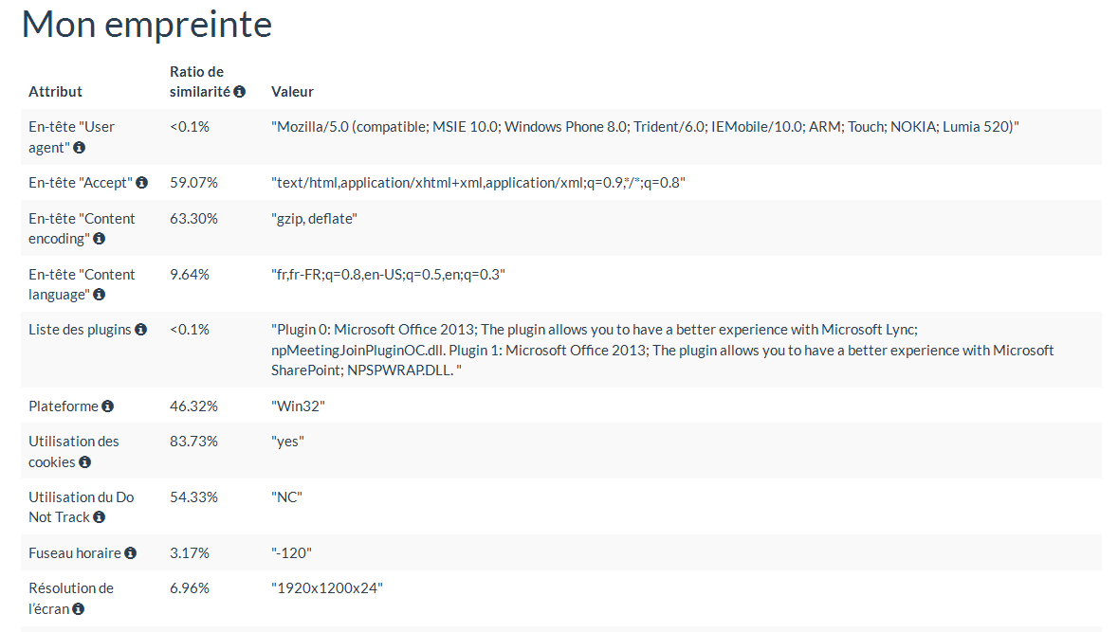
II. The problem of inconsistencies
480 x 800

Slide 27
II. Native spoofing
Instead of injecting JavaScript, the source code of the browser is modified to send new values.
Investigating JS objects is not enough to detect the modifications.
Fingerprinting script
Loaded webpage
JavaScript engine
Browser
OS
Hardware

Slide 28


II. Native spoofing
Custom browsers
Pros:
Easy to install and to use.
Very hard to detect if done well.
Cons: Can still create inconsistencies.
Mimic privacy browser
Tor browser

Slide 29

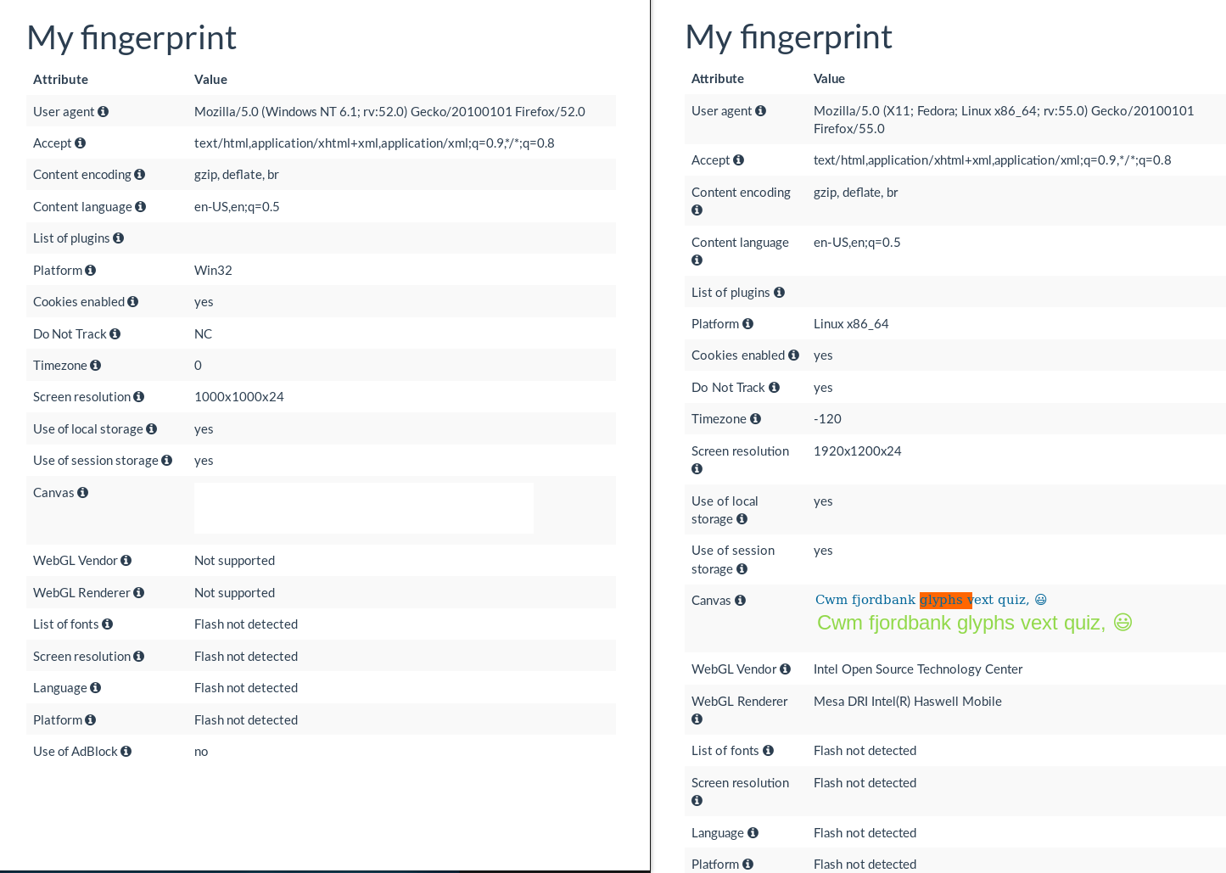
II. Tor browser and its fingerprint
Tor browser on Fedora 25
Firefox browser on Fedora 25
In theory, all fingerprints from the Tor Browser should be identical.
In reality, differences can still be found (screen resolution, platform…).

Slide 30
II. Changing browsers
One fingerprint for each browser
One profile for each fingerprint
The OS and Hardware layers are shared by both fingerprints.
Fingerprinting script
Fingerprinting script
Loaded webpage
Loaded webpage
JavaScript engine
JavaScript engine
Browser n°2
Browser n°1
OS
Hardware

Slide 31
II. Changing browsers
Browsers
Pros: Anybody can switch between any browsers.
Cons: Cross-browser fingerprinting exists. By collecting enough information on the OS and hardware, one can still be identified.
See uniquemachine.org (WebGL tests)

Slide 32
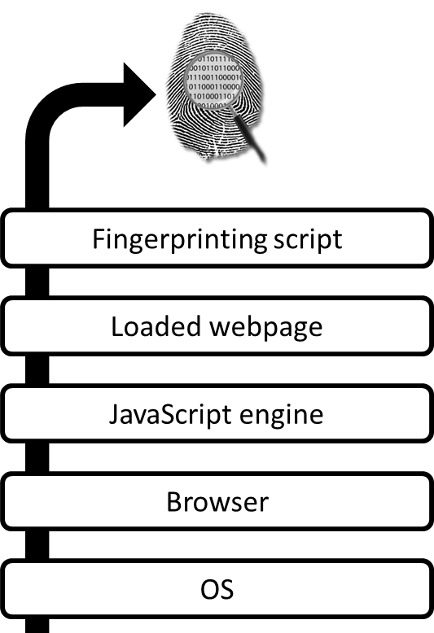




II. Recreating a complete environment
Disposable environments with a unique fingerprint for each browsing session
Database with different OS, fonts, plugins and browsers
Use of virtualization to isolate the host OS from the new environment
Database
Virtualization
OS
Hardware

Slide 33


II. Recreating a complete environment
Academic prototype called Blink
Pros: Does not create inconsistencies in fingerprint. The components truly exist.
Cons:
High resources consumption (disk space, CPU).
The usability is not as good as other solutions.
Version on VirtualBox
https://github.com/DIVERSIFY-project/blink
Version on Docker
https://github.com/plaperdr/blink-docker

Slide 34
II. Summary of defense techniques
Many different approaches:
Blocking scripts
Blocking browser APIs
Injecting JavaScript
Native spoofing
Changing browsers
Recreating complete environments
Fingerprinting script
Loaded webpage
JavaScript engine
Browser
OS
Hardware

Slide 35
II. Summary of defense techniques
No ultimate solutions
Each one has its pros and cons.
It is always a complicated tradeoff between protection and usability.
Easiest solution to put in place: block fingerprinting scripts.
Fingerprinting script
Loaded webpage
JavaScript engine
Browser
OS
Hardware

Slide 36
Conclusion
Browser fingerprinting is a stateless tracking technique that relies on the collection of information about a user’s device and its configuration.
This technique is a side-effect of the way the web and browsers have been built for the past two decades. A single patch cannot fix the problem.
Protecting users against fingerprinting is complicated. Many different approaches are possible with each their pros and cons.

Slide 37


Thank you!
Any questions?
Websites on fingerprinting
https://amiunique.org
https://extensions.inrialpes.fr
https://fpcentral.tbb.torproject.org/
Contact
plaperdrix@cs.stonybrook.edu
@RockPartridge

