Slide 1
IoT Based Speed Control for Semi-Autonomous Electric Off-Road Cargo Vehicle
Design, PCB & Schematic

Slide 2
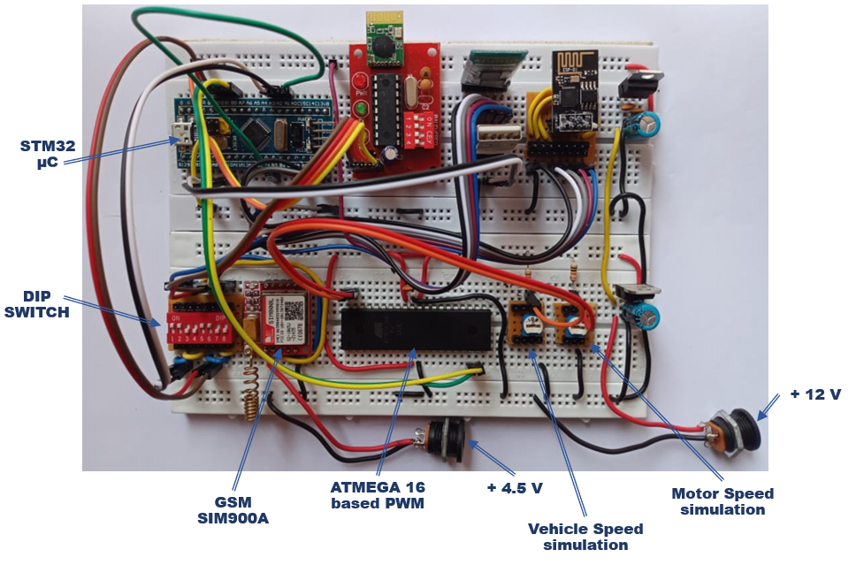

Slide 3
PWM_IN
PB5
PA1
PWM_OUT
PWM_IN1
Atmega16A
Potentiometer1
B1
PD4
PA0
STM32
PWM_IN2
PA1
B0
PD5
Potentiometer2
TX1
Cp2102
(USB to serial converter)
A9
HC-05 (BT module)
A10
RX1
RX3
DIP switch
B11
TX3
CC2500 (Zigbee module)
B10
ESP8266 (Wifi module)
PA3
RX2
TX2
DIP switch
PA2
sim800L (GPRS module)

