Slide 1
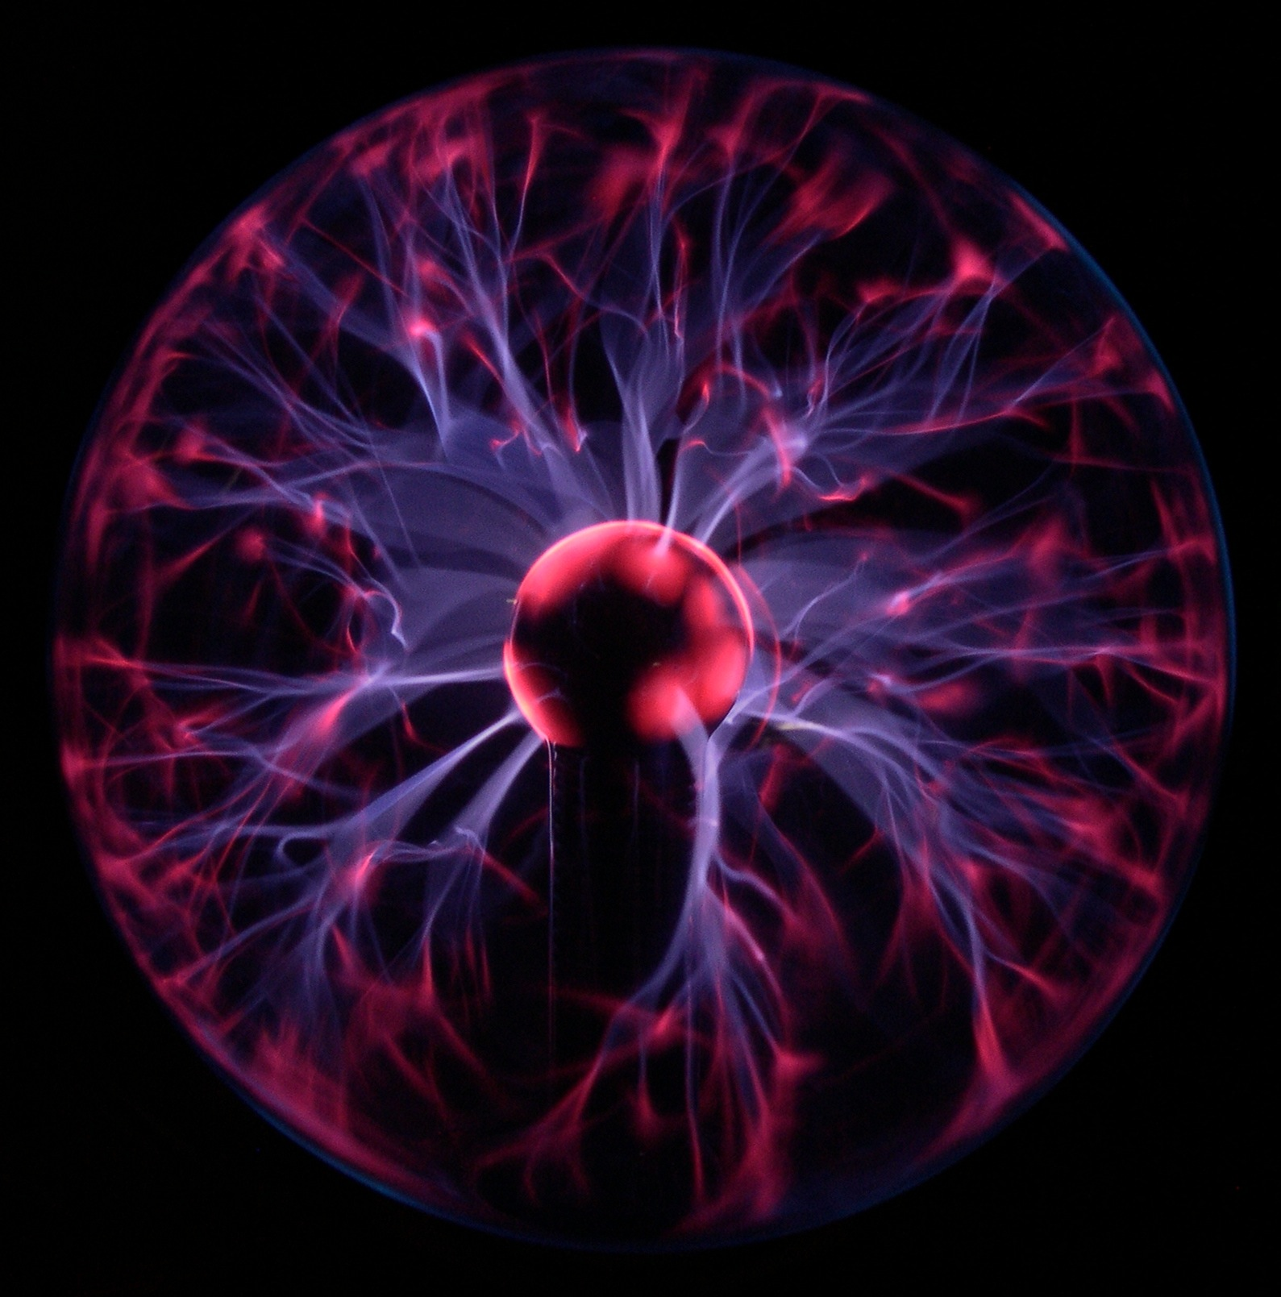
PLASMA
programming languages and systems at massachusetts
plasma.cs.umass.edu

Slide 2
http://plasma.cs.umass.edu
programming languages and systems at massachusetts
PLASMA

