Slide 1
Hippocratic Garbage Collection
Matthew Hertz, Yi Feng, & Emery Berger
Department of Computer Science
University of Massachusetts

Slide 2
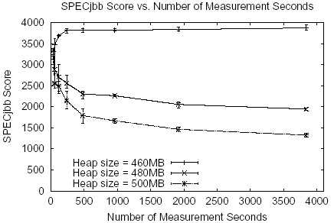
Dude, where’s my performance?
Heap exceeds available memory - throughput plummets

Slide 3
Program Throughput: Ideal vs. Real
The problem: paging

Slide 4
GC Pause Time
From 55 milliseconds to 30 seconds!

Slide 5

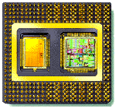

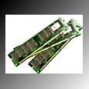
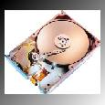
Ever-Steeper Memory Hierarchy
Higher = smaller, faster, closer to CPU
  A real desktop machine (mine)
registers
8 integer, 8 floating-point; 1-cycle latency
L1 cache
8K data & instructions; 2-cycle latency
L2 cache
512K; 7-cycle latency
RAM
1GB; 100 cycle latency
Disk
40 GB; 38,000,000 cycle latency (!)

Slide 6
Outline
Motivation
GC Paging Behavior
Hippocratic Garbage Collection
  Cooperation
  Bookmarking
Results
Future Work

Slide 7
What’s really going on here?

Slide 8
GC Performance While Paging
RAM
Hard Disk
GC: Touch evicted page

Slide 9
GC Performance While Paging
RAM
Hard Disk
VM: brings page in-core

Slide 10
GC Performance While Paging
RAM
Hard Disk
VM: evicts different page (LRU)

Slide 11
GC Performance While Paging
RAM
Hard Disk
GC: Touches page on disk

Slide 12
GC Performance While Paging
RAM
Hard Disk
VM: Evicts another page…and so on…

Slide 13
Oblivious Memory Management
Garbage collection: VM-oblivious
  Cannot adjust to changing memory pressure
  Touches non-resident pages
Virtual memory: GC-oblivious
  Likely to evict pages needed by GC

Slide 14
Outline
Motivation
GC Paging Behavior
Hippocratic Garbage Collection
  Cooperation
  Bookmarking
Results
Future Work

Slide 15
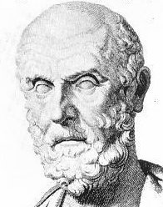
Our Inspiration
As to diseases, make a habit of two things: to help, or at least, to do no harm.
Hippocrates

Slide 16
Hippocratic Garbage Collection
Garbage collector
Virtual memory manager
page eviction notification
Evacuates pages
Selects victim pages
Page replacement
victim page(s)
Goal: GC triggers no additional paging
Key ideas:
  Minimize space consumption
  Exploit page information from VM
    Residency, eviction notifications
  Avoid touching evicted pages

Slide 17
HC Collector Overview
Generational
  Focused activity in nursery: improves locality
Mark-sweep (w/o pressure)
Compaction
  Shrink nursery
  Segregated size classes
    Eliminates fragmentation
    Reduces memory pressure
Essentially page-oriented GenMS + compaction

Slide 18
Segregated Size Classes
Mark objects

Slide 19
Segregated Size Classes
Copy into empty spaces

Slide 20
Cooperative Collection
GC and VM communication
  Before-paging callback
  Per-page eviction negotiation
Modify collector to limit paging
  Manage heap memory at page granularity
  GC on page eviction notification
  When possible, return empty pages
  Otherwise, process pages before eviction: “bookmarking”

Slide 21
Bookmarking
RAM
Hard Disk
Process pages before they are evicted…

Slide 22
Bookmarking
RAM
Hard Disk
…by “bookmarking” target objects

Slide 23
Bookmarking
RAM
Hard Disk
then allow page eviction

Slide 24
Collection with Bookmarking
RAM
Hard Disk
process objects as normal except…

Slide 25
Collection with Bookmarking
RAM
Hard Disk
…ignore references to evicted pages

Slide 26
Collection with Bookmarking
RAM
Hard Disk
bookmarks remember references from disk

Slide 27
Collection with Bookmarking
RAM
Hard Disk
Result: no paging!

Slide 28
Bookmarking Details
Cheap summary of connectivity
  One bit per object: stolen from object header
  One word per page: count of pages that hold bookmarks on this page
    Clear bookmarks when zero
Invoke VM-oblivious collection only when heap is exhausted
  Common case for all other collectors!
  In practice: hasn’t happened yet

Slide 29
Outline
Motivation
GC Paging Behavior
Hippocratic Garbage Collection
  Cooperation
  Bookmarking
Results
Future Work

Slide 30
Throughput Without Pressure

Slide 31
Throughput Without Pressure

Slide 32
Throughput Under Pressure

Slide 33
Pause Times Under Pressure
HC average pause always < 150ms

Slide 34
Pause Times Under Pressure
HC pause time always < 1 second

Slide 35
Future Work
Different eviction strategies
  Exploit type info, fewer pointers
Shrink heap vs. evict pages; grow heap
  Requires more VM info
Static analyses
Combine with automatic heap sizing
[Yang et al.]

Slide 36
Conclusion
Hippocratic Garbage Collection
  Cooperates with VM
  Competitive when not paging
    Performs up to 50% faster with small heaps
    Averages at most 4% slower at large heap size
  Greatly improves performance when paging
    Throughput up to 8x greater
    Average pause times up to 29x smaller

Slide 37
Backup Slides

Slide 38
Some Related Work
Compaction: reduce working set
  Linearize lists [Bobrow & Murphy]
  Semispace collection [Baker, Fenichel & Yochelson]
Reduce frequency of whole-heap collection
  Ephemeral [Moon] & generational collectors
  [Lieberman & Hewett, Ungar, Appel]
Cooperation
  Shrink heap [Alonso & Appel]
  Give up empty pages [Cooper, Nettles et al.]

Slide 39
Tracking Page Value
unprotected
protected
Maintain histogram per page position
  Provides value to application of n pages (for any n)

Slide 40
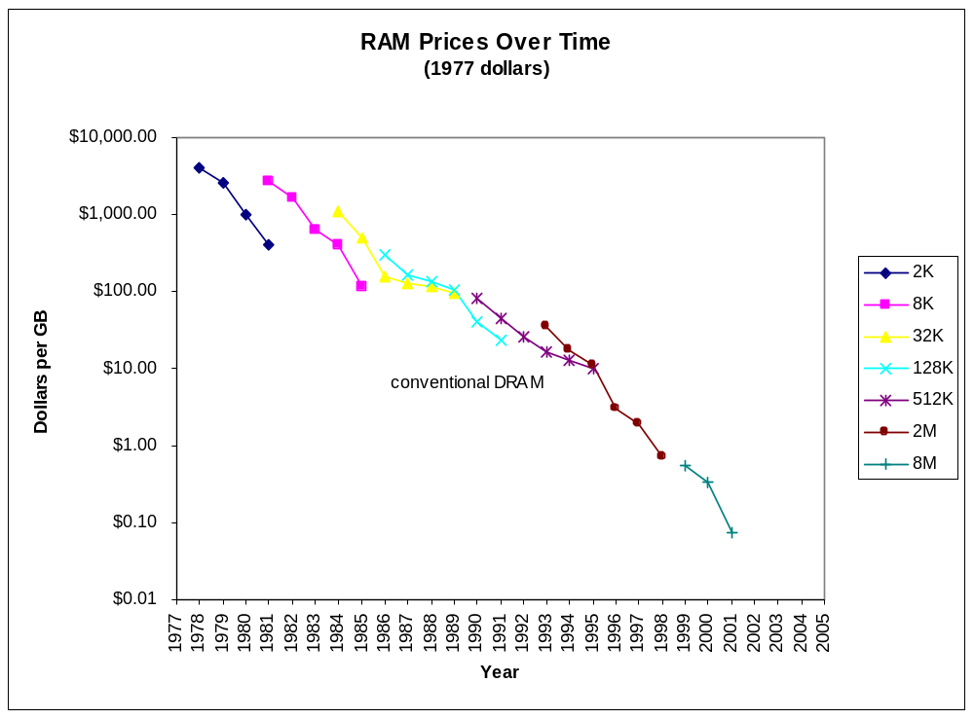
Memory Prices Over Time
“Soon it will be free…”

Slide 41
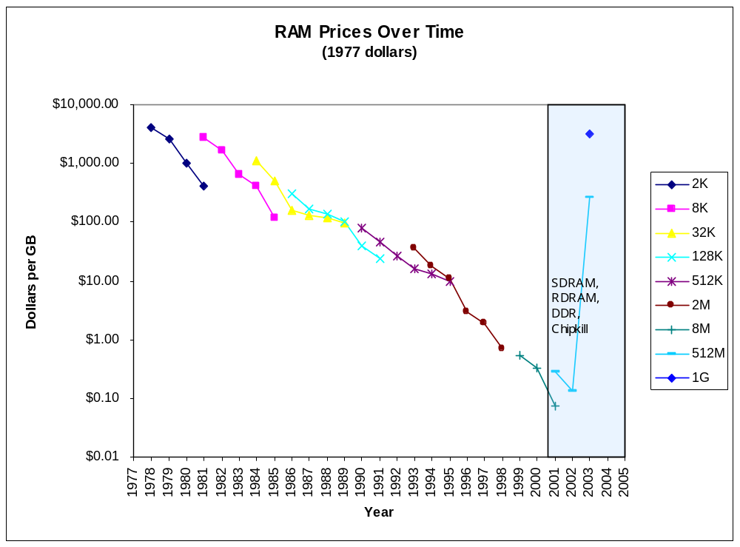
Memory Prices: Inflection Point

Slide 42
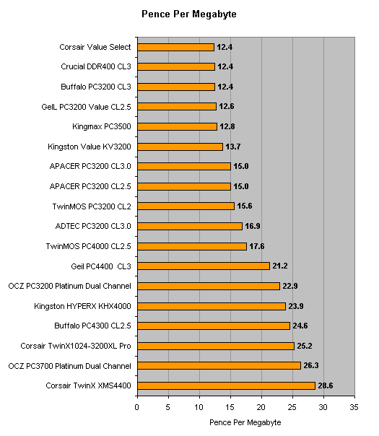
Fast DDR2 modules today: $500/GB

