Slide 1

CRAMM: Virtual Memory Support for Garbage-Collected Applications
Ting Yang, Emery Berger, Scott Kaplan†, Eliot Moss
Department of Computer Science Dept. of Math and Computer Science†
University of Massachusetts Amherst College
{tingy,emery,moss}@cs.umass.edu sfkaplan@cs.amherst.edu

Slide 2
Motivation: Heap Size Matters
GC languages
  Java, C#, Python, Ruby, etc.
  Increasingly popular
Heap size critical
  Too large:
    Paging (10-100x slower)
  Too small:
    Excessive # collections
    hurts throughput
JVM
Heap Size (120MB)
Memory (100MB)
VM/OS
Disk
Heap Size (60MB)
Memory (100MB)

Slide 3
What is the right heap size?
Find the sweet spot:
  Large enough to minimize collections
  Small enough to avoid paging
  BUT: sweet spot changes constantly (multiprogramming)
CRAMM: Cooperative Robust Automatic Memory Management
Goal: through cooperation with OS & GC,
keep garbage-collected applications
running at their sweet spot

Slide 4
CRAMM Overview
Cooperative approach:
  Collector-neutral heap sizing model (GC)
    suitable for broad range of collectors
  Statistics-gathering VM (OS)
Automatically resizes heap in response to memory pressure
  Grows to maximize space utilization
  Shrinks to eliminate paging
Improves performance by up to 20x
  Overhead on non-GC apps: 1-2.5%

Slide 5
Outline
Motivation
CRAMM overview
Automatic heap sizing
Information gathering
Experimental results
Conclusion

Slide 6
GC: How do we choose a good heap size?

Slide 7
GC: Collector-neutral model
heapUtilFactor: constant dependent on GC algorithm
Fixed overhead:
Libraries, codes, copying (app’s live size)
SemiSpace (copying)
a ≈ ½
b ≈ JVM, code + app’s live size

Slide 8
GC: a collector-neutral WSS model
heapUtilFactor: constant dependent on GC algorithm
Fixed overhead:
Libraries, codes, copying (app’s live size)
SemiSpace (copying)
MS (non-copying)
a ≈ ½
a ≈ 1
b ≈ JVM, code + app’s live size
b ≈ JVM, code

Slide 9
GC: Selecting new heap size
Set heap size so that working set
just fits in current available memory
GC: heapUtilFactor (a) & cur_heapSize
VMM: WSS & available memory

Slide 10
Heap Size vs. Execution time, WSS
Linear shape
1/x shape
Y=0.99*X + 32.56

Slide 11
VM: How do we collect information to support heap size selection?
(with low overhead)
WSS, Available Memory

Slide 12
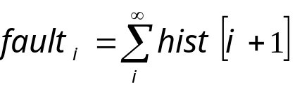
Calculating WSS w.r.t 5%
Memory reference sequence
m
n
l
k
c
a
m
n
l
k
b
m
n
l
c
m
n
d
n
c
e
f
g
h
i
j
k
l
m
n
c
k
l
m
n
b
d
c
e
d
f
e
g
f
h
g
i
h
j
i
k
j
l
k
m
l
m
n
c
n
k
c
l
k
m
l
m
n
n
LRU Queue
Pages in Least Recently Used order
m
b
a
n
l
k
c
n
m
m
k
c
n
a
l
m
l
c
n
l
k
m
k
n
l
k
c
m
c
j
n
l
k
j
j
j
j
j
i
i
i
i
i
h
i
h
h
h
h
h
g
g
g
g
g
g
f
f
e
f
f
f
f
e
e
e
e
e
d
c
d
d
d
d
d
b
b
b
b
b
b
a
a
a
a
a
a
1
14
0
0
0
0
4
Hit Histogram
3
2
1
0
0
0
0
0
0
0
1
0
0
0
Associated with each LRU position
5
faults
Fault Curve
1
1
4
11
14
pages

Slide 13
Computing hit histogram
Not possible in standard VM:
  Global LRU queues
  No per process/file information or control
    Difficult to estimate app’s WSS / available memory
CRAMM VM:
  Per process/file page management:
    Page list: Active, Inactive, Evicted
    Add & maintain histogram

Slide 14
Managing pages for a process
Pages protected by turning off permissions (minor fault)
Pages evicted to disk. (major fault)
Active (CLOCK)
Inactive (LRU)
Evicted (LRU)
Major fault
Header
Refill & Adjustment
Evicted
Page Des
AVL node
Minor fault
faults
Histogram
Pages

Slide 15
Controlling overhead
Pages protected by turning off permissions (minor fault)
Pages evicted to disk. (major fault)
Active (CLOCK)
Inactive (LRU)
Evicted (LRU)
Header
Page Des
AVL node
Buffer
faults
control the boundary: 1% of execution time
Histogram
Pages

Slide 16
Calculating available memory
What’s “available”?
  Page cache
    Are pages from closed files “free”?
    Policy decision: yes
      Easy to distinguish in CRAMM – on separate list
Available Memory =
resident application pages +
free pages in the system +
pages from closed files

Slide 17
Experimental Results

Slide 18
Experimental Evaluation
Experimental setup:
  CRAMM (Jikes RVM + Linux),
  unmodified Jikes RVM, JRockit, HotSpot
    GC: GenCopy, CopyMS, MS, SemiSpace, GenMS
    SPECjvm98, DaCapo, SPECjbb, ipsixql + SPEC2000
Experiments:
  Dynamic memory pressure
  Overhead w/o memory pressure

Slide 19
Dynamic Memory Pressure (1)
GenMS – SPECjbb (Modified) w/ 160M memory
stock w/o pressure
296.67 secs 1136 majflts
CRAMM w/ pressure 302.53 secs 1613 majflts 98% CPU
Stock w/ pressure 720.11 secs 39944 majflts 48% CPU
# transactions finished (thousands)
Initial heap size: 120MB
stock w/o pressure
CRAMM w/ pressure
Stock w/ pressure
Elapsed Time (seconds)

Slide 20
Dynamic Memory Pressure (2)
HotSpot
# transactions finished (thousands)
JRockit
CRAMM-GenMS
CRAMM-MS
CRAMM-SS
HotSpot
JRockit
SPECjbb (modified): Normalized Elapsed Time

Slide 21
CRAMM VM: Efficiency
CRAMM VM Overhead
4
Additional Overhead
3.5
Histogram Collection
3
2.5
% Overhead
2
1.5
1
0.5
0
SPEC2Kint
SPEC2Kfp
Java-
Java-
Java-
Java-GenMS
Java-
GenCopy
SemiSpace
MarkSweep
CopyMS
Overhead: on average, 1% - 2.5%

Slide 22
Conclusion
Cooperative Robust Automatic Memory Management (CRAMM)
  GC: Collector-neutral WSS model
  VM: Statistics-gathering virtual memory manager
Dynamically chooses nearly-optimal heap size for garbage-collected applications
  Maximizes use of memory without paging
  Minimal overhead (1% - 2.5%)
  Quickly adapts to memory pressure changes
http://www.cs.umass.edu/~tingy/CRAMM

Slide 24
Backup Slides
Example of paging Problem, javac
Understanding fault curves
Characterizing Paging Behavior
  Using fault curves / LRU
SegQ design
  Collecting fault curves on the fly
Calculating WSS of GCed applications

Slide 25
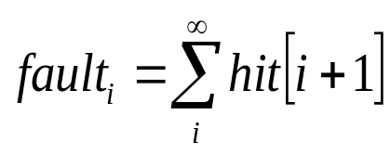
Characterizing Paging Behavior
Memory reference sequence
m
n
l
k
c
a
m
n
l
k
b
m
n
l
c
m
n
d
n
c
e
f
g
h
i
j
k
l
m
n
c
k
l
m
n
b
d
c
e
d
f
e
g
f
h
g
i
h
j
i
k
j
l
k
m
l
m
n
c
n
k
c
l
k
m
l
m
n
n
LRU Queue
Pages in Least Recently Used order
m
b
a
n
l
k
c
n
m
m
k
c
n
a
l
m
l
c
n
l
k
m
k
n
l
k
c
m
c
j
n
l
k
j
j
j
j
j
i
i
i
i
i
h
i
h
h
h
h
h
g
g
g
g
g
g
f
f
e
f
f
f
f
e
e
e
e
e
d
c
d
d
d
d
d
b
b
b
b
b
b
a
a
a
a
a
a
1
14
0
0
0
0
4
3
2
1
0
0
0
0
0
0
0
1
0
0
0
Hit Histogram
Associated with each LRU position
5
1
Fault Curve
1
4
11
14
5 pages
12 pages

Slide 26
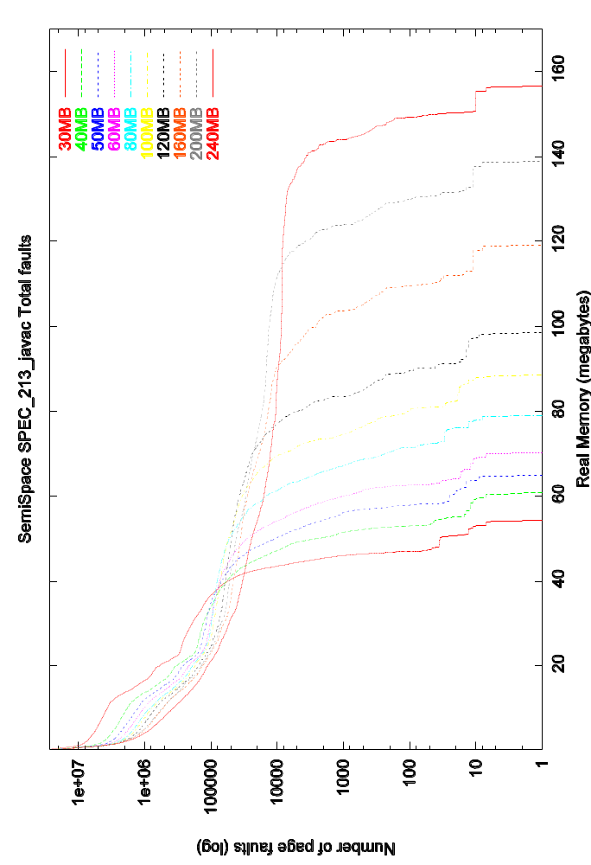
Heap size=
extreme paging
substantial paging:
“looping” behavior
50 seconds
fits into memory
# of Faults ≈ 1000
Heap Size = 240Mb
0.5 second
Memory = 145Mb
Fault curve: Relationship of heap size, real memory & page faults

Slide 27
VMM design: SegQ
CLOCK algorithm
Strict LRU
Active
LRU Queue
Inactive
Evicted
Minor fault (in memory)
Major fault (on disk)
Hit Histogram
0
0
0
0
0
0
0
0
0
0
0
0
0
0
0
0
0
0
0
0
0
0
0
0
0
0
0
0
0
0
0
0
0
0
0
0
0
0
0
0
0
0
0
0
0
0
0
0
0
0
0
0
0
0
0
Active / Inactive Boundary
Adaptive control of Inactive list size

Slide 28
VMM design: SegQ
CLOCK algorithm
Strict LRU
Active
Inactive
Evicted
WSS
0
0
0
0
0
0
0
0
0
0
0
0
0
0
0
0
0
0
0
0
0
0
Active / Inactive Boundary
What is the WSS w.r.t 5%?

Slide 29
CRAMM System: Demo
JVM
Other Apps
Heap Size (90MB)
Heap Size (150MB)
Heap Size (120MB)
Heap Size (100MB)
Need 60MB memory
Polling Memory Status
Collection Finished
WSS, Available Memory
Memory (150MB)
VMM
Other apps finished
GC: Collection is finished; Memory is released
VM: Calculates app’s WSS and Available memory
GC: Memory exhausted, triggers a full collection …
GC: Choose a new heap size using WSS model
GC: Shrinks the heap size again
GC: Grows the heap size to make better use of memory

Slide 30
CRAMM VM: Control overhead
Goal: 1% of execution time
  < 0.5%: grow inactive list size
  > 1.5%: shrink inactive list size
When
  Interval: 1/16 seconds
  # of minflts > (interval * 2%) / minflt_cost
How
  Grow: min(active, inactive)/32
  Shrink: min(active, inactive)/8
  Refill: min(active, inactive)/16

Slide 31
CRAMM vs. Bookmarking Collector
Two different approaches
CRAMM:
  A new VMM
  Moderate modifications in collectors
  Heap level control (coarse granularity)
BC:
  A new collector
  Moderate modifications in VMM
  Page level control (fine granularity)

Slide 32
Static Memory Pressure
optimal

Slide 33
Dynamic Memory Pressure (1)
stock w/o pressure
336.17 secs 1136 majflts
CRAMM w/ pressure 386.88 secs 1179 majflts 98% CPU
Stock w/ pressure 928.49 secs 47941 majflts 36% CPU
Initial heap size: 120MB

Slide 34
Dynamic Memory Pressure (1)
adaptive
Sample after every collection
Available memory
Heap size

Slide 35
Dynamic Memory Pressure (3)

Slide 36
Problem & Motivation
Too large:
page a lot
Optimal
Too small:
GC a lot
Heap size vs Running time
Appel _213_javac
60MB real memory

Slide 37
Manage processes/files
mem_info structure organization
  Unused list: closed files
  Normal list: running processes, files in use
Handling files
  close: deactivate all pages, move to unused list
  open: move to normal list, rebuild its active list
Eviction policy
  Scan Unused list first
  Then select from normal list in round-robin manner

Slide 38
Behind the WSS model?
Stop-the-world, tracing collectors
Two phases: mutator and collector
  Mutator: runs the app
    Allocation, references existing objects
  Collector:
    Traces pointers for live objects
  GC behavior dominates: no “infrequently” used pages
    Base rate: at least once for each GC cycle
Working Set Size (WSS)
the amount of memory needed so that the time spent on page faults is lower than certain percent of total execution time. (5%)

Slide 39
GC gives more choices !
Working Set Size W(k, t): at time t, the set of all pages used k most recent references
W(k,t)
W(k,t)
Search Criteria
Working Set Size:
The amount of memory needed so that the time spent on page faults is lower than certain percent of total execution time. (typical value: 5%)
Heap: 65MB
Heap: 45MB
Heap: 30MB
Heap: 20MB
Hmm… a search problem!
k
k
Non-GCed Application
GCed Application
Memory pressure , scan frequency , k , WSS , more pages can be evicted, page faults , running time
Larger search space. Change heap size, change WSS, avoid page faults, less impact on running time

