Slide 1
Autonomic Heap Sizing
Ting Yang, Emery Berger, Matthew Hertz, Scott Kaplan, Eliot Moss
Department of Computer Science
University of Massachusetts
Amherst MA 01003
{tingy,emery,hertz,moss}@cs.umass.edu sfkaplan@cs.amherst.edu

Slide 2
Problem & Motivation
Selecting right heap size is important
Too small: frequent GCs, less progress
Too large: excessive paging overhead
Previous study: Optimal size, given real memory
Multiprogramming: real memory changes ...
So cannot select heap size a priori, and
Must adjust during execution

Slide 3
Coarse-Grained Strategy
VMM and GC each need knowledge other has:
  VMM can tell real memory, determine footprint
  GC can tell VMM it’s adjustable, can adjust heap
Need to add communication:
  GC requests footprint and real memory
  VMM collects information, informs GC on demand

Slide 4
GC Paging Behavior
For strategy to work, need to relate:
  GC algorithm
  Heap size
  Footprint
Analysis methodology:
  Obtain reference trace: simulate Jikes RVM under DSS
  Process with LRU stack → # faults at all memory sizes
Considered:
  Mark-Sweep (MS), Semi-Space (SS), and Appel GCs
  SPECjvm98, ipsixql, and pseudojbb benchmarks

Slide 5
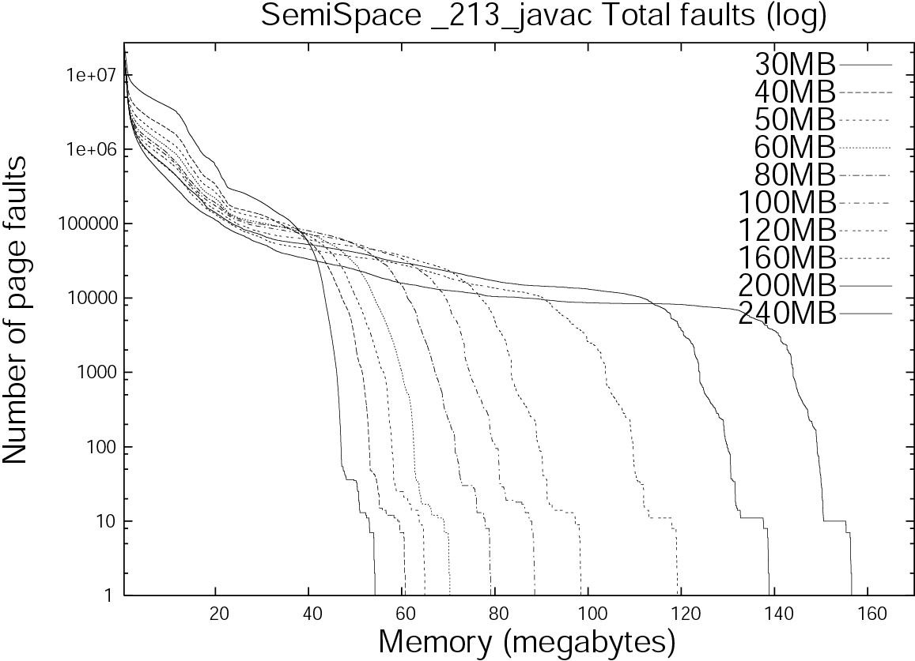

Slide 6
Paging Behavior Analysis
Each curve has three regions
  Extreme paging: left end; larger heaps better
  Substantial paging: “plateau”, GC “looping” behavior
  Sharp drop: heap fits
Heap footprint model:
  Footprint = a*HeapSize + b
  a depends only on GC algorithm:
    For SS and Appel: 1/2; for MS: 1
  b depends on Jikes RVM and on application live data size

Slide 7
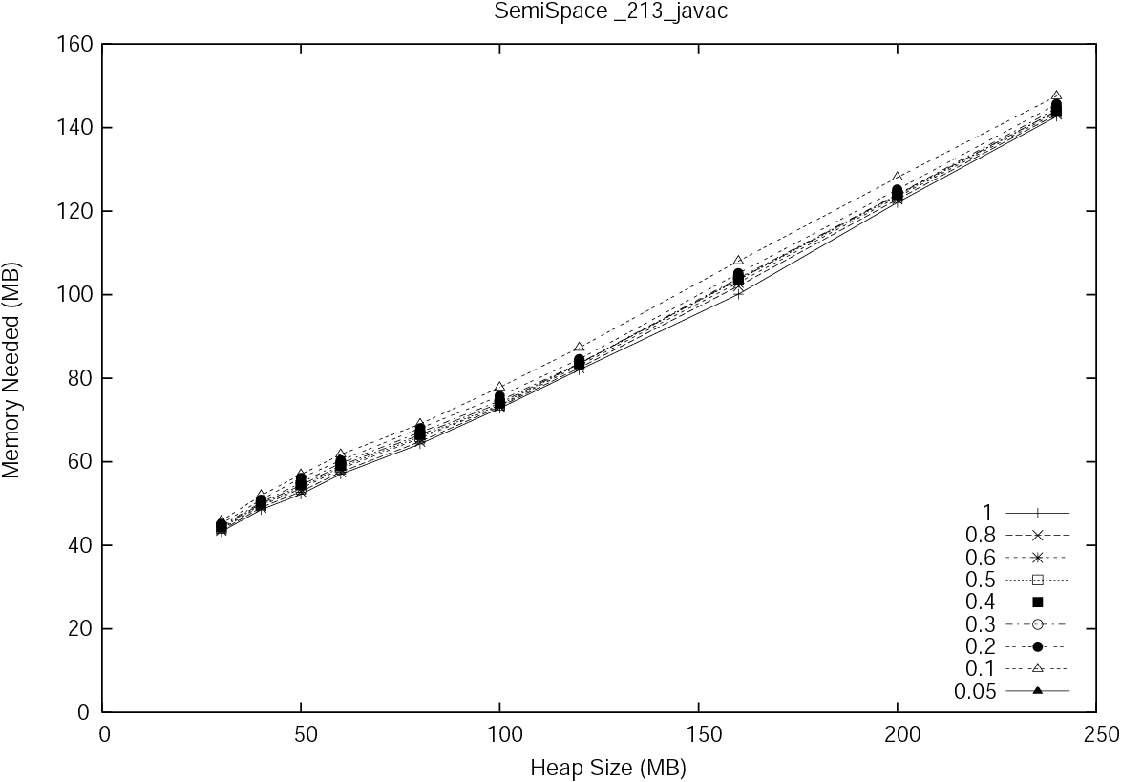

Slide 8
Modeling Cooperative GC
Extended DSS to:
  Support OS paging model
  Add footprint calculation:
  Add communication to GC (system calls)
Extended SS and Appel GCs to:
  Request footprint, real memory allocation
  Use them to adjust heap size
    Careful about growing heap
    Careful in using info from nursery GCs (Appel)

Slide 9
Experimental Results
Adjusting with fixed memory size:
Increases heap size to reduce # of GCs
Decreases heap size to reduce paging
Heap size about right: close to static GC

Slide 10
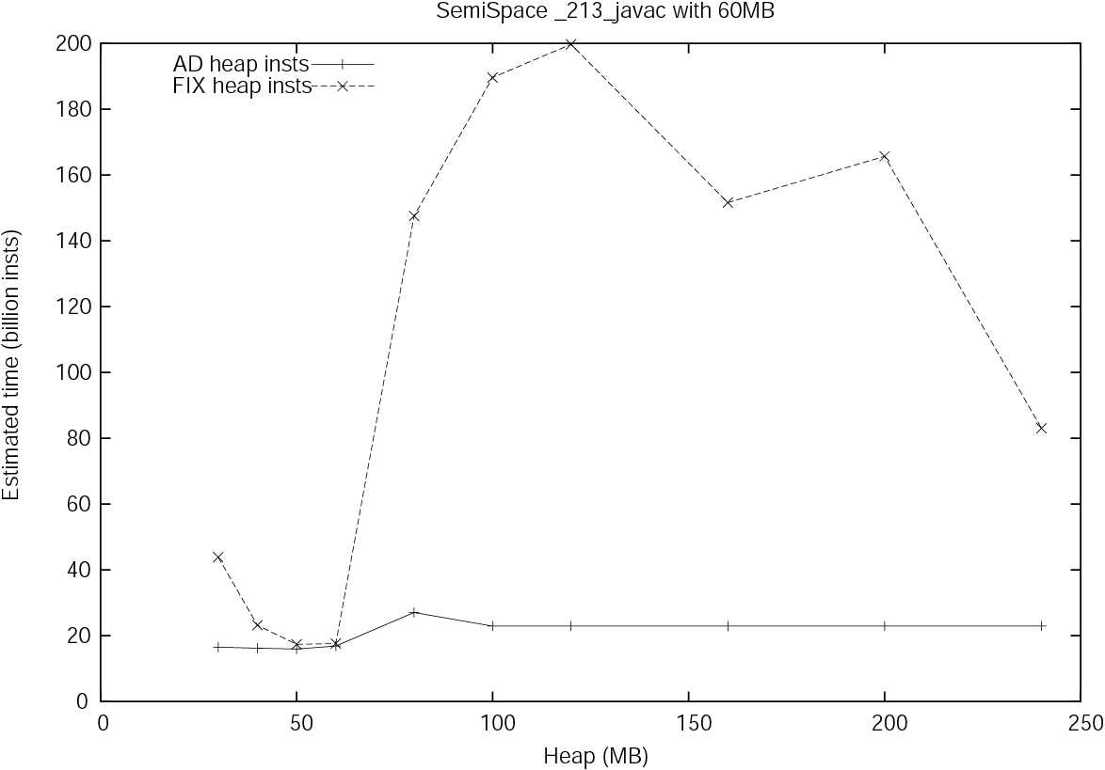

Slide 11
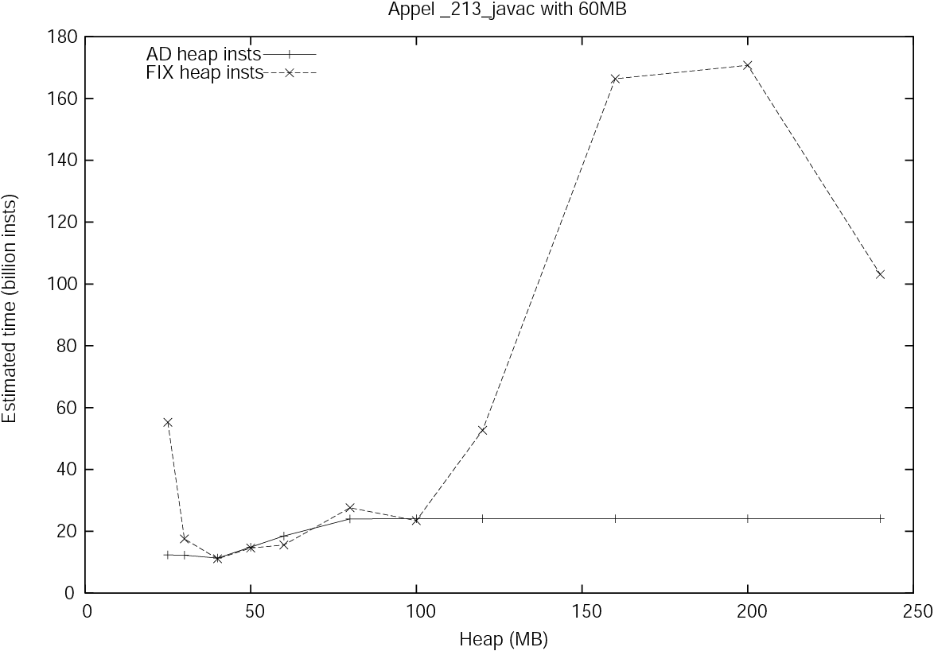

Slide 12
Experimental Results
Adjusting with changing memory size:
Increases heap when memory increases
Decreases heap when memory decreases
Dominates static GC’s performance

Slide 13
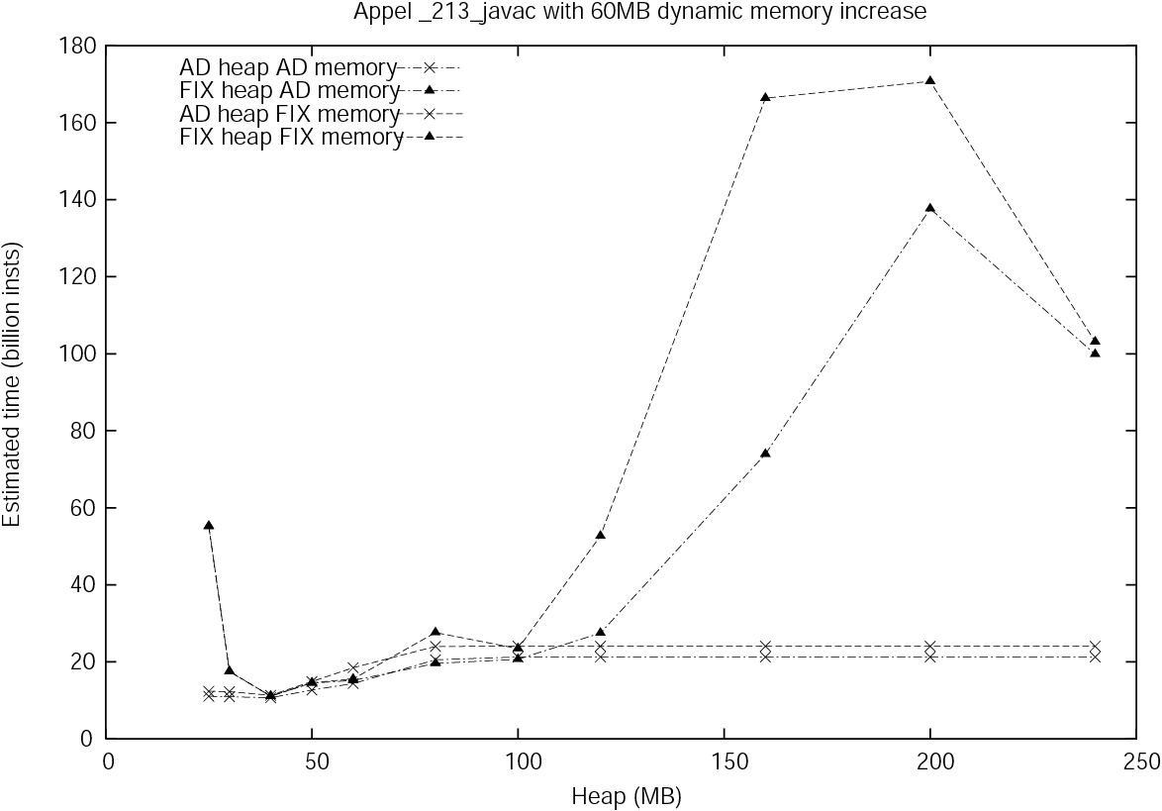

Slide 14
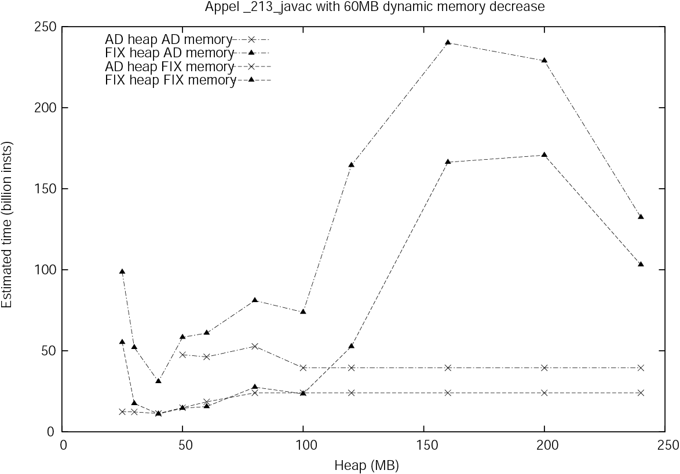

Slide 15
Conclusion
Footprint formula accurate in most cases
New collector usually picks heap size that:
  Maximizes memory utilization (reducing GCs)
  While avoiding paging
New collector adapts quickly to steady and to changing real memory allocations

