Slide 1

Automatic Heap Sizing
Ting Yang, Matthew Hertz
Emery Berger, Eliot Moss
University of Massachusetts
Scott Kaplan
Amherst College

Slide 2
Problem & Motivation
Important to select right heap size
  Too small: frequent GCs, less progress
  Too large: excessive paging overhead
Previous work
  Pick “optimal size”, given static real memory
BUT multiprogramming = dynamic real RAM
  Cannot select heap size a priori
  Must adjust during execution

Slide 3
Cooperation with VMM
GC needs support from virtual memory mgr:
  VMM determines footprint
    Memory needed to avoid % of misses that fault
  GC can then adjust heap
Need to add info & communication:
  GC requests footprint and real memory
  VMM collects needed information
    Informs GC on demand

Slide 4
Tracking Footprint
“hot”
“cold”
unprotected
protected
(dynamic)
hits
LRU stack position (pages)
Maintain (decayed) histogram per page position
  Provides value to application of n pages, for any n

Slide 5
GC Paging Behavior
Need to understand relationship:
  Heap size, footprint, GC algorithm
Analysis methodology:
  Obtain reference trace
  Simulate Jikes RVM under DSS
  Process LRU stack → # faults at all memory sizes
Experiments:
  GC: Mark-Sweep, Semi-Space, and Appel
  Benchmarks: SPECjvm98, ipsixql, and pseudojbb

Slide 6
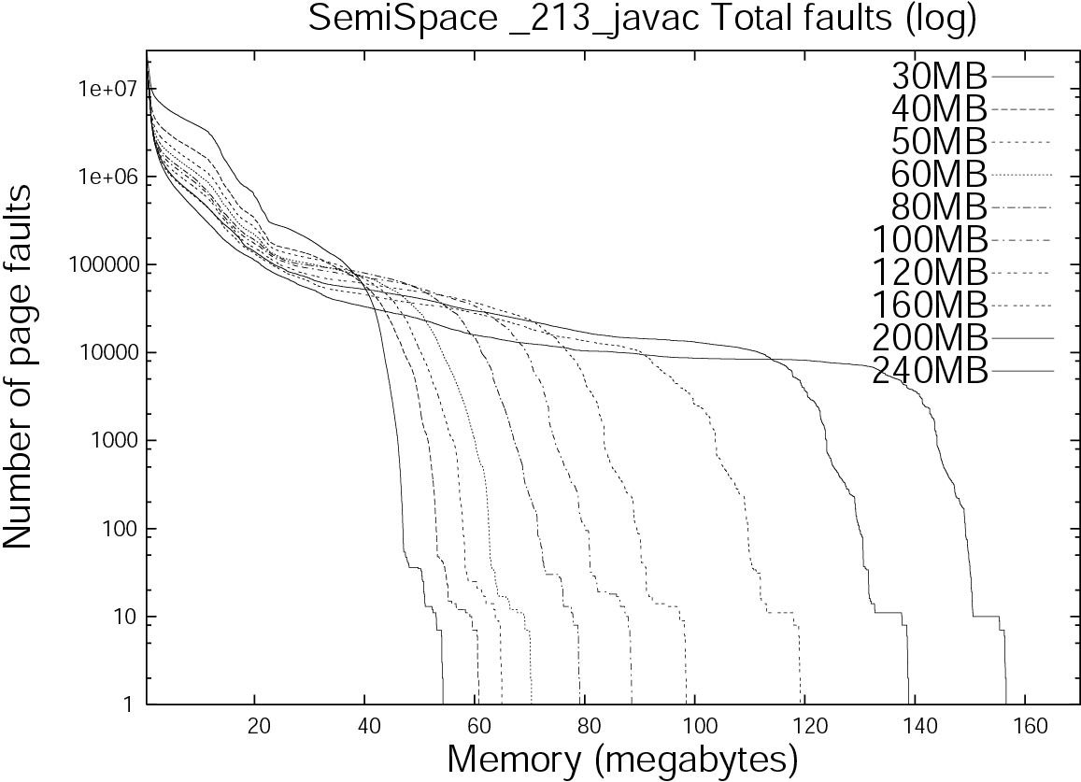
Paging Behavior
Three regions
  Extreme paging:
    larger heaps better
  Substantial paging:
    “plateau”
    GC “looping” behavior
  Drop in paging:
    heap fits in RAM

Slide 8
Paging Model
Propose linear heap footprint model, relating:
  Footprint
  Heap size
  GC algorithm
Model: Footprint = a*HeapSize + b
  a = intuitively, how much of heap we loop over
    depends on GC algorithm
    For SS and Appel: ½ (fill half then collect)
    For MS: 1
  b depends on Jikes RVM and application live data

Slide 9
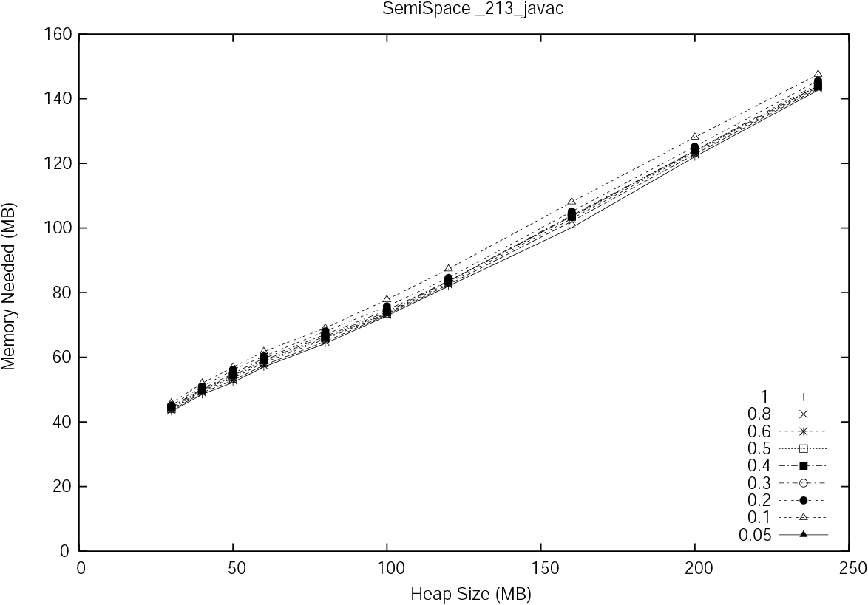
Validating Paging Model
Different thresholds t
of paging overhead
Good linear
fit

Slide 10
Modeling Cooperative GC
Extended DSS to:
  Simulate OS VMM
  Add footprint calculation
  Add communication to GC (system calls)
Extended SS and Appel GCs to:
  Request footprint, real memory allocation
  Use them to adjust heap size
    Careful about growing heap
    Careful in using info from nursery GCs (Appel)

Slide 11
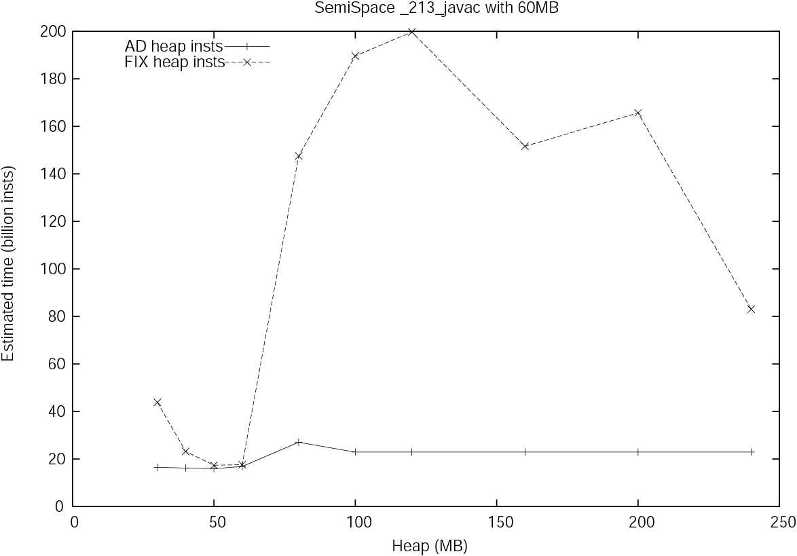
Experimental Results
Adjusting to fixed memory size:
  Increases heap size to reduce # of GCs
  Decreases heap size to reduce paging
  Heap size about right: close to static GC

Slide 13
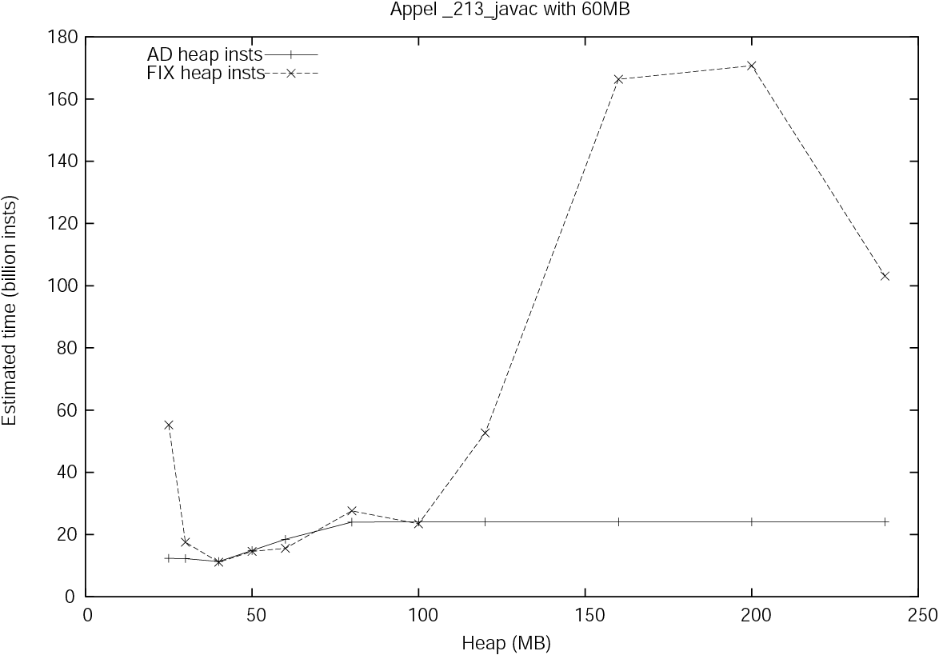

Slide 14
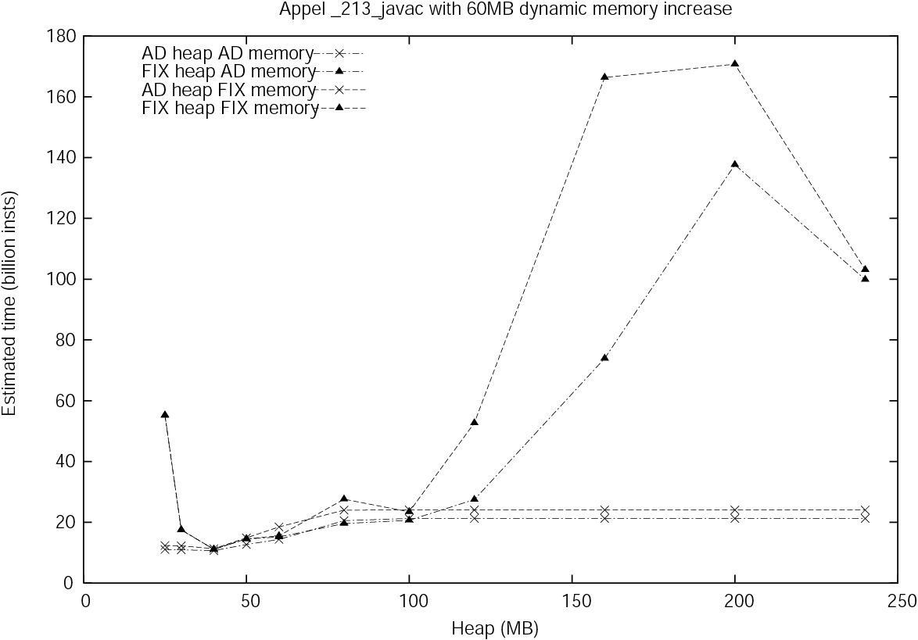
Experimental Results
Adjusting to changing memory size:
  Increases heap when memory increases
  Decreases heap when memory decreases
Dominates static GC’s performance
  Note: adjustable memory = higher throughput

Slide 16
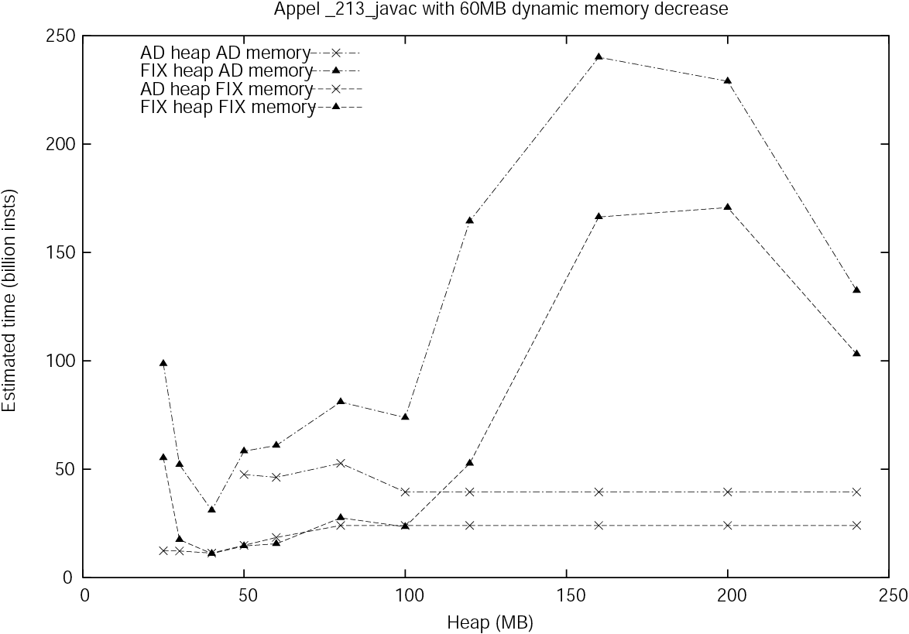

Slide 17
Conclusion
Automatic heap size adjustment
  Maximizes memory utilization
  Avoids paging
  Adapts quickly to steady and changing real memory allocations
Currently implementing VMM in Linux
  Useful for “scheduler-aware” virtual memory, and others

