Slide 1


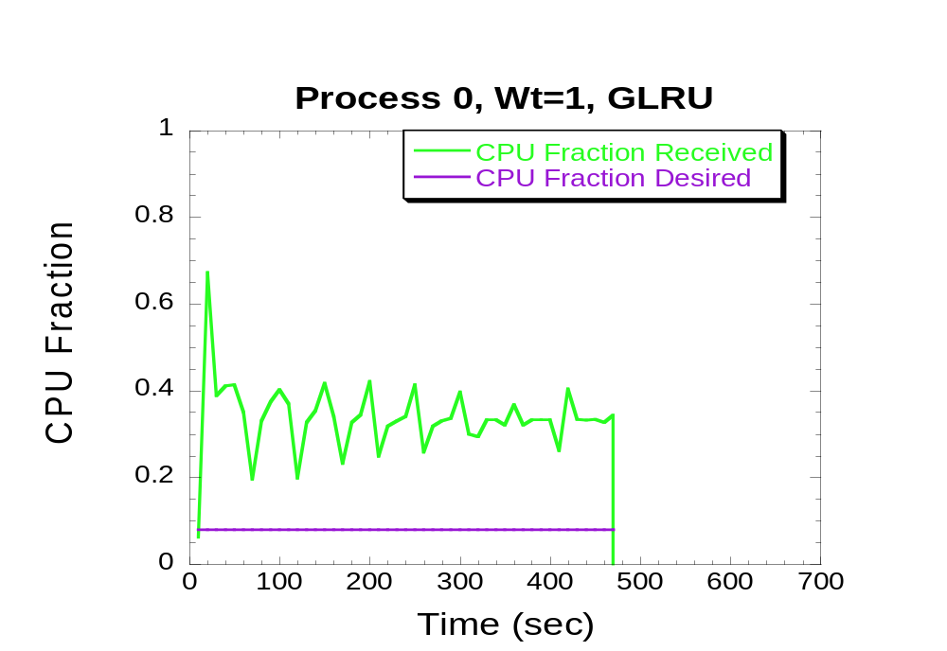
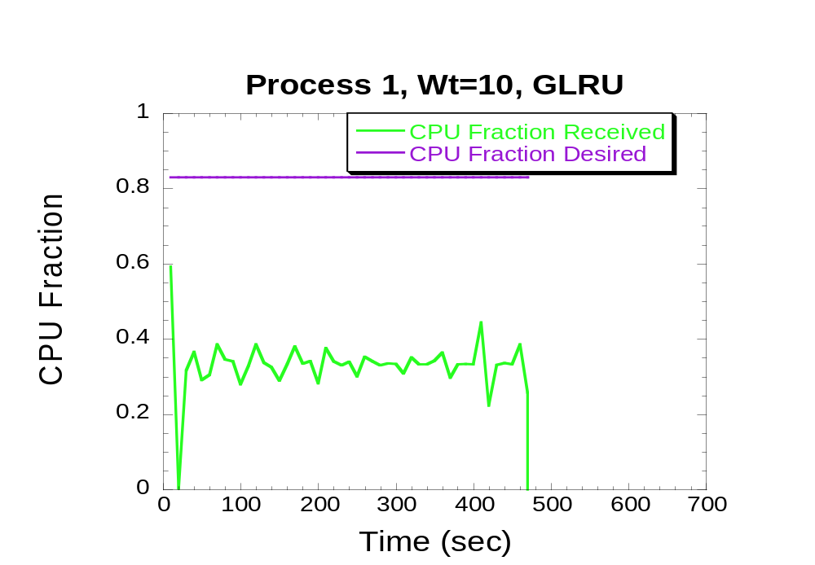
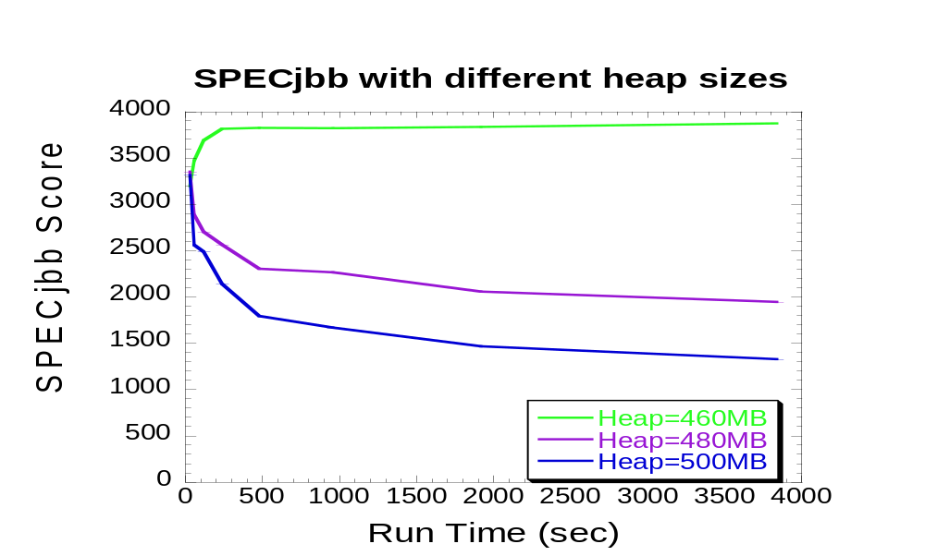
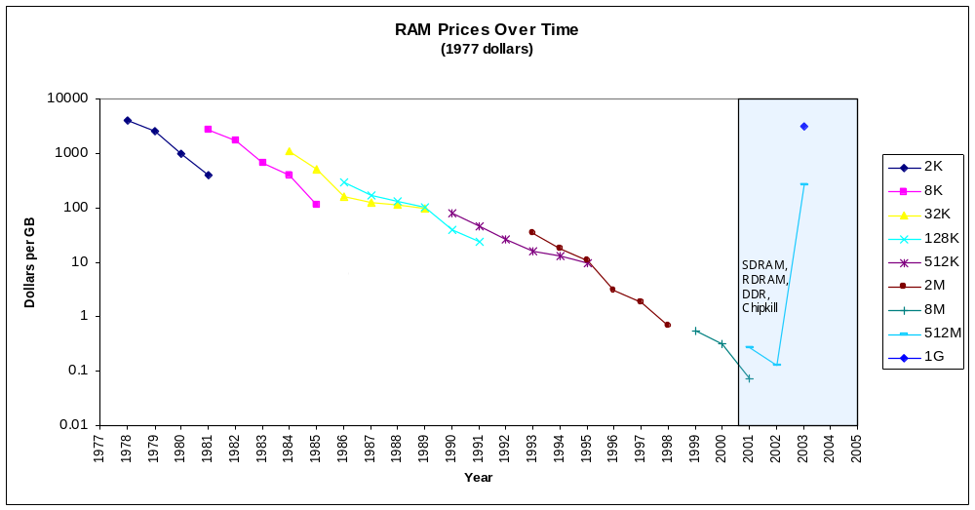
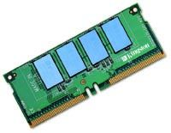



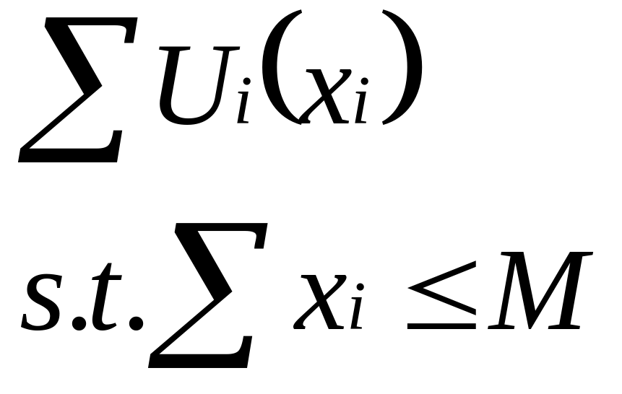

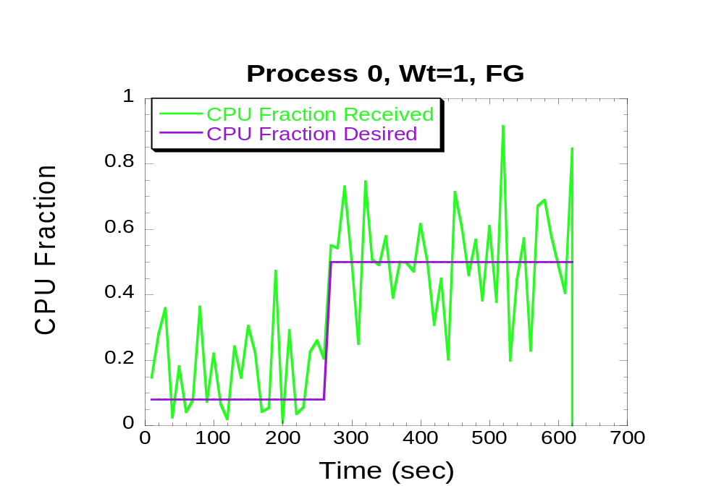
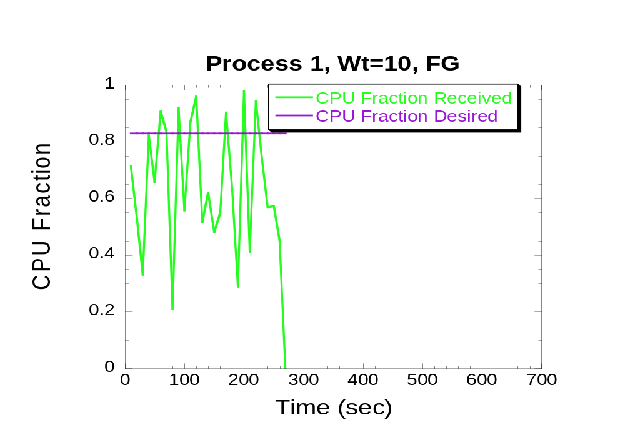
SAVMM: Scheduling Virtual Memory Under Load
Emery Berger, Scott F. Kaplan, Bhuvan Urgaonkar,
Pritesh Sharma, Abhishek Chandra, Prashant Shenoy
UMass Amherst & Amherst College
Current VM’s: Suffer Under Load
“Sleepy Head” problem, GLRU lacks fairness
Does not recognize process priorities.
Unpredictable behavior under memory pressure
memory manager = de facto CPU scheduler!!
Performance Bottleneck
(Server) Memory: Expensive
SAVMM: Scheduler-Aware Virtual Memory Management
Provide fairness while maintaining high throughput.
Utility based optimization problem :
Processes
Kernel Profiling to determine utility of pages per process
U_{i} – The Utility Function of Process i .
X_{i} – Number of pages allocated to process i .
M - Size of the Main Memory in pages.
MAXIMIZE:
Page allocation
CPU Weights
Optimizer
Optimizer
Per-Process Histogram
Solve optimization problem: determines page allocation.
Kernel Profiling
Scheduler
general optimization problem: too expensive
Memory Manager
Kernel Space
Use O(n) Forwards-Greedy (FG) heuristic .
User-Space
Optimal for concave utility curves .
preliminary results
ongoing work
Java-based trace driven simulator
Implementation of SAVMM in the Linux kernel
CPU schedulers & mem. management policies
- an extremely challenging task
Simulation results with FG heuristic:
Linux VMM: very complex beast !!
Efficient collection of per-process information: non-trivial
Evaluation of SAVMM with server applications.
e.g., Web servers (Apache), app servers, databases (MySQL)

