Slide 1


Eon: A language and runtime for perpetual systems
Jacob Sorber, Alexander Kostadinov, Matthew Garber,
Matthew Brennan†, Mark Corner, Emery Berger
University of Massachusetts Amherst
†University of Southern California

Slide 2
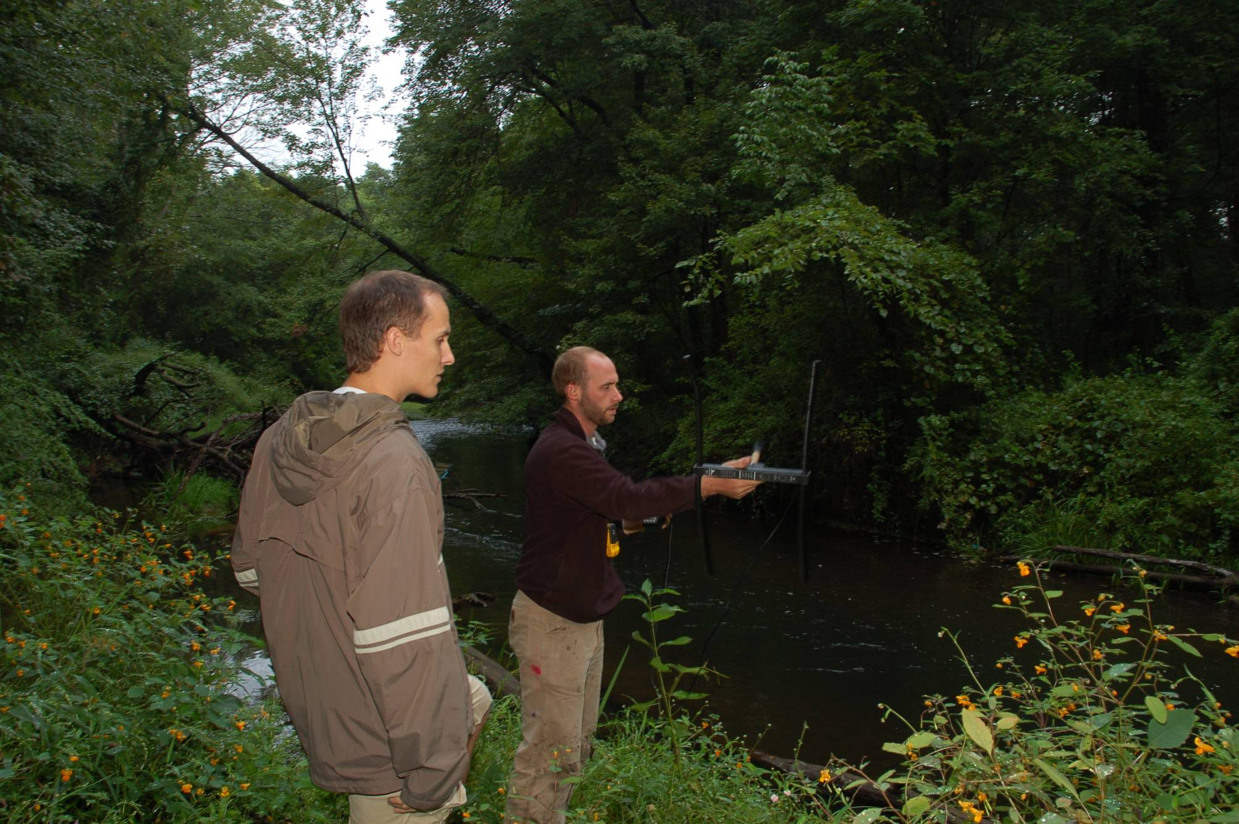

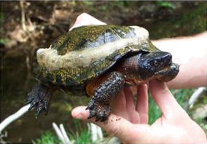
Example: Tracking Turtles
Wood turtle (Clemmys insculpta)
State of the art: Radio Telemetry
On-shell GPS tracking
  Small, lightweight, waterproof
  Need to last forever—a perpetual system

Slide 3
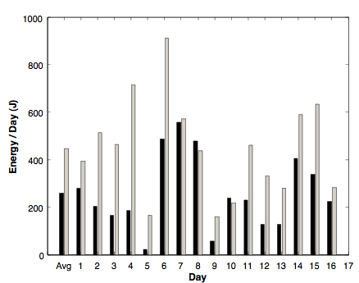
Daily Solar Production Varies
Weather and mobility = uncertain energy budget

Slide 4
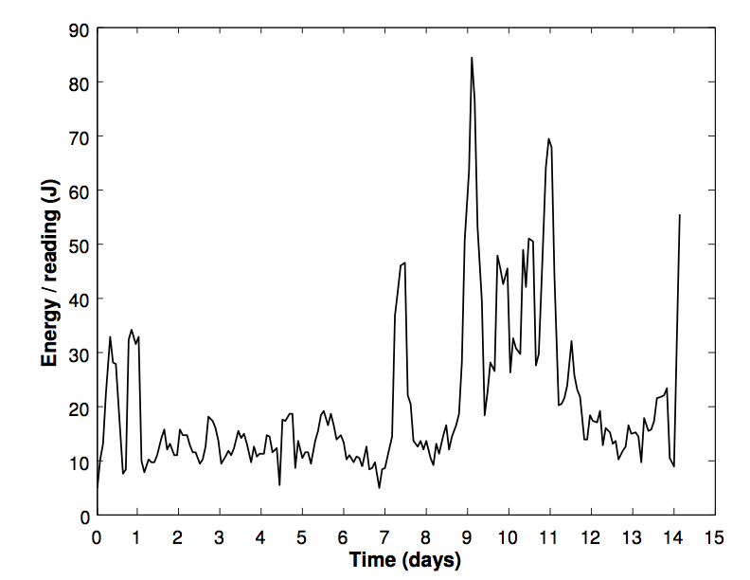
Energy Consumption Varies
GPS energy/reading is also uncertain

Slide 5
Challenges for Perpetual Systems
Variable energy budget
Size is limited
  Can’t overprovision
Always on GPS = 3 hour life
  Need an adaptive solution
Writing energy-aware code is difficult

Slide 6
Eon Language and Runtime
First energy-aware programming language
Tight link between program and runtime
  Explicit data flow and energy preferences
Measure energy harvesting and consumption
Automatically conserve energy as needed
  execute an alternate implementation
  adjust fine grained timers

Slide 7
Eon Programming Language
Coordination language
Structure: Directed Acyclic Graph
  Nodes = code written in C/NesC
  Edges = map node outputs to inputs
Execution starts at events
  Flow = path from event source to handler
Annotate Flows
  Describe how to conserve energy
GPSTimer
GetGPS
StoreData

Slide 8
Example Eon Program
// Predicate Types
typedef valid TestValid;
//Node declarations
GPSTimer() => ();
GPSFlow() => ();
GetGPS() => (GpsData_t data, bool valid);
HandleGPS(GpsData_t data, bool valid) => ();
LogData(GpsData_t data, bool valid) => ();
LogTimeout(GpsData_t data, bool valid) => ();
ListenRequest() => (msg_t msg);
ReadData(msg_t msg) => (msg_t msg);
SendData(msg_t msg) => ();
HandleRequest(msg_t msg) => ();
// Eon States
// there is always an implicit BASE state
stateorder {(HiGPS, Respond)};
// Sources
source ListenRequest => HandleRequest;
source timer GPSTiumer => GPSFlow;
// Adjustable Timer Limits
GPSTimer:[HiGPS] = (1 hr, 10 hr);
GPSTimer:[*] = 10 hr;
// Flows
GPSFlow = GetGPS -> HandleGPS;
HandleRequest:[*,*][Respond] = ReadData -> SendData;
HandleGPS:[*,valid][*] = LogData;
HandleGPS:[*,*][*] = LogTimeout;
GPSTimer
ListenRequest
(1 hr – 10 hr)
Respond?
// Adjustable Timer Limits
GPSTimer:[HiGPS] = (1 hr, 10 hr);
GPSFlow
HandleRequest
GetGPS
ReadData
HandleRequest:[*,*][Respond] = ReadData -> SendData;
valid?
HandleGPS
SendData
LogData
LogTimeout

Slide 9
Compiler
Check program graph for errors
Combine user and runtime system code
  Produce a single C/NesC program
Compile with gcc
Discrete-event simulator
Let’s run it

Slide 10
Runtime System
Basic flow execution
Choose sustainable energy state
High
Timer = 1 hr
High
…
Low
Timer = 5 hr
…
Timer = 10 hr
Low
What do we need to know?
  Solar energy
  Energy consumption
Not provided by most hardware.
Notes:
The runtime system does two things. It makes sure that the right data goes down the right flow, and it chooses a sustainable energy state for the system. Here’s the state space from our sample application. There are two states, High and Low, and High contains a timer range, so it is effectively a collection of many energy states.

Slide 11
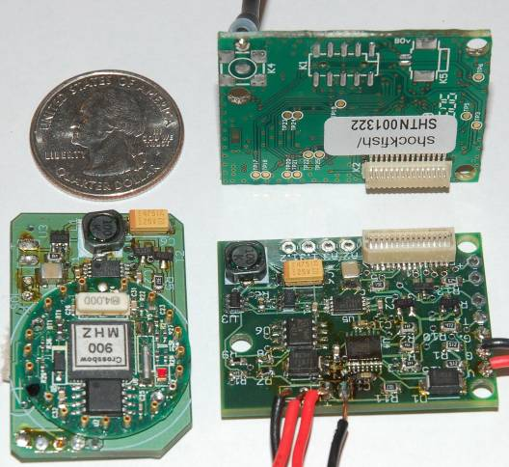
Hardware Support
Measures
  Energy harvested
  Per-flow energy
  Battery fullness
Energy independence
  Easily change hardware
  No offline profiling
Charge control: Heliomote
Only required for energy adaptation
Notes:
Modest support
Works without it

Slide 12
Choosing an energy state
Goal: Avoid empty and full battery
Predict outcomes per state
Detailed predictions are complex
  Too complex for motes
  Near-sighted approximation
100%
Battery
50%
0%
8
16
24
32
40
48
56
64
Time (hours, future)

Slide 13
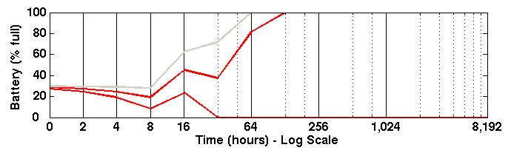
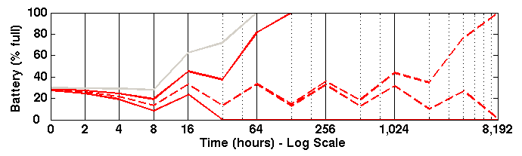
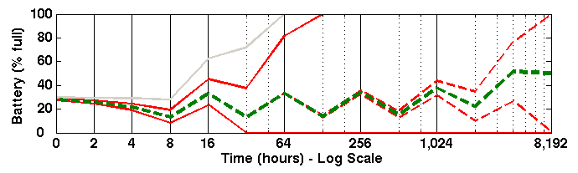
Choosing an energy state (cont)
Avoid Waste
Low
High(Min)
Avoid Empty
High(Max)
Choose between High and Low
Timer ranges: find two settings
  Avoid empty battery
  Avoid full battery
Any setting in between is sustainable
Done! Now do it again.

Slide 14
Evaluating Eon
Performance
  How well does Eon manage its energy?
Usability
  Does Eon make adaptive code easier?

Slide 15
Performance Evaluation
Vehicle tracking (proxy for hibernating turtles)
Trace-based simulations
  Five two-week traces
  Replay with different policies
Two static policies
  Conservative
  Greedy
Two oracle policies
  Best static (energy known beforehand)
  Eon w/energy oracle

Slide 16
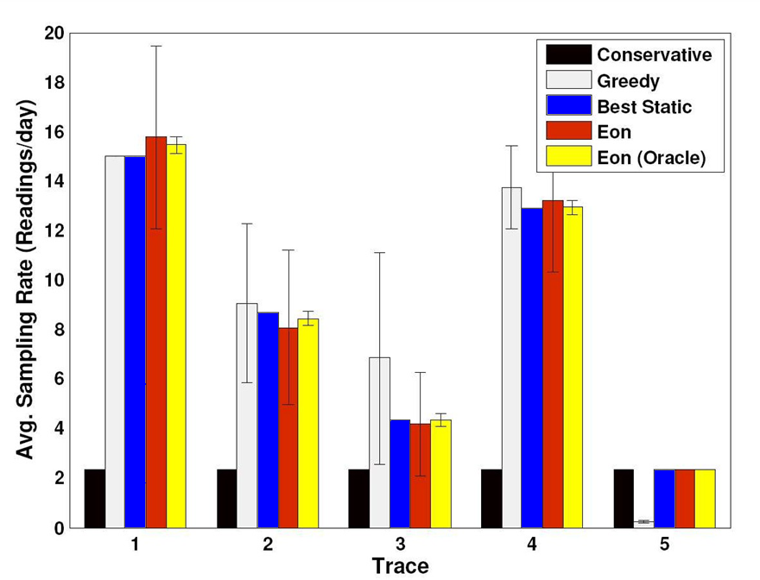
Eon Performance
0%
5%
30%
45%
65%
Eon performs on par with perfect weather prediction

Slide 17
User Study
Compare against a group coding in C
  Two groups of five users
Two phases
  Phase I: Simple app (Eon slightly slower)
  Phase II: Write adaptive version
Sensor Coverage
Time

Slide 18
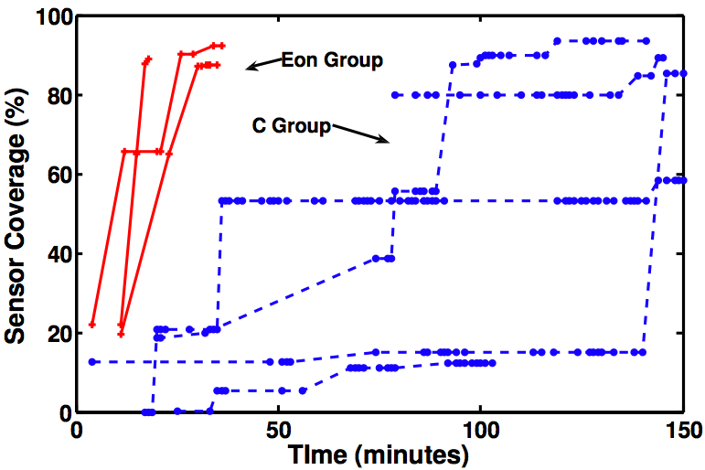
Writing adaptive code
Eon group performed 4x faster.

Slide 19
Conclusion
Eon: a language and runtime system for self-adapting perpetual systems
Ongoing work with turtles
  deployment in the coming months
Not just for adaptive programs
Code available for download
  http://prisms.cs.umass.edu/~sorber/eon

