Slide 1
Exterminator:
Automatically Correcting Memory Errors with High Probability
Gene Novark Emery Berger
University of Massachusetts Amherst
Ben Zorn
Microsoft Research
TexPoint fonts used in EMF.
Read the TexPoint manual before you delete this box.: AAAAA

Slide 2
Problems with Unsafe Languages
C, C++: pervasive apps, but unsafe
Numerous opportunities for security vulnerabilities, errors
  Double/Invalid free
  Uninitialized reads
  Dangling pointers
  Buffer overflows (stack & heap)
DieHard: eliminates some, probabilistically avoids others [PLDI 2006]
  Exterminator: builds on DieHard

Slide 3
DieHard Overview
[PLDI 2006]
Use randomization & (optionally) replication to reduce risk of memory errors
  Objects randomly spread across heap
Different run = different heap
  Probabilistic memory safety
    Errors across heaps independent
object size = 2^{i+3}
object size = 2^{i+4}
2
4
5
3
1
6
3
…
Run 1: “malignant” overflow
Run 2: “benign” overflow
1
6
3
2
5
4
1
…

Slide 4
DieHard Limitations
DieHard:
  Fine for single error
    But multiple errors eventually swamp probabilistic protection
    Not great for large overflows
  Tolerates errors
    But doesn’t find them
    No information for programmer
Exterminator:
Automatically isolate and fix memory errors

Slide 5
Diagnosing Buffer Overflows
Canonical buffer overflow:
  Allocate object – too small
  Write past end ) nukes object δ bytes forward
    Not necessarily contiguous
char * str = new char[8];
strcpy (str, “goodbye cruel world”);

Slide 6
Diagnosing Buffer Overflows
Canonical buffer overflow:
  Allocate object – too small
  Write past end ) nukes object δ bytes forward
    Not necessarily contiguous
char * str = new char[8];
strcpy (str, “goodbye cruel world”);

Slide 7
Diagnosing Buffer Overflows
Canonical buffer overflow:
  Allocate object – too small
  Write past end ) nukes object δ bytes forward
    Not necessarily contiguous
char * str = new char[8];
strcpy (str, “goodbye cruel world”);
bad object
(too small)

Slide 8
Diagnosing Buffer Overflows
Canonical buffer overflow:
  Allocate object – too small
  Write past end ) nukes object δ bytes forward
    Not necessarily contiguous
char * str = new char[8];
strcpy (str, “goodbye cruel world”);
δ bytes past end
bad object
(too small)

Slide 9

Diagnosing Buffer Overflows
Canonical buffer overflow:
  Allocate object – too small
  Write past end ) nukes object δ bytes forward
    Not necessarily contiguous
char * str = new char[8];
strcpy (str, “goodbye cruel world”);
δ bytes past end
bad object
(too small)

Slide 10
Diagnosing Buffer Overflows
Canonical buffer overflow:
  Allocate object – too small
  Write past end ) nukes object δ bytes forward
    Not necessarily contiguous
char * str = new char[8];
strcpy (str, “goodbye cruel world”);
δ bytes past end

Slide 11
Diagnosing Buffer Overflows
Canonical buffer overflow:
  Allocate object – too small
  Write past end ) nukes object δ bytes forward
    Not necessarily contiguous
char * str = new char[8];
strcpy (str, “goodbye cruel world”);
δ bytes past end

Slide 12
Diagnosing Buffer Overflows
Canonical buffer overflow:
  Allocate object – too small
  Write past end ) nukes object δ bytes forward
    Not necessarily contiguous
char * str = new char[8];
strcpy (str, “goodbye cruel world”);
δ bytes past end

Slide 13
Diagnosing Buffer Overflows
Canonical buffer overflow:
  Allocate object – too small
  Write past end ) nukes object δ bytes forward
    Not necessarily contiguous
char * str = new char[8];
strcpy (str, “goodbye cruel world”);
δ bytes past end

Slide 14
Diagnosing Buffer Overflows
Canonical buffer overflow:
  Allocate object – too small
  Write past end ) nukes object δ bytes forward
    Not necessarily contiguous
char * str = new char[8];
strcpy (str, “goodbye cruel world”);
δ bytes past end
1. Heap provides no useful information

Slide 15
Diagnosing Buffer Overflows
Canonical buffer overflow:
  Allocate object – too small
  Write past end ) nukes object δ bytes forward
    Not necessarily contiguous
char * str = new char[8];
strcpy (str, “goodbye cruel world”);
δ bytes past end
2. No way to detect corruption

Slide 16


Isolating Buffer Overflows
Canaries in freed space detect corruption
known random value
dead canary = corruption
Red =
possible
bad
object
Green =
not
bad
object
8
10
2
9
3
4
5
1
7
# = object id (allocation time)

Slide 17
Isolating Buffer Overflows
Canaries in freed space detect corruption
  Run multiple times with “DieFast” allocator
Red =
possible
bad
object
Green =
not
bad
object
8
10
2
9
3
4
5
1
7

Slide 18






Isolating Buffer Overflows
Canaries in freed space detect corruption
  Run multiple times with “DieFast” allocator
Red =
possible
bad
object
Green =
not
bad
object
8
10
2
9
3
4
5
1
7
1
8
7
5
3
10
2
9
6
4

Slide 19
Isolating Buffer Overflows
Canaries in freed space detect corruption
  Run multiple times with “DieFast” allocator
  Key insight: Overflow must be at same δ
Red =
possible
bad
object
Green =
not
bad
object
8
10
2
9
3
4
5
1
7
1
8
7
5
3
10
2
9
6
4

Slide 20

Isolating Buffer Overflows
Canaries in freed space detect corruption
  Run multiple times with “DieFast” allocator
  Key insight: Overflow must be at same δ
Red =
possible
bad
object
Green =
not
bad
object
8
10
2
9
3
4
5
1
7
1
8
7
5
3
10
2
9
6
4

Slide 21

Isolating Buffer Overflows
Canaries in freed space detect corruption
  Run multiple times with “DieFast” allocator
  Key insight: Overflow must be at same δ
Red =
possible
bad
object
Green =
not
bad
object
8
10
2
9
3
4
5
1
7
1
8
7
5
3
10
2
9
6
4

Slide 22

Isolating Buffer Overflows
Canaries in freed space detect corruption
  Run multiple times with “DieFast” allocator
  Key insight: Overflow must be at same δ
Red =
possible
bad
object
Green =
not
bad
object
8
10
2
9
3
4
5
1
7
1
8
7
5
3
10
2
9
6
4

Slide 23



Isolating Buffer Overflows
Canaries in freed space detect corruption
  Run multiple times with “DieFast” allocator
  Key insight: Overflow must be at same δ
) object 9 overflowed, with high probability
Red =
possible
bad
object
Green =
not
bad
object
8
10
2
9
3
4
5
1
7
1
8
7
5
3
10
2
9
6
4
4
9
6
8
2
5
7
3
1

Slide 24

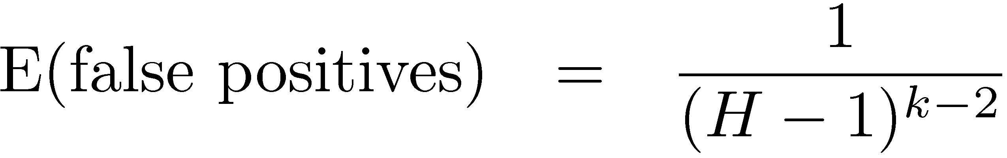

Buffer Overflow Analysis
8
10
2
9
3
4
5
1
7
1
8
7
5
3
10
2
9
6
4
  Example: H = 1,000,000 objects
  3 iterations ¼ false positives
Iterations exponentially increase precision
4
9
6
8
2
5
7
3
1
H = # heap objects
K = # iterations

Slide 25
Isolating Dangling Pointers
Dangling pointer error:
  Live object freed too soon
  Overwritten by some other object
int * v = new int[4];
…
delete [] v; // oops
…
char * str = new char[16];
strcpy (str, “die, pointer”);
v[3] = 12;
… use of v[0]

Slide 26


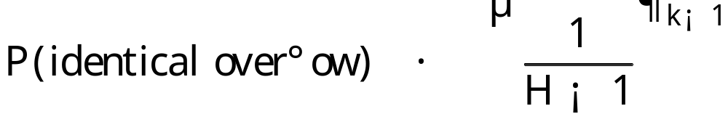
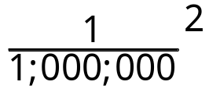
Isolating Dangling Pointers
Unlike buffer overflow:
  dangling pointer ) same corruption in all
  k = 3 ) false negatives ¼
8
11
2
9
3
6
4
5
10
1
12
7
1
8
7
5
3
12
2
9
11
4
6
10
4
10
6
4
8
2
12
5
7
3
1
9

Slide 27
Correcting Allocator
Generate runtime patches to correct errors
  Track object call sites in allocator
Prevent overflows: pad overflowed objects
malloc(8) ⇒ malloc(8 + δ)
Prevent dangling pointers: defer frees
free(ptr) ⇒ delay δ mallocs;
free(ptr)
1
⇒
1

Slide 28
Exterminator Architecture
Three main pieces:
  DieHard-based allocator (DieFast)
    Reveals bugs
  Error isolator
    Finds bugs across multiple heaps w.h.p.
  Correcting allocator
    Fixes bugs
Multiple modes suitable for testing (debugging) or deployment

Slide 29
Exterminator Modes
Iterative
  Run multiple times
  Same inputs
  Debugging
Replicated
  Run simultaneously
  Deployable w/limitations
  Can fix errors on-the-fly
Cumulative
  Different inputs, nondeterminism
  Deployable; see paper for details
runtime patches
Error isolator
correcting allocator
seed
DieFast replica₁
input
correcting allocator
output
seed
DieFast replica₂
broadcast
vote
correcting allocator
seed
DieFast replica₃
Notes:
Cumulative has fewer limitations: multithreaded, different inputs, nondeterminism.

Slide 30
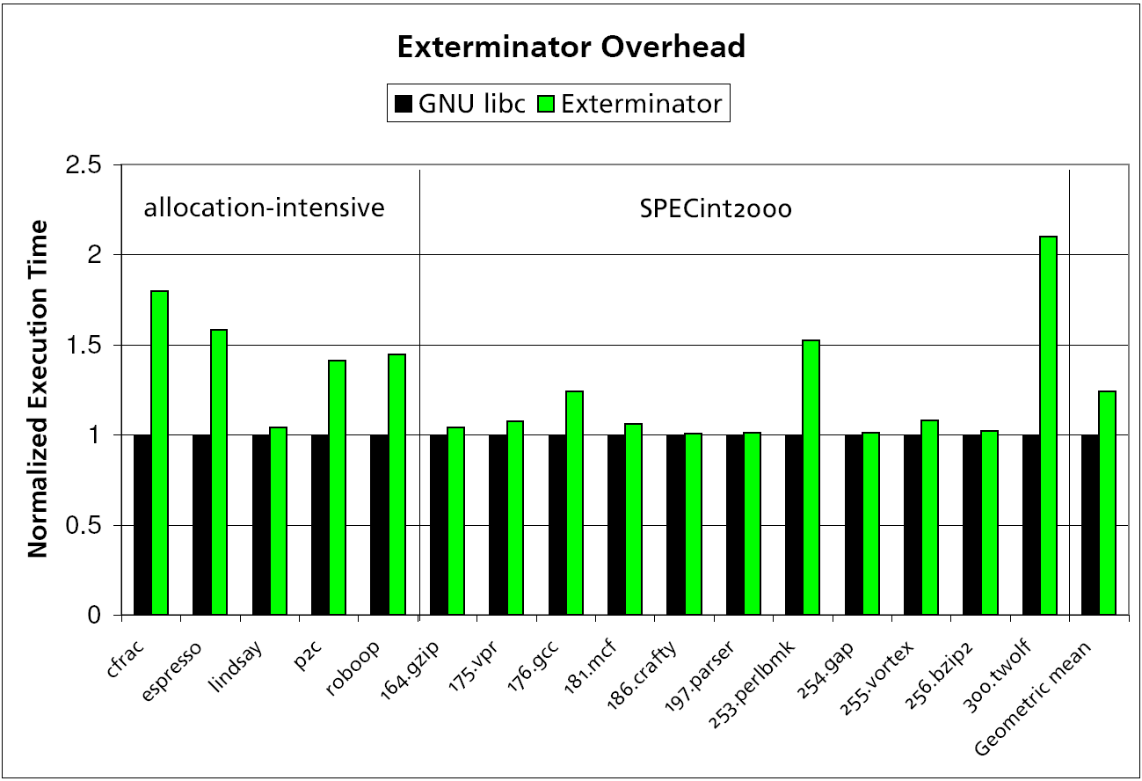
Exterminator Runtime Overhead
25%

Slide 31
Empirical Results: Real Faults
Squid heap overflow
  Crashes glibc 2.8.0 and BDW collector
  3 iterations to fix ) 6 byte pad
    Prevents overflow for all subsequent executions

Slide 32
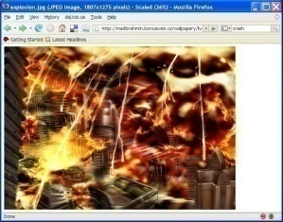
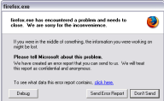
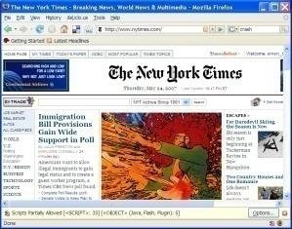
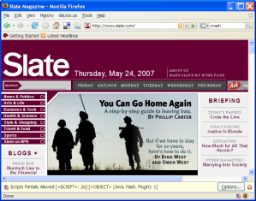
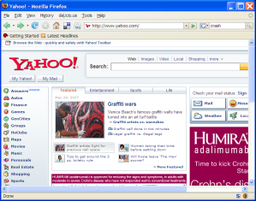
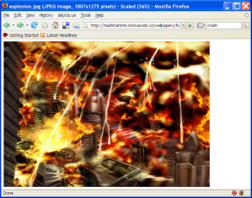
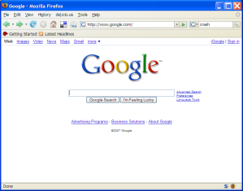
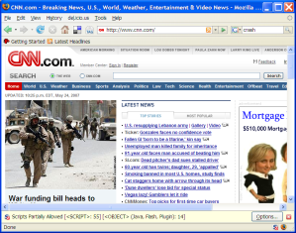
Empirical Results: Real Faults
Mozilla 1.7.3 buffer overflow
  Debug scenario:
    repeated load of PoC: 23 runs to fix overflow
  Deployed scenario:
    different browsing sessions: 34 runs to fix
1
2
3
1
2

Slide 33
Exterminator Conclusion
Exterminator: automatic error correction w.h.p.
  Randomization ⇒ bugs have different effects
  Statistical analysis combines information from multiple runs to isolate error
  Correcting allocator eliminates bugs at runtime
http://www.cs.umass.edu/~gnovark/

Slide 34


Slide 35
DieHard, heap layout
object size
allocation space
8
1
2
4
3
6
5
inUse
6
inUse
inUse
bitmap
2
4
16
1
inUse
miniheaps
1
inUse
1
Bitmap-based, segregated size classes
  Bit represents one object of given size
    i.e., one bit = 2^{i+3} bytes, etc.
malloc(): randomly probe bitmap for free space
free(): just reset bit

Slide 36

Exterminator Extensions
single miniheap
00000001
allocation bitmap
heap
DieHard
Exterminator
2
1
3
object id (serial number)
A₄
A₈
A₃
alloc site
D₉
D₆
dealloc site
3
2
dealloc time
Notes:
Next: Exterminator replicated mode diagram
Heap layout for all modes,
Like DieHard, there’s a replicated mode….:`

