Slide 1

Flux
A Language for Programming
High-Performance Servers
Emery Berger
University of Massachusetts Amherst
  with Brendan Burns, Kevin Grimaldi, Alex Kostadinov & Mark Corner
  to appear, USENIX 2006 Technical Conference

Slide 2

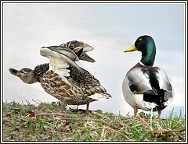








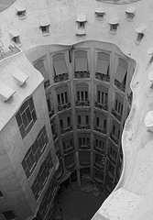




Image Server Example
image
server
Images in RAW format
Client
  Requests image @ desired quality, size
Server
  Compresses images
  Caches requests
  Sends to client
not found
http://server/Easter-bunny/
200x100/75
client

Slide 3
Scaling Up…
Sequential fine until:
  More clients
  Bigger server
    Multicores, multiprocessors
Hide latency, scale?
One approach: threads
  Limit reuse,
  risk deadlock,
  burden programmer
  Complicate debugging
image
server
libjpeg
clients

Slide 4
The Flux Language
Flux programmer describes flow
  Implicitly parallel = “one per client”
  Nodes: sequential C, C++, Java
Compiler generates:
  Deadlock-free server
  Discrete event simulator
Runtime:
  MT, Pool, events
  Hot path profiling

Slide 5
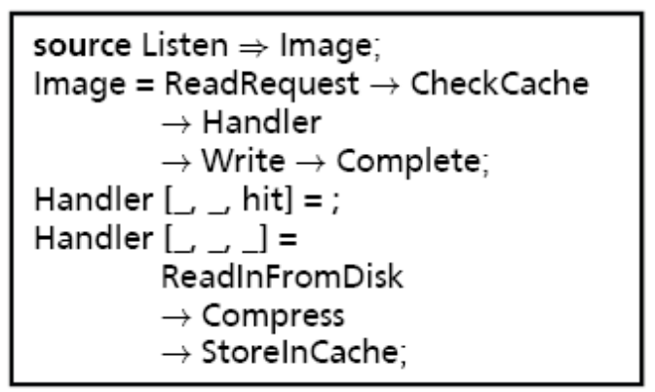
Flux Image Server
image
server
ReadRequest
CheckCache
hit
Write
Complete
ReadRequest
CheckCache
hit
Write
Complete
Listen
ReadInFromDisk
hit
ReadRequest
Compress
StoreInCache
CheckCache
Write
Complete
ReadInFromDisk
Compress
StoreInCache
ReadRequest
CheckCache
hit
Write
Complete
ReadInFromDisk
Compress
StoreInCache
ReadInFromDisk
Compress
StoreInCache
clients

Slide 6
Outline
Language overview
  Philosophy
  Constructs
  Deadlock avoidance
Performance results
  Running servers
  Simulator validation
Future work

Slide 7

Philosophy
“Make everything as simple as possible, but no simpler.”
  Few features
    Added only when needed
  Restricted to simplify analysis
    e.g., Flux programs acyclic
      Ensures deadlock-freedom
      Unique paths
      Easy to model
      Good enough so far!
  Language: easy to use

Slide 8
Source Nodes
Initiate data flows
  Execute in parallel with data flows
  Inside implicit infinite loop
source Listen ) Image;
hit
Listen
ReadRequest
CheckCache
hit
Write
Complete
ReadRequest
CheckCache
Write
Complete
ReadInFromDisk
hit
ReadRequest
Compress
StoreInCache
ReadInFromDisk
CheckCache
Write
Complete
Compress
StoreInCache
ReadRequest
CheckCache
hit
Write
Complete
ReadInFromDisk
Compress
StoreInCache
ReadInFromDisk
Compress
StoreInCache

Slide 9
Abstract Nodes
Organize & compose data flows
  Connections type-checked
    Image = ReadRequest ! CheckCache
    ! Handler ! Write ! Complete;
ReadRequest
CheckCache
hit
Write
Complete
ReadRequest
CheckCache
hit
Write
Complete
Listen
ReadRequest
CheckCache
hit
Write
Complete
ReadInFromDisk
Compress
StoreInCache
ReadInFromDisk
Compress
StoreInCache
ReadInFromDisk
Compress
hit
StoreInCache
ReadRequest
CheckCache
Write
Complete
ReadInFromDisk
Compress
StoreInCache

Slide 10
Predicate types
Direct data flows
  “Type” applied to output
    typedef hit TestInCache;
    Handler:[_,_,hit] = ;
    Handler:[_,_,_] = ReadFromDisk
    ! Compress ! StoreInCache;
ReadRequest
CheckCache
hit
Write
Complete
ReadRequest
CheckCache
hit
Write
Complete
Listen
ReadRequest
CheckCache
hit
Write
Complete
ReadInFromDisk
Compress
StoreInCache
ReadInFromDisk
Compress
StoreInCache
ReadInFromDisk
Compress
hit
StoreInCache
ReadRequest
CheckCache
Write
Complete
ReadInFromDisk
Compress
StoreInCache

Slide 11
Concrete Nodes
Actual server logic implementation
  Name, input types, output types
Compress (int socket, char *raw, int size)
! (int socket, char *jpeg, int size)
ReadRequest
CheckCache
hit
Write
Complete
ReadRequest
CheckCache
hit
Write
Complete
Listen
ReadRequest
CheckCache
hit
Write
Complete
ReadInFromDisk
Compress
StoreInCache
ReadInFromDisk
Compress
StoreInCache
ReadInFromDisk
Compress
hit
StoreInCache
ReadRequest
CheckCache
Write
Complete
ReadInFromDisk
Compress
StoreInCache
libjpeg

Slide 12
Atomicity Constraints
Maintain shared state consistency
  Same constraints ) mutual exclusion
    atomic CheckCache: {cache};
    atomic StoreInCache: {cache};
    atomic Complete: {cache};
ReadRequest
CheckCache
hit
Write
Complete
ReadRequest
CheckCache
hit
Write
Complete
Listen
ReadRequest
CheckCache
hit
Write
Complete
ReadInFromDisk
Compress
StoreInCache
ReadInFromDisk
Compress
StoreInCache
ReadInFromDisk
Compress
hit
StoreInCache
ReadRequest
CheckCache
Write
Complete
ReadInFromDisk
Compress
StoreInCache

Slide 13
Relaxed Atomicity
Reader / writer constraints
  Multiple readers or single writer
    atomic ReadList: {listAccess?};
    atomic AddToList: {listAccess!};
Per-session constraints
  One constraint per client / session
atomic AddHasChunk: {chunks(session)};

Slide 14
Preventing Deadlock
Establish canonical lock order
    X = A ! B;
    Y = C ! D;
    atomic A: {z};
    atomic B: {y};
    atomic C: {y};
    atomic D: {z};
    X = A ! B;
    Y = C ! D;
    atomic A: {y};
    atomic B: {z};
    atomic C: {y};
    atomic D: {z};
Currently just alphabetical order

Slide 15
Preventing Deadlock, II
Harder for abstract nodes…
Elevate “contained” constraints
A = B;
atomic A: {x};
atomic B: {y};
C = D;
atomic C: {y};
atomic D: {x};
A = B;
atomic A: {x};
atomic B: {y};
C = D;
atomic C: {x,y};
atomic D: {x};

Slide 16
Error Handlers
Problem: errors happen in middle
  Error handlers skip normal execution
handle error ReadInFromDisk
! FourOhFour;
ReadRequest
CheckCache
hit
Write
Complete
ReadRequest
CheckCache
hit
Write
Complete
Listen
ReadRequest
CheckCache
hit
Write
Complete
ReadInFromDisk
Compress
StoreInCache
ReadInFromDisk
Compress
StoreInCache
ReadInFromDisk
Compress
hit
StoreInCache
ReadRequest
CheckCache
Write
Complete
ReadInFromDisk
Compress
StoreInCache
FourOhFour

Slide 17
Compiler & Runtimes
Three-pass compiler
  Java + JavaCUP + JLex
  Builds AST
  Type-checking & constraint reordering
    Deadlock avoidance algorithm
  Runtime-specific code generation
    Visualizations (Dot)
    Discrete-event simulator (CSim)
Runtimes
  Threaded (1:1 & n:1)
  Event-Driven

Slide 18
Results
We’ve built four servers so far:
  Image server (+ libjpeg)
  Multi-player online game
  Web server (+ PHP)
  BitTorrent (2 undergrads: 1 week!)
Evaluation
  Benchmark: variant of SPECweb99
  Two Linux machines (client,server), dedicated 1Gb network
  Compared to Capriccio [SOSP03], SEDA [SOSP01]

Slide 19
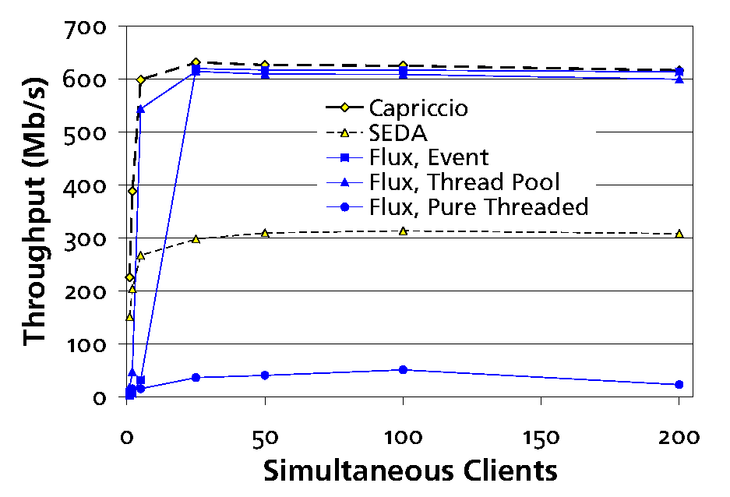
Web Server

Slide 20
Performance Prediction
Discrete event simulation
  Execute actual program
    Observe single CPU performance
  Execute simulator
    Predict multi-CPU performance
Validation
  Execute actual program on MP
    Compare observed to predicted

Slide 21
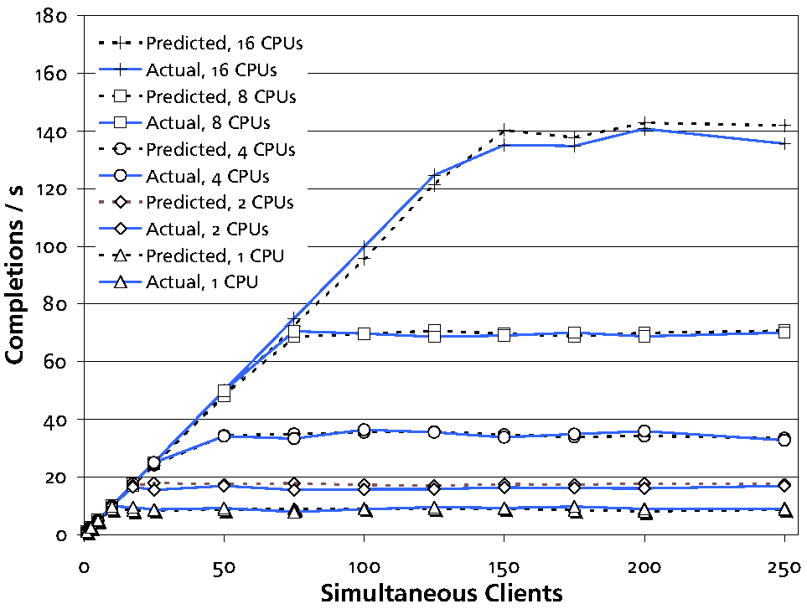
Performance Prediction

Slide 22
Flux Conclusions
Simplifies server programming
  Dataflow-like coordination language
  Separates logic and runtime
  Ease of use / Reuse
  Runtime independence
  Performance prediction
  Hot path profiling

Slide 23
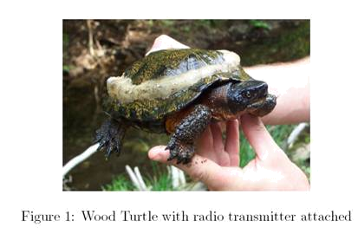
Future Work
Currently extending to:
  Distributed architectures (clusters)
  Embedded systems (turtles!)

Slide 24

The End
flux.cs.umass.edu
  Hosted by Flux web server; download via Flux BitTorrent
flux: from Latin fluxus,
p.p. of fluere = “to flow”

