Slide 1

Flux
A Language for Programming
High-Performance Servers
Brendan Burns, Kevin Grimaldi, Alex Kostadinov, Emery Berger, Mark Corner
University of Massachusetts Amherst

Slide 2















Motivation: Image Server
image
server
Client
  Requests image @ desired quality, size
Server
  Images: RAW
  Compresses to JPG
  Caches requests
  Sends to client
not found
http://server/Easter-bunny/
200x100/75
client

Slide 3
Problem: Concurrency
Sequential fine until:
  More clients
  Bigger server
    Multicores, multiprocessors
One approach: threads
  Limit reuse,
  risk deadlock,
  burden programmer
  Complicate debugging
  Mixes program logic & concurrency control
image
server
clients

Slide 4
The Flux Programming Language
High-performance & deadlock-free
concurrent programming w/ sequential components
Flux = Components + Flow + Atomicity
  Components = off-the-shelf C, C++, or Java
  Flow = path through components
    Implicitly parallel
  Atomicity = lightweight constraints
Compiler generates:
  Deadlock-free server
    Runtime independent (threads, events, …)
  Discrete event simulator

Slide 5
Outline
Intro to Flux: building a server
  Components
  Flows
  Atomicity
Performance results
  Server performance
  Performance prediction
Future work

Slide 6
Flux Server: Main
Source: one flow per connection
  Conceptually: separate thread
  Executes inside implicit infinite loop
source Listen → Image;
Listen
ReadRequest
Compress
Write
Complete
image server
ReadRequest
Compress
Write
Complete
ReadRequest
Compress
Write
Complete

Slide 7
Flux Image Server
Basic image server requires:
  HTTP parsing (http)
  Socket handling (socket)
  JPEG compression (libjpeg)
Single flow implements basic server:
Image = ReadRequest → Compress → Write → Complete;
image server
ReadRequest
Compress
Write
Complete
http
libjpeg
socket
http

Slide 8
Adding Caching
Cache frequently requested images
  Increase performance
Direct data flow with predicates
  Type test applied to output
typedef hit TestInCache;
Handler:[_,_,hit] = ;
Handler:[_,_,_] = ReadFromDisk → Compress → StoreInCache;
ReadRequest
CheckCache
hit
handler
Write
Complete
Listen
handler
ReadInFromDisk
Compress
StoreInCache

Slide 9
Supporting Concurrency
Many clients = concurrent flows
  Must keep cache consistent
Atomicity constraints
  Same name = mutual exclusion
  Multiple names, reader/writer, per-client (see paper)
atomic CheckCache {cacheLock};
atomic Complete {cacheLock};
atomic StoreInCache {cacheLock};
ReadRequest
CheckCache
hit
Write
Complete
ReadRequest
CheckCache
hit
Write
Complete
Listen
ReadRequest
CheckCache
hit
Write
Complete
ReadInFromDisk
Compress
hit
StoreInCache
ReadInFromDisk
Compress
handler
ReadRequest
CheckCache
StoreInCache
Write
Complete
ReadInFromDisk
Compress
StoreInCache
handler
ReadInFromDisk
Compress
StoreInCache

Slide 10
Preventing Deadlock
Naïve execution can deadlock
Establish canonical lock order
  Currently alphabetic by name
atomic A: {z,y};
atomic B: {y,z};
atomic A: {y,z};
atomic B: {y,z};

Slide 11
Preventing Deadlock, II
Harder with abstract nodes
A = B;
C = D;
atomic A{z};
atomic B{y};
atomic C{y,z}
A:{z}
A:{z}
A
C
C
C:{y}
B
B
B
Solution: Elevate constraints
A = B;
C = D;
atomic A{y,z};
atomic B{y};
atomic C{y,z}
A:{y,z}
C
B

Slide 12
Finally: Handling Errors
What if image requested doesn’t exist?
  Error = negative return value from component
Can designate error handlers
  Go to alternate paths on error
handle error ReadInFromDisk → FourOhFour;
hit
handler
ReadRequest
CheckCache
Write
Complete
Listen
handler
ReadInFromDisk
Compress
StoreInCache
FourOhFour

Slide 13
Complete Flux Image Server
source Listen → Image;
Image =
ReadRequest → CheckCache → Handler → Write → Complete;
Handler[_,_,hit] = ;
Handler[_,_,_] = ReadFromDisk → Compress → StoreInCache;
atomic CheckCache: {cacheLock};
atomic StoreInCache: {cacheLock};
atomic Complete: {cacheLock};
handle error ReadInFromDisk → FourOhFour;
Concise, readable expression of server logic
  No threads, etc.: simplifies programming, debugging
image
server
hit
ReadRequest
CheckCache
handler
Write
Complete
Listen
handler
ReadInFromDisk
Compress
StoreInCache

Slide 14
Outline
Intro to Flux: building a server
  Components, flow
  Atomicity, deadlock avoidance
Performance results
  Server performance
  Performance prediction
Future work

Slide 15
Results
Four servers:
  Image server (+ libjpeg) [23 lines of Flux]
  Multi-player online game [54]
  BitTorrent (2 undergrads: 1 week!) [84]
  Web server (+ PHP) [36]
Evaluation
  Benchmark: variant of SPECweb99
  Three different runtimes
    Thread, Thread pool, Event-Driven
  Compared to Capriccio [SOSP03], SEDA [SOSP01]

Slide 16
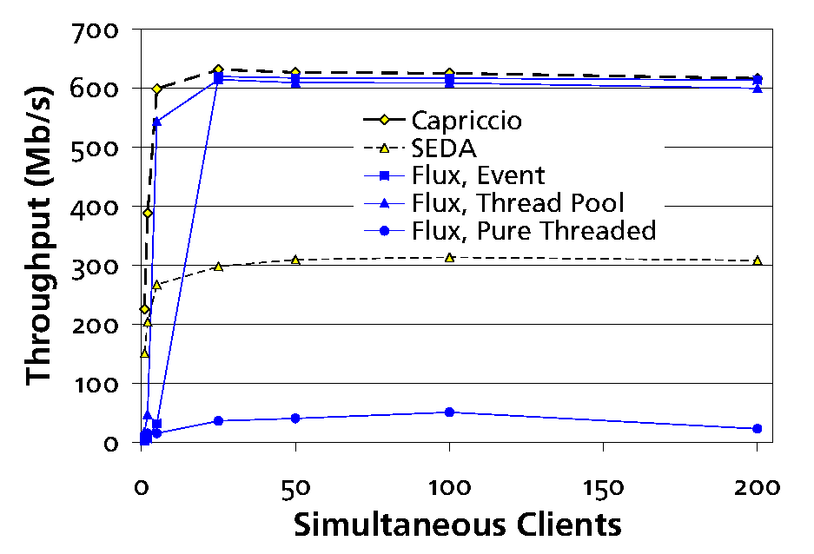
Web Server

Slide 17
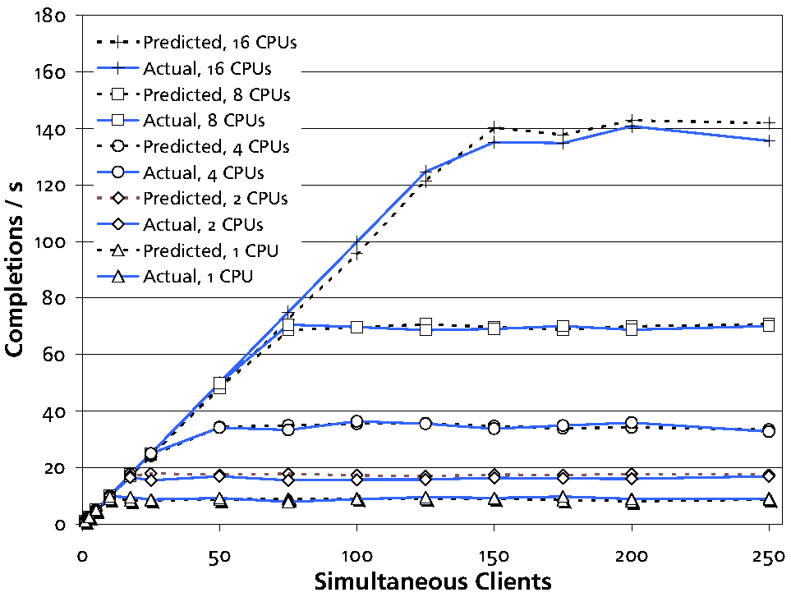
Performance Prediction
observed
parameters

Slide 18
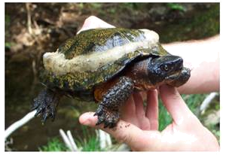
Future Work
Different runtimes
Distributed architectures
  Clusters
Embedded, power-aware systems
  Turtles!
  Embedded space similar to servers
  eFlux: includes power constraints
    Removes/adds flows dynamically
    in response to power

Slide 19

Conclusion
Flux: language for server programming
  Uses sequential code
  Separates logic and runtime
  Deadlock-free high-performance servers
  + simulators
flux.cs.umass.edu
  Hosted by Flux web server; download via Flux BitTorrent
flux: from Latin fluxus,
p.p. of fluere = “to flow”

Slide 20
Backup Slides

Slide 21
Relaxed Atomicity
Reader / writer constraints
  Multiple readers or single writer
    atomic ReadList: {listAccess?};
    atomic AddToList: {listAccess!};
Per-session constraints
  One constraint per client / session
atomic AddHasChunk: {chunks(session)};

