Slide 1

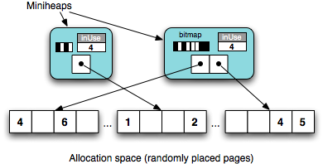
DieHarder: Securing Applications Against Heap Attacks
PI: Berger
Goal:
Make legacy C/C++ software resilient against security attacks and bugs
Approach:
Keep vulnerable parts of heap out of reach
Sparse structure “catches” attacks
Randomized placement + reuse render heap unpredictable
Results:
1
2
3
Greatly enhanced security
Low overhead
Inspired security hardening features in Windows 8 heap

Slide 2

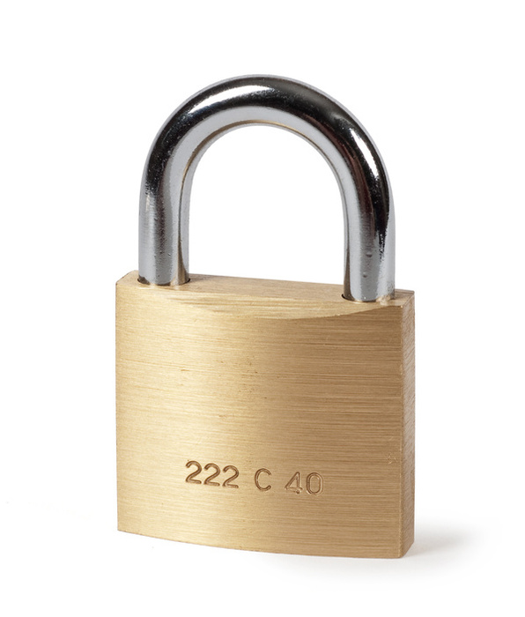
Dthreads: Resilience Against Concurrency Bugs
PI: Berger
Goal:
Make C/C++ software resilient to concurrency errors (e.g., races)
Approach:
No code modifications: just new library
Separate threads into processes: isolation
Update state only when necessary: prevents false sharing
Deterministically apply updates = no races!
Parallel
Serial
Parallel
“Thread” 1
“Thread” 2
“Thread” 3
Results:
No races, repeatable execution
Repeatable runs simplify debugging
Low overhead: can be faster than pthreads

Slide 3
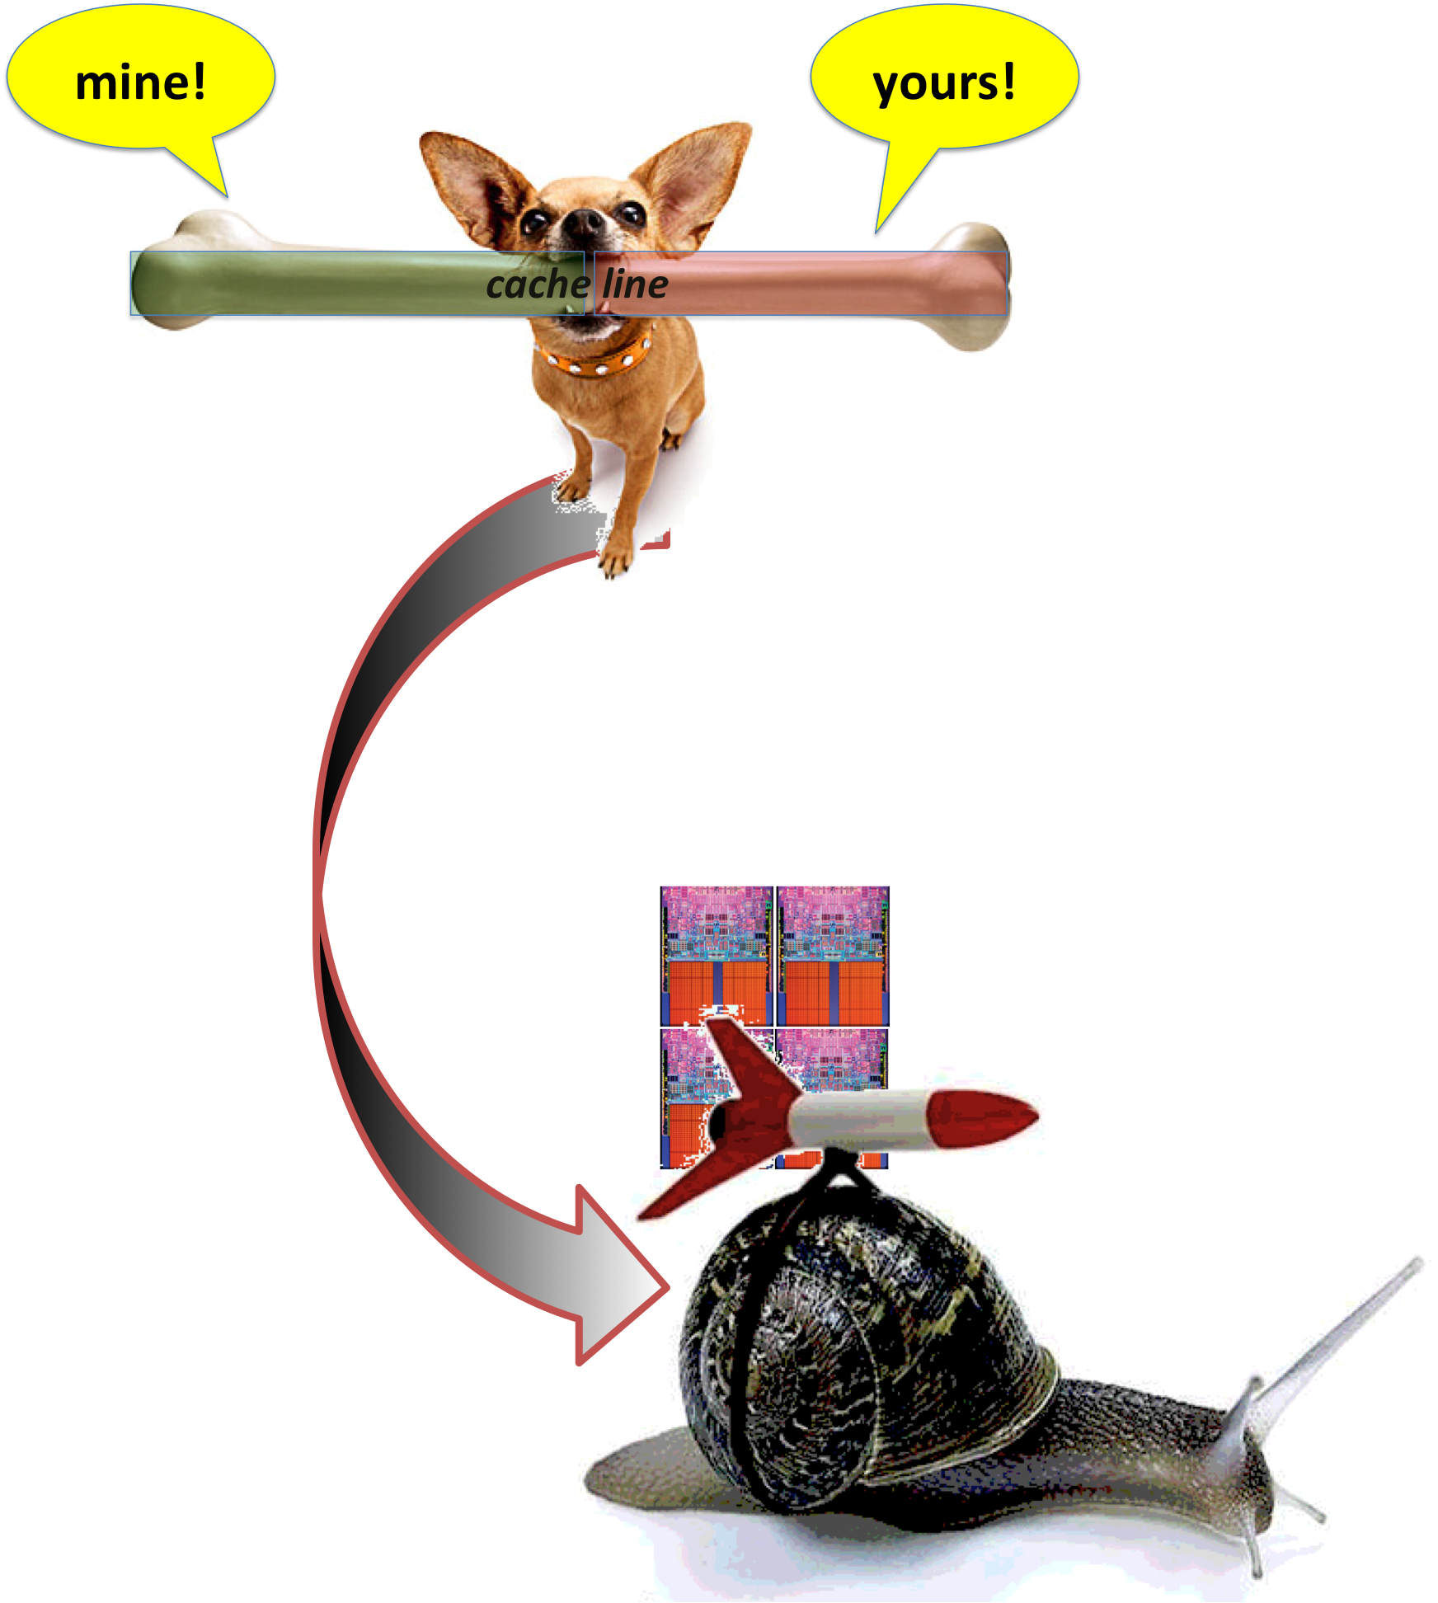

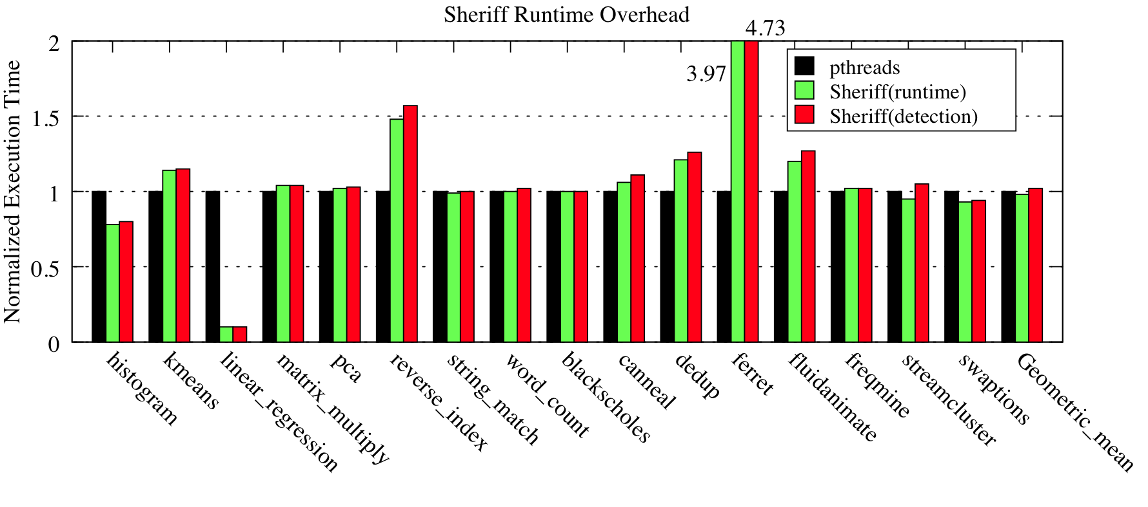
Sheriff: Detecting & Eliminating False Sharing
PI: Berger
Problem:
False sharing silently degrades performance of multithreaded apps
Goal:
Detect or prevent false sharing!
Approach:
Runtime system replacing pthreads
Transforms threads to processes; merges isolated updates
Results:
Low average overhead (< 10%)
Speeds up one benchmark by 10x!
Locates false sharing precisely, with no false positives

