Slide 1



Composing High-Performance
Memory Allocators
Emery Berger, Ben Zorn, Kathryn McKinley

Slide 2
Motivation & Contributions
Programs increasingly allocation intensive
  spend more than half of runtime in malloc/free
⇒ programmers require high performance allocators
  often build own custom allocators
Heap layers infrastructure for building memory allocators
  composable, extensible, and high-performance
  based on C++ templates
  custom and general-purpose, competitive with state-of-the-art

Slide 3
Outline
High-performance memory allocators
  focus on custom allocators
  pros & cons of current practice
Previous work
Heap layers
  how it works
  examples
Experimental results
  custom & general-purpose allocators

Slide 4
Using Custom Allocators
Can be very fast:
  Linked lists of objects for highly-used classes
  Region (arena, zone) allocators
“Best practices” [Meyers 1995, Bulka 2001]
  Used in 3 SPEC2000 benchmarks (parser, gcc, vpr), Apache, PGP, SQLServer, etc.

Slide 5
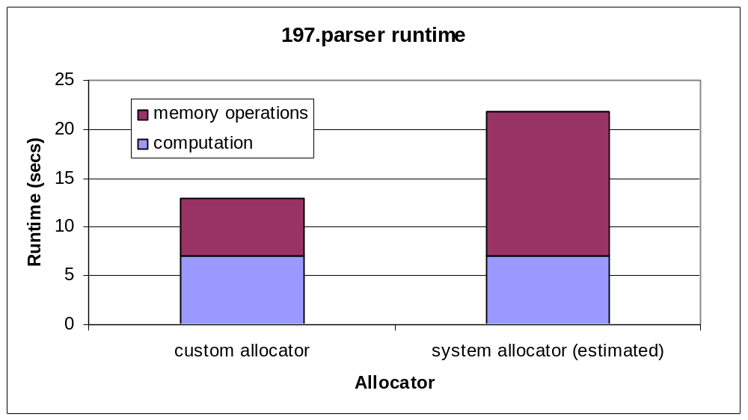
Custom Allocators Work
Using a custom allocator reduces runtime by 60%

Slide 6
Problems with Current Practice
Brittle code
  written from scratch
  macros/monolithic functions to avoid overhead
  hard to write, reuse or maintain
Excessive fragmentation
  good memory allocators:
  complicated, not retargetable

Slide 7
Allocator Conceptual Design
People think & talk about heaps as if they were modular:
System memory manager
Manage small objects
Manage large objects
Select heap based on size
malloc
free

Slide 8
Infrastructure Requirements
Flexible
  can add functionality
Reusable
  in other contexts & in same program
Fast
  very low or no overhead
High-level
  as component-like as possible

Slide 9
Possible Solutions
 | Flexible | Reusable | Fast | High-level
Indirect function calls (Vmalloc [Vo 1996]) | ✓ | ✓ | function call overhead | function-pointer assignment
Object-oriented (CMM [Attardi et al. 1998]) | ✓ | rigid hierarchy | virtual method overhead | ✓
Mixins (our approach) | ✓ | ✓ | ✓ | ✓

Slide 10
Ordinary Classes vs. Mixins
Ordinary classes
  fixed inheritance dag
  can’t rearrange hierarchy
  can’t use class multiple times
Mixins
  no fixed inheritance dag
  multiple hierarchies possible
  can reuse classes
  fast: static dispatch

Slide 11
A Heap Layer
Provides malloc and free methods
“Top heaps” get memory from system
  e.g., mallocHeap uses C library’s malloc and free
  template <class SuperHeap>
  class HeapLayer : public SuperHeap {…};
void * malloc (sz) {
do something;
void * p = SuperHeap::malloc (sz);
do something else;
return p;
}
heap layer

Slide 12
Example: Thread-safety
LockedHeap
  protects the parent heap with a single lock
class LockedMallocHeap:
public LockedHeap<mallocHeap> {};
mallocHeap
void * malloc (sz) {
acquire lock;
void * p =
release lock;
return p;
}
LockedHeap
SuperHeap::malloc (sz);

Slide 13
Example: Debugging
DebugHeap
  Protects against invalid & multiple frees.
class LockedDebugMallocHeap:
public LockedHeap<
DebugHeap<mallocHeap> > {};
mallocHeap
void free (p) {
check that p is valid;
check that p hasn’t been freed before;
}
DebugHeap
SuperHeap::free (p);
LockedHeap

Slide 14
Implementation in Heap Layers
Modular design and implementation
FreelistHeap
manage objects on freelist
SizeHeap
add size info to objects
SegHeap
select heap based on size
malloc
free

Slide 15
Experimental Methodology
Built replacement allocators using heap layers
  custom allocators:
    XallocHeap (197.parser), ObstackHeap (176.gcc)
  general-purpose allocators:
    KingsleyHeap (BSD allocator)
    LeaHeap (based on Lea allocator 2.7.0)
      three weeks to develop
      500 lines vs. 2,000 lines in original
Compared performance with original allocators
  SPEC benchmarks & standard allocation benchmarks

Slide 16
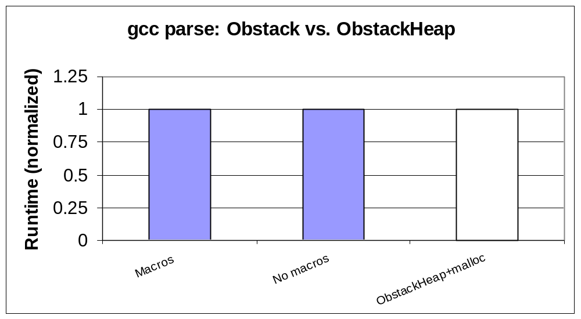
Experimental Results:
Custom Allocation – gcc

Slide 17
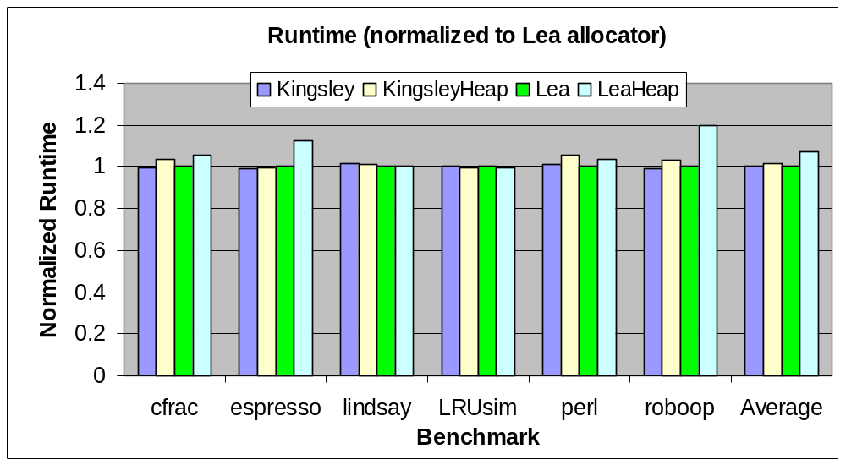
Experimental Results:
General-Purpose Allocators

Slide 18
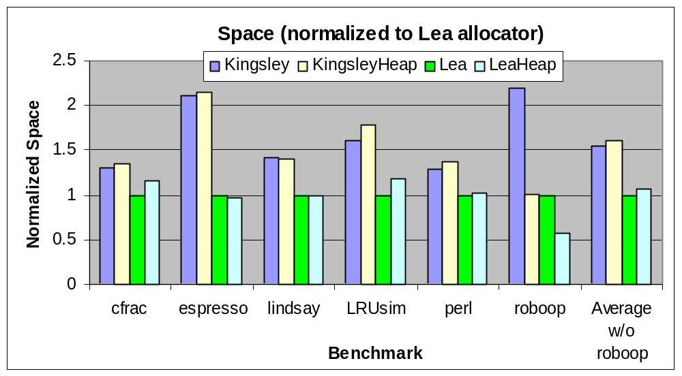
Experimental Results:
General-Purpose Allocators

Slide 19
Conclusion
Heap layers infrastructure for composing allocators
Useful experimental infrastructure
Allows rapid implementation of high-quality allocators
  custom allocators as fast as originals
  general-purpose allocators comparable to state-of-the-art
  in speed and efficiency

Slide 21
A Library of Heap Layers
Top heaps
  mallocHeap, mmapHeap, sbrkHeap
Building-blocks
  AdaptHeap, FreelistHeap, CoalesceHeap
Combining heaps
  HybridHeap, TryHeap, SegHeap, StrictSegHeap
Utility layers
  ANSIWrapper, DebugHeap, LockedHeap, PerClassHeap, STLAdapter

Slide 22
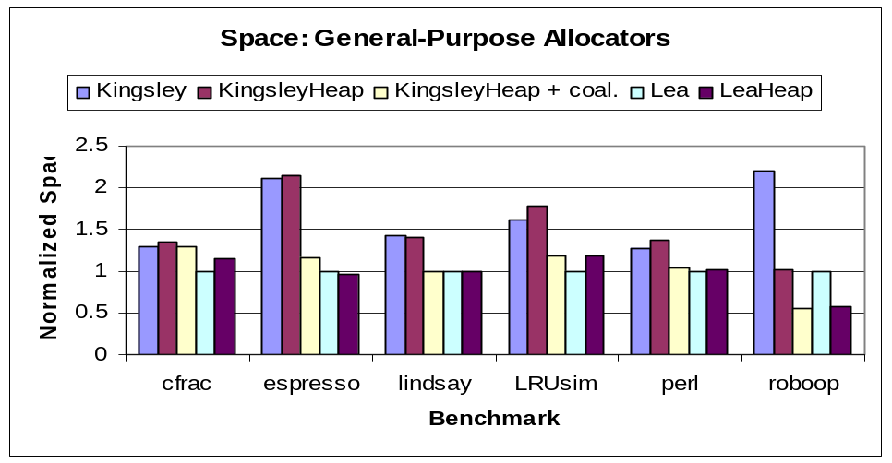
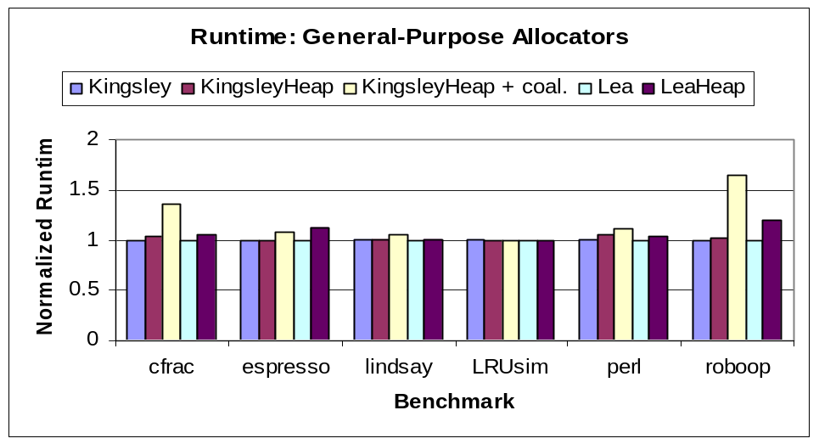
Heap Layers as Experimental Infrastructure
Kingsley allocator
  averages 50% internal fragmentation
  what’s the impact of adding coalescing?
Just add coalescing layer
  two lines of code!
Result:
  Almost as memory-efficient as Lea allocator
  Reasonably fast for all but most allocation-intensive apps

