Slide 1

Hoard:
A Scalable Memory Allocator for Multithreaded Applications
Emery Berger
University of Massachusetts, Amherst

Slide 2
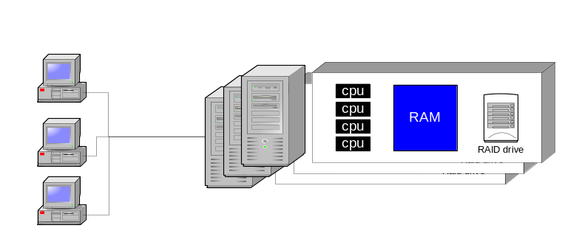
High-Performance Applications
Web servers, search engines, scientific codes
C or C++ (still…)
Run on one or cluster of server boxes
software
compiler
Needs support at every level
runtime system
operating system
hardware

Slide 3
New Applications,
Old Memory Managers
Applications and hardware have changed
  Multiprocessors now commonplace
  Object-oriented, multithreaded
  Increased pressure on memory manager
  (malloc, free)
But memory managers have not kept up
  Inadequate support for modern applications

Slide 4
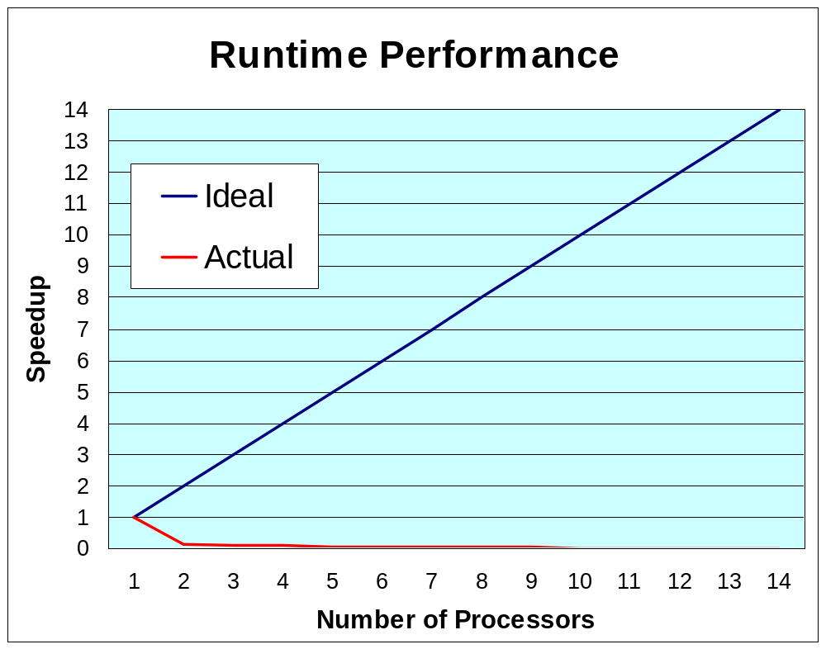
Current Memory Managers
Limit Scalability
As we add processors, program slows down
Caused by heap contention
Larson server benchmark on 14-processor Sun

Slide 5
The Problem
Current memory managers
inadequate for high-performance applications on modern architectures
  Limit scalability, application performance, and robustness

Slide 6
Overview
Problems with memory managers
  Contention, space, false sharing
Solution: provably scalable allocator
  Hoard

Slide 7
Problems with General-Purpose Memory Managers
Previous work for multiprocessors
  Concurrent single heap [Bigler et al. 85, Johnson 91, Iyengar 92]
    Impractical
  Multiple heaps [Larson 98, Gloger 99]
Reduce contention but cause other problems:
  P-fold or even unbounded increase in space
  Allocator-induced false sharing
we show

Slide 8
Multiple Heap Allocator:
Pure Private Heaps
One heap per processor:
  malloc gets memory
  from its local heap
  free puts memory
  on its local heap
STL, Cilk, ad hoc
Key:
= in use, processor 0
= free, on heap 1
processor 0
processor 1
x1= malloc(1)
x2= malloc(1)
free(x1)
free(x2)
x3= malloc(1)
x4= malloc(1)
free(x3)
free(x4)

Slide 9
Problem:
Unbounded Memory Consumption
Producer-consumer:
  Processor 0 allocates
  Processor 1 frees
Unbounded memory consumption
  Crash!
processor 0
processor 1
x1= malloc(1)
free(x1)
x2= malloc(1)
free(x2)
x3= malloc(1)
free(x3)

Slide 10
Multiple Heap Allocator:
Private Heaps with Ownership
free returns memory to original heap
Bounded memory consumption
  No crash!
“Ptmalloc” (Linux),
LKmalloc
processor 0
processor 1
x1= malloc(1)
free(x1)
x2= malloc(1)
free(x2)

Slide 11
Problem:
P-fold Memory Blowup
Occurs in practice
Round-robin producer-consumer
  processor i mod P allocates
  processor (i+1) mod P frees
Footprint = 1 (2GB),
but space = 3 (6GB)
  Exceeds 32-bit address space: Crash!
processor 0
processor 1
processor 2
x1= malloc(1)
free(x1)
x2= malloc(1)
free(x2)
x3=malloc(1)
free(x3)

Slide 12
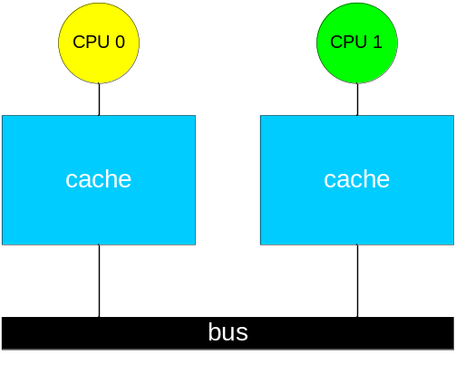
Problem:
Allocator-Induced False Sharing
False sharing
  Non-shared objects
  on same cache line
  Bane of parallel applications
  Extensively studied
All these allocators
cause false sharing!
cache line
processor 0
processor 1
x1= malloc(1)
x2= malloc(1)
thrash…
thrash…

Slide 13
So What Do We Do Now?
Where do we put free memory?
  on central heap:
  on our own heap:
  (pure private heaps)
  on the original heap:
  (private heaps with ownership)
How do we avoid false sharing?
  Heap contention
  Unbounded memory consumption
  P-fold blowup

Slide 14
Overview
Problems with memory managers
  Contention, space, false sharing
Solution: provably scalable allocator
  Hoard

Slide 15
Hoard: Key Insights
Bound local memory consumption
  Explicitly track utilization
  Move free memory to a global heap
  Provably bounds memory consumption
Manage memory in large chunks
  Avoids false sharing
  Reduces heap contention

Slide 16
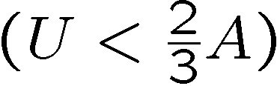
Overview of Hoard
global heap
Manage memory in heap blocks
  Page-sized
  Avoids false sharing
Allocate from local heap block
  Avoids heap contention
Low utilization
Move heap block to global heap
  Avoids space blowup
processor 0
processor P-1
…

Slide 17
Summary of Analytical Results
Space consumption: near optimal worst-case
  Hoard: O(n log M/m + P) {P « n}
  Optimal: O(n log M/m)
  [Robson 70]: ≈ bin-packing
  Private heaps with ownership:
  O(P n log M/m)
Provably low synchronization
    n = memory required
    M = biggest object size
    m = smallest object size
    P = processors

Slide 18
Empirical Results
Measure runtime on 14-processor Sun
  Allocators
    Solaris (system allocator)
    Ptmalloc (GNU libc)
    mtmalloc (Sun’s “MT-hot” allocator)
  Micro-benchmarks
    Threadtest: no sharing
    Larson: sharing (server-style)
    Cache-scratch: mostly reads & writes
    (tests for false sharing)
Real application experience similar

Slide 19
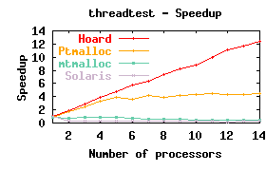
Runtime Performance: threadtest
Many threads,
no sharing
Hoard achieves linear speedup
speedup(x,P) = runtime(Solaris allocator, one processor)
/ runtime(x on P processors)

Slide 20
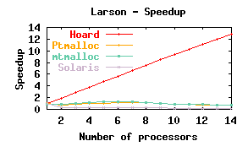
Runtime Performance: Larson
Many threads,
sharing
(server-style)
Hoard achieves linear speedup

Slide 21
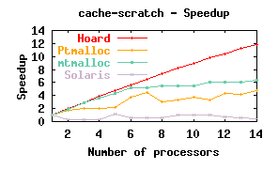
Runtime Performance: false sharing
Many threads,
mostly reads & writes of heap data
Hoard achieves linear speedup

Slide 22
Hoard in the “Real World”
Open source code
  www.hoard.org
  13,000 downloads
  Solaris, Linux, Windows, IRIX, …
Widely used in industry
  AOL, British Telecom, Novell, Philips
  Reports: 2x-10x, “impressive” improvement in performance
  Search server, telecom billing systems, scene rendering,
  real-time messaging middleware, text-to-speech engine, telephony, JVM
Scalable general-purpose memory manager

Slide 23
The End

Slide 24
If You Can Read This,
I Went Too Far

Slide 25
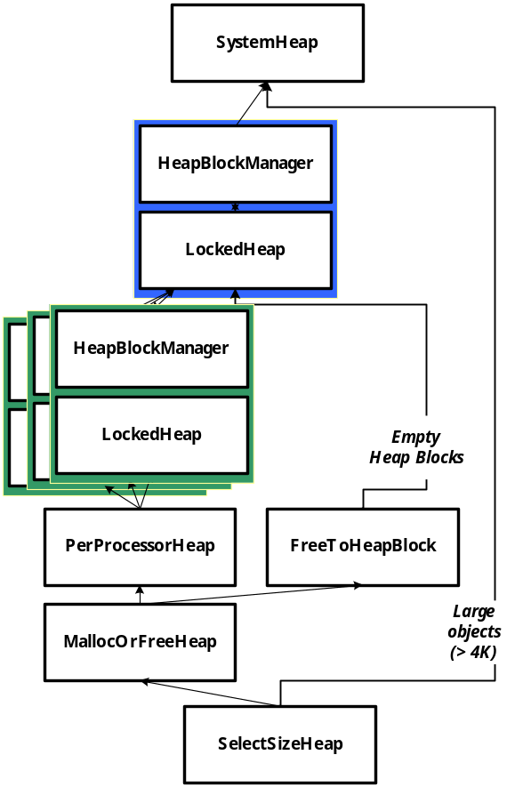
Hoard: Under the Hood
get or return memory to global heap
malloc from local heap,
free to heap block
select heap based on size

