Slide 1

Quantifying the Performance of Garbage Collection vs. Explicit Memory Management
Matthew Hertz & Emery Berger
University of Massachusetts Amherst

Slide 2
Motivation
C/C++ memory explicitly managed
  May not reclaim unneeded memory
  Can free memory too early
  Potential for security violations
Java's improvement: garbage collection

Slide 3
Conventional Wisdom
GC worse than malloc:
  Extra processing (collection)
  Poor cache performance (ibid)
  Increased memory needs (delayed reclamation)
  Bad page locality (collection)
GC better than malloc:
  Extra processing (allocation)
  Poor cache performance (headers)
  Bad page locality (fragmentation)

Slide 4
Outline
Motivation
Quantifying GC performance
  Why is this difficult?
Oracular memory management
  Choosing & generating our oracles
Experimental methodology
Results

Slide 5
Quantifying GC Performance
Perform apples-to-apples comparison
  Examine unaltered applications
  Measurements differ only in memory manager
Consider range of metrics
  Both time and space measurements

Slide 6
Comparing Memory Managers
Node v = malloc(sizeof(Node));
v->data=malloc(sizeof(NodeData));
memcpy(v->data, old->data,
sizeof(NodeData));
free(old->data);
v->next = old->next;
v->next->prev = v;
v->prev = old->prev;
v->prev->next = v;
free(old);
BDW
Collector
Using GC in C/C++ is easy:

Slide 7
Comparing Memory Managers
Node v = malloc(sizeof(Node));
v->data=malloc(sizeof(NodeData));
memcpy(v->data, old->data,
sizeof(NodeData));
free(old->data);
v->next = old->next;
v->next->prev = v;
v->prev = old->prev;
v->prev->next = v;
free(old);
BDW
Collector
…ignore calls to free().

Slide 8
Comparing Memory Managers
Node node = new Node();
node.data = new NodeData();
useNode(node);
node = null;
...
node = new Node();
...
node.data = new NodeData();
...
Lea
Allocator
Adding malloc/free to Java:
not so easy…

Slide 9
Comparing Memory Managers
Node node = new Node();
node.data = new NodeData();
useNode(node);
node = null;
...
node = new Node();
...
node.data = new NodeData();
...
Lea
Allocator
free(node)?
free(node.data)?
... need to insert free() calls,
but where?

Slide 10
Oracular Memory Manager
Java
C malloc/free
execute program here
Simulator
perform actions at
no cost below here
allocation
Oracle
Consult oracle at each allocation
  Oracle does not disrupt hardware state
  Simulator places free()…

Slide 11
Choice of Oracle
Two ways to determine when we should reclaim an object:
  Reachability – free an object just after it is last reachable
    Last possible moment
  Liveness – free an object after its last use
    First possible moment

Slide 12
Reachability as Oracle
live
dead
reachable
unreachable
allocation time
can be explicitly freed
can be garbage collected
Reclaim object when first unreachable
  Last possible moment to free objects
  Most conservative estimate of programmer behavior

Slide 13
Reachability Oracle Generation
Java
C malloc/free
execute program here
PowerPC
Simulator
perform actions at
no cost below here
allocations,
ptr updates,
prog. roots
Merlin analysis
Oracle
trace
file
Illegal instructions mark heap events
  Simulated identically to legal instructions
  Use in all simulations

Slide 14
Liveness as Oracle
live
dead
reachable
unreachable
allocation time
can be explicitly freed
can be garbage collected
Remove objects after last use
  Earliest time to reclaim objects
  May not reflect programmer practice
    Few programmers capable of this perfection

Slide 15
Liveness Oracle Generation
Java
C malloc/free
execute program here
PowerPC
Simulator
perform actions at
no cost below here
allocation, mem access, prog. roots
Post-
process
Oracle
trace
file
Record allocations, memory accesses
  Preserve code, type objects, etc.
  May use objects without accessing them

Slide 16
Oracular Memory Manager
Java
C malloc/free
execute program here
PowerPC
Simulator
perform actions at
no cost below here
allocations,
ptr updates,
roots,
mem access
Post-
process
trace
file
oracle
Consult oracle before each allocation
  When needed, modify instruction to call free()
  Extra costs hidden by simulator

Slide 17
Oracular Memory Manager
Java
C malloc/free
execute program here
PowerPC
Simulator
perform actions at
no cost below here
allocation
oracle
Consult oracle before each allocation
  When needed, modify instruction to call free()
  Extra costs hidden by simulator

Slide 18
Experimental Methodology
Java platform:
  MMTk/Jikes RVM(2.3.2)
Simulator:
  Dynamic SimpleScalar (DSS)
  Simulates 2GHz PowerPC processor
    G5 cache configuration
Garbage collectors:
  GenMS, GenCopy, GenRC, SemiSpace, CopyMS, MarkSweep
Explicit memory managers:
  Lea, MSExplicit (MS + explicit deallocation)

Slide 19
Experimental Methodology
Perfectly repeatable runs
  Pseudoadaptive compiler
    Same sequence of optimizations
    Compiler advice from average of 5 runs
  Deterministic thread switching
  Deterministic system clock

Slide 20
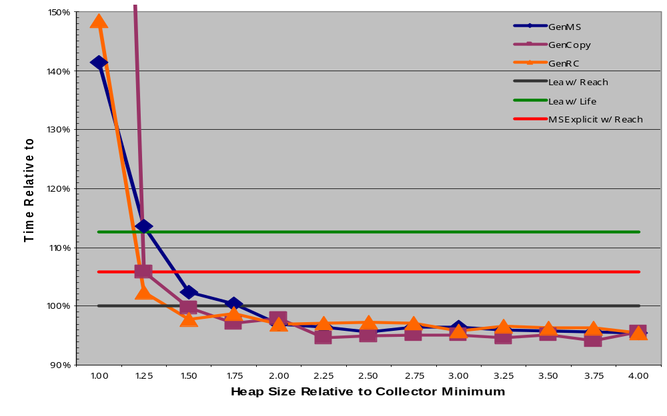
Execution Time for pseudoJBB
GC performance can be competitive

Slide 21
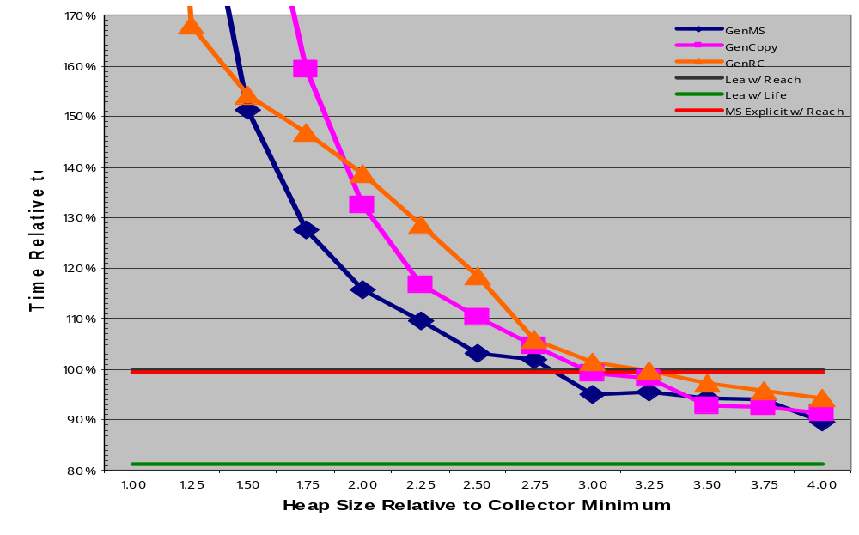
Execution Time for ipsixql
Object lifetimes can be very important

Slide 22
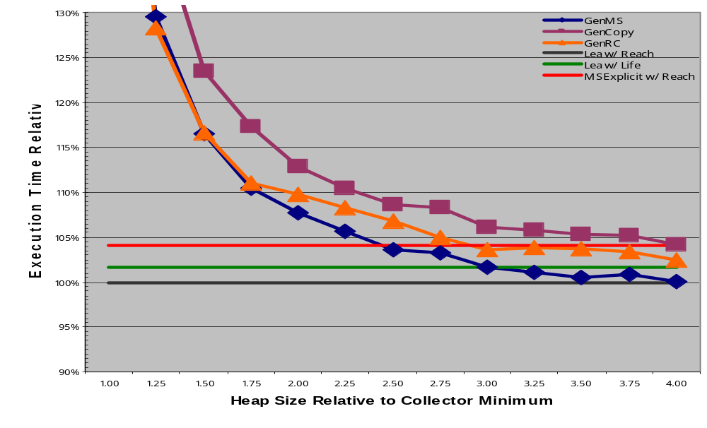
Geo. Mean of Execution Time
Garbage collection trades space for time

Slide 23
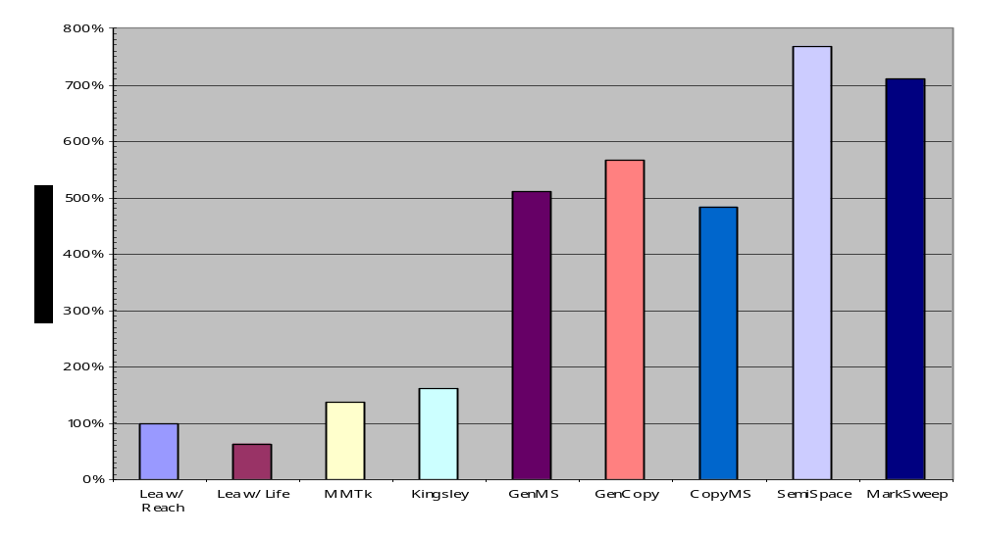
Footprint at Quickest Run
GC uses much more memory

Slide 24
Footprint at Quickest Run
7.69
7.09
5.66
5.10
4.84
1.38
1.61
1.00
0.63
GC uses much more memory

Slide 25
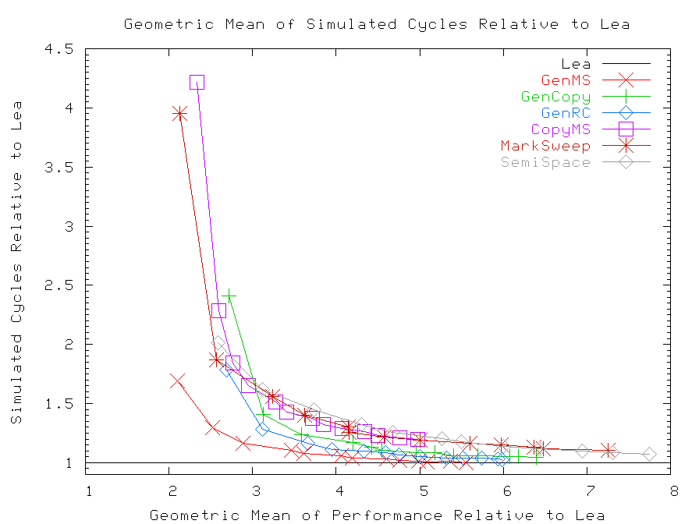
Avg. Relative Cycles and Footprint
GC always requires more space

Slide 26
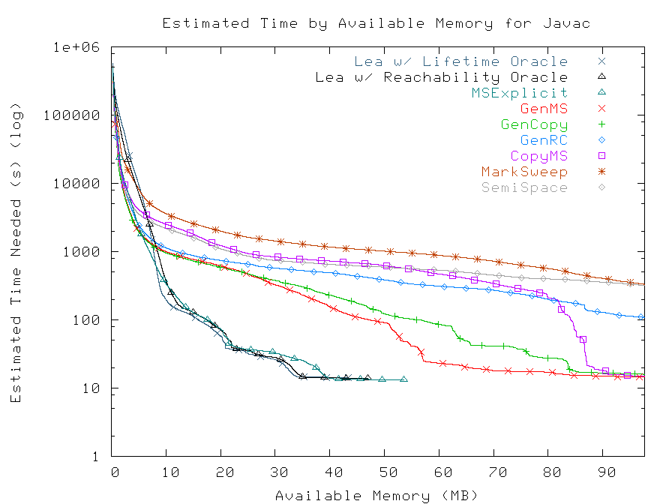
Javac Paging Performance
GC paging performance lags

Slide 27
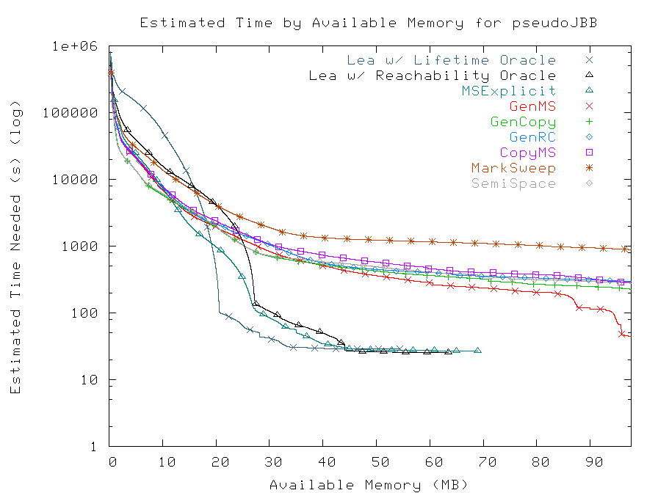
pseudoJBB Paging Performance
Lifetime analysis can be helpful

Slide 28
Future Work
Measure GC with out-of-line allocation
Measure the bookmarking collector
Examine impact of different cache sizes
Compare pause times
Evaluate other memory management methods

Slide 29
Summary of Results
Best collector equals Lea's performance…
  Up to 10% faster on some benchmarks
... but uses more memory
  Quickest runs require 5x or more memory
  GenMS at least doubles mean footprint

Slide 30
Thank you

Slide 31

What's the Catch?
There just aren’t all that many worse ways to f*ck up your cache behavior than by using lots of allocations and lazy GC to manage your memory.
Linus
Torvalds
“famous computer
scientist”
GC sucks donkey brains through a straw from a performance standpoint.

Slide 32
Who Cares About Memory?
RAM is not cheap
  Already up to 25% of the cost of computer
    Percentage continues to rise
  Sun E1000: 4GB costs $75,000
    Get additional CPU for free!
  Upgrading laptops may require new machine

