Slide 1

Quantifying the Performance of Garbage Collection vs. Explicit Memory Management
Emery Berger
University of Massachusetts Amherst

Slide 2
Explicit Memory Management
malloc / new
  allocates space for an object
free / delete
  returns memory to system
Simple, but tricky to get right
  Forget to free ⇨ memory leak
  free too soon ⇨ “dangling pointer”

Slide 3
Dangling Pointers
Node x = new Node (“happy”);
Node ptr = x;
delete x; // But I’m not dead yet!
Node y = new Node (“sad”);
cout << ptr->data << endl; // sad ☹
Insidious, hard-to-track down bugs

Slide 4
Solution: Garbage Collection
No need to free
Garbage collector periodically scans objects on heap
Reclaims non-reachable objects
  Won’t reclaim objects until they’re dead
  (actually somewhat later)

Slide 5

No More Dangling Pointers
Node x = new Node (“happy”);
Node ptr = x;
// x still live (reachable through ptr) Node y = new Node (“sad”);
cout << ptr->data << endl; // happy! ☺
Wow! Why don’t we use GC
all the time?

Slide 6


It’s The Performance…
GC sucks donkey brains through a straw from a performance standpoint.
There just aren’t all that many worse ways to f*** up your cache behavior than by using lots of allocations and lazy GC to manage your memory.
Linus
“I-Hate-Spongebob”
Torvalds

Slide 7
Slightly More Technically…
GC impairs performance
  Extra processing (collection, copying)
  Degrades cache performance (ibid)
  Degrades page locality (ibid)
  Increases memory needs
  (delayed reclamation)

Slide 8
On the other hand…
No, GC enhances performance!
[Some Esteemed Academics, et al.]
  Faster allocation
  (pointer-bumping vs. freelist)
  Improves cache performance
  (no need for headers)
  Better locality
  (can reduce fragmentation, compact data structures according to use)

Slide 9
Outline
Quantifying GC performance
  A hard problem
Oracular memory management
Experimental methodology
Results

Slide 10
Comparing Memory Managers
Node v = malloc(sizeof(Node));
v->data=malloc(sizeof(NodeData));
memcpy(v->data, old->data,
sizeof(NodeData));
free(old->data);
v->next = old->next;
v->next->prev = v;
v->prev = old->prev;
v->prev->next = v;
free(old);
BDW
Collector
Using GC in C/C++ is easy:

Slide 11
Comparing Memory Managers
Node v = malloc(sizeof(Node));
v->data=malloc(sizeof(NodeData));
memcpy(v->data, old->data,
sizeof(NodeData));
free(old->data);
v->next = old->next;
v->next->prev = v;
v->prev = old->prev;
v->prev->next = v;
free(old);
BDW
Collector
…slide in BDW and ignore calls to free.

Slide 12
What About Other Garbage Collectors?
That lets us compare malloc to GC, but only with conservative, non-copying collectors (really only BDW)
  Can’t reduce fragmentation,
  reorder objects, etc.
But we want to compare against the faster precise, copying collectors
  Incompatible with C/C++
  Standard for Java…

Slide 13
Comparing Memory Managers
Node node = new Node();
node.data = new NodeData();
useNode(node);
node = null;
...
node = new Node();
...
node.data = new NodeData();
...
Lea
Allocator
Adding malloc/free to Java:
not so easy…

Slide 14
Comparing Memory Managers
Node node = new Node();
node.data = new NodeData();
useNode(node);
node = null;
...
node = new Node();
...
node.data = new NodeData();
...
Lea
Allocator
free(node)?
free(node.data)?
... need to insert frees, but where?

Slide 15
Oracular Memory Manager
Java
C malloc/free
execute program here
Simulator
perform actions at
no cost below here
allocation
Oracle
Consult oracle at each allocation
  Oracle does not disrupt hardware state
  Simulator invokes free()…

Slide 16
Object Lifetime & Oracle Placement
freed by
lifetime-based oracle
can be freed
obj =
new Object;
live
dead
reachable
unreachable
freed by
reachability-based oracle
free(obj)
free(obj)
free(??)
can be collected
Oracles bracket placement of frees
  Lifetime-based: most aggressive
  Reachability-based: most conservative

Slide 17
Liveness Oracle Generation
Java
C malloc/free
execute program here
PowerPC
Simulator
perform actions at
no cost below here
allocation, mem access, prog. roots
Post-
process
Oracle
trace
file
Record allocations, memory accesses
  Preserve code, type objects, etc.
  May use objects without accessing them

Slide 18
Reachability Oracle Generation
Java
C malloc/free
execute program here
PowerPC
Simulator
perform actions at
no cost below here
allocations,
ptr updates,
prog. roots
Merlin analysis
Oracle
trace
file
Illegal instructions mark heap events
  Simulated identically to legal instructions
  Use in all simulations

Slide 19
Oracular Memory Manager
Java
C malloc/free
execute program here
PowerPC
Simulator
perform actions at
no cost below here
allocation
oracle
Consult oracle before each allocation
  When needed, modify instruction to call free
  Extra costs hidden by simulator

Slide 20
Experimental Methodology
Java platform:
  MMTk/Jikes RVM(2.3.2)
Simulator:
  Dynamic SimpleScalar (DSS)
  Simulates 2GHz PowerPC processor
    G5 cache configuration
Garbage collectors:
  GenMS, GenCopy, GenRC, SemiSpace, CopyMS, MarkSweep
Explicit memory managers:
  Lea, MSExplicit (MS + explicit deallocation)

Slide 21
Experimental Methodology
Perfectly repeatable runs
  Pseudoadaptive compiler
    Same sequence of optimizations
    Compiler advice from average of 5 runs
  Deterministic thread switching
  Deterministic system clock

Slide 22
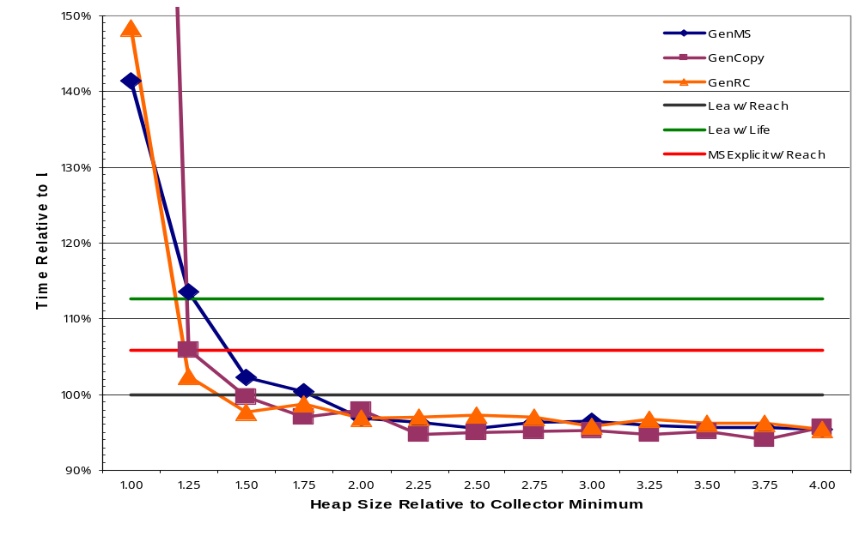
Execution Time for pseudoJBB
GC performance can be competitive

Slide 23
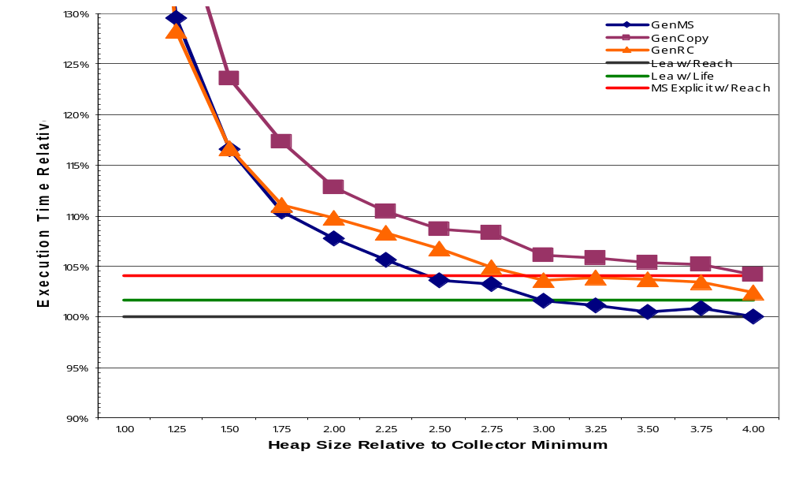
Geo. Mean of Execution Time
Garbage collection trades space for time

Slide 24
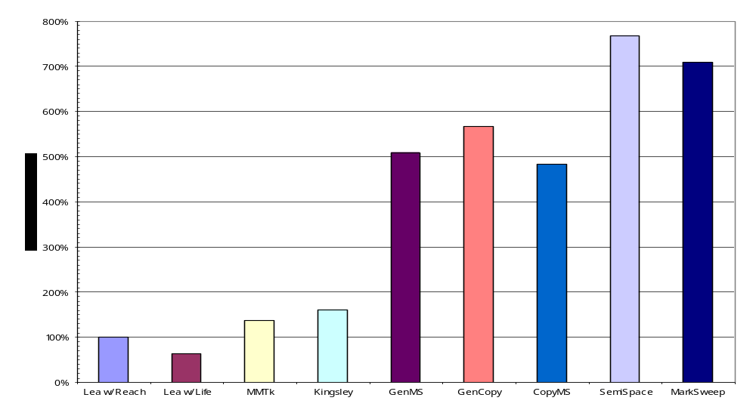
Footprint at Quickest Run
GC uses much more memory

Slide 25
Footprint at Quickest Run
7.69
7.09
5.66
5.10
4.84
1.38
1.61
1.00
0.63
GC uses much more memory

Slide 26
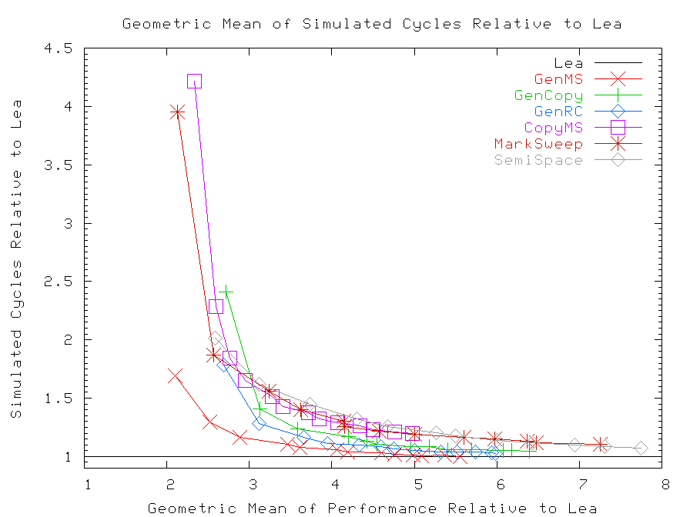
Avg. Relative Cycles and Footprint
GC always requires more space

Slide 27
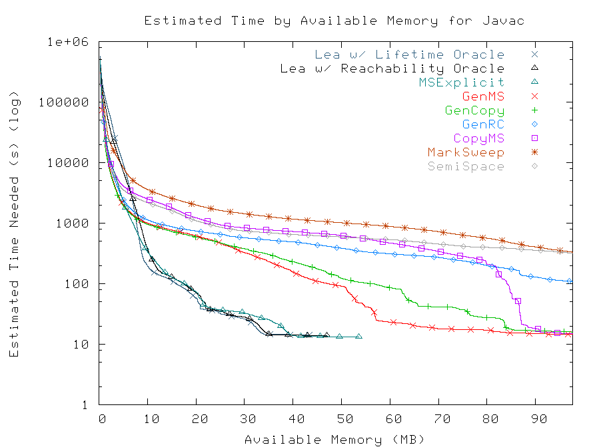
Javac Paging Performance
GC: poor paging performance

Slide 28
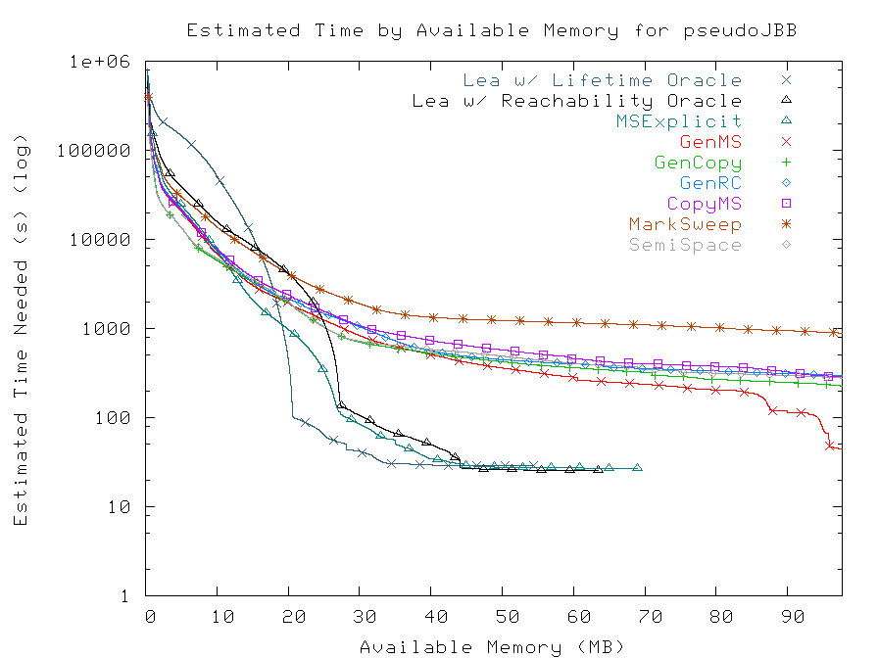
pseudoJBB Paging Performance
Lifetime vs. reachability… a wash

Slide 29
Summary of Results
Best collector equals Lea's performance…
  Up to 10% faster on some benchmarks
... but uses more memory
  Quickest runs require 5x or more memory
  GenMS at least doubles mean footprint

Slide 30
Take-home: Practitioners
Practitioners: GC - ok
  if system has more than 3x needed RAM
  and no competition with other processes
Not so good:
  Limited RAM
  Competition for physical memory
  Depends on RAM for performance
    In-memory database
    Search engines, etc.

Slide 31
Take-home: Researchers
GC performance already good enough with enough RAM
Problems:
  Paging is a killer
  Performance suffers for limited RAM

Slide 32
Future Work
Obvious dimensions
  Other collectors:
    Bookmarking collector [PLDI 05]
  Other allocators:
    New version of DLmalloc (2.8.2)
    Our locality-improving allocator [ISMM 05]
  Other architectures:
    Examine impact of different cache sizes
Other memory management methods
  Regions, reaps

Slide 33
Thank you
Joint work with Matthew Hertz

Slide 34
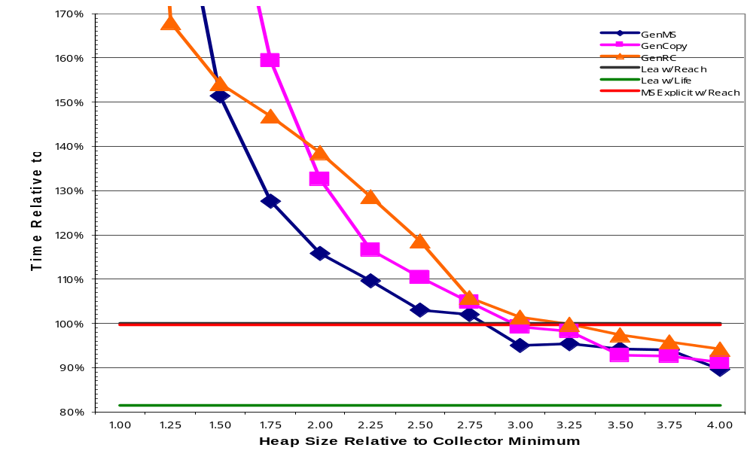
Execution Time for ipsixql
Object lifetimes can be very important

Slide 35
What's the Catch?
There just aren’t all that many worse ways to f*ck up your cache behavior than by using lots of allocations and lazy GC to manage your memory.
Linus
Torvalds
“famous computer
scientist”
GC sucks donkey brains through a straw from a performance standpoint.

Slide 36
Who Cares About Memory?
RAM is not cheap
  Already up to 25% of the cost of computer
    Percentage continues to rise
  Sun E1000: 4GB costs $75,000
    Get additional CPU for free!
  Upgrading laptops may require new machine

Slide 37
Quantifying GC Performance
Perform apples-to-apples comparison
  Examine unaltered applications
  Measurements differ only in memory manager
Consider range of metrics
  Both time and space measurements

