Slide 1

A Locality-Improving Dynamic Memory Allocator
Yi Feng & Emery Berger
University of Massachusetts Amherst

Slide 2
motivation
Memory performance:
bottleneck for many applications
Heap data often dominates
Dynamic allocators dictate spatial locality of heap objects

Slide 3
related work
Previous work on dynamic allocation
  Reducing fragmentation
  [survey: Wilson et al., Wilson & Johnstone]
  Improving locality
    Search inside allocator
    [Grunwald et al.]
    Programmer-assisted
    [Chilimbi et al., Truong et al.]
    Profile-based
    [Barrett & Zorn, Seidl & Zorn]

Slide 4
this work
Replacement allocator called Vam
  Reduces fragmentation
  Improves allocator & application locality
    Cache and page-level
  Automatic and transparent

Slide 5
outline
Introduction
Designing Vam
Experimental Evaluation
  Space Efficiency
  Run Time
  Cache Performance
  Virtual Memory Performance

Slide 6
Vam design
Builds on previous allocator designs
  DLmalloc
  Doug Lea, default allocator in Linux/GNU libc
  PHKmalloc
  Poul-Henning Kamp, default allocator in FreeBSD
  Reap [Berger et al. 2002]
Combines best features

Slide 7
DLmalloc
Goal
  Reduce fragmentation
Design
  Best-fit
  Small objects:
    fine-grained, cached
  Large objects:
    coarse-grained, coalesced
    sorted by size, search
  Object headers ease deallocation and coalescing

Slide 8
PHKmalloc
Goal
  Improve page-level locality
Design
  Page-oriented design
  Coarse size classes: 2^{x} or n*page size
  Page divided into equal-size chunks, bitmap for allocation
    Objects share headers at page start (BIBOP)
  Discards free pages via madvise

Slide 9
Reap
Goal
  Capture speed and locality advantages of region allocation while providing individual frees
Design
  Pointer-bumping allocation
  Reclaims free objects
  on associated heap

Slide 10
Vam overview
Goal
  Improve application performance
  across wide range of available RAM
Highlights
  Page-based design
  Fine-grained size classes
  No headers for small objects
Implemented in Heap Layers using C++ templates [Berger et al. 2001]

Slide 11
page-based heap
Virtual space divided into pages
Page-level management
  maps pages from kernel
  records page status
  discards freed pages

Slide 12
page-based heap
Heap Space
Page Descriptor Table
discard
free

Slide 13
fine-grained size classes
Small (8-128 bytes) and medium (136-496 bytes) sizes
  8 bytes apart, exact-fit
  dedicated per-size page blocks (group of pages)
    1 page for small sizes
    4 pages for medium sizes
    either available or full
  reap-like allocation inside block
available
full

Slide 14
fine-grained size classes
Large sizes (504-32K bytes)
  also 8 bytes apart, best-fit
  collocated in contiguous pages
  aggressive coalescing
Extremely large sizes (above 32KB)
  use mmap/munmap
Free List Table
coalesce
free
free
504
empty
512
520
528
empty
536
empty
544
552
empty
560
empty
…
…
Contiguous Pages

Slide 15
header elimination
Object headers simplify deallocation & coalescing but:
  Space overhead
  Cache pollution
Eliminated in Vam for small objects
per-page metadata
header
object

Slide 16
header elimination
Need to distinguish “headered” from “headerless” objects in free()
  Heap address space partitioning
16MB area (homogeneous objects)
partition table
address space

Slide 17
outline
Introduction
Designing Vam
Experimental Evaluation
  Space efficiency
  Run time
  Cache performance
  Virtual memory performance

Slide 18
experimental setup
Dell Optiplex 270
  Intel Pentium 4 3.0GHz
  8KB L1 (data) cache, 512KB L2 cache,
  64-byte cache lines
  1GB RAM
  40GB 5400RPM hard disk
Linux 2.4.24
  Use perfctr patch and perfex tool to set Intel performance counters (instructions, caches, TLB)

Slide 19
benchmarks
Memory-intensive SPEC CPU2000 benchmarks
  custom allocators removed in gcc and parser
 | 176.gcc | 197.parser | 253.perlbmk | 255.vortex
Execution Time | 24 sec | 275 sec | 43 sec | 62 sec
Instructions | 40 billion | 424 billion | 114 billion | 102 billion
VM Size | 130MB | 15MB | 120MB | 65MB
Max Live Size | 110MB | 10MB | 90MB | 45MB
Total Allocations | 9M | 788M | 5.4M | 1.5M
Average Object Size | 52 bytes | 21 bytes | 285 bytes | 471 bytes
Alloc Rate (#/sec) | 373K | 2813K | 129K | 30K
Alloc Interval (# of inst) | 4.4K | 0.5K | 21K | 68K

Slide 20
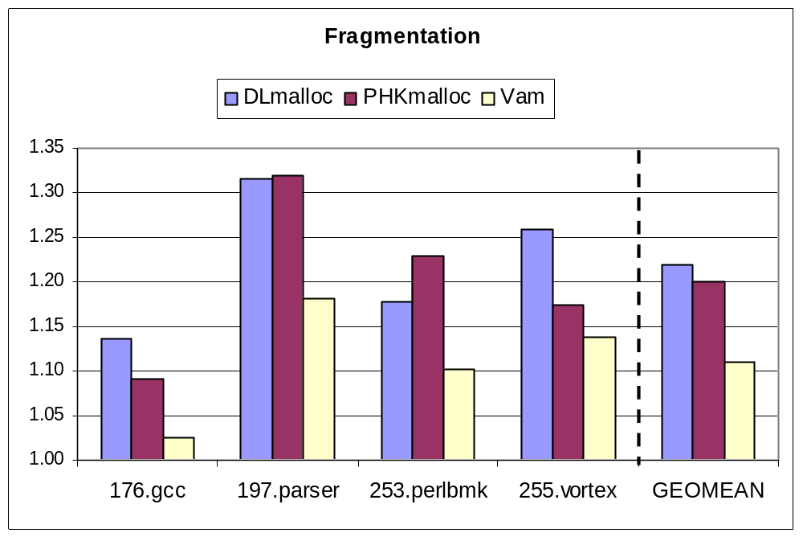
space efficiency
Fragmentation = max (physical) mem in use / max live data of app

Slide 21
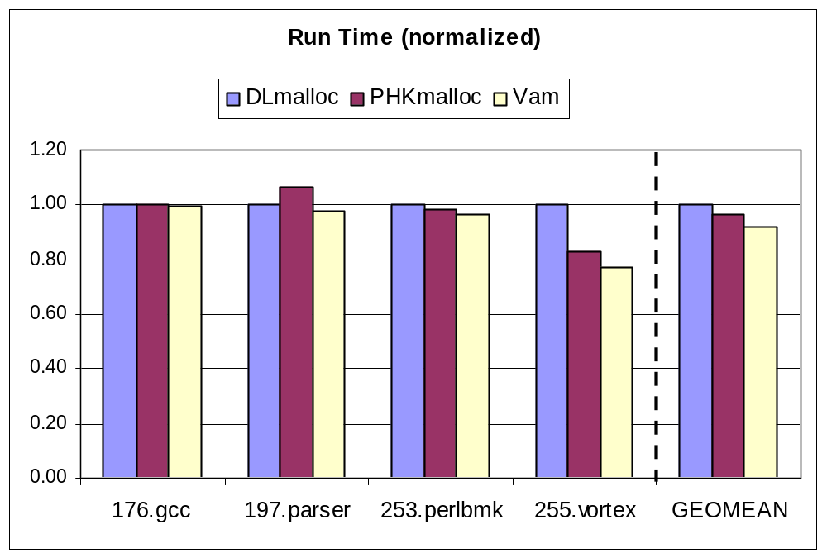
total execution time

Slide 22
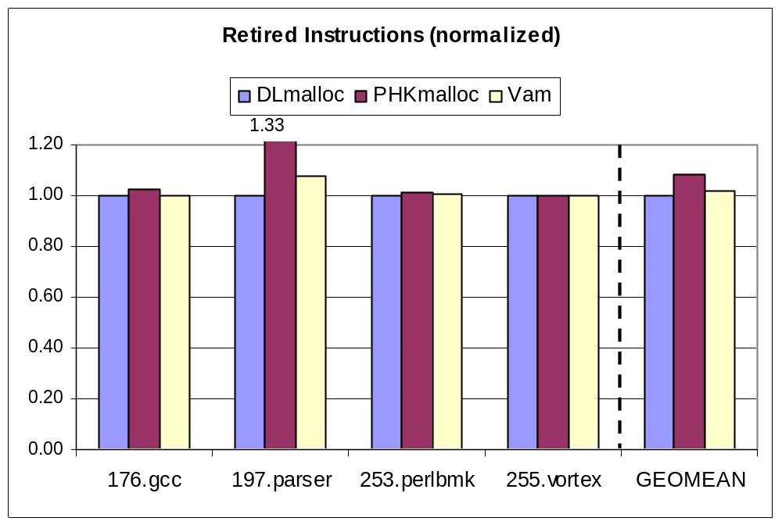
total instructions

Slide 23
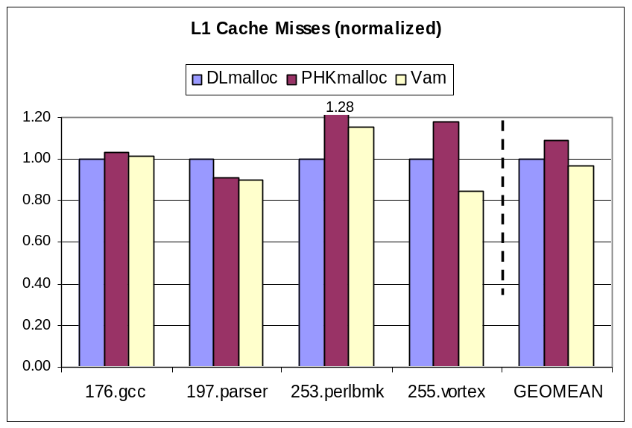
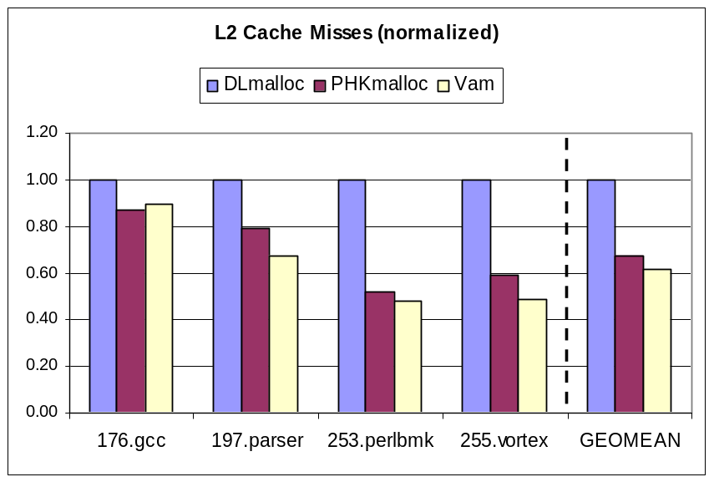
cache performance
L2 cache misses closely correlated to run time performance

Slide 24
VM performance
Application performance degrades with reduced RAM
Better page-level locality produces better paging performance, smoother degradation

Slide 25
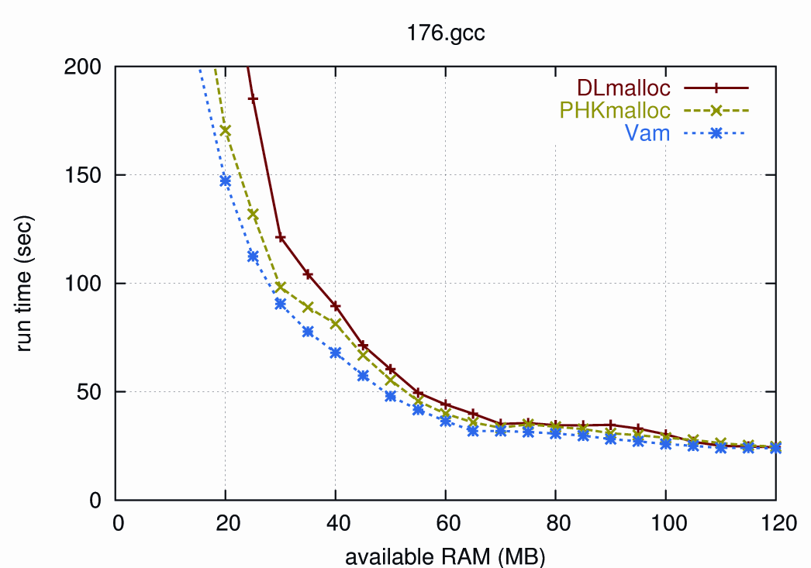
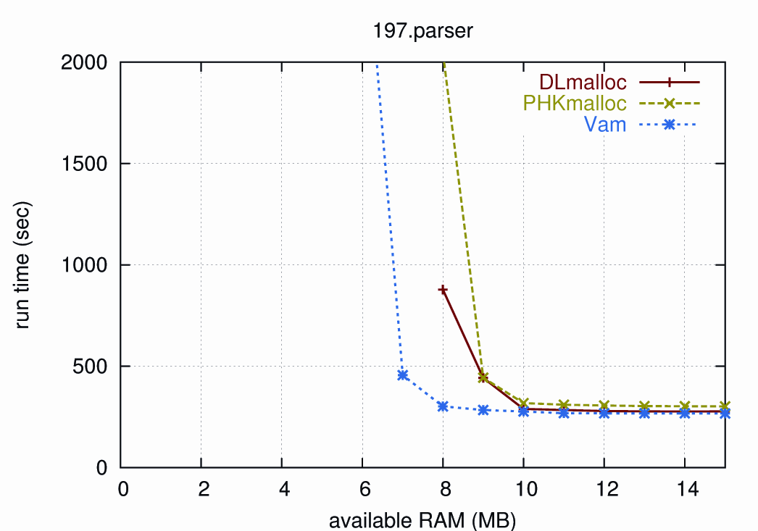
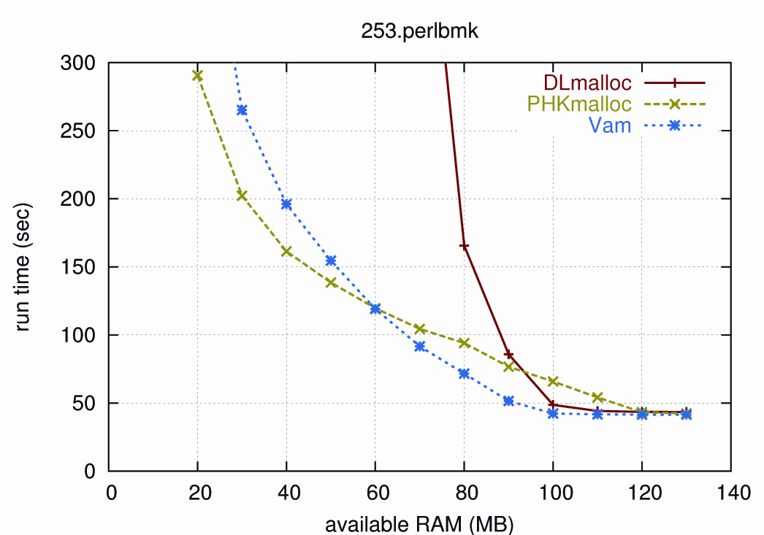
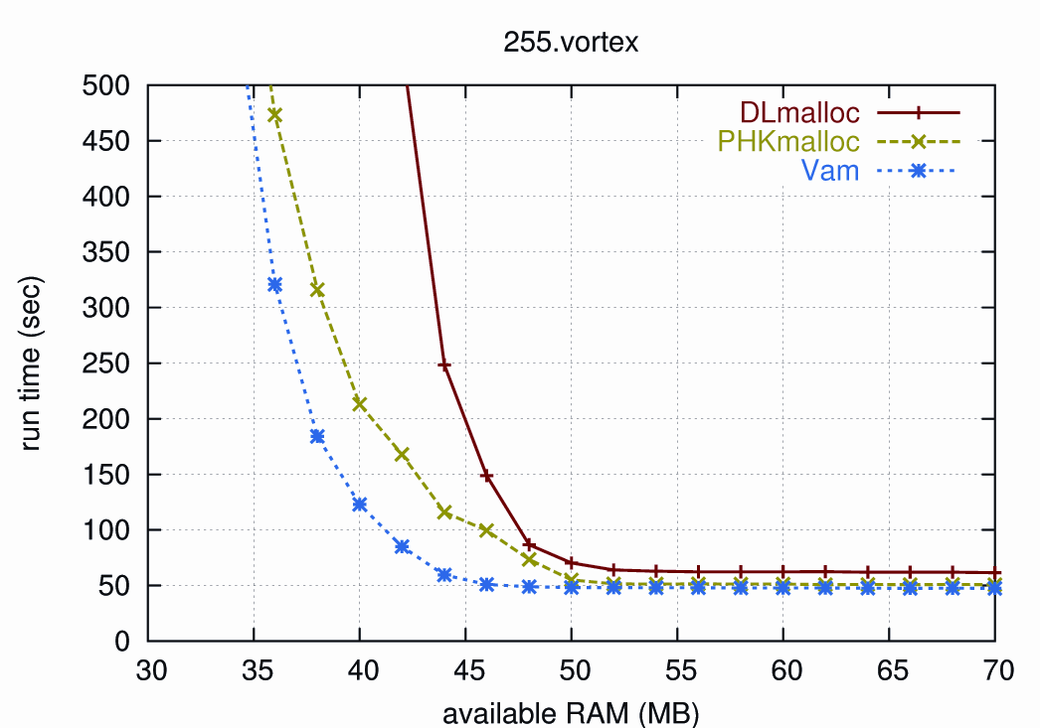

Slide 26
Vam summary
Outperforms other allocators both with enough RAM and under memory pressure
Improves application locality
  cache level
  page-level (VM)
  see paper for more analysis

Slide 27
the end
Heap Layers
  publicly available
  http://www.heaplayers.org
  Vam to be included soon

Slide 28
backup slides

Slide 29
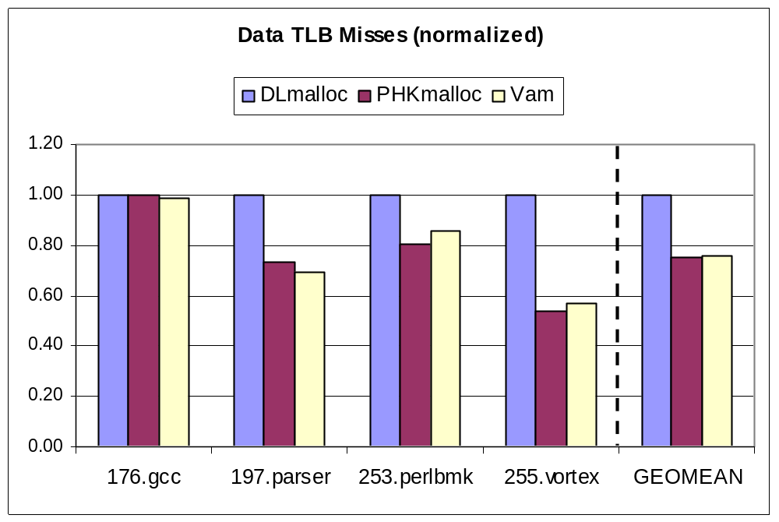
TLB performance

Slide 30
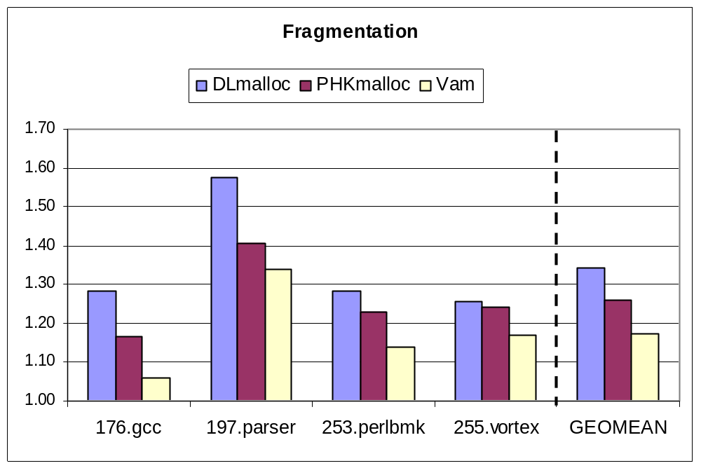
average fragmentation
Fragmentation = average of mem in use / live data of app

