Slide 1

A Locality-Improving Dynamic Memory Allocator
Yi Feng & Emery Berger
University of Massachusetts Amherst

Slide 2
motivation
Memory performance is bottleneck for many applications
Heap data often dominates
Dynamic allocators dictate spatial locality of heap objects
Vam, malloc/free replacement that improves application locality through allocation

Slide 3
related work
Previous research on dynamic allocation
  Fragmentation [Wilson & Johnstone]
  Locality
    Search algorithms inside allocator [Grunwald et al.]
    Programmer-assisted approach [Chilimbi et al., Truong et al.]
    Profile-based approach [Barrett, Zorn, Seidl]

Slide 4
outline
Introduction
Designing Vam
Experimental Evaluation
  Space Efficiency
  Run Time
  Cache Performance
  Virtual Memory Performance

Slide 5
Vam design
Builds on previous allocator designs
  DLmalloc
  Doug Lea, default allocator in Linux/GNU libc
  PHKmalloc
  Poul-Henning Kamp, default allocator in FreeBSD
  Reap
  Berger et al., region allocation with individual frees
Extracts best features

Slide 6
DLmalloc
Goal
  Reducing fragmentation
Design
  Best-fit allocation
  Fine-grained small size classes, coarse large size classes
  Cache small objects, coalesce large objects
  Use object headers to ease deallocation and coalescing

Slide 7
PHKmalloc
Goal
  Improving page-level locality
Design
  Page-oriented design
  Segregated power-of-two size classes
  Page divided into equal-size chunks, recording status in bitmap
  Objects share headers at page start
  Discards free pages

Slide 8
Reap
Goal
  Capturing speed and locality advantages of region allocation while providing individual frees
Design
  Pointer-bumping allocation
  Reclaims free objects on associated heap

Slide 9
Vam overview
Page-based design
Fine-grained size classes
No headers for small objects
Implemented in Heap Layers using C++ templates

Slide 10
page-based heap
Virtual space divided into pages
Page-level management
  maps pages from kernel
  records page status
  aggressively discards freed pages

Slide 11
page-based heap
Heap Space
Page Descriptor Table
discard
free

Slide 12
fine-grained size classes
Small (8-128 bytes) and medium (136-496 bytes) sizes
  8-byte apart, exact-fit
  dedicated per-size page blocks (group of pages)
    1 page for small objects
    4 pages for medium objects
  reap-like allocation inside block
available
full

Slide 13
fine-grained size classes
Large sizes (504-32K bytes)
  also 8-byte apart, best-fit, fast search
  collocated in regions of contiguous pages
  aggressive coalescing
Extremely large sizes (above 32KB)
  use mmap/munmap
free
coalesce
free
Contiguous Pages

Slide 14
no object headers
Used in free() for proper deallocation and coalescing
Space overhead
Cache pollution
Eliminated in Vam for small objects
per-page metadata
header
object

Slide 15
no object headers
How to distinguish headered and headerless objects in free()?
  Address space partitioning
16MB area (homogeneous objects)
partition table
address space

Slide 16
outline
Introduction
Designing Vam
Experimental Evaluation
  Space efficiency
  Run time
  Cache performance
  Virtual memory performance

Slide 17
experimental setup
Intel Pentium 4 3.0GHz
8KB L1 (data) cache, 512KB L2 cache, 64-byte cache lines
1GB RAM
40GB 5400RPM hard disk
Linux 2.4.24
Also use perfctr patch and perfex tool to set CPU performance counters (instructions, caches, TLB)

Slide 18
benchmarks
Memory-intensive SPECint2000 benchmarks
  Custom memory allocators removed in gcc and parser
 | 176.gcc | 197.parser | 253.perlbmk | 255.vortex
Execution Time | 24 sec | 275 sec | 43 sec | 62 sec
Instructions | 40 billion | 424 billion | 114 billion | 102 billion
VM Size | 130MB | 15MB | 120MB | 65MB
Max Live Size | 110MB | 10MB | 90MB | 45MB
Total Allocations | 9M | 788M | 5.4M | 1.5M
Average Object Size | 52 bytes | 21 bytes | 285 bytes | 471 bytes
Alloc Rate (#/sec) | 373K | 2813K | 129K | 30K
Alloc Interval (# of inst) | 4.4K | 0.5K | 21K | 68K

Slide 19
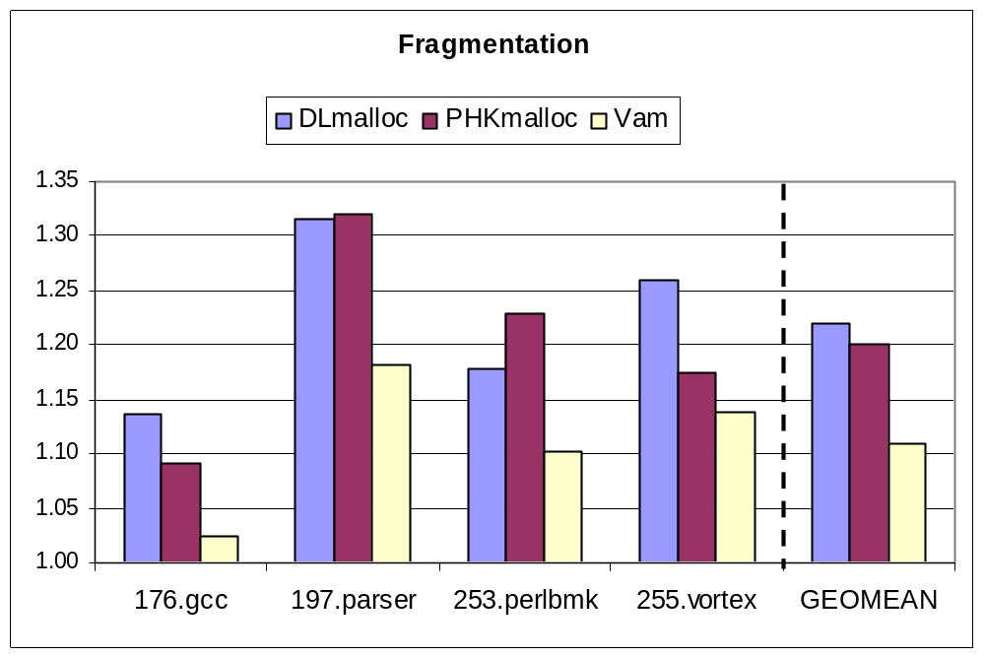
space efficiency
Fragmentation = max mem in use / max live data of app

Slide 20
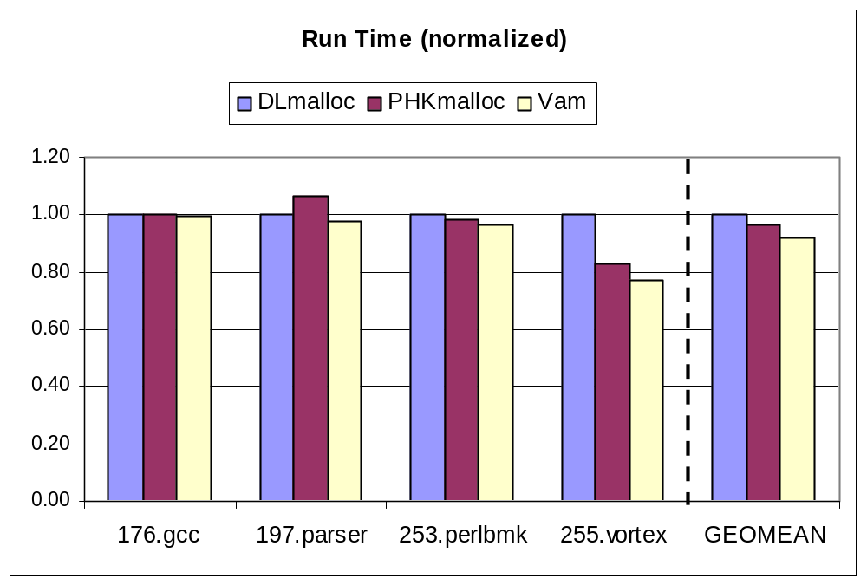
total execution time

Slide 21
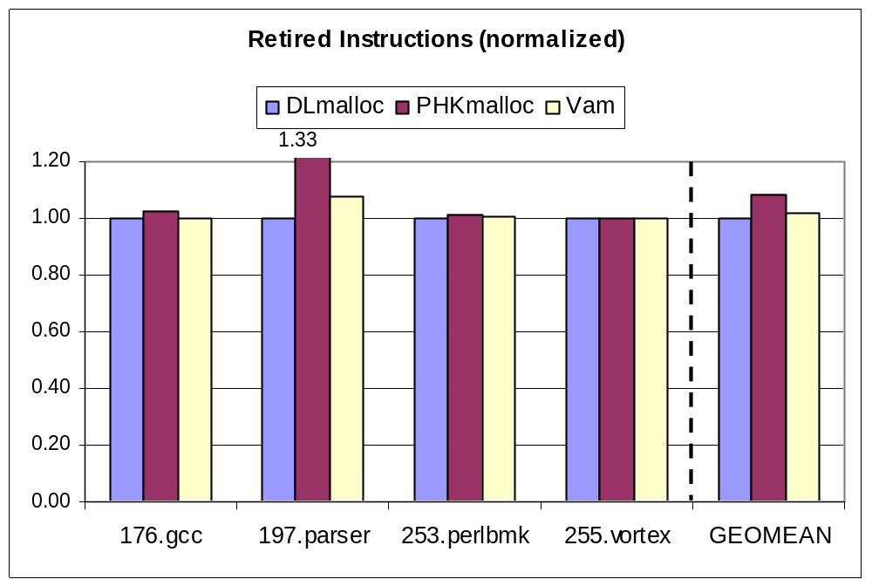
total instructions

Slide 22
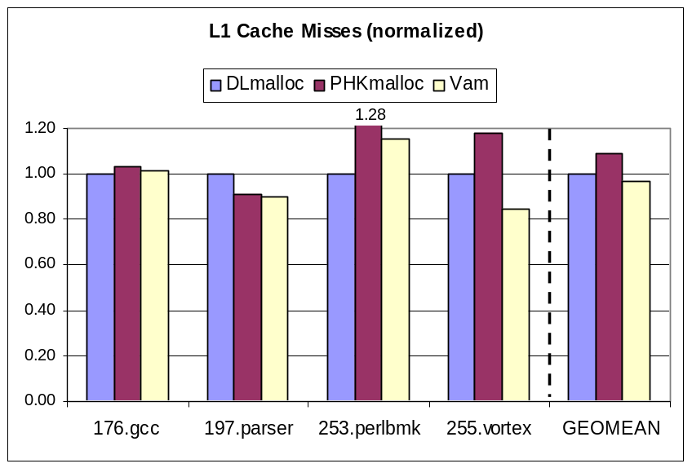
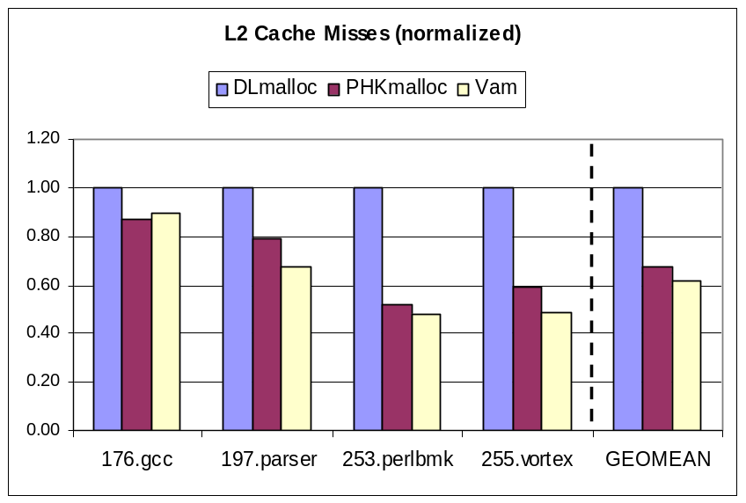
cache performance

Slide 23
VM performance
Application performance degrades with reduced RAM
Better page-level locality produces better paging performance, smoother degradation

Slide 24
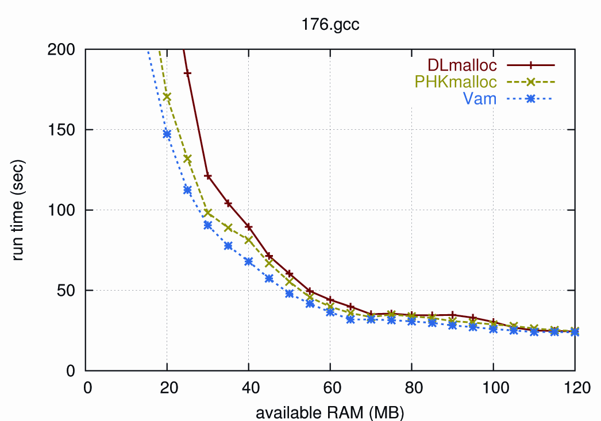
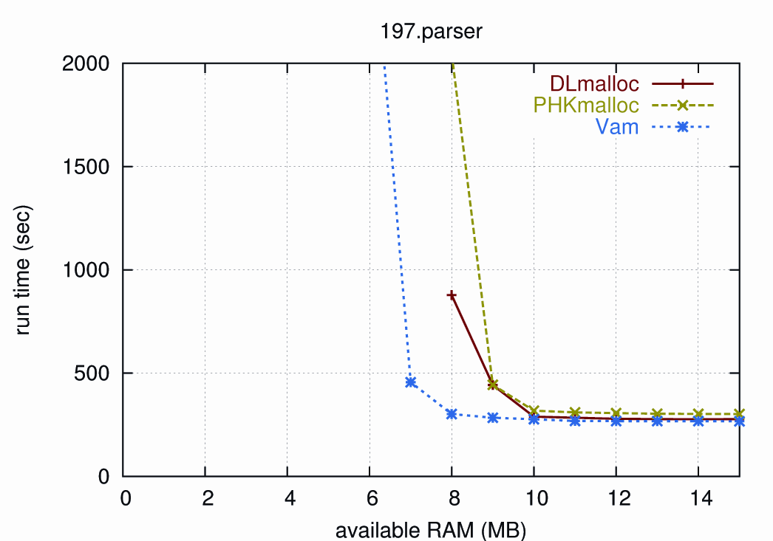
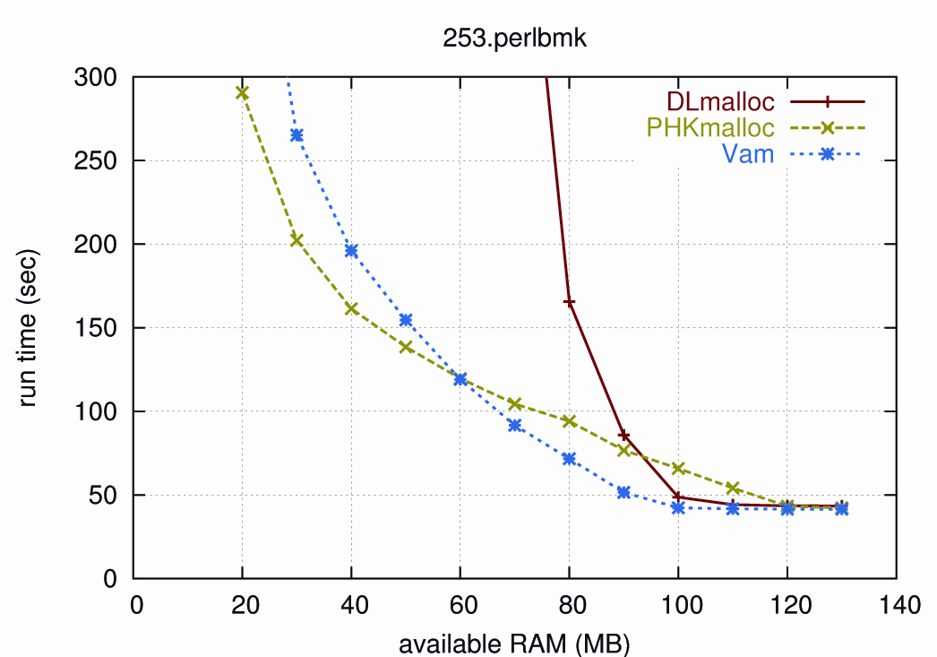
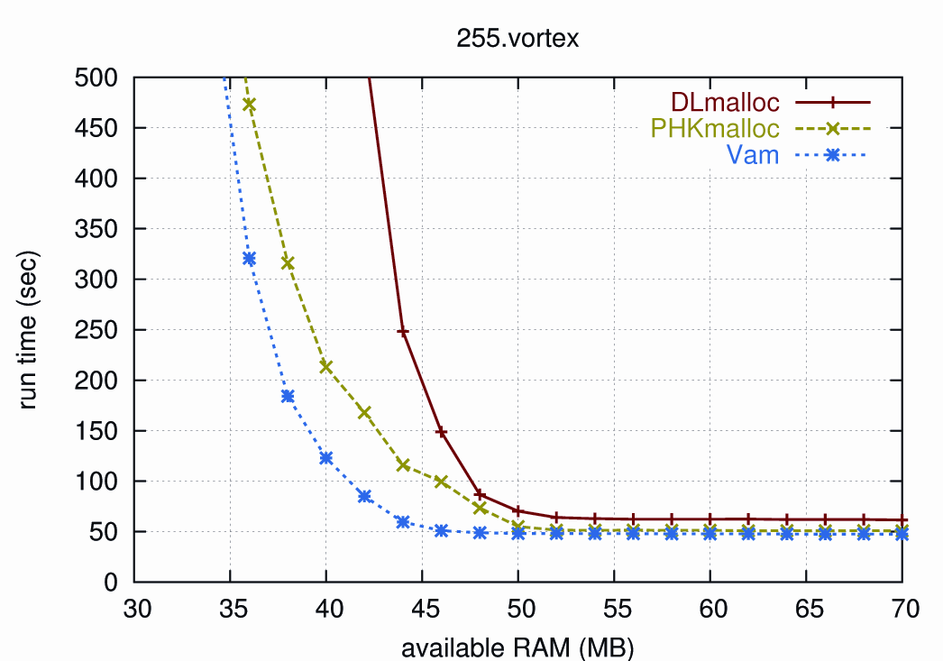

Slide 25
Vam summary
Outperforms other allocators both with enough RAM and under memory pressure
Improves application locality
  Cache level
  VM level

Slide 26
the end
Mention something about availability in Heap Layers and add URL

Slide 27
future work
Page discarding overhead
Allocator locality vs. application locality
Cooperation between user-level memory manager and kernel VM manager

