Slide 1

Transparent Contribution of Memory
James Cipar, Mark Corner, Emery Berger
University of Massachusetts, Amherst

Slide 2
Motivation
Applications depend on contributed resources
  CPU cycles, disk space, memory, network bandwidth etc.
  Condor, Folding/SETI@home
Compete with local applications for memory
  Up to 50% performance impact on local applications

Slide 3
Transparent Memory Manager
Operating system mechanism
  Contributory applications can be run as-is
  No special programming techniques or recompilation
Contribute memory without affecting local performance
  Detects local application’s working set size
  Limits contributory applications accordingly
Dynamically adjusts to local working set
  Can protect the performance of any local working set
  Gives as much memory as possible to contributory applications

Slide 4
Overview: What it Does
Trace memory accesses of local applications
Simulate LRU queue of local memory
  Include out-of-core memory in simulation
Determine local working set size
Limit contributory applications to the leftovers

Slide 5
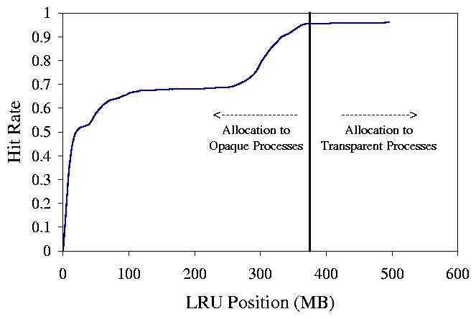
Measuring Working Set Size
Trace memory accesses
Simulate LRU queue
Cumulative histogram of LRU access pattern
  This shows predicted hit rate for any allocation
  Allow a 5% increase in miss rate

Slide 6
Experimental Setup
Compare TMM to static allocations
  How much memory is contributed
  What is the performance impact
Three typical working sets of different sizes
  Web browsing
  Viewing a large image
  Plotting a large dataset
User takes a break, and resumes after a few minutes
  Contributory application runs during break
Record page faults after user resumes work

Slide 7
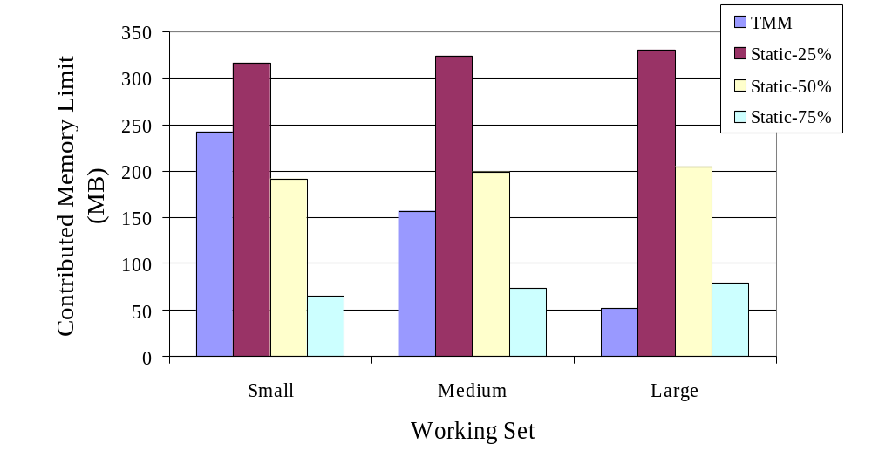
Amount of Memory Contributed

Slide 8
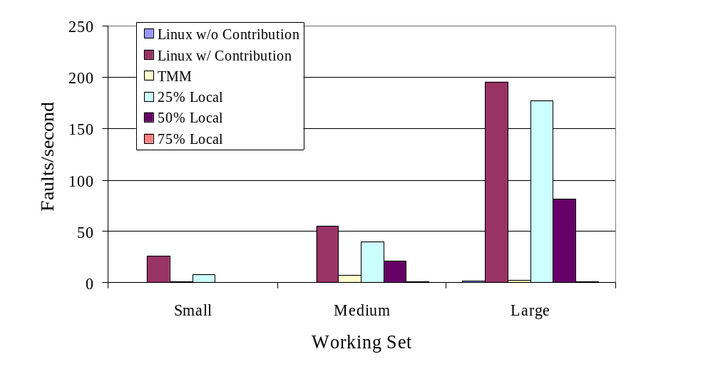
Local Application’s Page Faults

Slide 9
Related Work

Slide 10
Conclusions
Dynamically determines appropriate memory limits
Prevents local applications from being swapped out
Allows memory-intensive contributory applications

