Slide 1
Victorious
Secrets
Ankit Jalan
Aayush Dwivedi
Akshat Anand
Pogiri Kala Sagar
Sudhir Kumar
14006
14055
14466
14716

Slide 2
Outline
Problem Statement
Solution Approach
Previous Works
System Architecture
Technology Used
Experiment
Result

Slide 3
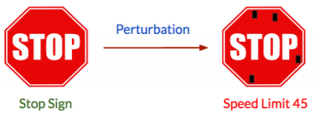
Problem statement
Adversarial examples for machine learning (ML) models are the samples which are modified in such a way that it is difficult for a human eye to distinguish between original and modified version, yet, when a classification model is presented with these examples they classify it differently, and in general, the modified sample is misclassified.
So, there is need to simulate a defensive strategy against adversarial examples for a image classification model.
Solution to adversary in image classification

Slide 4
Our Solution
We propose a novel method for defense against perturbation of image in CNN image classifier. The solution is based on fashioning a black box which assists CNN model to overcome the pixel perturbation.
The black-box is a setup of two stages:
Pixel Aggregation
Classifier
Tackling the adversary using Image Super Pixel Segmentation

Slide 5
Previous Works
Highlight the previous work in the field.

Slide 6
System Architecture

Slide 7
Technology Used
Language and Frameworks
Python
Tensor Flow
Skimage and OpenCV
Algorithms
CNN for Image Classifier
FGSM for generating adversary
SLIC for image segmentation
Datasets
CIFAR-10
Fashion MNIST

Slide 8
Experiment
Training the model
Testing the model on test images
Adversary Generation
Checking the accuracy with perturbed images
Pixel Aggregation on test images, normal as well as perturbed
Training the model with pixel aggregated training images.
Test the new model with pixel aggregated
perturbed test images

Slide 9
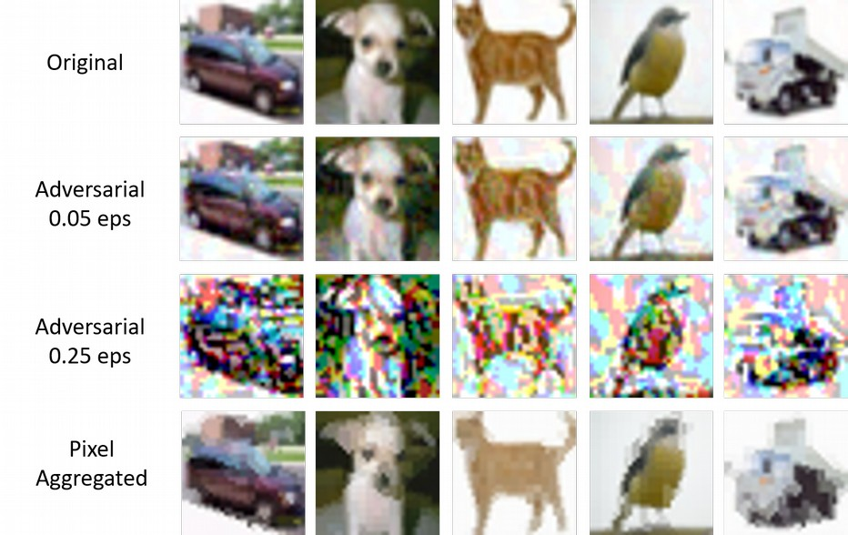
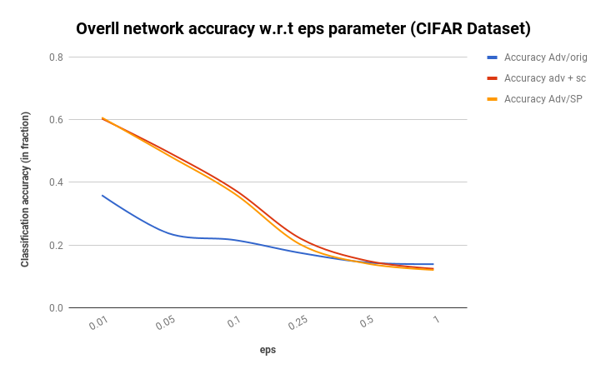
Result on CIFAR dataset
1
Here, we present the tables and graph representing the result on CIFAR dataset

Slide 10
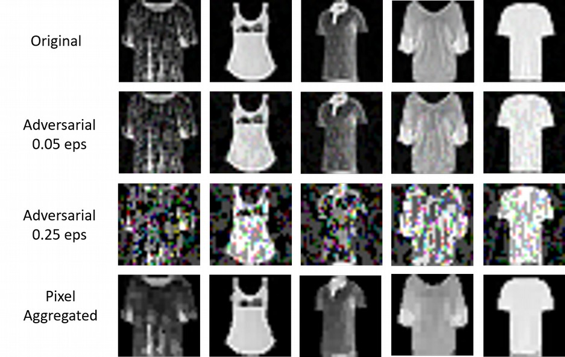
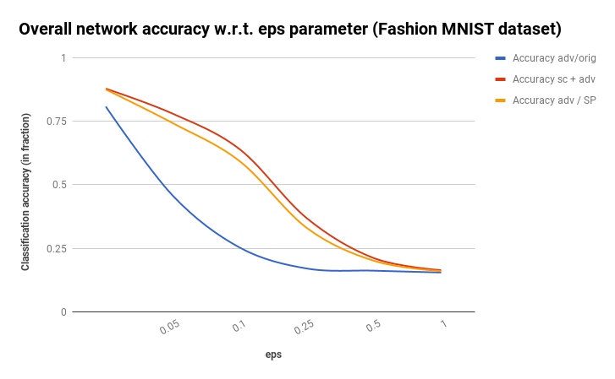
Result on Fashion MNIST dataset
1
Here, we present the tables and graph representing the result on Fashion MNIST dataset

Slide 11
Conclusions
The black box works in improving the accuracy of the classifier with perturbed image.
With large epsilon the image is very much perturbed, so accuracy goes down significantly.
The number of segments depends on size of image and can be fine tuned accordingly.
The averaging filter also depends on image and can be coded accordingly.
The various parameters of CNN on tensor flow can be tuned to give better accuracy.

Slide 12
Questions?

Slide 13
References
Explaining and harnessing adversarial examples, Goodfellow, Ian J and Shlens, Jonathon and Szegedy, Christian
SLIC super pixels compared to state-of-the-art super pixel methods, Achanta, Radhakrishna and Shaji, Appu and Smith, Kevin and Lucchi, Aurelien and Fua, Pascal
Learning multiple layers of features from tiny images, Krizhevsky, Alex and Hinton, Geoffrey
cleverhans v2.0.0: an adversarial machine learning library, Nicolas Papernot, Nicholas Carlini, Ian Goodfellow, Reuben Feinman, Fartash Faghri, Alexander Matyasko, Karen Hambardzumyan, Yi-Lin Juang, Alexey Kurakin, Ryan Sheatsley, Abhibhav Garg, Yen-Chen Lin
These are few references, more references can be found in our report here.

