Slide 1



Declarative Static Program Analysis with Doop
Yannis Smaragdakis
with Martin Bravenboer,
George Kastrinis,
George Balatsouras

Slide 2
Overview
What do we do?
  static program analysis
    “discover program properties that hold for all executions”
  declarative (logic-based specification)
Why do you care?
  simple, very powerful
  fast!
  different, major lessons learned
    several new algorithms, optimization techniques, implementation insights (no BDDs)
Yannis Smaragdakis
University of Athens

Slide 3


Program Analysis: Run Faster
(e.g., compiler optimization)
Yannis Smaragdakis
University of Athens

Slide 4

Program Analysis:
Software Understanding
(e.g., slicing, refactoring, program queries)
Yannis Smaragdakis
University of Athens

Slide 5

Program Analysis: Find Bugs
Yannis Smaragdakis
University of Athens

Slide 6
Our Work
In the past 6 years:
  Doop: a very powerful framework for Java pointer analysis
    the mother of all sophisticated static analyses
  declarative, using the Datalog language
  some work on client analyses
In the future:
  analyses for other languages
  lots of other low- and high-level analyses
Yannis Smaragdakis
University of Athens

Slide 7
Pointer Analysis
objects represented
by allocation sites
What objects can a variable point to?
program
points-to
void foo() {
Object a = new A1();
Object b = id(a);
}
void bar() {
Object a = new A2();
Object b = id(a);
}
Object id(Object a) {
return a;
}
foo:a new A1()
bar:a new A2()
Yannis Smaragdakis
University of Athens

Slide 8
Pointer Analysis
What objects can a variable point to?
program
points-to
void foo() {
Object a = new A1();
Object b = id(a);
}
void bar() {
Object a = new A2();
Object b = id(a);
}
Object id(Object a) {
return a;
}
foo:a new A1()
bar:a new A2()
id:a new A1(), new A2()
Yannis Smaragdakis
University of Athens

Slide 9
Pointer Analysis
What objects can a variable point to?
program
points-to
void foo() {
Object a = new A1();
Object b = id(a);
}
void bar() {
Object a = new A2();
Object b = id(a);
}
Object id(Object a) {
return a;
}
foo:a new A1()
bar:a new A2()
id:a new A1(), new A2()
foo:b new A1(), new A2()
bar:b new A1(), new A2()
remember for later:
context-sensitivity is what makes an analysis precise
context-sensitive points-to
foo:a new A1()
bar:a new A2()
id:a (foo) new A1()
id:a (bar) new A2()
foo:b new A1()
bar:b new A2()
Yannis Smaragdakis
University of Athens

Slide 10
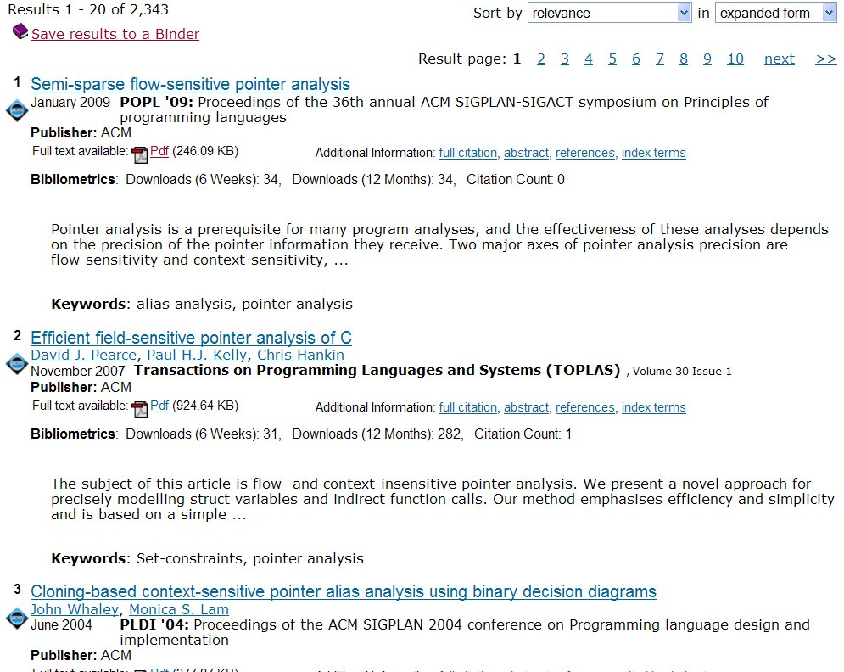
Pointer Analysis: A Complex Domain
flow-sensitive
field-sensitive
heap cloning
context-sensitive
binary decision diagrams
inclusion-based
unification-based
on-the-fly call graph
k-cfa
object sensitive
field-based
demand-driven
Yannis Smaragdakis
University of Athens

Slide 11
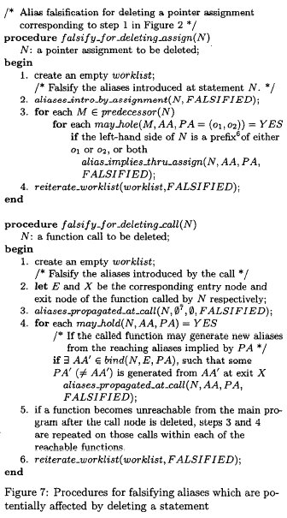
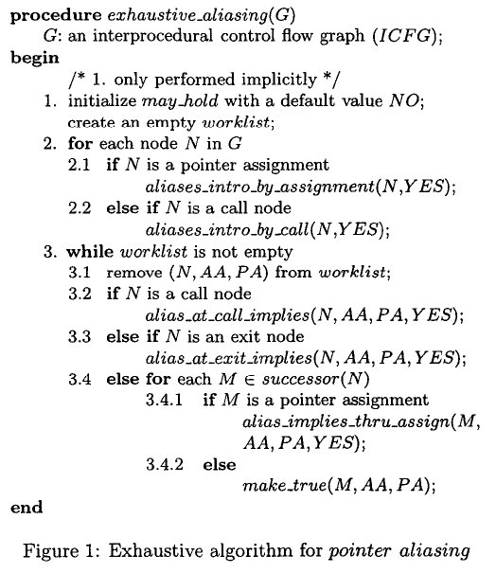
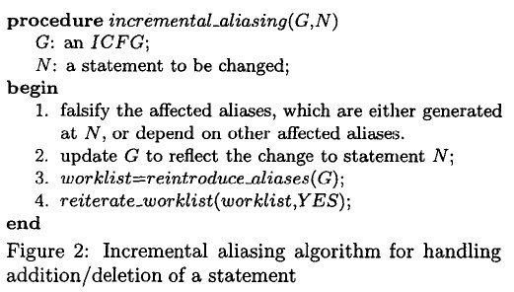
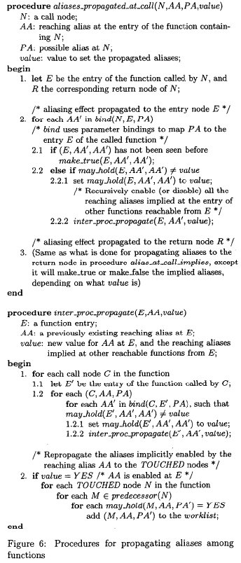
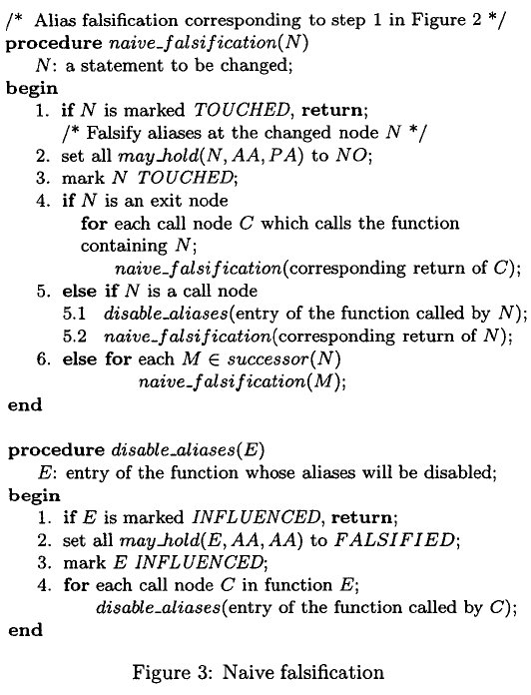
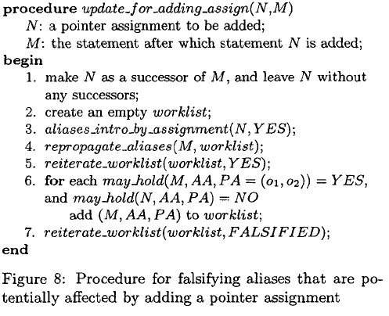
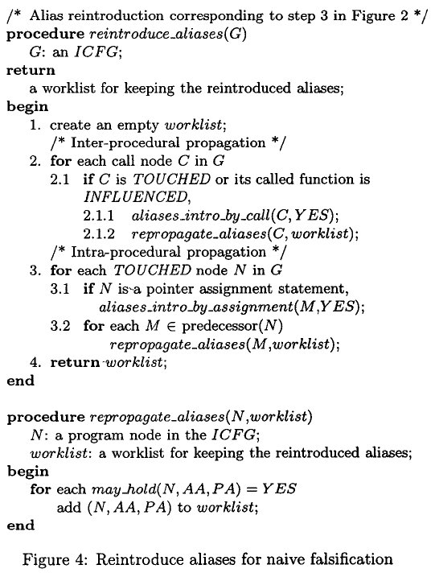
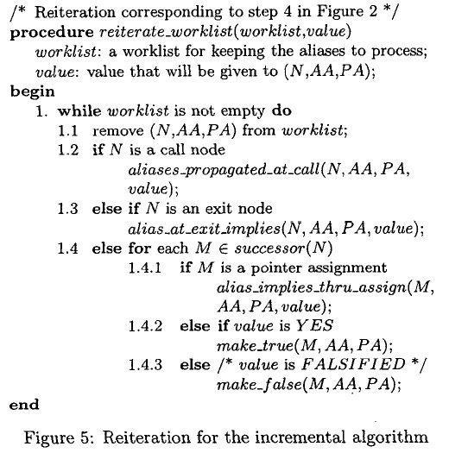
Algorithms Found In a 10-Page Pointer Analysis Paper
variation points unclear
every variant a new algorithm
correctness unclear
incomparable in precision
Yannis Smaragdakis
University of Athens

Slide 12
Program Analysis: a Domain of Mutual Recursion
x = y
var points-to
Yannis Smaragdakis
University of Athens

Slide 13
Program Analysis: a Domain of Mutual Recursion
x = f()
var points-to
call graph
Yannis Smaragdakis
University of Athens

Slide 14
Program Analysis: a Domain of Mutual Recursion
x = y.f()
var points-to
call graph
Yannis Smaragdakis
University of Athens

Slide 15
Program Analysis: a Domain of Mutual Recursion
x = new A()
var points-to
call graph
reachable methods
Yannis Smaragdakis
University of Athens

Slide 16
Program Analysis: a Domain of Mutual Recursion
x.f = y
var points-to
call graph
field points-to
reachable methods
Yannis Smaragdakis
University of Athens

Slide 17
Program Analysis: a Domain of Mutual Recursion
x = y.f
var points-to
call graph
field points-to
reachable methods
Yannis Smaragdakis
University of Athens

Slide 18
Program Analysis: a Domain of Mutual Recursion
throw e
var points-to
call graph
exceptions
field points-to
reachable methods
Yannis Smaragdakis
University of Athens

Slide 19
Program Analysis: a Domain of Mutual Recursion
catch(E e)
var points-to
call graph
exceptions
field points-to
reachable methods
Yannis Smaragdakis
University of Athens

Slide 20
Program Analysis: a Domain of Mutual Recursion
g()
var points-to
call graph
exceptions
field points-to
reachable methods
Yannis Smaragdakis
University of Athens

Slide 21
Program Analysis: a Domain of Mutual Recursion
var points-to
call graph
exceptions
field points-to
reachable methods
Yannis Smaragdakis
University of Athens

Slide 22
Datalog: Declarative Mutual Recursion
source
a = new A();
b = new B();
c = new C();
a = b;
b = a;
c = b;
Yannis Smaragdakis
University of Athens

Slide 23
Datalog: Declarative Mutual Recursion
source
Alloc
a = new A();
b = new B();
c = new C();
a = b;
b = a;
c = b;
a new A()
b new B()
c new C()
Move
a b
b a
c b
rules
VarPointsTo(var, obj) <-
Alloc(var, obj).
VarPointsTo(to, obj) <-
Move(to, from),
VarPointsTo(from, obj).
Yannis Smaragdakis
University of Athens

Slide 24
Datalog: Declarative Mutual Recursion
source
Alloc
a = new A();
b = new B();
c = new C();
a = b;
b = a;
c = b;
a new A()
b new B()
c new C()
Move
a b
b a
c b
head
VarPointsTo(var, obj) <-
Alloc(var, obj).
VarPointsTo(to, obj) <-
Move(to, from),
VarPointsTo(from, obj).
Yannis Smaragdakis
University of Athens

Slide 25
Datalog: Declarative Mutual Recursion
source
Alloc
VarPointsTo
a = new A();
b = new B();
c = new C();
a = b;
b = a;
c = b;
a new A()
b new B()
c new C()
Move
a b
b a
c b
head relation
VarPointsTo(var, obj) <-
Alloc(var, obj).
VarPointsTo(to, obj) <-
Move(to, from),
VarPointsTo(from, obj).
Yannis Smaragdakis
University of Athens

Slide 26
Datalog: Declarative Mutual Recursion
source
Alloc
VarPointsTo
a = new A();
b = new B();
c = new C();
a = b;
b = a;
c = b;
a new A()
b new B()
c new C()
Move
a b
b a
c b
bodies
VarPointsTo(var, obj) <-
Alloc(var, obj).
VarPointsTo(to, obj) <-
Move(to, from),
VarPointsTo(from, obj).
Yannis Smaragdakis
University of Athens

Slide 27
Datalog: Declarative Mutual Recursion
source
Alloc
VarPointsTo
a = new A();
b = new B();
c = new C();
a = b;
b = a;
c = b;
a new A()
b new B()
c new C()
Move
a b
b a
c b
body relations
VarPointsTo(var, obj) <-
Alloc(var, obj).
VarPointsTo(to, obj) <-
Move(to, from),
VarPointsTo(from, obj).
Yannis Smaragdakis
University of Athens

Slide 28
Datalog: Declarative Mutual Recursion
source
Alloc
VarPointsTo
a = new A();
b = new B();
c = new C();
a = b;
b = a;
c = b;
a new A()
b new B()
c new C()
Move
a b
b a
c b
join variables
VarPointsTo(var, obj) <-
Alloc(var, obj).
VarPointsTo(to, obj) <-
Move(to, from),
VarPointsTo(from, obj).
Yannis Smaragdakis
University of Athens

Slide 29
Datalog: Declarative Mutual Recursion
source
Alloc
VarPointsTo
a = new A();
b = new B();
c = new C();
a = b;
b = a;
c = b;
a new A()
b new B()
c new C()
Move
a b
b a
c b
recursion
VarPointsTo(var, obj) <-
Alloc(var, obj).
VarPointsTo(to, obj) <-
Move(to, from),
VarPointsTo(from, obj).
Yannis Smaragdakis
University of Athens

Slide 30
Datalog: Declarative Mutual Recursion
source
Alloc
VarPointsTo
a = new A();
b = new B();
c = new C();
a = b;
b = a;
c = b;
a new A()
b new B()
c new C()
a new A()
b new B()
c new C()
Move
a b
b a
c b
1st rule result
VarPointsTo(var, obj) <-
Alloc(var, obj).
VarPointsTo(to, obj) <-
Move(to, from),
VarPointsTo(from, obj).
Yannis Smaragdakis
University of Athens

Slide 31
Datalog: Declarative Mutual Recursion
source
Alloc
VarPointsTo
a = new A();
b = new B();
c = new C();
a = b;
b = a;
c = b;
a new A()
b new B()
c new C()
a new A()
b new B()
c new C()
Move
a b
b a
c b
2nd rule evaluation
VarPointsTo(var, obj) <-
Alloc(var, obj).
VarPointsTo(to, obj) <-
Move(to, from),
VarPointsTo(from, obj).
Yannis Smaragdakis
University of Athens

Slide 32
Datalog: Declarative Mutual Recursion
source
Alloc
VarPointsTo
a = new A();
b = new B();
c = new C();
a = b;
b = a;
c = b;
a new A()
b new B()
c new C()
a new A()
b new B()
c new C()
a new B()
Move
a b
b a
c b
2nd rule result
VarPointsTo(var, obj) <-
Alloc(var, obj).
VarPointsTo(to, obj) <-
Move(to, from),
VarPointsTo(from, obj).
Yannis Smaragdakis
University of Athens

Slide 33
Datalog: Declarative Mutual Recursion
source
Alloc
VarPointsTo
a = new A();
b = new B();
c = new C();
a = b;
b = a;
c = b;
a new A()
b new B()
c new C()
a new A()
b new B()
c new C()
a new B()
b new A()
c new B()
c new A()
Move
a b
b a
c b
VarPointsTo(var, obj) <-
Alloc(var, obj).
VarPointsTo(to, obj) <-
Move(to, from),
VarPointsTo(from, obj).
Yannis Smaragdakis
University of Athens

Slide 34
Datalog: Properties
Limited logic programming
  SQL with recursion
  Prolog without complex terms (constructors)
Captures PTIME complexity class
Strictly declarative
  as opposed to Prolog
    conjunction commutative
    rules commutative
  increases algorithm space
    enables different execution strategies, aggressive optimization
Less programming, more specification
Yannis Smaragdakis
University of Athens

Slide 35

Our Framework
Datalog-based pointer analysis framework for Java
Declarative: what, not how
Sophisticated, very rich set of analyses
  subset-based analysis, fully on-the-fly call graph discovery, field-sensitivity, context-sensitivity, call-site sensitive, object sensitive, thread sensitive, context-sensitive heap, abstraction, type filtering, precise exception analysis
Support for full semantic complexity of Java
  jvm initialization, reflection analysis, threads, reference queues, native methods, class initialization, finalization, cast checking, assignment compatibility
http://doop.program-analysis.org
Yannis Smaragdakis
University of Athens

Slide 36
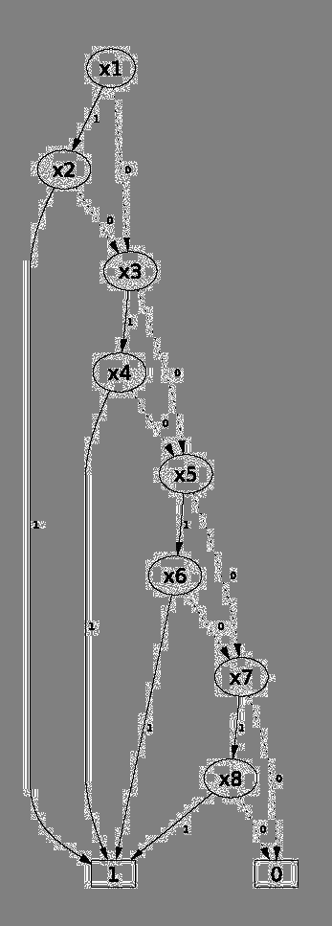
Pointer Analysis: Previous Approaches
Context-sensitive pointer analysis for Java
paddle
  Java + relational algebra +
  binary decision diagrams (BDD)
wala
  Java, conventional approach
bddbddb (pioneered Datalog for realistic points to analysis)
  Datalog + Java + BDD
no purely declarative approach
coupling of specification and algorithm
Yannis Smaragdakis
University of Athens

Slide 37
Some Doop Contributions
Expressed complete, complex pointer analyses in Datalog
    core specification: ~1500 logic rules
    parameterized by a handful of rules per analysis flavor
Synthesized efficient algorithms from specification
    order of magnitude performance improvement
    allowed to explore more analyses than past literature
Approach: heuristics for searching algorithm space
    targeted at recursive problem domains
Demonstrated scalability with explicit representation
    no BDDs
Yannis Smaragdakis
University of Athens

Slide 38
Not Expected
Expressed complete, complex pointer analyses in Datalog
“[E]ncoding all the details of a complicated program analysis problem [on-the-fly call graph construction, handling of Java features] purely in terms of subset constraints may be difficult or impossible.” (Lhotak)
Scalability and Efficiency
“Efficiently implementing a 1H-object-sensitive analysis without BDDs will require new improvements in data structures and algorithms”
Yannis Smaragdakis
University of Athens

Slide 39
Grand Tour of Interesting Results
What have we done with this?
Yannis Smaragdakis
University of Athens

Slide 40
Better Understanding of Existing Algorithms, More Precise and Scalable New Algorithms
[PLDI’10, POPL’11, CC’13, PLDI’13, PLDI’14]
Yannis Smaragdakis
University of Athens

Slide 41
Expressiveness and Insights
Greatest benefit of the declarative approach: better algorithms
  the same algorithms can be described non-declaratively
    the algorithms are interesting regardless of how they are implemented
  but the declarative formulation was helpful in finding them
    and in conjecturing that they work well
Yannis Smaragdakis
University of Athens

Slide 42
Recall: Context-Sensitivity
(call-site sensitivity)
What objects can a variable point to?
program
points-to
void foo() {
Object a = new A1();
Object b = id(a);
}
void bar() {
Object a = new A2();
Object b = id(a);
}
Object id(Object a) {
return a;
}
foo:a new A1()
bar:a new A2()
id:a new A1(), new A2()
foo:b new A1(), new A2()
bar:b new A1(), new A2()
call-site-sensitive points-to
foo:a new A1()
bar:a new A2()
id:a (foo) new A1()
id:a (bar) new A2()
foo:b new A1()
bar:b new A2()
Yannis Smaragdakis
University of Athens

Slide 43
Object-Sensitivity
program
class S {
Object id(Object a) { return a; }
Object id2(Object a) { return id(a); }
}
class C extends S {
void fun1() {
Object a1 = new A1();
Object b1 = id2(a1);
}
}
class D extends S {
void fun2() {
Object a2 = new A2();
Object b2 = id2(a2);
}
}
1-call-site-sensitive points-to
fun1:a1 new A1()
fun2:a2 new A2()
id2:a (fun1) new A1()
id2:a (fun2) new A2()
id:a (id2) new A1(),new A2()
id2:ret (*) new A1(),new A2()
fun1:b1 new A1(),new A2()
fun2:b2 new A1(),new A2()
Yannis Smaragdakis
University of Athens

Slide 44
Object-Sensitivity
program
class S {
Object id(Object a) { return a; }
Object id2(Object a) { return id(a); }
}
class C extends S {
void fun1() {
Object a1 = new A1();
Object b1 = id2(a1);
}
}
class D extends S {
void fun2() {
Object a2 = new A2();
Object b2 = id2(a2);
}
}
1-object-sensitive points-to
fun1:a1 new A1()
fun2:a2 new A2()
id2:a (C1) new A1()
id2:a (D1) new A2()
id:a (C1) new A1()
id:a (D1) new A2()
id2:ret (C1) new A1()
fun1:b1 new A1()
fun2:b2 new A2()
Yannis Smaragdakis
University of Athens

Slide 45
A General Formulation of Context-Sensitive Analyses
Every context-sensitive flow-insensitive analysis there is (ECSFIATI)
  ok, almost every
    most not handled are strictly less sophisticated
  and also many more than people ever thought
Also with on-the-fly call-graph construction
In 9 easy rules!
Yannis Smaragdakis
University of Athens

Slide 46
Simple Intermediate Language
We consider Java-bytecode-like language
  allocation instructions (Alloc)
  local assignments (Move)
  virtual and static calls (VCall, SCall)
  field access, assignments (Load, Store)
  standard type system and symbol table info (Type, Subtype, FormalArg, ActualArg, etc.)
Yannis Smaragdakis
University of Athens

Slide 47
Rule 1: Allocating Objects (Alloc)
Record(obj, ctx) = hctx,
VarPointsTo(var, ctx, obj, hctx)
<-
Alloc(var, obj, meth),
Reachable(meth, ctx).
obj: var = new Something();
Yannis Smaragdakis
University of Athens

Slide 48
Rule 2: Variable Assignment (Move)
VarPointsTo(to, ctx, obj, hctx)
<-
Move(to, from),
VarPointsTo(from, ctx, obj, hctx).
to = from
Yannis Smaragdakis
University of Athens

Slide 49
Rule 3: Object Field Write (Store)
FldPointsTo(baseObj, baseHCtx, fld, obj, hctx)
<-
Store(base, fld, from),
VarPointsTo(from, ctx, obj, hctx),
VarPointsTo(base, ctx, baseObj, baseHCtx).
base . fld = from
baseObj
obj
Yannis Smaragdakis
University of Athens

Slide 50
Rule 4: Object Field Read (Load)
VarPointsTo(to, ctx, obj, hctx)
<-
Load(to, base, fld),
FldPointsTo(baseObj, baseHCtx, fld, obj, hctx),
VarPointsTo(base, ctx, baseObj, baseHCtx).
to = base.fld
baseObj
fld
obj
Yannis Smaragdakis
University of Athens

Slide 51
Rule 5: Static Method Calls (SCall)
MergeStatic(invo, callerCtx) = calleeCtx,
Reachable(toMeth, calleeCtx),
CallGraph(invo, callerCtx, toMeth, calleeCtx)
<-
SCall(toMeth, invo, inMeth),
Reachable(inMeth, callerCtx).
invo: toMeth(..)
Yannis Smaragdakis
University of Athens

Slide 52
Rule 6: Virtual Method Calls (VCall)
Merge(obj, hctx, invo, callerCtx) = calleeCtx,
Reachable(toMeth, calleeCtx),
VarPointsTo(this, calleeCtx, obj, hctx),
CallGraph(invo, callerCtx, toMeth, calleeCtx)
<-
VCall(base, sig, invo, inMeth),
Reachable(inMeth, callerCtx),
VarPointsTo(base, callerCtx, obj, hctx),
LookUp(obj, sig, toMeth),
ThisVar(toMeth, this).
invo: base.sig(..)
obj
sig
toMeth
Yannis Smaragdakis
University of Athens

Slide 53
Rule 7: Parameter Passing
InterProcAssign(to, calleeCtx, from, callerCtx)
<-
CallGraph(invo, callerCtx, meth, calleeCtx),
ActualArg(invo, i, from),
FormalArg(meth, i,to).
invo: meth(.., from, ..) → meth(.., to, ..)
Yannis Smaragdakis
University of Athens

Slide 54
Rule 8: Return Value Passing
InterProcAssign(to, callerCtx, from, calleeCtx)
<-
CallGraph(invo, callerCtx, meth, calleeCtx),
ActualReturn(invo, to),
FormalReturn(meth, from).
invo: to = meth(..) → meth(..) { .. return from; }
Yannis Smaragdakis
University of Athens

Slide 55
Rule 9: Parameter/Result Passing as Assignment
VarPointsTo(to, toCtx, obj, hctx)
<-
InterProcAssign(to, toCtx, from, fromCtx),
VarPointsTo(from, toCtx, obj, hctx).
Yannis Smaragdakis
University of Athens

Slide 56
Can Now Express Past Analyses Nicely
1-call-site-sensitive with context-sensitive heap:
  Context = HContext = Instr
Functions:
  Record(obj, ctx) = ctx
  Merge(obj, hctx, invo, callerCtx) = invo
  MergeStatic(invo, callerCtx) = invo
Yannis Smaragdakis
University of Athens

Slide 57
Can Now Express Past Analyses Nicely
1-object-sensitive+heap:
  Context = HContext = Instr
Functions:
  Record(obj, ctx) = ctx
  Merge(obj, hctx, invo, callerCtx) = obj
  MergeStatic(invo, callerCtx) = callerCtx
Yannis Smaragdakis
University of Athens

Slide 58
Can Now Express Past Analyses Nicely
PADDLE-style 2-object-sensitive+heap:
  Context = Instr² , HContext = Instr
Functions:
  Record(obj, ctx) = first(ctx)
  Merge(obj, hctx, invo, callerCtx) =
  pair(obj, first(ctx))
  MergeStatic(invo, callerCtx) = callerCtx
Yannis Smaragdakis
University of Athens

Slide 59
Lots of Insights and New Algorithms (all with major benefits)
Discovered that the same name was used for two past algorithms with very different behavior
Proposed a new kind of context (type-sensitivity), easily implemented by uniformly tweaking Record/Merge functions
Found connections between analyses in functional/OO languages
Showed that merging different kinds of contexts works great (hybrid context-sensitivity)
Yannis Smaragdakis
University of Athens

Slide 60
Impressive Performance, Implementation Insights
[OOPSLA’09, ISSTA’09]
Yannis Smaragdakis
University of Athens

Slide 61
Impressive Performance
Compared to Paddle
  most complete, scalable past framework
    includes analyses with a context sensitive heap
Large speedup for fully equivalent results
    15.2x faster for 1-obj, 16.3x faster for 1-call, 7.3x faster for 1-call+heap, 6.6x faster for 1-obj+heap
Large speedup for more precise results!
    9.7x for 1-call, 12.3x for 1-call+heap, 3x for 1-obj+heap
Scaling to analyses Paddle cannot handle
    2-call+1-heap, 2-object+1-heap, 2-call+2-heap
Yannis Smaragdakis
University of Athens

Slide 62
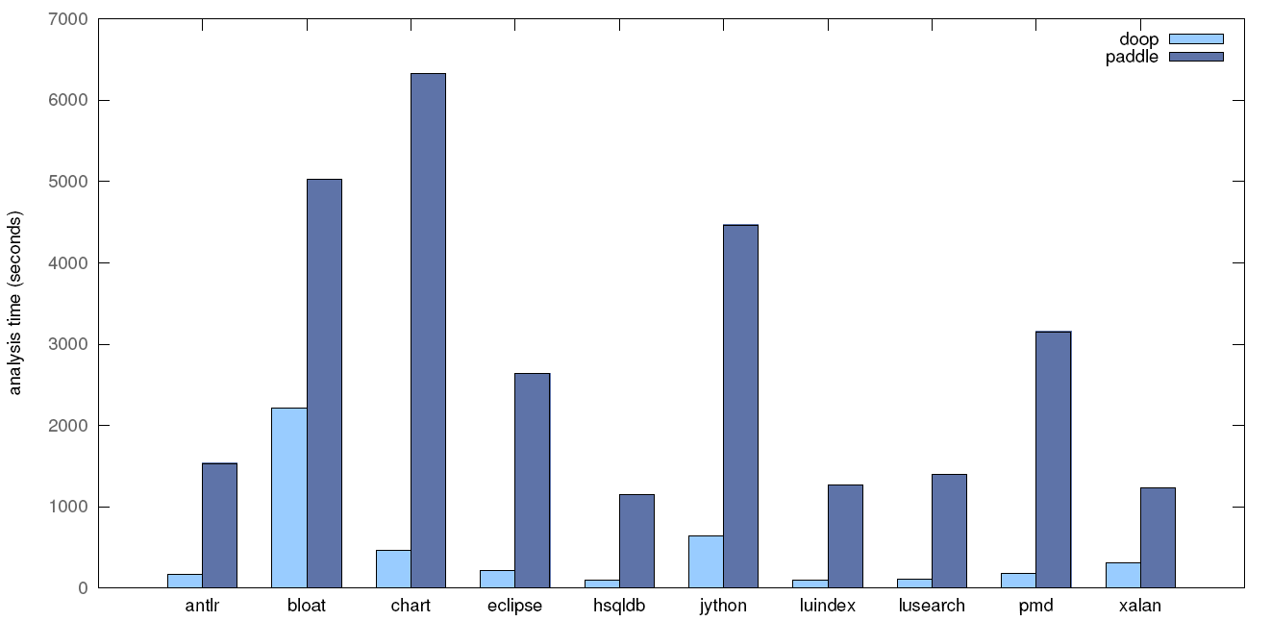
1-call-site-sensitive+heap
Yannis Smaragdakis
University of Athens

Slide 63
Where Is The Magic?
Surprisingly, in very few places
  4 orders of magnitude via optimization methodology for highly recursive Datalog!
    straightforward data processing optimization (indexes), but with an understanding of how Datalog does recursive evaluation
  no BDDs
    are they needed for pointer analysis?
  simple domain-specific enhancements that increase both precision and performance in a direct (non-BDD) implementation
Yannis Smaragdakis
University of Athens

Slide 64
Datalog: Naïve Evaluation
Datalog
Naïve Evaluation (relational algebra)
VarPointsTo(?var, ?obj) <-
AssignObjectAllocation(?var, ?obj).
VarPointsTo(?to, ?obj) <-
Assign(?from, ?to), VarPointsTo(?from, ?obj).
VarPointsTo := AssignObjectAllocation
repeat
tmp := π_{to→var,obj}(VarPointsTo ∞ _{from=var} Assign)
VarPointsTo := VarPointsTo ∪ tmp
until fixpoint
Yannis Smaragdakis
University of Athens

Slide 65

Datalog: Naïve Evaluation
VarPointsTo
Assign
Yannis Smaragdakis
University of Athens

Slide 66
Datalog: Naïve Evaluation
VarPointsTo
Assign
Yannis Smaragdakis
University of Athens

Slide 67
Datalog: Semi-Naïve Evaluation
VarPointsTo
Assign
no repeated iteration over computed results
Yannis Smaragdakis
University of Athens

Slide 68
Datalog: Semi-Naïve Evaluation
VarPointsTo
Assign
no repeated iteration over computed results
Yannis Smaragdakis
University of Athens

Slide 69
Datalog: Naïve Evaluation
Specification
Semi-naïve executions
FieldPointsTo(?baseobj, ?field, ?obj) <-
StoreField(?from, ?base, ?field),
VarPointsTo(?base, ?baseobj),
VarPointsTo(?from, ?obj).
ΔFieldPointsTo(?baseobj, ?field, ?obj) <-
StoreField(?from, ?base, ?field),
ΔVarPointsTo(?base, ?baseobj),
VarPointsTo(?from, ?obj).
ΔFieldPointsTo(?baseobj, ?field, ?obj) <-
StoreField(?from, ?base, ?field),
VarPointsTo(?base, ?baseobj),
ΔVarPointsTo(?from, ?obj).
Yannis Smaragdakis
University of Athens

Slide 70
Optimization Insight
For highly recursive Datalog programs,
relation deltas produced by semi-naive evaluation should bind all the variables needed to index into other relations
Can require complex reasoning
  whole program optimization
  human needs to be in the loop in the search of algorithm space!
Yannis Smaragdakis
University of Athens

Slide 71
From Specification To Algorithms
Illustration of optimizations (much more in paper)
Yannis Smaragdakis
University of Athens

Slide 72

Optimizations = Datalog Source Transformations
The Datalog engine we use exposes indexing
  argument order determines index
Essentially, the engine does not represent relations, only indexes (as b-trees)
  i.e., functions
  very much like a vertical/column store in DBs, but with everything exposed to the Datalog language level
Yannis Smaragdakis
University of Athens

Slide 73
Relations As Multidimensional Indexes
index organized by
reverse argument order
VarPointsTo
a new A()
b new B()
c new C()
a new B()
b new A()
c new B()
c new A()
VarPointsTo(?var, ?obj)
new A(), b
new B(), a
new A(), a
new A(), c
new B(), b
new B(), c
new c(), c
Yannis Smaragdakis
University of Athens

Slide 74
Relations As Multidimensional Indexes
index organized by
reverse argument order
VarPointsTo
new A() a
new B() b
new C() c
new B() a
new A() b
new B() c
new A() c
VarPointsTo(?obj, ?var)
a, new B()
b, new B()
a, new A()
b, new A()
c, new A()
c, new B()
c, new c()
Yannis Smaragdakis
University of Athens

Slide 75
Heuristics For Searching Algorithm Space
Always use index efficiently
ΔVarPointsTo(?from, ?obj) ∞ Assign(?from, ?to)
Yannis Smaragdakis
University of Athens

Slide 76
Heuristics For Searching Algorithm Space
Always use index efficiently
ΔVarPointsTo(?from, ?obj) ∞ Assign(?from, ?to)
ΔVarPointsTo(?from, ?obj) ∞ Assign(?to, ?from)
Yannis Smaragdakis
University of Athens

Slide 77
Heuristics For Searching Algorithm Space
Never iterate over full views
ΔAssign(?to, ?from) ∞ VarPointsTo(?from, ?obj)
Yannis Smaragdakis
University of Athens

Slide 78
Heuristics For Searching Algorithm Space
Never iterate over full views
ΔAssign(?to, ?from) ∞ VarPointsTo(?from, ?obj)
VarPointsTo(?from, ?obj) ∞ ΔAssign(?to, ?from)
Yannis Smaragdakis
University of Athens

Slide 79
Heuristics For Searching Algorithm Space
Never iterate over full views
ΔAssign(?to, ?from) ∞ VarPointsTo(?from, ?obj)
VarPointsTo(?from, ?obj) ∞ ΔAssign(?to, ?from)
ΔAssign(?to, ?from) ∞ VarPointsTo(?obj, ?from)
Yannis Smaragdakis
University of Athens

Slide 80
Not Always Easy
Specification
Semi-naïve executions
FieldPointsTo(?baseobj, ?field, ?obj) <-
StoreField(?from, ?base, ?field),
VarPointsTo(?base, ?baseobj),
VarPointsTo(?from, ?obj).
ΔFieldPointsTo(?baseobj, ?field, ?obj) <-
StoreField(?from, ?base, ?field),
ΔVarPointsTo(?base, ?baseobj),
VarPointsTo(?from, ?obj).
ΔFieldPointsTo(?baseobj, ?field, ?obj) <-
StoreField(?from, ?base, ?field),
VarPointsTo(?base, ?baseobj),
ΔVarPointsTo(?from, ?obj).
Yannis Smaragdakis
University of Athens

Slide 81
Not Always Easy: Whole Program Property
Specification
Join orderings
FieldPointsTo(?baseobj, ?field, ?obj) <-
StoreField(?from, ?base, ?field),
VarPointsTo(?base, ?baseobj),
VarPointsTo(?from, ?obj).
there is no efficient variable ordering for StoreField
(?base and ?from cannot both be last)
ΔVarPointsTo(?base, ?baseobj)
∞ StoreField(?from, ?base, ?field)
∞ VarPointsTo(?from, ?obj)
ΔVarPointsTo(?from, ?obj)
∞ StoreField(?from, ?base, ?field)
∞ VarPointsTo(?base, ?baseobj)
Yannis Smaragdakis
University of Athens

Slide 82
Solution: Introduce New Index/Relation
Specification
Optimized rules
FieldPointsTo(?baseobj, ?field, ?obj) <-
StoreField(?from, ?base, ?field),
VarPointsTo(?base, ?baseobj),
VarPointsTo(?from, ?obj).
FieldPointsTo(?obj, ?field, ?baseobj) <-
StoreObjectField(?baseobj, ?field, ?from),
VarPointsTo(?obj, ?from).
StoreObjectField(?baseobj, ?field, ?from) <-
StoreField(?from, ?field, ?base),
VarPointsTo(?baseobj, ?base).
Yannis Smaragdakis
University of Athens

Slide 83
No Binary Decision Diagrams (BDDs)
Scalable precise (context-sensitive) points-to analyses had used BDDs in the past
We use an explicit representation
BDDs offer memory efficiency but also overheads
  traverse 48 links to get a 48-bit tuple
  cost of normalizing/minimizing
Yannis Smaragdakis
University of Athens

Slide 84
Are BDDs Right For Points-To Analysis?
We have not found the benefit of BDDs to outweigh the costs
Relations are reducible, but not clearly extremely regular
  even though we use BDD variable orderings that have been heavily optimized
    “impressive results”
Yannis Smaragdakis
University of Athens

Slide 85
Are BDDs Right For Points-To Analysis?
The Paddle results optimize for speed, size of VarPointsTo relation
But other relations may be large
For no analysis does the “optimal” BDD ordering simultaneously minimize relations VarPointsTo, FieldsPointsTo, CallGraphEdge
30x differences in ratio facts/BDDnodes are common!
BDDs (as currently used in points-to analyses) do not seem to pay off
Yannis Smaragdakis
University of Athens

Slide 86
Algorithmic Enhancements
BDDs are necessary if one is not careful about precision
We introduced simple algorithmic enhancements to avoid redundancy
  static initializers handled context-insensitively
  on-the-fly exception handling
Better analyses, as well as faster!
Yannis Smaragdakis
University of Athens

Slide 87
Set-Based Pre-Analysis a universal optimization technique for flow-insensitive analyses
[OOPSLA’13]
Yannis Smaragdakis
University of Athens

Slide 88
Set-Based Pre-Analysis
Idea: can do much reasoning at the set level instead of the value level
  can simplify the program as a result
  a local transformation
  think of it as creating a normal form (or IR) for points-to analysis
Yannis Smaragdakis
University of Athens

Slide 89
“hello, world” Example
p = q;
r = p;
r = q; // redundant
Simple subset reasoning
  statement redundant for analysis purposes
∧
P ⊇ Q
R ⊇ P
⇓
R ⊇ Q
(MOVE elimination)
Yannis Smaragdakis
University of Athens

Slide 90
“hello, world” Example
p = q;
r = p;
r = q; // redundant
Simple subset reasoning
  statement redundant for analysis purposes
Rewrite program, eliminate redundant statement
  an intraprocedural, pattern-based transformation
occurring in any order anywhere in same method
(MOVE elimination)
Yannis Smaragdakis
University of Athens

Slide 91
More Examples
r = q;
p.f = r;
p.f = q; // redundant
p.f = q;
r = p.f
r = q; // redundant
(STORE elimination)
(another MOVE elimination)
Yannis Smaragdakis
University of Athens

Slide 92
Even More Examples
r = q;
q = p.f;
r = p.f; // redundant
r = q;
q = p.m();
r = p.m(); // redundant
(LOAD elimination)
(CALL elimination!!!)
Yannis Smaragdakis
University of Athens

Slide 93
Not Even Close To Done
r = q;
q = arr[*];
r = arr[*]; // redundant
can apply all previous patterns in combination with array ops, or with static loads, calls, stores, etc.
transforms apply to fixpoint (one enables others)
(ARRAYLOAD elimination—for array insensitive analyses)
Yannis Smaragdakis
University of Athens

Slide 94
And Also…
Duplicate variable elimination
  same as past work using the
  constraint graph to merge
  points-to sets
E.g.,
    merge vars in same strongly connected component of constraint graph [Faehndrich et al.]
    merge vars with identical in-flows [Rountev and Chandra, Hardekopf and Lin]
    merge vars with same dominator [Nasre]
Constraint Graph:
∀
p = q; Q P
Yannis Smaragdakis
University of Athens

Slide 95
So, How Is This Different From Constraint-Graph Techniques (I) ?
r = q;
p.f = r;
p.f = q; // redundant
Applies even if points-to sets q and r (also q and p.f) are distinct
Ours is eliminating statements, not vars
  eliminating edges, not nodes in constraint graph
Yannis Smaragdakis
University of Athens

Slide 96
So, How Is This Different From Constraint-Graph Techniques (II) ?
An intra-procedural program transformation
  Reduce program once-and-for-all, apply multiple analyses to it
  Reduce library once-and-for-all, analyze with multiple programs
  Pattern-based local program rewrites
  Perfectly compatible with on-the-fly call-graph construction (i.e., applicable to Java)
  Applicable very widely
Yannis Smaragdakis
University of Athens

Slide 97
Transform Effect, Pictorially
private void rotateRight(java.util.TreeMap$Entry)
java.util.TreeMap r0;
java.util.TreeMap$Entry r1, r2, $r3, $r4, $r5, $r6, $r7, $r8, $r9, $r10, $r11;
r0 := @this: java.util.TreeMap;
r1 := @param0: java.util.TreeMap$Entry;
if r1 == null goto label4;
r2 = r1.<java.util.TreeMap$Entry: java.util.TreeMap$Entry left>;
$r3 = r2.<java.util.TreeMap$Entry: java.util.TreeMap$Entry right>;
r1.<java.util.TreeMap$Entry: java.util.TreeMap$Entry left> = $r3;
$r4 = r2.<java.util.TreeMap$Entry: java.util.TreeMap$Entry right>;
if $r4 == null goto label0;
$r5 = r2.<java.util.TreeMap$Entry: java.util.TreeMap$Entry right>;
$r5.<java.util.TreeMap$Entry: java.util.TreeMap$Entry parent> = r1;
label0: $r6 = r1.<java.util.TreeMap$Entry: java.util.TreeMap$Entry parent>;
r2.<java.util.TreeMap$Entry: java.util.TreeMap$Entry parent> = $r6;
$r7 = r1.<java.util.TreeMap$Entry: java.util.TreeMap$Entry parent>;
if $r7 != null goto label1;
r0.<java.util.TreeMap: java.util.TreeMap$Entry root> = r2;
goto label3;
label1: $r8 = r1.<java.util.TreeMap$Entry: java.util.TreeMap$Entry parent>;
$r9 = $r8.<java.util.TreeMap$Entry: java.util.TreeMap$Entry right>;
if $r9 != r1 goto label2;
$r10 = r1.<java.util.TreeMap$Entry: java.util.TreeMap$Entry parent>;
$r10.<java.util.TreeMap$Entry: java.util.TreeMap$Entry right> = r2;
goto label3;
label2: $r11 = r1.<java.util.TreeMap$Entry: java.util.TreeMap$Entry parent>;
$r11.<java.util.TreeMap$Entry: java.util.TreeMap$Entry left> = r2;
label3: r2.<java.util.TreeMap$Entry: java.util.TreeMap$Entry right> = r1;
r1.<java.util.TreeMap$Entry: java.util.TreeMap$Entry parent> = r2;
label4: return;
private void rotateRight(java.util.TreeMap$Entry)
java.util.TreeMap$Entry r2, $r3, $r6, $r9;
if @param0 == null goto label4;
r2 = @param0.<java.util.TreeMap$Entry: java.util.TreeMap$Entry left>;
$r3 = r2.<java.util.TreeMap$Entry: java.util.TreeMap$Entry right>;
@param0.<java.util.TreeMap$Entry: java.util.TreeMap$Entry left> = $r3;
if $r3 == null goto label0;
$r3.<java.util.TreeMap$Entry: java.util.TreeMap$Entry parent> = @param0;
label0: $r6 = @param0.<java.util.TreeMap$Entry: java.util.TreeMap$Entry parent>;
r2.<java.util.TreeMap$Entry: java.util.TreeMap$Entry parent> = $r6;
if $r6 != null goto label1;
@this.<java.util.TreeMap: java.util.TreeMap$Entry root> = r2;
goto label3;
label1: $r9 = $r6.<java.util.TreeMap$Entry: java.util.TreeMap$Entry right>;
if $r9 != @param0 goto label2;
$r6.<java.util.TreeMap$Entry: java.util.TreeMap$Entry right> = r2;
goto label3;
label2: $r6.<java.util.TreeMap$Entry: java.util.TreeMap$Entry left> = r2;
label3: r2.<java.util.TreeMap$Entry: java.util.TreeMap$Entry right> = @param0;
@param0.<java.util.TreeMap$Entry: java.util.TreeMap$Entry parent> = r2;
label4: return;
Yannis Smaragdakis
University of Athens

Slide 98
Observations
The reduced program is NOT valid for execution
  only for flow-insensitive points-to analysis
Set-based reasoning makes sense since points-to analyses are expressible via subset constraints
  MOVE elimination follows from MOVE rule in analysis
p = q;
r = p;
r = q; // redundant
VarPointsTo(to, obj) <-
Move(to, from),
VarPointsTo(from, obj).
Yannis Smaragdakis
University of Athens

Slide 99
So, How Well Does This Work?
Over many analyses, DaCapo benchmarks
  (ctx-insens, 1call, 1call+H, 1obj, 1obj+H, 2obj+H, 2type+H)
20% average speedup
  (median: 20%, max: 110%)
Eliminates ~30% of local vars
Decimates (97% elimination!) MOVE instructions
Eliminates more than 30% of context-sensitive points-to facts
Yannis Smaragdakis
University of Athens

Slide 100
Latest Emphasis: Soundness
[CACM Feb’15][APLAS’15][upcoming]
Yannis Smaragdakis
University of Athens

Slide 101
What Is a Sound Analysis?
Most static analyses are “may-analyses”
  they overapproximate what can happen when the program runs
“Sound” for may-analysis = it’s ok to
over-approximate
  it’s not ok (unsound) to miss things that can happen
  for points-to: sets should contain all values that arise at runtime
Yannis Smaragdakis
University of Athens

Slide 102
Why Is Soundness Difficult?
No realistic static points-to analysis is sound
  due to reflection, dynamic loading, native code
Best-effort handling of these features still too expensive!
  major limitation of current frameworks
  due to imprecision
    e.g., too many strings match at a reflection operation
Yannis Smaragdakis
University of Athens

Slide 103
So, What Can We Do?
Identify the problem and raise awareness
Emphasize empirical soundness
  “quantify unsoundness, get it close to zero”
  lots of backwards reasoning: see where the results of imprecise analysis may be used
Get full soundness for parts of the program unaffected by intractable features
  requires clever encoding to avoid pollution:
    “never do work unless instruction guaranteed unaffected by reflection, dynamic loading, etc.”
Yannis Smaragdakis
University of Athens

Slide 104
Conclusions, Future Work
Yannis Smaragdakis
University of Athens

Slide 105
Declarative Program Analysis
Doop is probably the most complete points-to analysis framework for Java
  aids exploration
  competitive performance
Already yielded new algorithms, implementation techniques
Latest: flow-sensitive, LLVM, client analyses
Future: commercialization as program comprehension service
Yannis Smaragdakis
University of Athens

Slide 106
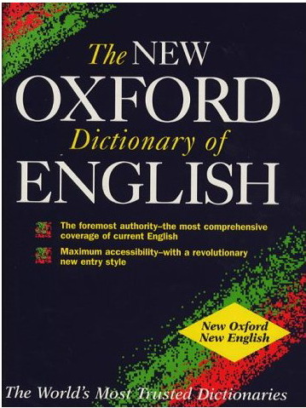
What Does It Mean To Be Declarative?
“denoting high-level programming languages
which can be used to solve problems without
requiring the programmer to specify an exact
procedure to be followed.”
  high-level
  what, not how
  no control-flow
  no side-effects
  specifications, not programs, not algorithms
Yannis Smaragdakis
University of Athens

Slide 107
Can Now Express Past Analyses Nicely
Call-site-sensitivity:
  Context = HContext = Instr^{n}
Functions:
  Record(obj, ctx) = ctx
  Merge(obj, hctx, invo, callerCtx) =
  cons(invo, firstn-1(callerCtx))
  MergeStatic(invo, callerCtx) =
  cons(invo, firstn-1(callerCtx))
Yannis Smaragdakis
University of Athens

Slide 108
Can Now Express Past Analyses Nicely
Original Milanova et al.-style object-sensitivity:
  Context = HContext = Instr^{n}
Functions:
  Record(obj, ctx) = cons(obj, firstn-1(ctx))
  Merge(obj, hctx, invo, callerCtx) = hctx
  MergeStatic(invo, callerCtx) = callerCtx
Yannis Smaragdakis
University of Athens

Slide 109
Can Now Express Past Analyses Nicely
PADDLE-style object-sensitivity:
  Context = HContext = Instr^{n}
Functions:
  Record(obj, ctx) = cons(obj, firstn-1(ctx))
  Merge(obj, hctx, invo, callerCtx) =
  cons(first(hctx), firstn-1(ctx))
  MergeStatic(invo, callerCtx) = callerCtx
Yannis Smaragdakis
University of Athens

Slide 110
Idea: Type-Sensitivity
Why not alleviate the combinatorial explosion by reducing combinations
Instead of allocation sites, keep types
Otherwise precisely isomorphic to object-sensitivity
  just some elements of context are transformed by a function T: Instr → ClassName
Yannis Smaragdakis
University of Athens

Slide 111
Example type-sensitive analyses
2type+1H:
  HContext = Instr x ClassName
  Context = ClassName²
Functions:
  Record(obj, [ctx1,ctx2]) = [obj,ctx1]
  Merge(obj, [hctx1,hctx2], invo, callerCtx) =
  [T(hctx1), hctx2]
  MergeStatic(invo, callerCtx) = callerCtx
Yannis Smaragdakis
University of Athens

Slide 112
Another Idea: Why Not Combine Context Flavors?
E.g., for a 1-object-sensitive analysis
Functions:
  Record(obj, ctx) = obj
  Merge(obj, hctx, invo, callerCtx) = hctx
  MergeStatic(invo, callerCtx) = invo
“keep an allocation site as context for virtual calls and a call-site for static calls”
Yannis Smaragdakis
University of Athens

Slide 113
Another Idea: Why Not Combine Context Flavors?
E.g., for a 2-object-sensitive+heap analysis
Functions:
  Record(obj, ctx) = first(ctx)
  Merge(obj, hctx, invo, callerCtx) =
  triple(obj, hctx, ⊥)
  MergeStatic(invo, callerCtx) =
  triple(first(ctx), invo, second(ctx))
“behave like object-sensitivity for virtual calls, for ﬁrst static call use combined call-site/object context. For further static calls, favor call-site sensitivity, without disturbing the part of the context used for Record ”
Yannis Smaragdakis
University of Athens

Slide 114
You Got a Taste
Such combinations significantly enhance both precision and performance
  a lot more combinations possible and explored
A lot more exploration possible because of declarative nature
  e.g., joint points-to and exception analysis, with similar parameterization [ISSTA’09, CC’13]
    exception handling has surprisingly large impact for Java points-to analysis
Yannis Smaragdakis
University of Athens

Slide 115
Example 2: Precise Exception Analysis
Method invocations: propagated exceptions
void f() {
g();
}
ThrowPointsTo(?caller, ?obj) <-
CallGraphEdge(?invocation, ?tomethod),
ThrowPointsTo(?tomethod, ?obj),
Type[?obj] = ?objtype,
not exists ExceptionHandler[?objtype, ?invocation],
Method[?invocation] = ?caller.
void f() {
try {
g();
} catch(E e) {..}
}
Method invocations: caught exceptions
VarPointsTo(?param, ?obj) <-
CallGraphEdge(?invocation, ?tomethod),
ThrowPointsTo(?tomethod, ?obj),
Type[?obj] = ?objtype,
ExceptionHandler[?objtype, ?invocation] = ?handler,
ExceptionHandler:FormalParam[?handler] = ?param.
lots of recursion →
fully precise, modular, on-the-fly exception analysis logic
Yannis Smaragdakis
University of Athens

Slide 116
An Instance Of a Greater Domain?
Datalog = first-order logic + recursion
  captures PTIME
Plan to use many other declarative, logic-based languages in the future
  inspired by Neil Immerman’s “Descriptive Complexity” work
Yannis Smaragdakis
University of Athens

Slide 117
Examples
Guaranteed linear-time, “single-touch” language for computation during garbage collection
  forall, exists, access to fields, one relation
  work in progress, with Sam Guyer (Tufts)
Embedded language for parallelism
  any program guaranteed to have optimal parallel speedup
  first order + transitive closure? Less?
Yannis Smaragdakis
University of Athens

Slide 118
From Algorithms To Specification And Back
algorithm
algorithm
policy
algorithm
algorithm
algorithm
policy
specification
algorithm
algorithm
algorithm
algorithm
policy
algorithm
analysis
synthesis
Yannis Smaragdakis
University of Athens

Slide 119
We can now express past analyses nicely
Most commonly called “object-sensitivity”:
  HContext = Instr, Context = Instr^{n}
Functions:
  record(i,c) = i
  merge(i, hc, c) = cons(hc, first_{n-1}(c))
record: Instr x Context → HContext
merge: Instr x HContext x Context → Context
i: [v = new C(); ] with context c ➔
store heap context record(i,c) with v
i: [v.m(…); ] with context c ➔
analyze m with context merge(i,hc,c) where hc is the context stored with v
Yannis Smaragdakis
University of Athens

Slide 120
We can now express past analyses nicely
object-sensitive+H analyses (heap cloning):
  HContext = Instr^{n+1}, Context = Instr^{n}
Functions:
  record(i,c) = cons(i, c)
  merge(i, hc, c) = [any of the previous options]
record: Instr x Context → HContext
merge: Instr x HContext x Context → Context
i: [v = new C(); ] with context c ➔
store heap context record(i,c) with v
i: [v.m(…); ] with context c ➔
analyze m with context merge(i,hc,c) where hc is the context stored with v
Yannis Smaragdakis
University of Athens

