Slide 1
Introduction
Program Dependence Graphs
First introduced in 1984
The program is represented as a graph where every statement is a node
Dependences between instructions are represented as edges
Makes explicit the data and control dependencies in each method of a program
Can be used for optimization, parallelization, taint analysis, debugging, slicing...

Slide 2
Types of dependences
Data dependence
B = A+1 (S1)
C = B+2 (S2)
S2 depends on S1, as it uses the variable defined in S1
Control dependence
if (A < 10) (S1)
B = 1 (S2)
S2 depends on S1, as S1 decides whether S2 is going to be executed

Slide 3
Data (flow) dependence
Defined in terms of def-use chains:
Each instruction has a def and a use set, which contain the variables defined and used by that instruction, respectively.
x = y + z (S1)
Def(S1) = {x}
Use(S1) = {y, z}
An instruction S2 is data-dependent on another instruction S1 if S1 defines a variable used by S2 and there is a path from S1 to S2 with no re-definitions if that variable.
This becomes simple to express if we use Single Static Assignment form.
(Other types of data dependence exist, such as write after write dependence, which prevent us from reordering instructions and are of interest in parallelization)

Slide 4
Single Static Assignment
Soot supports the generation of an intermediate representation in SSA form.
In SSA form, each variable is assigned exactly once, with a new version of that variable being used whenever a new assignment happens.
a = 1
a = a+1
b = a
a1 = 1
a2 = a1+1
b = a2
SSA Form
This way, we can say instruction S1 depends on S2 simply iff
which can easily be expressed in Datalog

Slide 5
Control dependence
An instruction S2 is control dependent on an instruction S1 iff S1 has two possible exits: Following one leads to S2 always being executed, while the other may lead to S2 not being executed.
Typically an if-else pr a while statement, however other types of unstructured control flow exist, such as break and continue.
Besides, there is no notion of structured control flow in Java bytecode, only conditional jumps and switches.
For the formal definition, we need the concept of a post-dominator.

Slide 6
Dominators and Post-Dominators
We say that an instruction S1 dominates another instruction S2 if every path from the beginning of the method to S2 passes through S1.
Similarly, we say S1 post-dominates S2 if every path from S2 to the end of the method (any return instruction) passes through S1.
int k = 1; (S1)
if (i < 10) (S2)
k *= 2; (S3)
else k /= 2 (S4)
j += k; (S5)
S5
S2
S3
S4
S1
Simple post-dominator tree

Slide 7
Post-Dominators and Control Dependence
The Dominates relation is already defined in the Doop CFG analysis addon, while the Post-Dominates relation can easily be defined in a similar manner.
We say that instruction S2 is control dependent on S1 iff:
There exists a path from S1 to S2
S2 post-dominates all instructions on that path except for S1
(Intuitively, S1 is the last instruction executed before the decision whether the path with S2 in it will be taken, therefore it is the instruction that decides whether S2 will be executed)

Slide 8
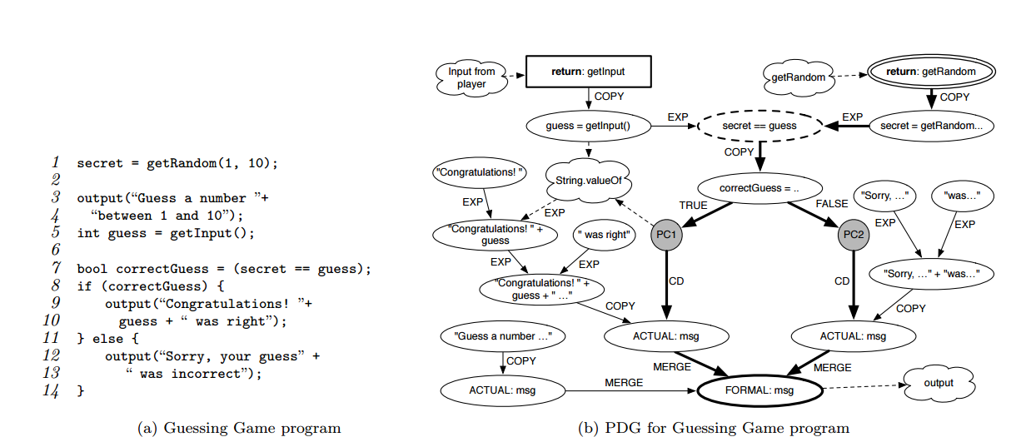
PDG for a simple program
Displays all the ways the user's input can affect the program's output

Slide 9
System Dependence Graph
Each PDG models only a single method
We can construct what is called an SDG by adding edges from the actual params in the invocation of a method to the formal params in the method body
Similarly, add an edge from the return instruction to the call instruction

Slide 10
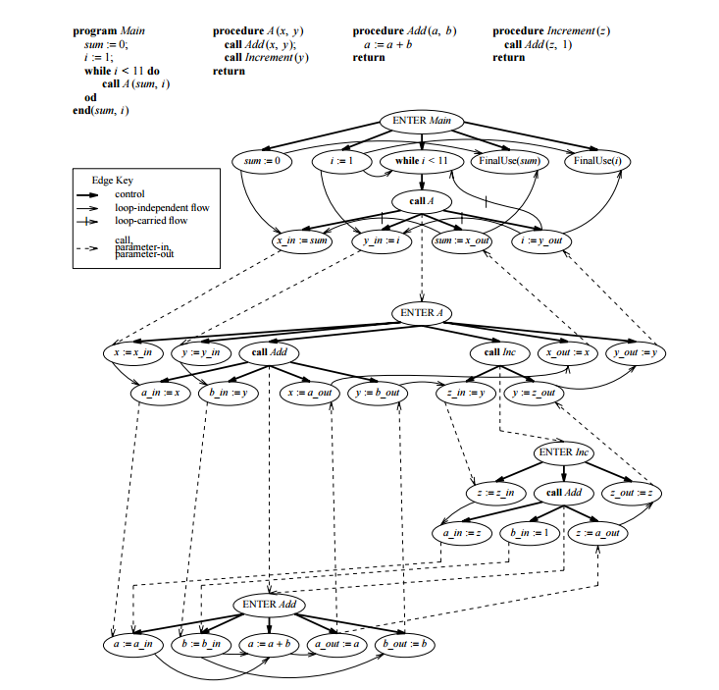

Slide 11
Heap data dependences
All this is pretty much still about primitive values
We haven't considered the heap at all
Luckily, Points-To analysis takes care of the biggest part
We can define def-use chains across different methods
So, if instruction S1 in method A writes to the field X.y and instruction S2 in method B reads from it, we can consider it dependent on S1

