Slide 1

Customer relationship portability
Plat: An app where customers don't have to start all over when switching banks
Today, customers receive multiple scores used to determine suitability and pricing of various financial products.
Financial institutions value customers with certain behaviors over others and these behaviors help institutions better understand a customer’s financial needs. However, financial institutions rarely incentivize financial behaviors.
Additionally, a customer with high quality financial behavior developed over a long period of time with a single institution may feel locked into their current institution due to fear of starting over and the frictions of migrating to a new institution.
Customers should be able to transfer the benefits of their relationship to a new bank and start from day one on a superior footing.
Programming Language Addition: TypeScript
Aaron Bridgers, CFA
Daniel Stahl
Thomas Nguyen
Chris Kennedy, CFA
https://github.com/platapp/plat-mvp

Slide 2

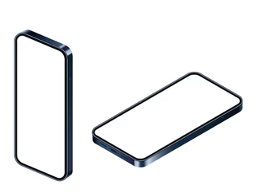
Plat Hackathon Highlights
Customer relationship portability
Plat: An app where customers don't have to start all over when switching banks
Market Landscape
Transferring or consolidating accounts is still cumbersome
Background
Regulatory focus on Relationship Portability: Competition and Innovation
Key Plat Use Cases
Exploring the Account Transfer and Marketplace Use cases
Bank Import
Bank of the Jedi
Big Trust
Machine Bank
Plat & Open Banking: Helps unbanked, underbanked,
and multi-banked customers
Plat App Architecture Application architecture and workflows
There remain significant
limitations to relationship portability
Illustrative: delivered as web-app
FDX API Recommendations
Automation and FDX API enhancements for relationship portability use cases
Open banking use cases are simplified with central network facilitators

Slide 3
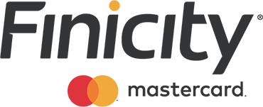
Market Landscape for Relationship Portability
Customer relationship portability
If switching or consolidating banks was easy, you wouldn’t need a multi-page how-to guide with checklists and spreadsheets
https://www.forbes.com/advisor/banking/how-to-switch-banks-a-step-by-step-guide/
From May 2022
https://time.com/nextadvisor/banking/how-to-switch-banks/
From Oct 2022
Data Access Platforms are offering account open-services that provide “rapid account verification” or “fast movement of funds”
Data Access Platforms require the financial institution to provide a front-end for customers
Plat attacks the back-end and front-end problem while also providing a roadmap for marketplace solutions for customers
Data Access Platforms
Providing Account Transfer Services
This list is not exhaustive as not all transfer services products are publicly facing – most data access platforms could assist in some capacity via Account aggregation
https://www.finicity.com/blog/secure-account-opening-wins-in-digital-world/

Slide 4





Relationship portability – Account Transfers to New Bank
Customer relationship portability
This Mock-up
Client Bank A
Plat (or target bank) registers with other banks in advance.
As part of onboarding, client authorizes each bank to import their financial banking data.
Client Bank B
Target Bank
Client Bank C
Bank-Bank or Bank-App Registration
Client Consent to Share Data
Future State
Client Bank A
Data Access Platform
Plat (or target bank) registers with central data access platform.
Authorization is still required for each client bank, but registration is simplified due to the data access platform.
Bank-Access Platform Connectivity
Client Bank B
Target Bank
Client Bank C
Note that the data access platform has the data, resources, and market power to essentially replicate Plat functionality and eliminate the need for a middleware fintech app to offer relationship portability services

Slide 5
Relationship portability - Marketplace Use Case
Customer relationship portability
Future State
Plat uses data from data access platform and connectivity from data access platform to allow consumers to shop between different offerings by product line, to determine the optimal mix of financial institutions to meet their needs
Target Banks
Client Bank A
Data Access Platform
Bank-Access Platform Connectivity
Client Bank B
Client Bank C
Note that the data access platform has the data, resources, and market power to essentially replicate Plat functionality and eliminate the need for a middleware fintech app to offer relationship portability services

Slide 6
Plat Architecture
Customer relationship portability
Front End
Back End
React
Typescript
React-router 6
Typescript
Middleware: handles auth and data summarization/ aggregation
Login to FDX Member(s)
Add FDX information to pre-populate application
Select existing accounts to migrate to new FDX Member
Key Features:
Modules:
Server
index.ts: entrypoint and api definitions
scores.ts: aggregation and summarization of FDX data
service.ts: communicate with FDX API
Client
home.tsx: entrypoint to UI
listBanks.tsx: list FDX Members and optionally login/select each member
register.tsx: create a new relationship with FDX Member, optionally bringing in information from existing FDX Member account
accounts.tsx: select existing accounts to move to new FDX Member

Slide 7
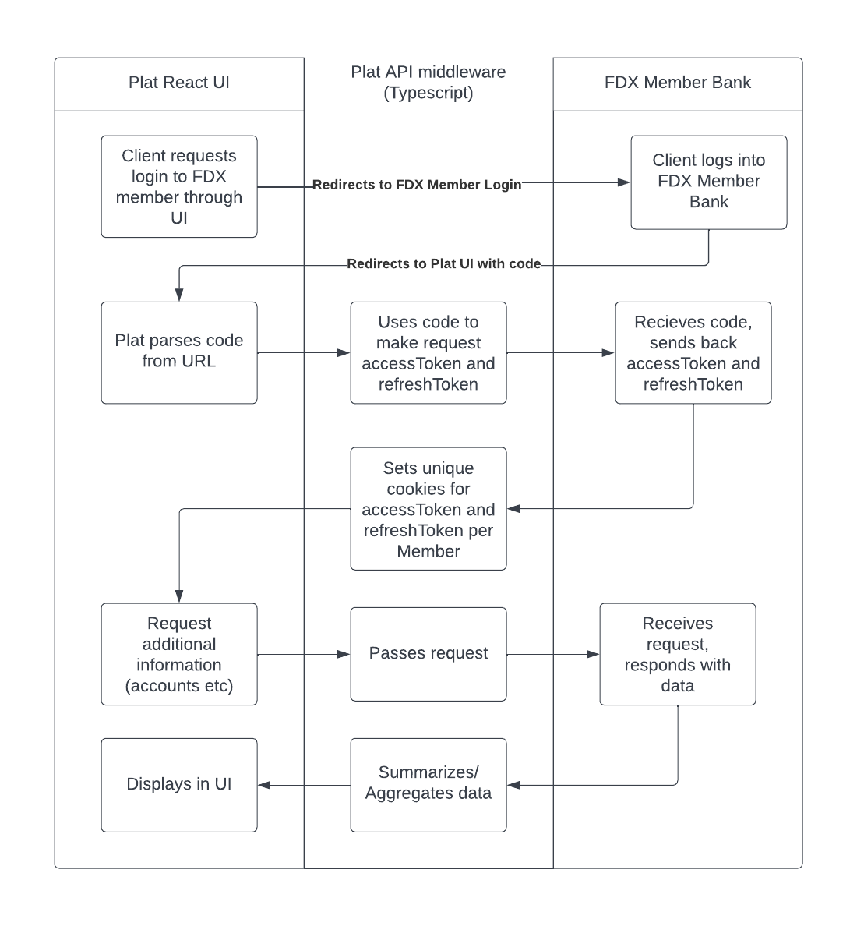
Plat Workflow
Customer relationship portability

Slide 8
Potential Automation – Financial Services Certification
Customer relationship portability
Problem: With approximately 5,000 banks in the US, connecting each bank to each other would require more than 12 million API registrations across the industry. This number grows quickly as Fintech firms seek to connect directly with bank APIs as well
Data Access Platforms solve challenges of scale for interoperability of secure APIs, but this approach conflicts with the decentralized market objective
Alternative Proposal – Financial Services Certification
Regulatory or Industry designated body¹ has a centralized registration utility that provides a means for automated verification of third-parties through certificates
Network participates can use automated registration, either asynchronous (in advance) or synchronous by verifying other parties. Registration occurs with the central body once and then can be automated for each member of the network
A CFPB goal is decentralized markets: Limit dependency on critical infrastructure; do not rely only a few large market players; avoid gatekeepers; limit monopolies; increase competition; reduce consolidation; reduce impact of a few intermediaries to impose rent or control.
¹Examples include the CFPB, FRB, FDX, Akoya, OCC, FDIC, etc.

Slide 9
FDX API Improvement Opportunities
Customer relationship portability
API Style
When you retrieve all accounts from a customer using the API, you get an array of AccountType details which has differing fields as opposed to a common field set with inherited parameter differences along with a field defining the account type.
example:
{
"loanAccount": {
"accountId": "12345678",
"accountType": "LOAN",
"displayName": "XXXXX4567",
"status": "OPEN",
"description": "30 Year Mortgage",
"nickname": "My Home Mortgage",
"currency": {"currencyCode": "USD"},
"interestRate": 4.0,
"loanTerm": 0,
"totalNumberOfPayments": 0
}
}
example (illustrative)
{
"Account": {
"accountId": "12345678",
"accountType": "LOAN",
"displayName": "XXXXX4567",
"status": "OPEN",
"description": "30 Year Mortgage",
"nickname": "My Home Mortgage",
"currency": {"currencyCode": "USD"},
"interestRate": 4.0,
"loanTerm": 0,
"totalNumberOfPayments": 0
}
}
API Fields
AccountOpenDate
AccountCloseDate
PrepaymentPenalties
Variable Rate Index
CustomerOnboardDate
API Endpoints
Consider a “product” endpoint which provides market pricing in exchange for client data (Will banks really want pricing accessible via API) and what about relationship pricing?
Developer Portal and Sandbox
Only 1 bank is available – need to be able to simulate multiple parties
Need broader range of data to show capabilities around:
Direct Deposit
Recurring Payments
Transfers vs. Credit Payments
Fees
Changing Rates

Slide 10




About the Team
Customer relationship portability
Daniel Stahl
Chris Kennedy, CFA
Thomas Nguyen
Aaron Bridgers, CFA
Technology lead
Architecture
Ideation
API Enhancements
Use Cases
Regulatory Matters
Open Banking Concepts
Ecosystem Limitations
API Enhancements
UI / UX & Design
Technology
Video Production
Ideation
Open Banking lead
Use Cases
Ideation
Open Banking Concepts
Certification
danstahl1138@gmail.com
Chris.b.kennedy@outlook.com
thomasnguyen704@gmail.com
aarontbridgers@gmail.com

Slide 11
BACKGROUND MATTER
Customer relationship portability

Slide 12
CFPB Relationship portability themes
Customer relationship portability
Sourced from Chopra’s Money 20/20 speech and CFPB SBREFA Outline
Competition | Decentralized Markets | Limit dependency on critical infrastructure; do not rely only a few large market players; avoid gatekeepers; limit monopolies; increase competition; reduce consolidation; reduce impact of a few intermediaries to impose rent or control. | FDX API Supports: Open Banking API facilitates new products, increased competition, and improvements to existing products. Ecosystem limitation: only a few major data aggregators. A secure ecosystem requires multi-party API registration (cumbersome) or central providers (Akoya + Aggregators) Rulemaking impact: Comparison shopping expectations creates a strong incentive for centralized market players, which data aggregators are well positioned for.
 | Increased Competition | Increase competition by enabling improvements to existing products and services, by fostering competition for existing products and services, and by enabling the development of new types of products and services
Portability | Relationship Portability | Ability for customers to easily shop among banks and switch to a new bank; such portability drives pricing, product offerings, customer service, privacy and security, reduced fees, and consumer control. | FDX API Supports, with limitations: The FDX API supports the ability for customers to transfer their data and accounts to a new institution with two limitations: Recurring payments and direct deposit are not transferrable via the client’s bank or the API – these are held by the source. The FDX API cannot transmit this data because banks do not have this information due to ecosystem limitations. A client must authorize each of their banks, one at a time, for EACH bank they wish to shop for UNLESS a central market player simplifies this (see above)
 | Reduce Switching Costs | Transaction and data portability for records-keeping, ability to switch direct deposit and recurring payments, and reduced reliance on industry credit-scores.
Innovation | New Opportunities | Support new approaches for underwriting, payment services, personal financial management, income verification, account switching, and comparison shopping. | FDX API Supports: The FDX API supports the sharing of consumer data for deposits, credit, wealth management, and transactions. Ecosystem limitation: Even with an interoperable API standard, there is a many-many registration problem between client’s banks and target banks for comparison shopping.

Slide 13
Open Banking can help with the underbanked
Customer relationship portability
US Households¹ with no checking or savings account:
5.9 million (4.5%)
Open banking can help with the following reasons¹ cited for not having a back account:
Reason | % Cited Overall | % Main Reason | How Open Banking Helps
Don’t Have Enough Money to Meet Minimum Balance Requirements | 40.1% | 21.7% | Customers need to be able to comparison shop for banks without a minimum balance requirement.
Bank Account Fees too High Bank Account Fees too Unpredictable | 29.5% 27.3% | 6.0% 1.5% | Open Banking and personal financial data rights should allow customers to reduce their fees through competition and relationship portability.
Banks Do Not Offer Needed Products & Services | 19.2% | 2.4% | Open banking should enable increased competition for products and services, as well as new products and services. Additionally, customers should be able to obtain those product and services more easily, through relationship portability or transferability of financial history to new banks.
Problems with Past Banking or Credit History | 13.6% | 5.3% | Open Banking’s portability of consumer data means banks can use balance and transaction history as an alternative to traditional credit scores to increase visibility into customer’s ability to pay and creditworthiness.
¹2021 FDIC National Survey of Unbanked and Underbanked Households

Slide 14
Open Banking can help with multi-banked consumers
Customer relationship portability
Average accounts per consumer¹ across financial institutions:
5.3
Consumers with two or more bank² accounts:
50%
Open banking can help with the following reasons² cited for multiple bank accounts:
Reason | % Reason | How Open Banking Helps
Flexibility / Convenience | 31% | Open banking and customer data portability improves the flexibility and convenience for customers. They may not need as many bank accounts or may be able to opt into additional accounts more easily for specific benefits.
Different services/products offered | 24% | Open banking will make it easier for customers to obtain new relationships for new products and services.
Lower fees | 20% | Open banking and customer data portability means customers can shop for lower fees, better service, and more easily switch their relationships to new banks.
¹Mercator, 2019 Payments Journal
²GoBankingRates 2018 Survey

Slide 15
Relationship portability limitations
Customer relationship portability
Can I connect all my bank accounts at once with a single authorization?
No, not without a central party like a data access platform/data aggregator
Using secure APIs, the following must occur:
(1) App/Bank Registration: The application or target bank must register with a bank to be able to access their FDX API on behalf of a client This step cannot occur automatically on behalf of the customer and must be completed in advance by the applications / providers / banks
(2) Client Consent: The client must, individually for each of their banks, authorize data sharing to the application or target bank
This process is limiting– consider a customer with 5 accounts across 3 banks (22% of US customers have 3 or more banks):
If a customer wants to consider moving their accounts to the destination bank, they must perform 3 data sharing authorizations to connect all their banks to the target bank.
That customer may find that their products are not all offered at the destination bank and may need to repeat this process for another bank.
A customer may find it easier instead to download their data once and then either
Submit their data to each bank of interest for consideration
Use a central platform, marketplace, or data access platform that only requires the initial 3 data sharing authorizations to consider many banks simultaneously
Client Bank A
If banks are not already registered this process cannot proceed.
If banks are registered, the client must authorize all three banks to share their data with the target bank.
These steps must be repeated for each bank considered by the client.
Bank-Bank Registration
Bank-Bank connectivity given 5,000 banks is 12.5 million API registrations without central market connectors
Client Bank B
Target Bank
Client Bank C
Client Consent to Share Data

Slide 16
Relationship portability limitations – Part II
Customer relationship portability
Can I automatically switch over my direct deposit?
Can I automatically switch over recurring payments?
In a limited manner – this is a data and ecosystem limitation today:
Direct deposit is handled by the employer and is originated from the employer’s ERP and bank handling checks and ACH
Recurring payments instructions are often setup with the target (who you are paying) as opposed to where the funds are coming from (your bank)
The FDX API does allow for you to extract recurring payments, for those known or originating from the client’s bank.
Because these instructions are not with the client’s bank, the client’s bank does not have the data to share with another institution or the means to change the instructions.
That data is also not captured at banks explicitly and likewise is not captured through the FDX API.
Using transaction data, a clever application or bank could identify likely candidates and create a checklist on behalf of the customer; however, it would be up to the customer to make those changes to their instructions for direct deposit and recurring payments. This is not currently possible through the open banking and payment ecosystem today absent material changes to these data fields or payment instructions (e.g. two-party registration for payments and direct deposit, or automated transmission of instructions to the bank once instructions are setup in an industry standard format).
This could be an opportunity for FDX to facilitate this standard but may be beyond its current scope as it moves beyond simple data sharing via API and is instead adjustments to existing industry mechanisms for payments and direct deposits. Rulemaking could assist here.
Data access platforms have (currently via screen-scraping) access to a large volume of unencrypted data flowing between banks and fintechs. These platforms may be positioned to better detect these kinds of transactions, but there is still no mechanism to automatically move them on behalf of customers.

Slide 17
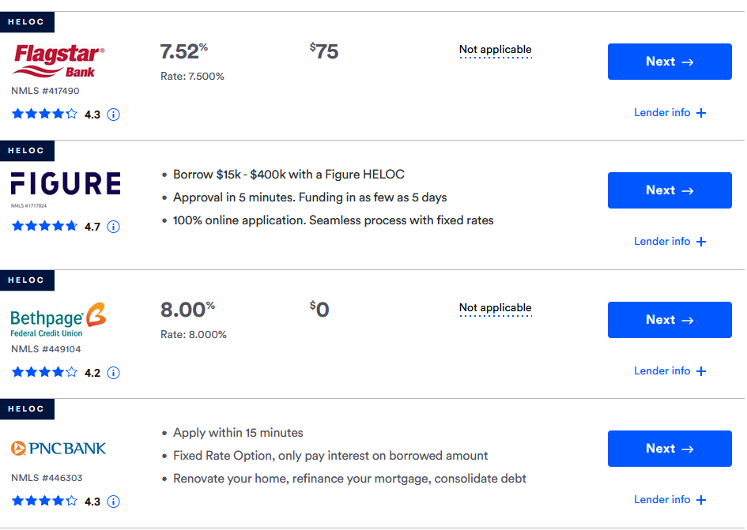
Relationship portability limitations – Part III
Customer relationship portability
Can I compare pricing?
Can I compare fees?
Yes, in a very limited manner – this is a limitation of the FDX API today due to the variety of products and services in the marketplace today.
Transaction data includes fees incurred
Account Data includes current rates for pricing
Deposit Accounts do not provide:
In general, the deposit data provides current state of the customer’s information as opposed to pricing and proprietary details from the bank itself. This meets the spirit of data sharing of customer data without sharing proprietary bank pricing information; however, this makes comparison shopping difficult
A fee schedule
Minimum balance requirements
Pricing tiers (only current rate)
The index for variable rates
Loan and credit accounts do not provide: In general, the loan data provides current state of the customer’s information as opposed to pricing and proprietary details from the bank itself. This partially meets the spirit of data sharing of customer data without sharing proprietary bank pricing information as certain fields like the index for variable rates and prepayment penalties are useful information for consumers.
A fee schedule
Prepayment penalties
Renewal options
The index for variable rates
Rate resets (Adjustable-rate mortgages)
Example – Not supported via FDX API:
with competitive interest rates and next-tier rates with balances of $2,500 or more. And if your balance drops below $2,500, the monthly charge is only $10 ($8 with eStatements).
Example – Not supported via FDX API:
Source: Bankrate.com

Slide 18
Relationship portability limitations – Part IV
Customer relationship portability
Can I transfer accounts other than deposits?
Yes, for simple products like credit cards – No for other credits and products
The FDX API is designed to provide portability of customer financial data, not all the KYC details, legal terms and conditions of credits, and pricing and fee structure of your source bank’s products and services.
For things like credit cards, enough information is provided for another provide to evaluate the credit worthiness of the customer (using a combination of balance, transaction data, and credit scores) to decide whether to offer a balance transfer or card transfer.
However, if the credit card is paid on-time, the rate may show as 0.0% because there is no interest due as opposed to the actual rate owed once penalty rates apply.
For other products like loans or lines of credit, there is not enough information (such as prepayment penalties) that could allow the bank and client to decide if payoff or transfer is possible.
Can the target bank detect duplicate customers?
To some degree, there are ecosystem limitations due to no central identifier.
There is no single US bank account identifier; however, there is sufficient data (customer name, address, social security number (tax ID), government ID, birthday) to check for duplicates.
Centralization from open banking may reduce privacy which can deter some customers away from the banking system. Privacy concerns were 34.1% of the reasons and 8.4% of the primary reasons that customers did not have a bank account in the US.
How does consent and portability work with joint account owners, custodial accounts, and others?
Consent works for individual account owners. For joint account owners, there will need to be logic embedded to ensure appropriate behavior.
The FDX API can pull customer-account holder relationships for things like joint accounts, custodial accounts, etc.; however, there is limited logic or principles as to what is required over the FDX API to get consent from all parties.
#AccountHolderRelationship

Slide 19
Relationship portability limitations – Part V
Customer relationship portability
Can I reduce reliance on credit scores?
Yes, to some degree, the FDX API historical transactions can help
Credit scores measure credit-worthiness through a combination of:
On-time transactions or payments to creditors for a customer (not late)
Sufficient levels of payments (met the minimum requirement)
Usage of credit (utilization rates)
Overall debt (amount, mix, and new)
Overall credit history (length of credit history)
Transaction History:
Transaction history can show payments and transactions; however, those payments:
Do not differentiate between transfers for service (immediate) vs. repayment of debt (credit).
Do not indicate timeliness of payment (a due date for recurring payment order does not imply consistency or timeliness with due date for the bill)
Do not indicate completeness of payment (above minimum required)
May not indicate overall credit history if bank data transferred has less data than overall credit history for a customer.
Payee for Payments:
Payments can be used to identify the payee; however, there is no purpose data field to indicate credit vs. transfer, even if there is a transfer vs. payment API (unless you consider all payments to be implied credit).
If all creditors (including non-banks) are on the open banking ecosystem and using the FDX API, in theory all payees should be accounted for; however, this is out-of-scope of the current FDX approach to non-banks.
Example:
FICO scores¹ are based on these five factors:
Payment history (35%)
Amounts owed (30%)
Length of credit history (15%)
New credit (10%)
Credit mix (10%)
The top category on payment history is not fully available within historical bank payments unless every credit owed is captured from all institutions a debt is owed (including non-banks)
¹FICO, https://www.myfico.com/credit-education/whats-in-your-credit-score

Slide 20
Videos
App Walkthrough
ABC Bank & Plat Commercial
UI/UX
Plat FAQ

