Slide 1
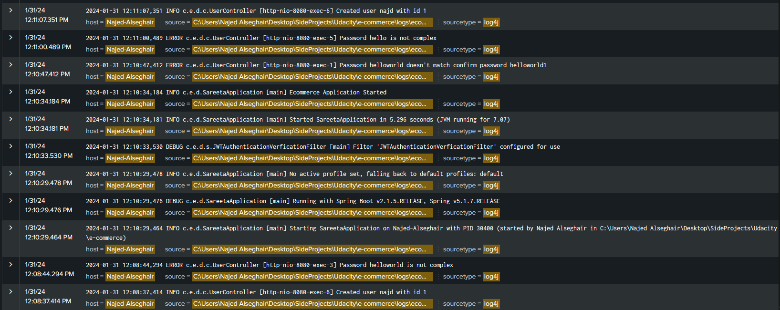
Create user successful and failure requests

Slide 2

Exceptions

Slide 3

Create order successful and failure requests

Slide 4

Dashboard

