Slide 1
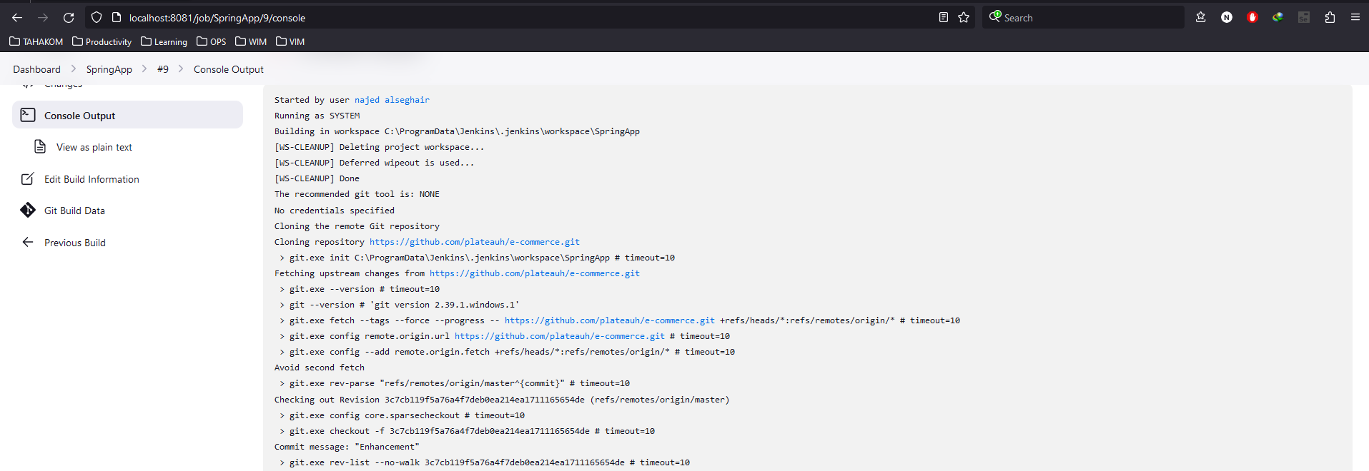
Pull from Github repository

Slide 2
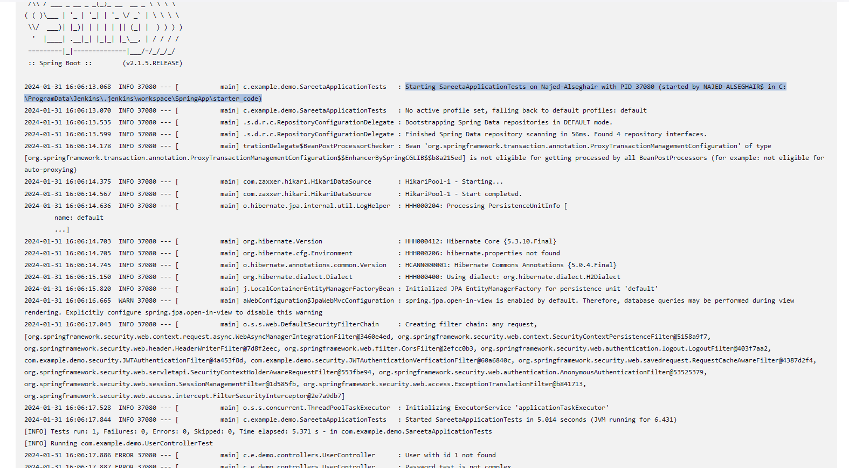
Build

Slide 3

Deploy

